Slide 1
IT490 Project: Room Finder
John Rafael De Los Reyes: 20%
Maciej Jedryczka: 50%
Hima Patel: 10%
Bhargav Jillepalli: 10%
Darian Moore: 10%
Professor: Dipesh Patel | Course: IT490 | Date: 12/17/23

Slide 2
Table of Contents
Title Page
Description of your project
Technology Package
Components used (software & hardware)
Schematics/design
Security
Scalability
Downtime Strategy
Demo
Lessons Learned
References

Slide 3
Description of your Project
Describe the project idea that you come up with.
Room Finder is a software as a service that provides the user with an up-to-date feed of all the usable NJIT classrooms
What existing problem are you solving?
Currently, the only way to figure out if a classroom is available is by either physically going to the classroom or by searching a long course list that provides when a section meets and its location.
What Market are you catering? This is catering to NJIT Students
Why is this a good product/service?
It makes it easier for students to find a room because of the lack of convenience that exists for them to check for unused classrooms.
How it will solve the problem identified? Create a software that provides a visual model for students to view room availability in a building in NJIT.

Slide 4
Description of your Project
Why you selected this topic? This was an incurring inconvenience for some of us who stay on campus all day. We wanted to choose a topic that would be of use for us and other students.
How did you achieve your project? The main source of our project is the same source used on NJIT’s schedule builder. This provides course information on when it will happen and where it will happen. By using this data, we can plot down the same information in a similar format to provide room occupancy data.
What are the results of the project? The main functionality of the software is working properly on displaying room occupancy. There can be improvements in terms of UI and additional information and services to make this software better, but that was on hindsight.

Slide 5
Technology Package
How do you build this product or service?
Software and Applications used: RabbitMQ, NodeJS, PM2, Nginx, MariaDB, Zerotier, DigitalOcean
What is the technology required? Laptop or desktop (Computers that can access the internet)
Describe both the software and hardware components you used in your project.
Explained through Schematics (next slides)

Slide 6
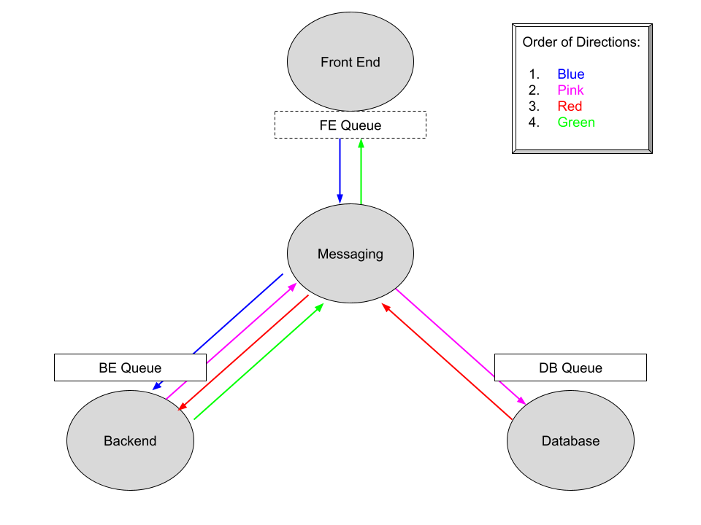
Technology Package

Slide 7
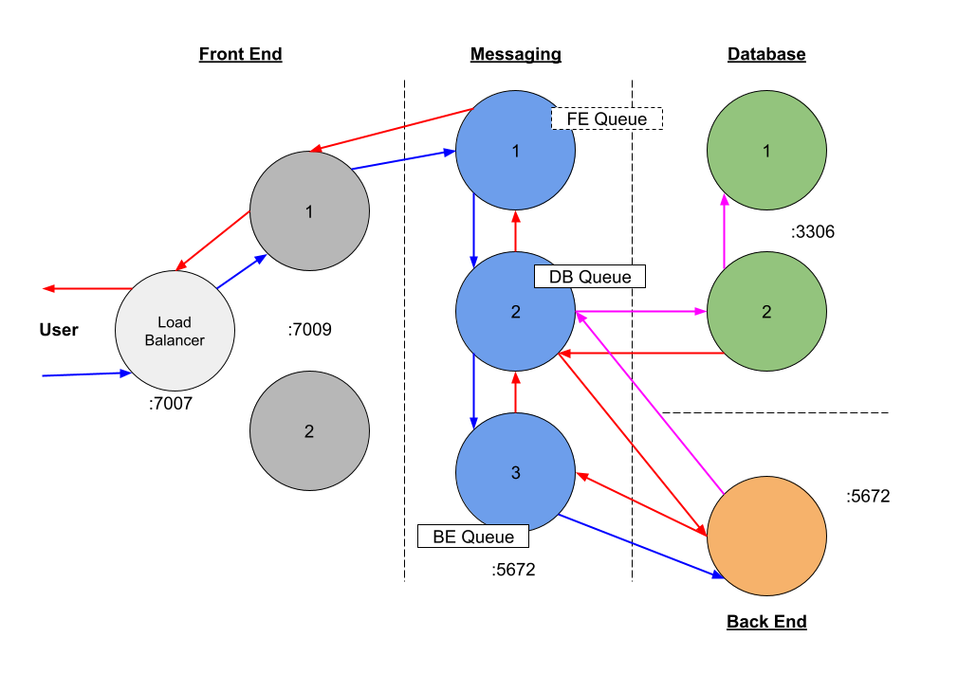
Technology Package

Slide 8
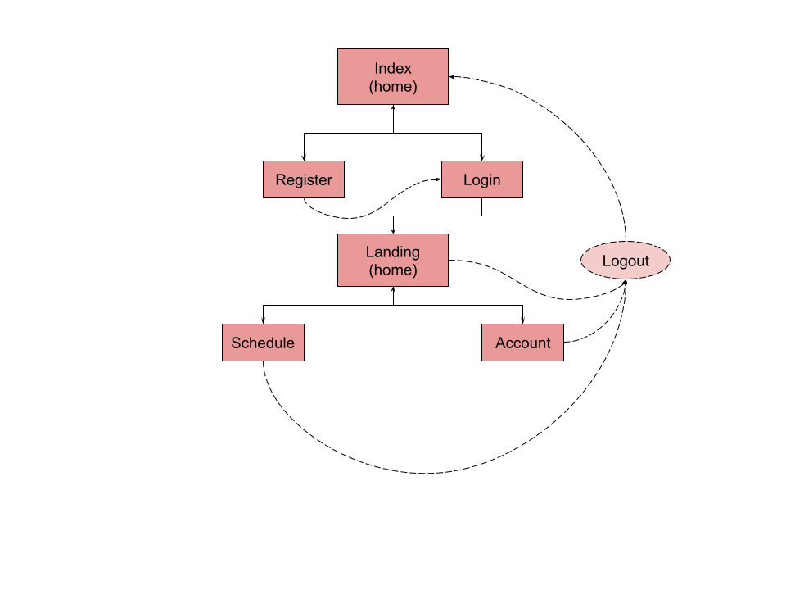
Technology Package

Slide 9
Security
Security considerations so you won’t be hacked by others while doing this project
Input Validation
Verified by Frontend and In/Out of Backend
Hashed passwords
Passwords and security questions are hashed before reaching the webserver
Security Questions
Permanent untargeted/unbiased questions for users to reset passwords

Slide 10
Scalability
Scalability in response to failure to any of the four systems
All scripts auto-restart
Frontend automatically creates processes in response to load
DigitalOcean also provides autoscaling, which is scaling that dynamically adjusts computing resources based on current workload. When autoscaling, the number of active servers will fluctuate, depending on what is required by the server farm or pool’s workload.

Slide 11
Downtime Strategy
Zero downtime deployment strategy - a deployment method where your website or application is never down or in an unstable state during the deployment process.
Blue/Green Deployment - a deployment strategy in which you create two separate, but identical environments. One environment (blue) is running the current application version and one environment (green) is running the new application version.
Front End Node and Messaging Node both have identical environment for the website. When maintenance and updates need to be done, we work in the messaging node’s server while keep front end’s node running the current application.

Slide 12
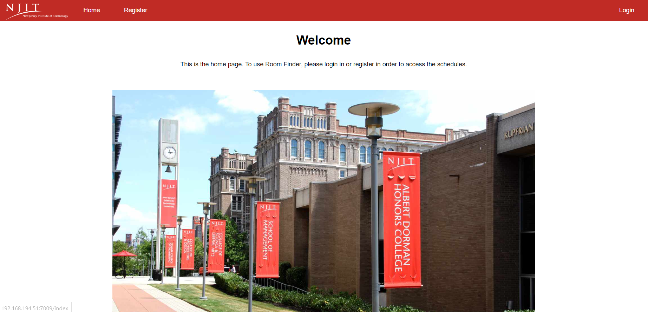
Demo

Slide 13
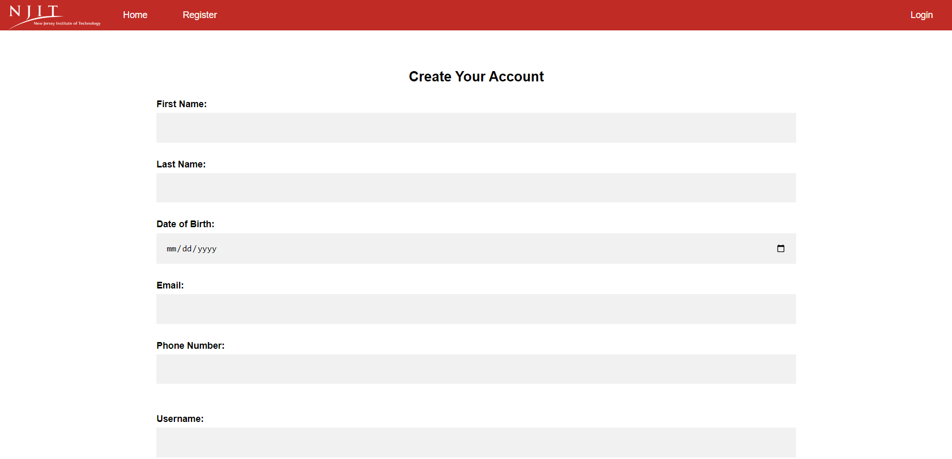
Demo

Slide 14
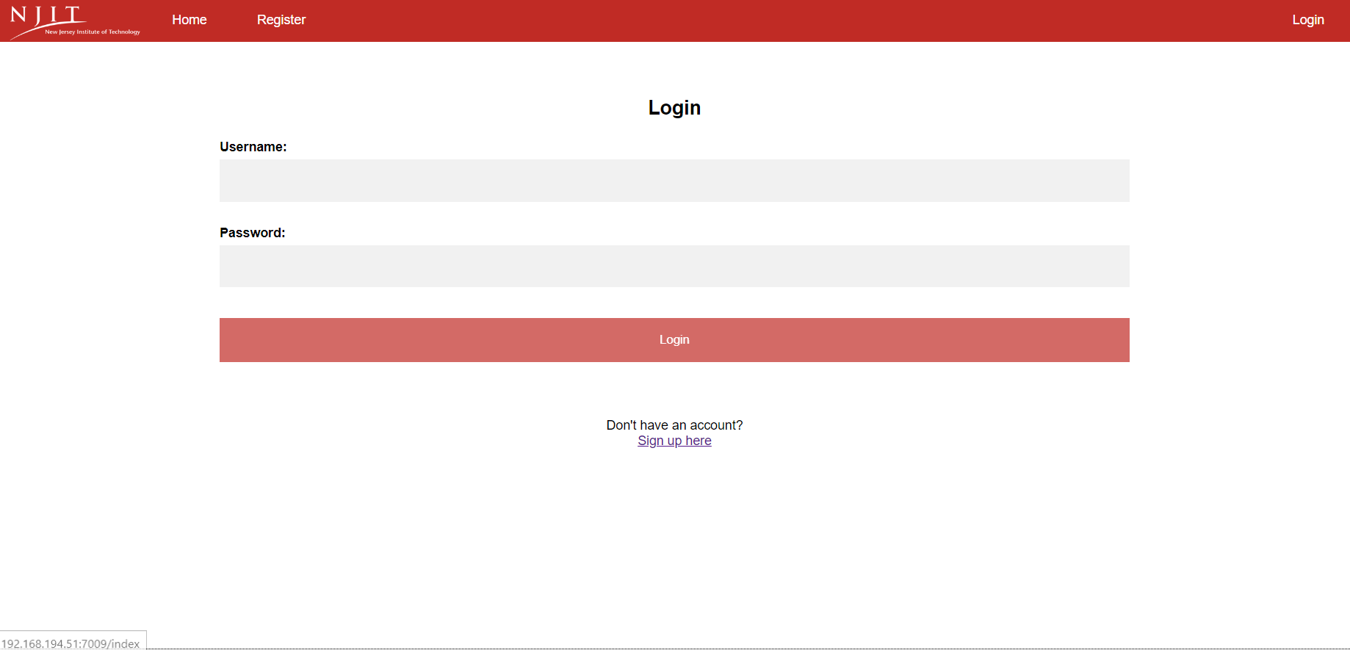
Demo

Slide 15
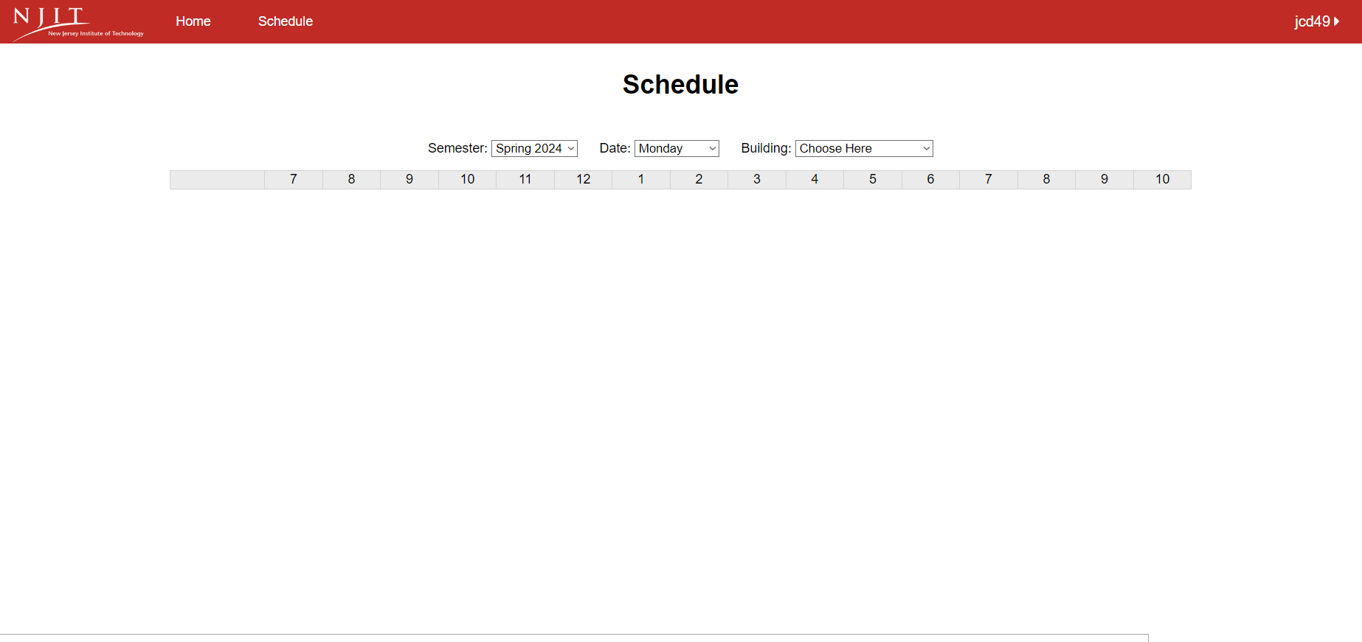
Demo

Slide 16
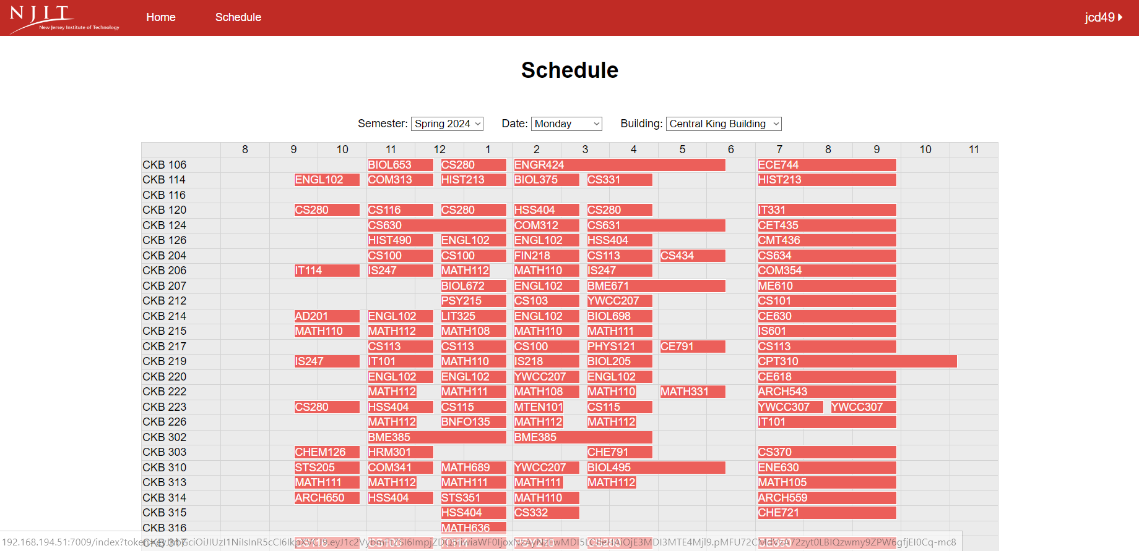
Demo

Slide 17
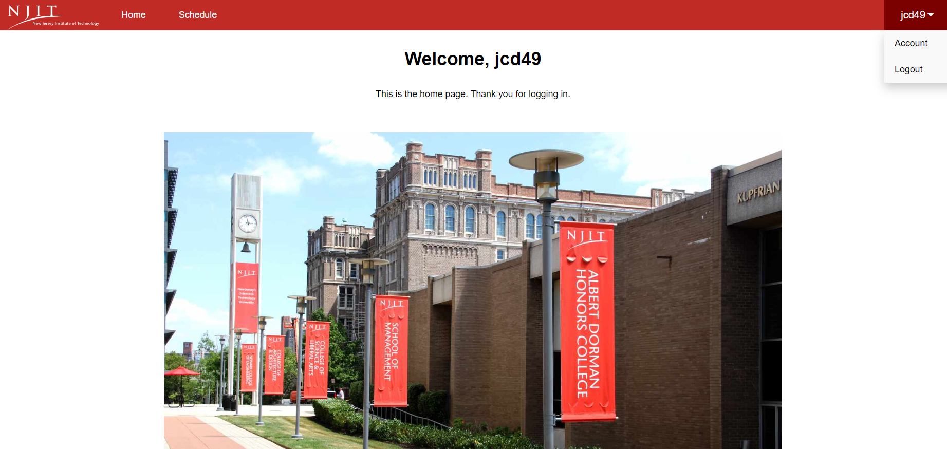
Demo

Slide 18
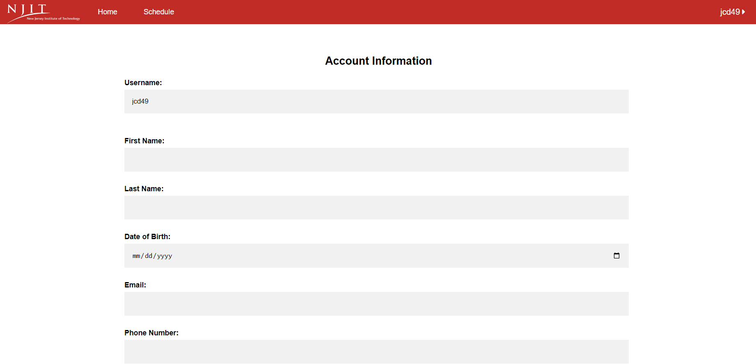
Demo

Slide 19
Lessons Learned
What did you learn from this project? How to troubleshoot software related issues, teamwork, clustering, rabbit mq, and integrating systems
What will you do the same?
We found the right database software. MariaDB is superior to MySQL clustering because it works much easier. Postgres because there aren’t guides on how to do master master. MariaDB also uses fot notation like postgres.
What will you do different?
Did more research on actual login techniques and maybe invested into an API like Google authenticator.

Slide 20
References
Installing frontend stuff
Npm - (https://github.com/nodesource/distributions)
Nginx - (https://www.digitalocean.com/community/tutorials/how-to-install-nginx-on-ubuntu-20-04)
Installing messaging stuff
Rabbitmq - (https://www.rabbitmq.com/download.html)
For database stuff
MariaDB - (https://www.linuxbabe.com/mariadb/install-mariadb-10-5-ubuntu)
Galera 4 - (https://www.linuxbabe.com/mariadb/galera-cluster-ubuntu)

