Slide 1
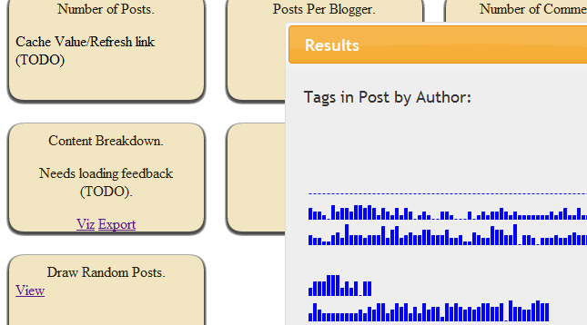
svn log
.svnlog
QuickDiff
svn diff
-- summarize
.diff
Html Export
svn export
*.java
Histogram, Online View
AST.Parse
tokens
Token diff
.diff
Export
*.xml
*.sql

