Slide 1
The Harmony of Connections
Home
About us
What I do
My experience
My work
Hypertext and
Inter-text

Slide 2
Group 1
01
02
Intertext
Hypertext
03
04
Inter-text and Hypertext
Essence
01
02
03
04

Slide 3
RAWS
Home
About us
What I do
My experience
My work
When words intertwine,
they beautifully spiral about.
Recreate and replicate,
To the references around.

Slide 4
RAWS
Home
About us
What I do
My experience
My work
Link for link, text for text,
Words chained together to present.
Hyperlinks that are key to next concepts,
Upcoming pages are where you ingress.

Slide 5
RAWS
Home
About us
What I do
My experience
My work
Hypertext grants access to the
quest of the reader,
It allows them to discern
information better.
Intertext, however, involves
inspiration from another writer,
A new style and characteristics
born within the seeker.

Slide 6
RAWS
Home
About us
What I do
My experience
My work
They're more than just simple
characters,
Together they dance and gather
Influencer to emotion and wonders,
Linking and chasing like explorers.

Slide 7
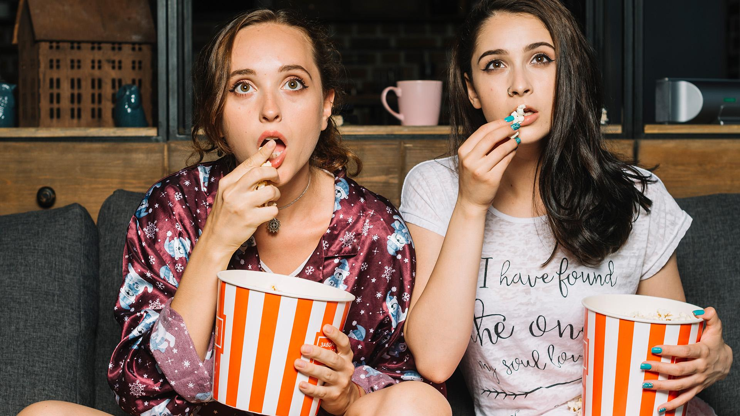
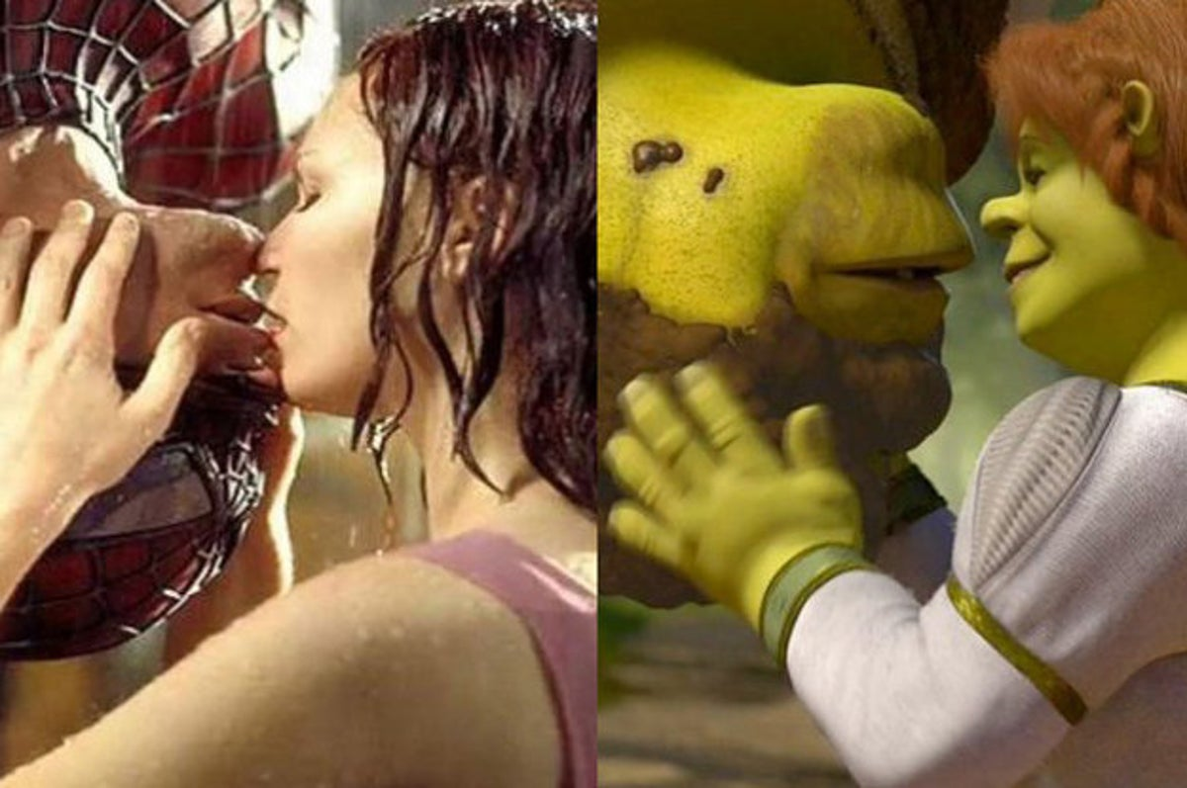
I Back<-
Home
About us
What I do
My experience
My work

Slide 8
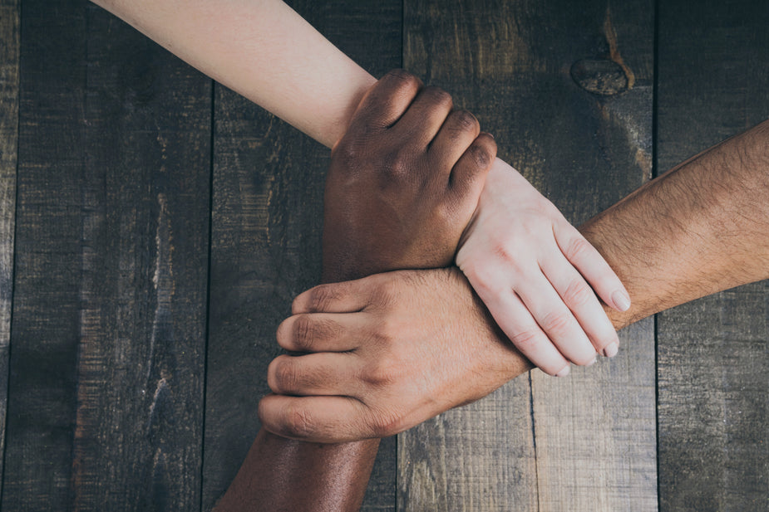
I Back<-
Home
About us
What I do
My experience
My work

Slide 9
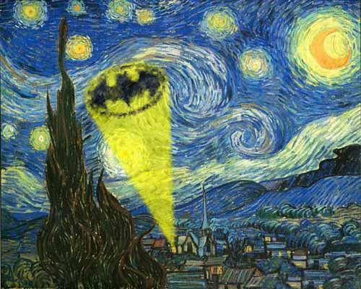
I Back<-
Home
About us
What I do
My experience
My work

Slide 10
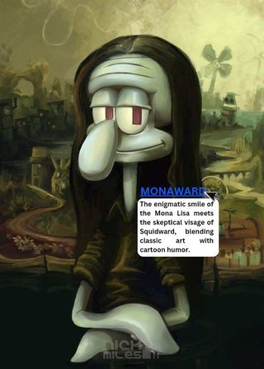
I Back<-
Home
About us
What I do
My experience
My work

Slide 11
CAST
11-Agoncillo(boys)
Escalada, Carlo
Esperanza, Ahzlan
Martin, C-Jay
Matillano, Justine
Home
About us
What I do
My experience
My work

Slide 12
CAST
11-Agoncillo(girls)
Buensuceso, Keirah
Buhay, Jean Clyde
Canta, Julliene
Cando, Cassandra
Home
About us
What I do
My experience
My work
Carel, Charmelle

Slide 13
CAST
11-Agoncillo(girls)
Cunanan, Jaztine
Malabanan, Geraldine
Mariano, Jaicy
Marimla, Ericka
Home
About us
What I do
My experience
My work

