Slide 1
Numerical Optimization
Minimize a real-valued function of n real variables,
p = f(x₀, x₁, ..., x_{n-1})
In vector notation: among x ∈ ℜ^{n}, find x* = argmin f(x)
Usually we’re more interested in x* than in p* = min f(x) = f(x*)
f(x) is the “objective function” or (for DNNs) the “loss function”

Slide 2
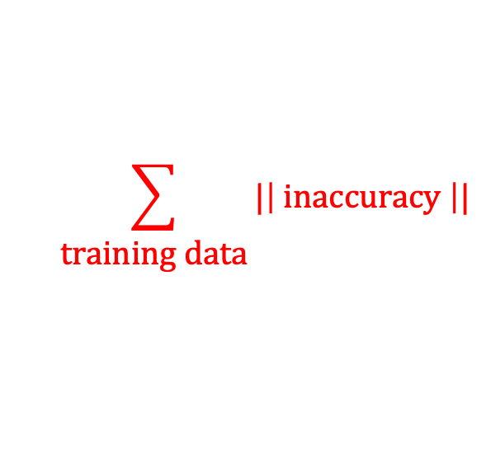
Examples
Best location (x₀, x₁) for a new cell tower
f(x₀, x₁) = weakest signal in neighborhood
Best cross-section for an airplane wing
f(x₀, ..., x₁₀₀₀) = – lift (to maximize lift)
Least squares data fitting, Ax ≈ b
f(x) = || Ax – b ||²
Training deep neural nets: Best weights x₀, ..., x₁₀9
f(x) = “loss function” =
$$\sum_{\begin{aligned} \\ \text{training} \text{data}\end{aligned}}{|\left| \text{inaccuracy} \right||}$$

Slide 3
Possible additional features
Sometimes there are constraints on x:
Ax = b, Ax ≤ b, x(i) ∊ {0,1}, etc.
Convex constraints, nonlinear constraints, etc.
Sometimes the function f has special features:
Convex
Linear
Smooth
Integer-valued
In CS 111, we will only consider:
Unconstrained minimization (x can be anything in ℜ^{n} )
Convex functions f (every chord is above the function values)
Smooth functions f (continuous, sometimes derivatives too)

Slide 4
Optimization: Scales and Algorithms
n = 1 to 100 : Newton’s method (dense)
n = 100 to 10⁴ : Newton (w/ sparse matrices)
n = 10⁴ to 10⁶ : quasi-Newton, e.g. BFGS
n = 10⁶ to 10⁸ : gradient descent (w/ acceleration)
n = 10⁸ to 10¹⁰⁺ : stochastic gradient descent (SGD)
(roughly speaking, with exceptions and caveats)

