Slide 1
DJANGO

Slide 2
What is Django?
Django is a high-level Python web framework that enables the rapid creation of secure and maintainable websites. Django, created by experienced developers, eliminates much of the hassle of web development, allowing you to focus on writing your app without having to reinvent the wheel. It is free and open source, with a thriving and active community, excellent documentation, and numerous options for both free and paid support.

Slide 3
Django helps you write software that is:
Complete
Django adheres to the "batteries included" philosophy and offers almost everything developers might want to do "out of the box". Because everything you need is included in one "product," it all works together seamlessly, adheres to consistent design principles, and comes with extensive and up-to-date documentation.
Versatile
Django can (and has been) used to create almost any type of website, including content management systems, wikis, social networks, and news sites. It is compatible with any client-side framework and can deliver content in almost any format (HTML, RSS feeds, JSON, and XML).
Internally, it offers options for almost any functionality you may require (for example, several popular databases, templating engines, and so on), but it can also be extended to use other components if necessary.

Slide 4
Django helps you write software that is:
Secure
Django helps developers avoid many common security mistakes by providing a framework designed to "do the right things" to automatically protect the website. Django, for example, provides a secure way to manage user accounts and passwords, avoiding common mistakes such as storing session information in vulnerable cookies (instead, cookies only contain a key, and the actual data is stored in the database) and storing passwords directly rather than hashing them.
Scalable
Django employs a component-based "shared-nothing" architecture (each component is independent of the others and can thus be replaced or changed as needed). Because of the clear separation of the various components, it can scale for increased traffic by adding hardware at any level: caching servers, database servers, or application servers. Some of the most popular websites, such as Instagram and Disqus, have successfully scaled Django to meet their demands.

Slide 5
Django helps you write software that is:
Maintainable
Django code is written with design principles and patterns that promote the creation of maintainable and reusable code. It employs the Don't Repeat Yourself (DRY) principle, which eliminates unnecessary duplication and reduces the amount of code. Django also encourages the grouping of related functionality into reusable "applications" and, at a lower level, related code into modules (similar to the Model View Controller (MVC) pattern.
Portable
Django is written in Python and runs on a variety of platforms. That means you are not limited to a single server platform and can run your applications on a variety of Linux, Windows, and macOS distributions. Furthermore, Django is well-supported by many web hosting companies, which frequently provide specific infrastructure and documentation for hosting Django websites.

Slide 6
Where did it come from?
Django was created between 2003 and 2005 by a web team tasked with creating and maintaining newspaper websites. After building a few sites, the team started factoring out and reusing a lot of common code and design patterns. This shared code evolved into a generic web development framework known as the "Django" project, which was made available as open source in July 2005.
Django has grown and improved since its first milestone release (1.0) in September 2008, with version 4.0 expected in 2022. Each release has included new functionality and bug fixes, ranging from support for new types of databases, template engines, and caching to the addition of "generic" view functions and classes (which reduce the amount of code required by developers for a variety of programming tasks).

Slide 7
How popular is Django?
There is no readily available and definitive measure of the popularity of server-side frameworks. A more pressing question is whether Django is "popular enough" to avoid the pitfalls of unpopular platforms. Does it continue to evolve? Can you get assistance if you need it? Is it possible for you to get paid work if you learn Django?
Django is a popular framework, as evidenced by the number of high-profile sites that use it, the number of people who contribute to the codebase, and the number of people who provide both free and paid support.
Django is used by a number of high-profile websites, including Disqus, Instagram, the Knight Foundation, the MacArthur Foundation, Mozilla, National Geographic, the Open Knowledge Foundation, Pinterest, and OpenStack.

Slide 8
Is Django opinionated?
Web frameworks frequently refer to themselves as "opinionated" or "unopinionated".
Opinionated frameworks are those that believe they know the "right way" to handle a specific task. They frequently encourage rapid development in a specific domain (solving problems of a specific type) because the proper way to do anything is usually well understood and documented. However, they can be less adaptable when solving problems outside of their primary domain, and they tend to provide fewer options for which components and approaches to use.
Unopinionated frameworks, on the other hand, place far fewer constraints on the best way to glue components together to achieve a goal, or even which components should be used. They make it easier for developers to use the most appropriate tools to complete a specific task, but at the expense of having to find those components themselves.

Slide 9
Is Django opinionated?
Django is "somewhat opinionated" and thus provides the "best of both worlds". It includes a set of components that can handle the majority of web development tasks, as well as one (or two) preferred methods for using them. However, because of Django's decoupled architecture, you can typically select from a variety of options, or add support for entirely new ones if desired.

Slide 10
What does Django code look like?
In a conventional data-driven website, a web application awaits HTTP requests from the web browser (or other client). When a request is received, the application determines what is required based on the URL and possibly information in POST or GET data. Depending on the requirements, it may then read or write data from a database or perform other tasks to fulfill the request. The application will then send a response to the web browser, often dynamically creating an HTML page for it to display by inserting the retrieved data into placeholders in an HTML template.

Slide 11
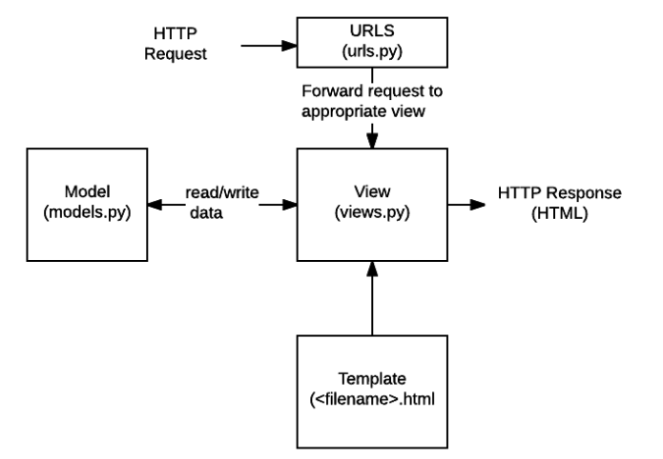
What does Django code look like?
Django web applications typically group the code that handles each of these steps into separate files.

Slide 12
What does Django code look like?
URLs - While it is possible to process requests from all URLs using a single function, it is far more maintainable to write a separate view function for each resource. A URL mapper redirects HTTP requests to the appropriate view based on the request URL. The URL mapper can also match specific patterns of strings or digits in a URL and pass them to a view function as data.
Views - A view is a request handler function that accepts HTTP requests and returns HTTP responses. Models provide views with access to the data required to satisfy requests, while templates handle the response formatting.
Models- Python objects that define an application's data structure and provide mechanisms for managing (adding, modifying, deleting) and querying database records.
Templates- A template is a text file that defines the structure or layout of a file (such as an HTML page), using placeholders to represent actual content. A view can dynamically generate an HTML page from an HTML template and populate it with data from a model. A template can be used to define the structure of any file, not just HTML!

Slide 13
Setting up Django Development Environment
The development environment is a Django installation on your local computer that you can use to create and test Django applications before deploying them to a production environment.
Django's main tools are a set of Python scripts for creating and working with Django projects, as well as a simple development web server that you can use to test local Django web applications on your computer's web browser.
Other peripheral tools that are part of the development environment will not be covered in this document. These include a text editor or integrated development environment (IDE) for code editing and a source control management tool such as Git for safely managing different versions of your code.

Slide 14
What are the Django setup options?
Django is extremely flexible in terms of how and where it can be installed and configured. Django can be:
Installed on different operating systems.
Installed from source, from the Python Package Index (PyPi) and in many cases from the host computer's package manager application.
Configured to use one of several databases, which may also need to be separately installed and configured.
Run in the main system Python environment or within separate Python virtual environments.

Slide 15
What operating systems are supported?
Django web applications can run on almost any machine that supports the Python 3 programming language, including Windows, macOS, Linux/Unix, and Solaris, to name a few. Almost any computer should have enough power to run Django during development.

Slide 16
What version of Python should be used?
You can use any Python version supported by your target Django release. For Django 4.2 the allowed versions are Python 3.8 to 3.11.
The Django project recommends (and "officially supports") using the newest available supported Python release.

Slide 17
Where can we download Django?
There are three places to download Django:
The Python Package Repository (PyPi), accessed via the pip tool. This is the best way to get the most recent stable version of Django.
Use the version from your computer's package manager. Django distributions bundled with operating systems provide a familiar installation mechanism. However, the packaged version may be quite old and can only be installed in the system Python environment (which may not be what you are looking for).
Install from source. You can download and install the most recent bleeding-edge version of Django from the source. This is not recommended for beginners, but it is required once you are ready to start contributing to Django itself.

Slide 18
Which database?
Django officially supports the PostgreSQL, MariaDB, MySQL, Oracle, and SQLite databases, and there are community libraries that provide varying levels of support for other popular SQL and NoSQL databases. We recommend that you select the same database for both production and development (although Django abstracts many of the database differences using its Object-Relational Mapper (ORM), there are still potential issues that are better to avoid).

Slide 19
Installing Python 3
In order to use Django you must have Python 3 on your operating system. You will also need the Python Package Index tool — pip3 — which is used to manage (install, update, and remove) Python packages/libraries used by Django and your other Python apps.

Slide 20
Windows 10 or 11
Windows doesn't include Python by default, but you can easily install it (along with the pip3 tool) from python.org:
Download the required installer:
Go to https://www.python.org/downloads/windows/
Download the most recent supported version that works with Django 4.2. (at time of writing this is Python 3.11.4).
Install Python by double-clicking on the downloaded file and following the installation prompts.
Be sure to check the box labeled "Add Python to PATH"

Slide 21
Using Django in Python virtual environment
The libraries we'll use for creating our virtual environments are virtualenvwrapper (Linux and macOS) and virtualenvwrapper-win (Windows), which in turn both use the virtualenv tool. The wrapper tools creates a consistent interface for managing interfaces on all platforms.
pip install virtualenvwrapper-win

Slide 22
Using Django in Python virtual environment
Windows virtual environment setup
Installing virtualenvwrapper-win is even simpler than setting up virtualenvwrapper because you don't need to configure where the tool stores virtual environment information (there is a default value). All you need to do is run the following command in the command prompt:

Slide 23
Creating a virtual environment
Once you've installed virtualenvwrapper or virtualenvwrapper-win then working with virtual environments is very similar on all platforms.
Now you can create a new virtual environment with the mkvirtualenv command. As this command runs you'll see the environment being set up (what you see is slightly platform-specific). When the command completes the new virtual environment will be active — you can see this because the start of the prompt will be the name of the environment in parentheses.

Slide 24

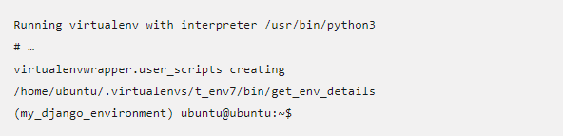
Creating a virtual environment
You should see output similar to the following:

Slide 25
Using a virtual environment
There are just a few other useful commands that you should know:
deactivate — Exit out of the current Python virtual environment
workon — List available virtual environments
workon name_of_environment — Activate the specified Python virtual environment
rmvirtualenv name_of_environment — Remove the specified environment.

Slide 26
Installing Django
Once you've created a virtual environment, and called workon to enter it, you can use pip3 to install Django.

Slide 27

Testing your installation
The previous test works, but it isn't very much fun. A more interesting test is to create a skeleton project and see it working. To do this, first navigate in your command prompt/terminal to where you want to store your Django apps. Create a folder for your test site and navigate into it.

Slide 28
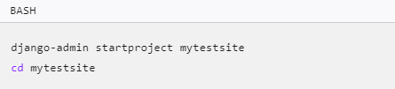
Creating Test Site
You can then create a new skeleton site called "mytestsite" using the django-admin tool as shown. After creating the site, you can navigate into the folder where you will find the main script for managing projects, called manage.py.

Slide 29

Creating Test Site
We can run the development web server from within this folder using manage.py and the runserver command, as shown.

Slide 30
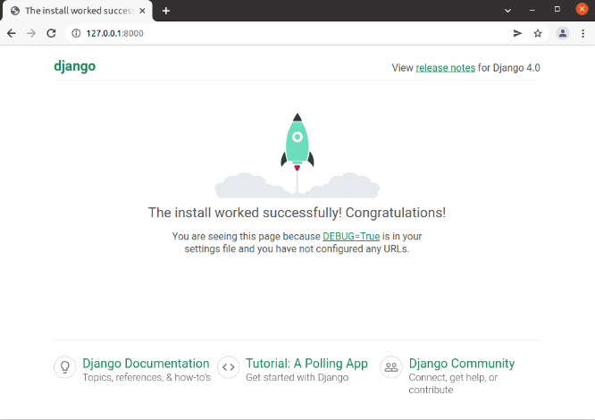
Creating Test Site
Once the server is running you can view the site by navigating to the following URL on your local web browser: http://127.0.0.1:8000/. You should see a site that looks like this:

Slide 31
DJANGO PROJECT AND APPLICATION

Slide 32
Starting a New Project
In Django, every web app you want to create is called a project; and a project is a sum of applications. An application is a set of code files relying on the MVT pattern. As example let's say we want to build a website, the website is our project and the forum, news, contact engine are applications. This structure makes it easier to move an application between projects since every application is independent.

Slide 33

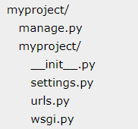
Create a Project
Whether you are on Windows or Linux, just get a terminal or a cmd prompt and navigate to the place you want your project to be created (cd to your created environment my_django_environment), then use this code:
This will create a "myproject" folder with the following structure:

Slide 34

The Project Structure
The “myproject” folder is just your project container, it actually contains two elements:
manage.py − This file is kind of your project local django-admin for interacting with your project via command line (start the development server, sync db...). To get a full list of command accessible via manage.py you can use the code −

Slide 35
The Project Structure
The “myproject” subfolder − This folder is the actual python package of your project. It contains four files:
__init__.py − Just for python, treat this folder as package.
settings.py − As the name indicates, your project settings.
urls.py − All links of your project and the function to call.
wsgi.py − If you need to deploy your project over WSGI.

Slide 36
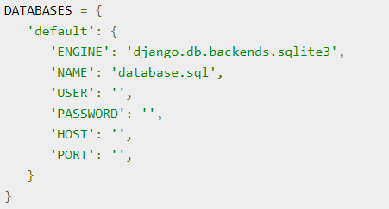
Setting Up Your Project
Database is set in the ‘Database’ dictionary. The example above is for SQLite engine. As stated earlier, Django also supports:
MySQL (django.db.backends.mysql)
PostGreSQL (django.db.backends.postgresql_psycopg2)
Oracle (django.db.backends.oracle) and NoSQL DB
MongoDB (django_mongodb_engine)

Slide 37

Setting Up Your Project
Now that your project is created and configured make sure it's working:

Slide 38
Apps Life Cycle
A project is a sum of many applications. Every application has an objective and can be reused into another project, like the contact form on a website can be an application and can be reused for others. See it as a module of your project.

Slide 39

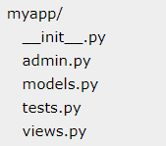
Create an Application
We assume you are in your project folder. In our main “myproject” folder, the same folder then manage.py:
You just created myapp application and like project, Django create a “myapp” folder with the application structure:

Slide 40
Application Structure
__init__.py − Just to make sure python handles this folder as a package.
admin.py − This file helps you make the app modifiable in the admin interface.
models.py − This is where all the application models are stored.
tests.py − This is where your unit tests are.
views.py − This is where your application views are.

Slide 41
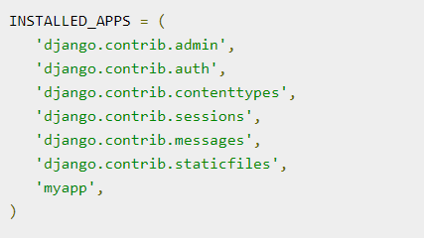
Get the Project to Know About Your Application
At this stage we have our "myapp" application, now we need to register it with our Django project "myproject". To do so, update INSTALLED_APPS tuple in the settings.py file of your project (add your app name):

Slide 42
Admin Interface
Django provides a ready-to-use user interface for administrative activities. We all know how an admin interface is important for a web project. Django automatically generates admin UI based on your project models.

Slide 43
Starting the Admin Interface
The Admin interface depends on the django.countrib module. To have it working you need to make sure some modules are imported in the INSTALLED_APPS and MIDDLEWARE_CLASSES tuples of the myproject/settings.py file.

Slide 44
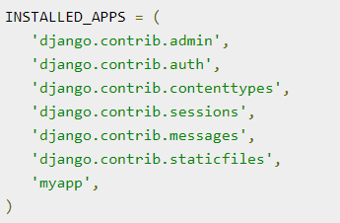
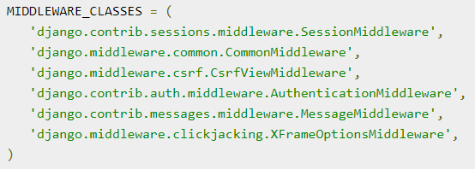
Starting the Admin Interface
For INSTALLED_APPS make sure you have:
For MIDDLEWARE_CLASSES:

Slide 45


Starting the Admin Interface
Before launching your server, to access your Admin Interface, you need to initiate the database:
syncdb will create necessary tables or collections depending on your db type, necessary for the admin interface to run. Even if you don't have a superuser, you will be prompted to create one.
If you already have a superuser or have forgotten it, you can always create one using the following code:

Slide 46
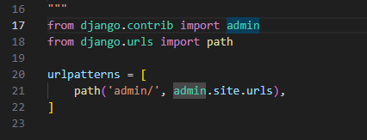
Starting the Admin Interface
Now to start the Admin Interface, we need to make sure we have configured a URL for our admin interface. Open the myproject/url.py and you should have something like:

Slide 47

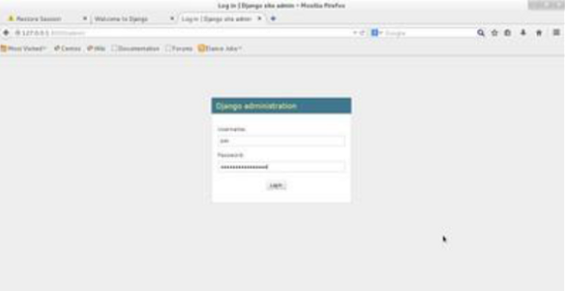
Starting the Admin Interface
Now just run the server.
And your admin interface is accessible at: http://127.0.0.1:8000/admin/

Slide 48
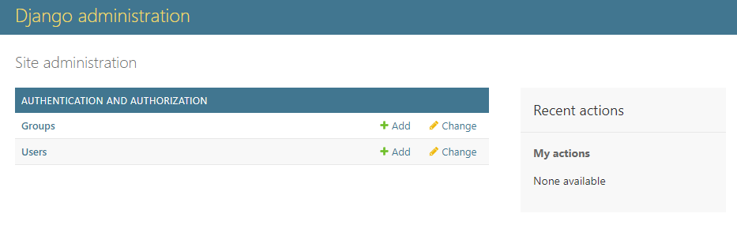
Starting the Admin Interface
Once connected with your superuser account, you will see the following screen:
That interface will let you administrate Django groups and users, and all registered models in your app. The interface gives you the ability to do at least the "CRUD" (Create, Read, Update, Delete) operations on your models.

Slide 49
IMPLEMENTING VIEWS

Slide 50
Creating Views
A view function, or “view” for short, is simply a Python function that takes a web request and returns a web response. This response can be the HTML contents of a Web page, or a redirect, or a 404 error, or an XML document, or an image, etc. Example: You use view to create web pages, note that you need to associate a view to a URL to see it as a web page.

Slide 51
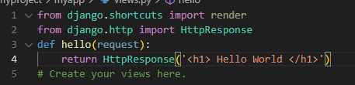
Simple View
We will create a simple view in myapp to say “Hello World”
See the following view:
In this view, we use HttpResponse to render the HTML (as you have probably noticed we have the HTML hard coded in the view). To see this view as a page we just need to map it to a URL.

Slide 52
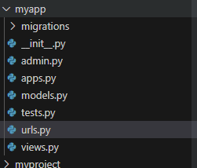
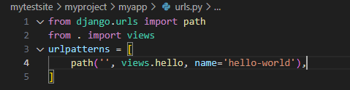
Creating urls.py in app folder

Slide 53
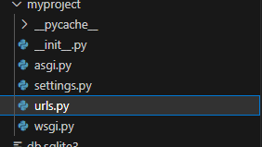
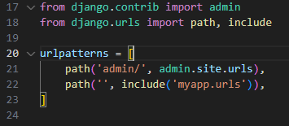
Adding myapp urls to the main

Slide 54
Run the Server

Slide 55
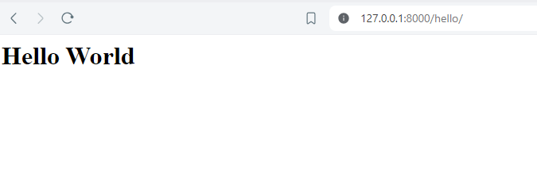
Output

Slide 56
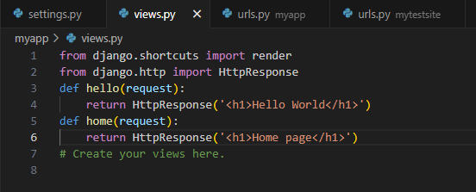
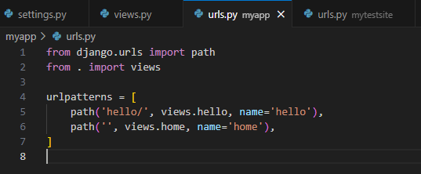
Creating another views and url

Slide 57
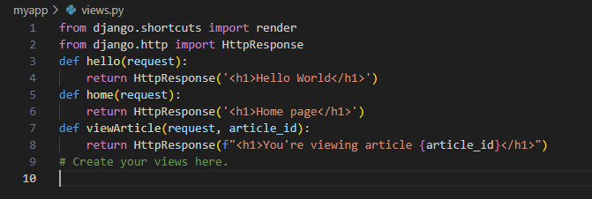
Sending Parameters to Views
return HttpResponse(f"<h1>You're viewing article {article_id}</h1>"): This line returns an HttpResponse object. Inside the HttpResponse, there's an f-string that dynamically inserts the value of the article_id into the HTML string. The {article_id} placeholder will be replaced with the actual value of the article_id variable.

Slide 58
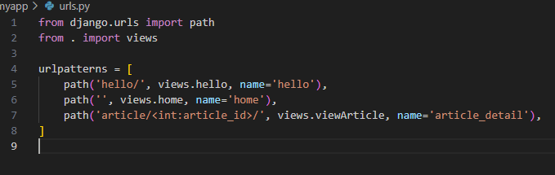
Sending Parameters to Views
when a request matches the URL pattern 'article/<int:article_id>/', Django will call the viewArticle function in your views.py module and pass the captured article_id as a parameter to the function.

Slide 59
TEMPLATES AND TAGS

Slide 60
Template System
Django makes it possible to separate python and HTML, the python goes in views and HTML goes in templates. To link the two, Django relies on the render function and the Django Template language.

Slide 61
The Render Function
This function takes three parameters:
Request − The initial request.
The path to the template − This is the path relative to the TEMPLATE_DIRS option in the project settings.py variables.
Dictionary of parameters − A dictionary that contains all variables needed in the template. This variable can be created or you can use locals() to pass all local variable declared in the view.

Slide 62
Django Template Language (DTL)
Django’s template engine offers a mini-language to define the user-facing layer of the application.
Displaying Variables
A variable looks like this: {{variable}}. The template replaces the variable by the variable sent by the view in the third parameter of the render function.

Slide 63

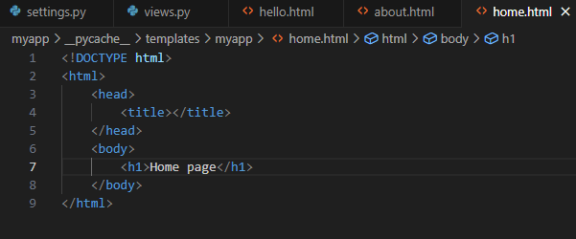
Creating templates folder
Before changing utilizing the variable function, we first need to create a templates folder with a subdirectory of the app templates resulting into templates/myapp:
Then our change view into an html :

Slide 64
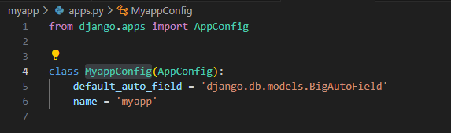
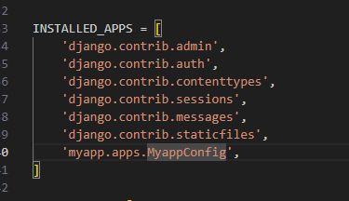
Templates
Then install the templates to the project by first copying the class name in apps.py in this case it is the MyappConfig:
Then to our project settings located in myproject folder, extend the ‘myapp’ into myapp.apps.MyappConfig:

Slide 65
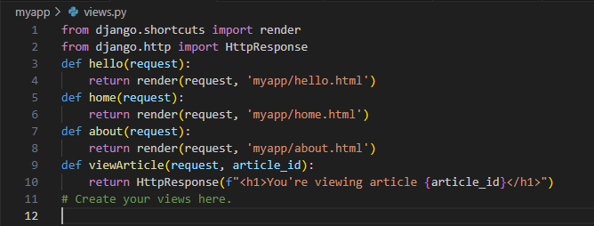
Templates
Then update the views.py file in the myapp folder
Then open localhost:8000 to check the website, and inspect the page.

Slide 66
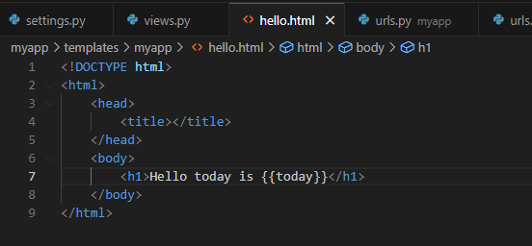

Variables
Now let us use the variable method.
Then change the views.py file in the app folder:

Slide 67
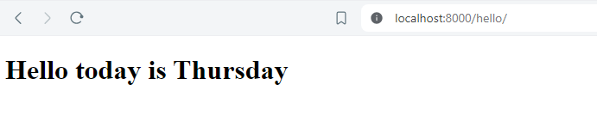
Variables
Now check the localhost:8000/hello.
From this figure, we can substitute the content of {{variable}} tags in the views.py folder by calling the {variable:value} in this example it is the {‘today’:’Thursday’}. We can also assign external variable into the value parameter.

Slide 68

Variables
Change the code into this:
Then you should be able to see the same output as the previous slide.

Slide 69
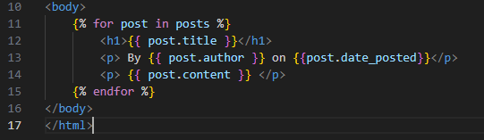
Tags
Tags lets you perform the following operations: if condition, for loop, template inheritance and more.
Tag for - just like in Python you can use for loop in your template
It is denoted by {%for x in list%} and ends with {%endfor%}

Slide 70
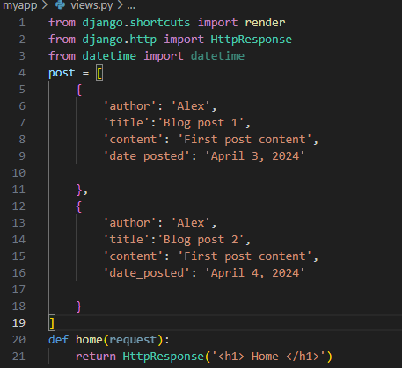
Tags
Let us create a list with a dictionary key-pair values inside.

Slide 71
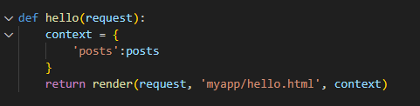
Tags
Then edit our def hello(request) into creating a context variable where it is a dictionary of the key-pair value of the list to be used for the for loop in the hello.html file.

Slide 72
Django Template Language (DTL)
Then edit inside the hello.html the following:

Slide 73
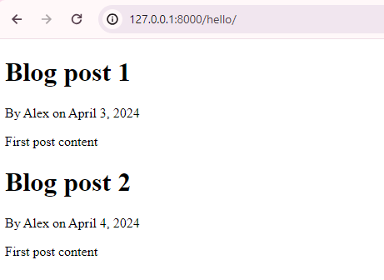
Django Template Language (DTL)
Then you should be able to get the following output in localhost:8000/hello:

Slide 74
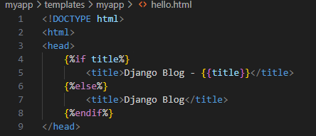
Tags
Tag if - just like in Python you can also use if, else if, and else statement in your template with {%if condition%} {%else%} {%endif%}
Let us add a condition to our links that if the page has a title, it would that specific title, else it would just result our default value: Django Blog. Change the hello.html with the following syntax:

Slide 75
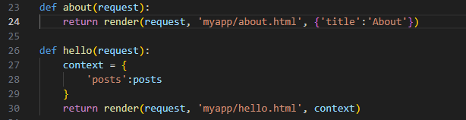
Tags
Then let’s change the views.py file in the myapp folder and adding a title variable in the def about {‘title’: About} while leaving the hello function with no title at all.

Slide 76
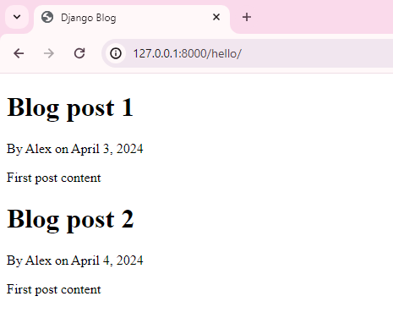
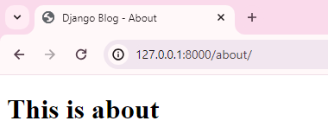
Tags
It should be able to output this result:

Slide 77
Block and Extend Tags
A template system cannot be complete without template inheritance. Meaning when you are designing your templates, you should have a main template with holes that the child's template will fill according to his own need, like a page might need a special css for the selected tab.
Let’s change the hello.html and about.html template to inherit from a base.html.

Slide 78

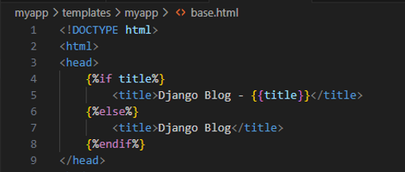
Tags
Let us first create a base.html file in the templates folder.
Then copy the function which about.html and hello.html has in common.

Slide 79
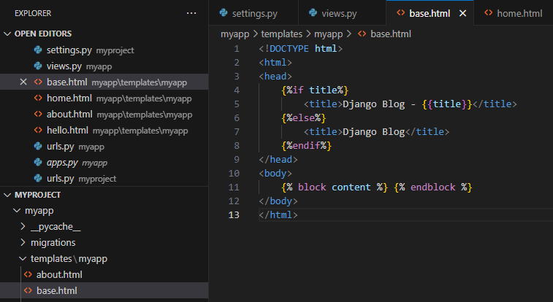
Tags
We’ll then use the block function where we will input the uniqueness of each webpage in where we placed the block function in our case it is the body.

Slide 80
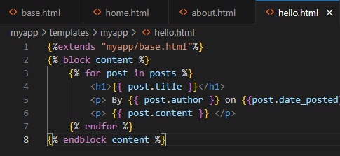
Tags
Then we use our extends function for our html where we will put the base.html template. Which is the hello.html and about.html

Slide 81
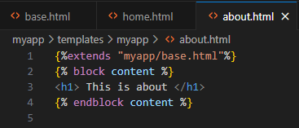
Tags
Then we use our extends function for our html where we will put the base.html template. Which is the hello.html and about.html
Now access the localhost:8000/hello and localhost:8000/about

Slide 82
Block and Extend Tags
In the example, on calling /myapp/hello and /myapp/home we still get the same result as before but now we rely on extends and block to refactor our code −
In the base.html we define blocks using the tag block. The title block will contain the page title and the content block will have the page main content. In home.html and about.html we use extends to inherit from the base.html then we fill the block define above (body).

Slide 83
to be continued…

Slide 84
Thank you!

