Slide 1
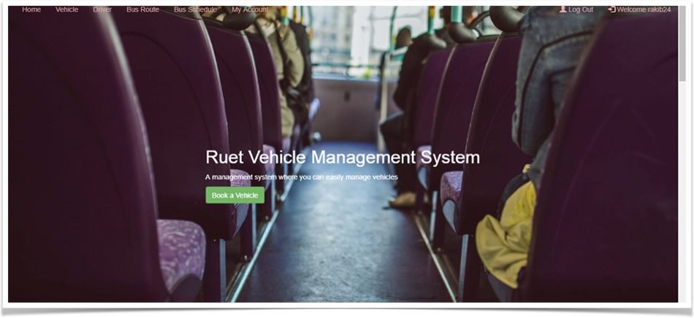
Vehicle Management
This application was develop to manage vehicles system of RUET.

Slide 2
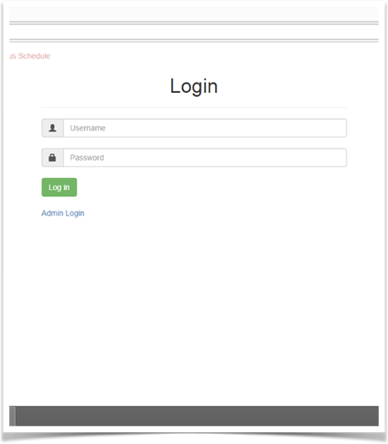
Login page
User and Admin login page

Slide 3
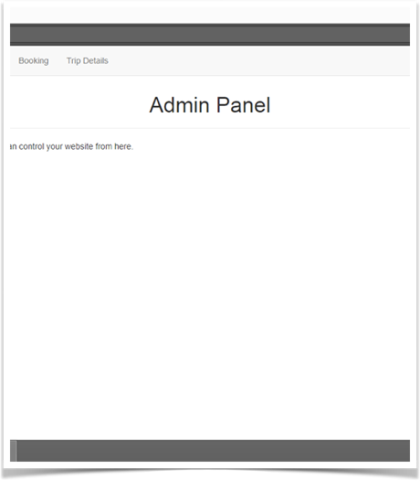
Admin Area
Admin area for adding , managing vehicles , drivers. They can also respond on bookings.

Slide 4
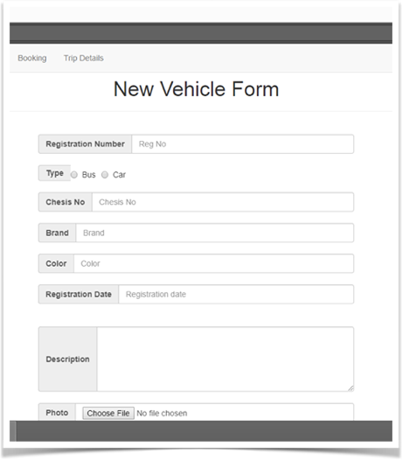
Adding Vehicle
Admin perform adding new vehicles in the system.

Slide 5
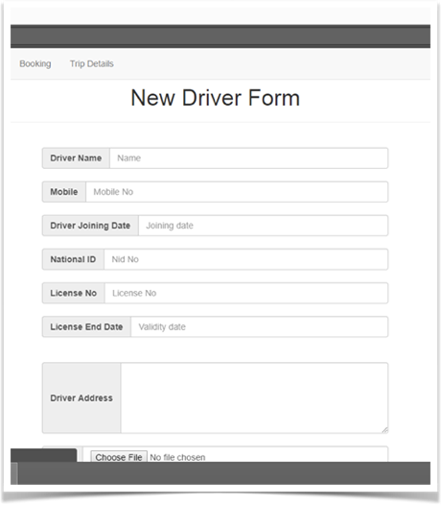
Adding Drivers
Only admin can add new drivers

Slide 6
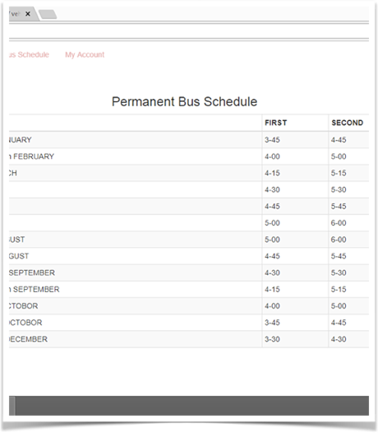
Bus Schedules
All users can view but only admins can perform changes.

Slide 7
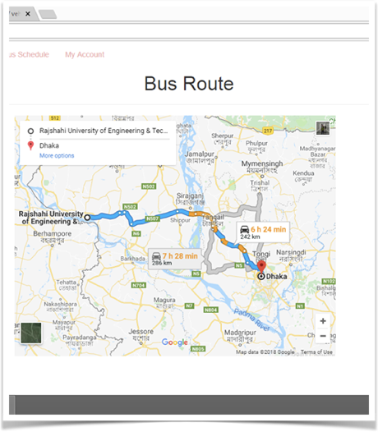
Adding Routes
Authority must define the availability of routes .

Slide 8
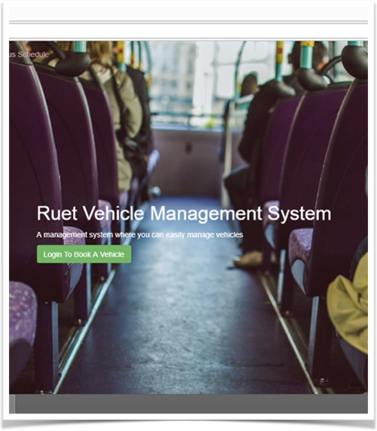
Booking Request
User must login and then need to fill the form for booking a vehicle.

Slide 9
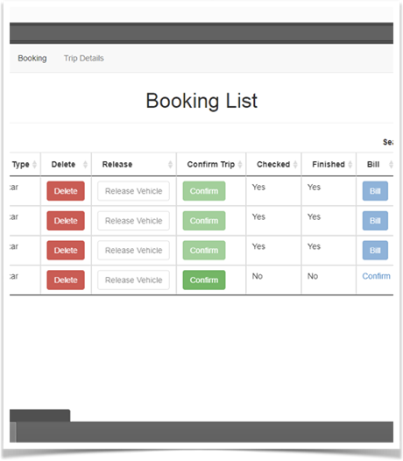
Booking List
User can only view but the admin can also manage.

Slide 10
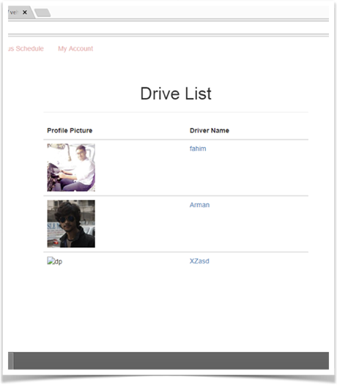
Driver List
All drivers informations.

Slide 11
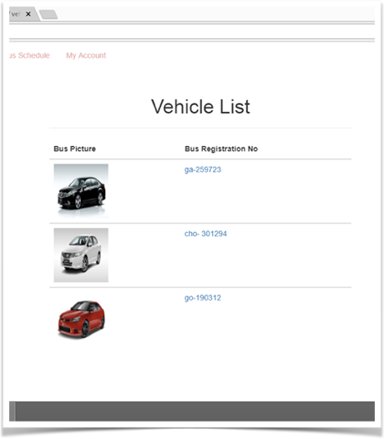
Vehicle List
All vehicle informations are there.

Slide 12
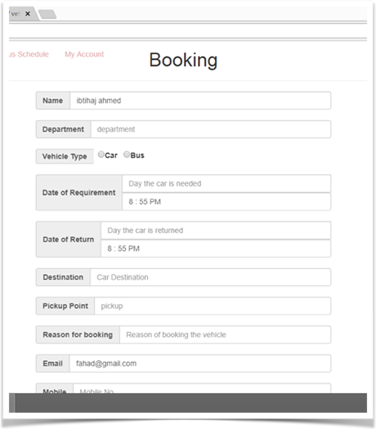
Booking Request Form
User need to fill this info form correctly to have a booking request.

Slide 13
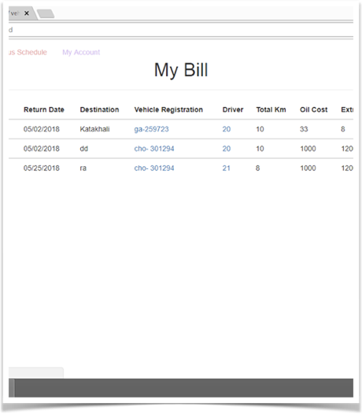
Billing
Admin generates the bills and users get their bills according to their usage.

Slide 14
