Slide 2
cd c:/advweb2018
ls
mkdir week7
cd week7
git init

Slide 3
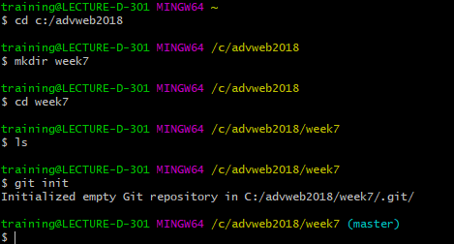

Slide 4
git status
git add index.html

Slide 5
