Slide 2
Working with git
Workflow

Slide 3
cd c:/advweb2018
ls
mkdir week7
cd week7
git init

Slide 4
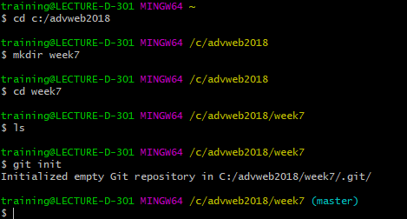

Slide 5
git status
git add index.html
git commit –a –m”message”

Slide 6
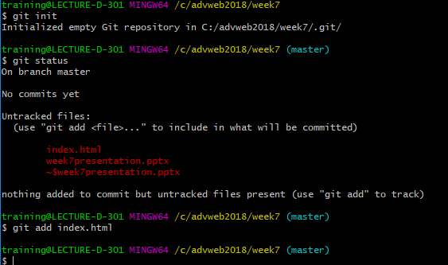

Slide 7
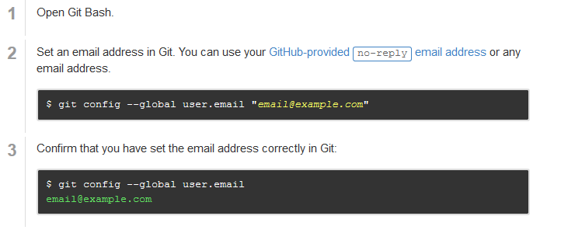

Slide 8
