Slide 2
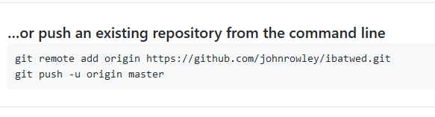

Slide 3
Working with git
Workflow

Slide 4
cd c:/advweb2018
ls
mkdir week7
cd week7
git init

Slide 5
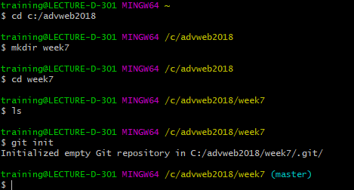

Slide 6
git status
git add index.html
git commit –a –m”message”

Slide 7
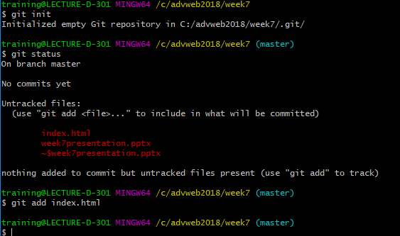

Slide 8
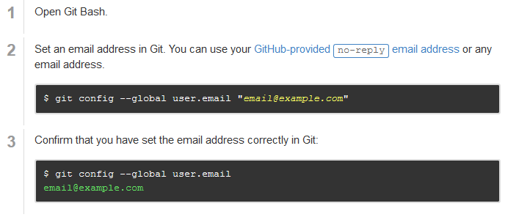

Slide 9
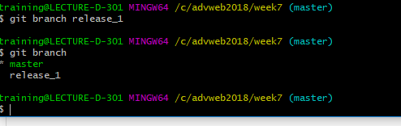

Slide 10
