Slide 1
MAX-3-SAT problem
Liam Herkins and Elizabeth Johnson

Slide 2
Our Decision & Optimization Problem
The Max3Sat problem is an instance of a boolean satisfiability problem(SAT)
Given a 3-CNF formula, you must find the boolean assignments that make the largest number of clauses evaluate to true
  Ex:
  Each clause has three literals, which can either be normal of negated. Literals are separated by OR operators, and clauses separated by AND
Since Max3Sat is NP-complete, there is no known optimal solution algorithms that can run in polynomial time, which is why there are approximation algorithms, such as the Karloff-Zwick Algorithm

Slide 3
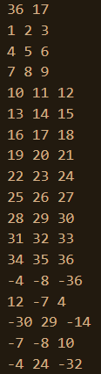
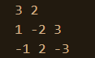
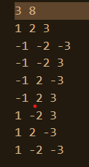
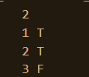


Inputs/Outputs
Sample Input:
Input that shows not all the clauses can be true:
Another test had 5 literals and 68 clauses to test if it would make the exact algorithm significantly longer.
The input to the right caused the exact solution to run for over 20 minutes, while the approximate solution completes almost immediately.
Exact and Sample get the same output:
Exact Output:
Approx Output:

Slide 4
Real-life Applications of Max3Sat
Use to verify the validity of gene algorithms in bioinformatics
AI can use this algorithm to create schedules
Networks use for routing

Slide 5
Certifier Process and its Polynomial Nature
Input: Formula with clauses and an assignment of truth values (random)
Evaluate clauses:
  Check each clauses against its truth assignment
  Increment counter if the clause has been satisfied
This process is Polynomial because clause evaluation happens in constant time, random assignment takes linear time, and the number of evaluations is also linear.

Slide 6
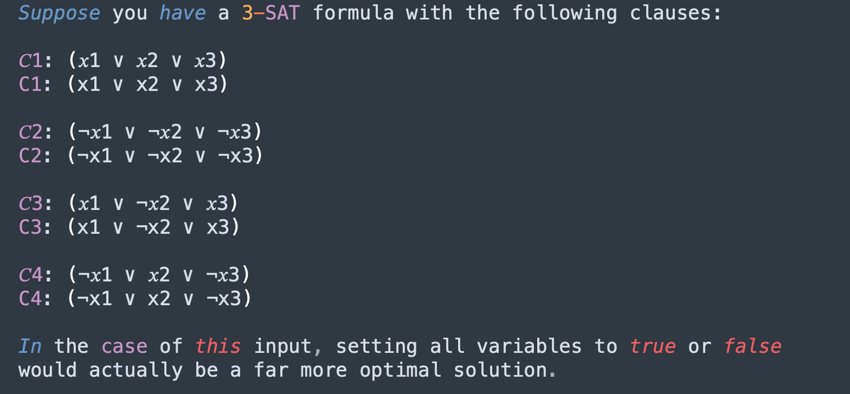
Suboptimal Nature and Input
Since Karloff-Zwick uses random assignment it can lead to a suboptimal assignment of truth values

Slide 7
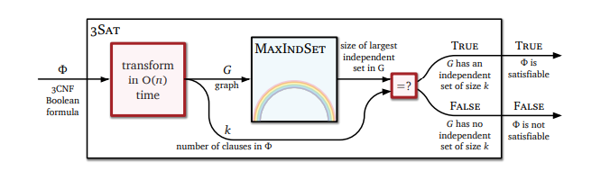
Known NP-Hard Reduction
Proving that Max3Sat is NP Hard

Slide 8
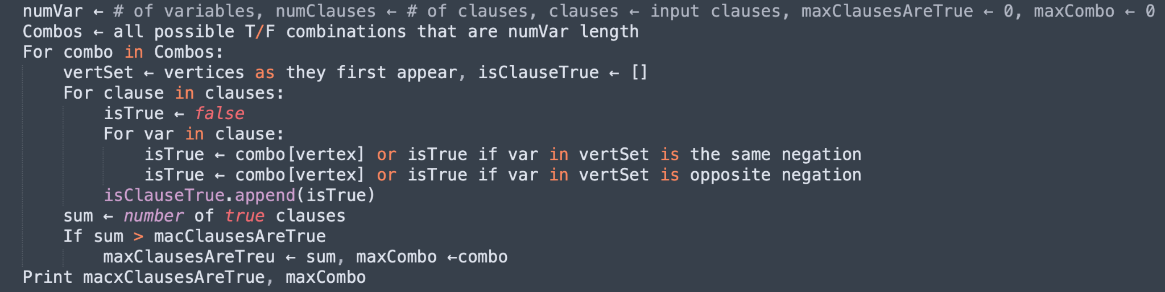
Exact Pseudocode - Brute Force

Slide 9
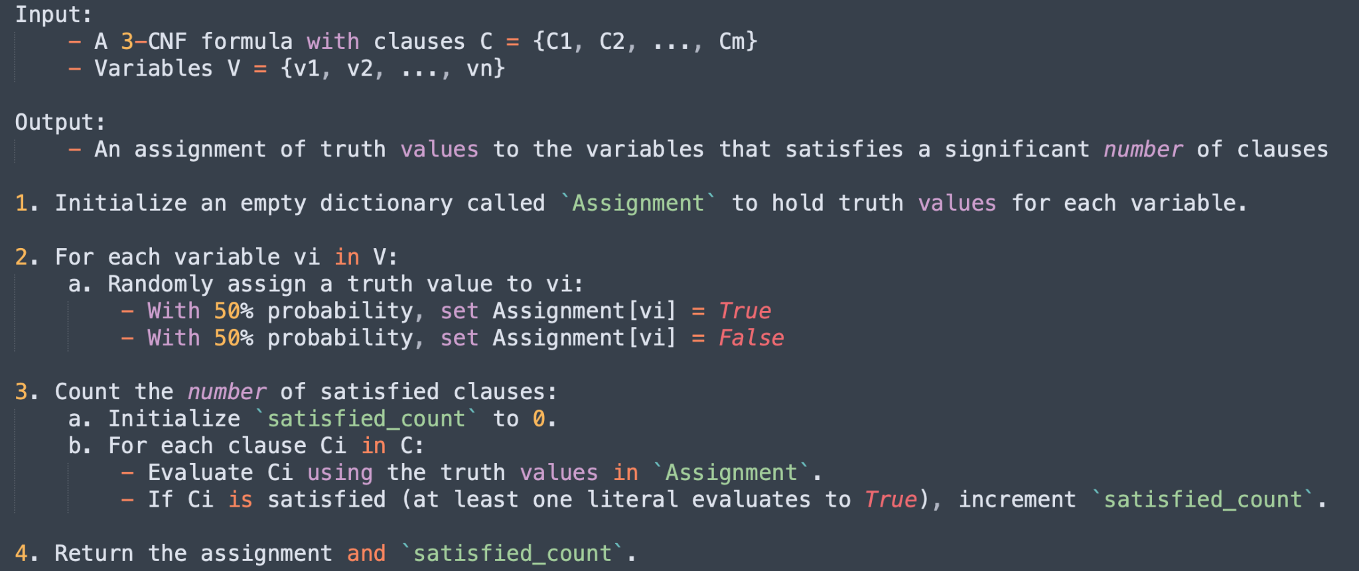
Approx Pseudocode

Slide 10
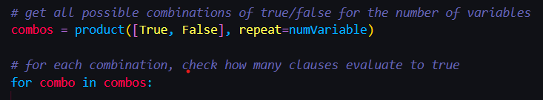
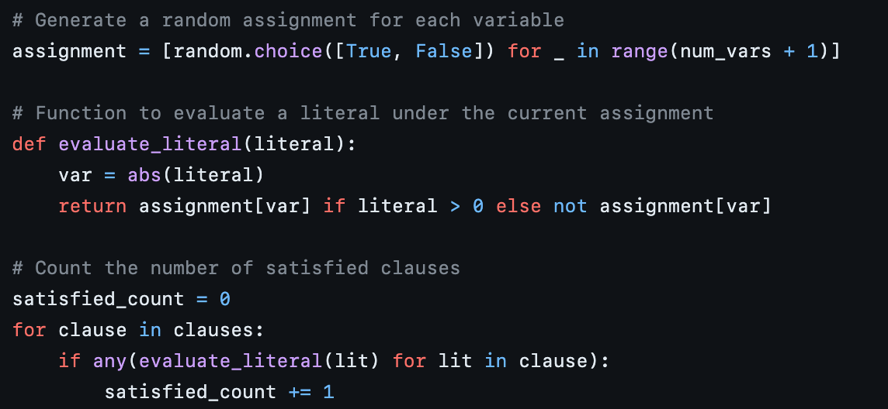
Big-O Analysis of Solutions
The exact solution runs in O(M^{N}) because it has to test all possible truth values for each literal.
The Karloff-Zwick algorithm runs in O(N²)/O(n*m):
It first randomly assigns truth values to each variable = O(n)
Then it must check each clause O(m)
  Each clause has 3 variables = O(1)

Slide 11
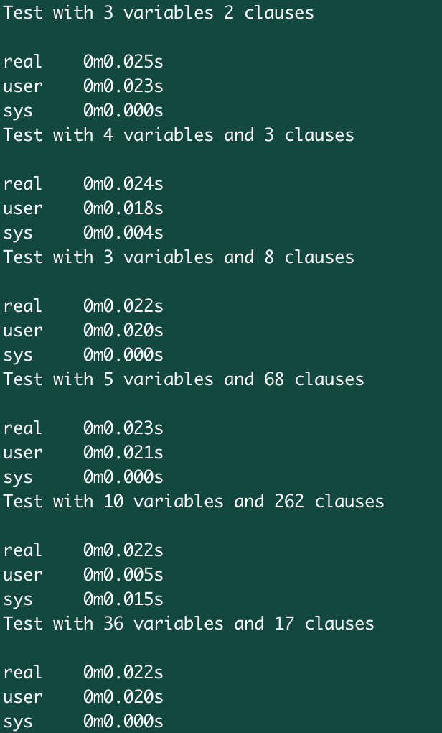
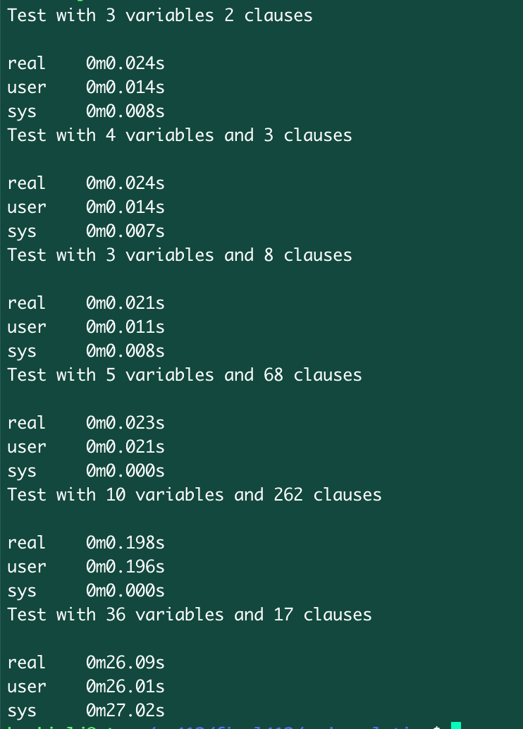
Empirical Runtime (wall-clock)
Approximation: Exact:

Slide 12
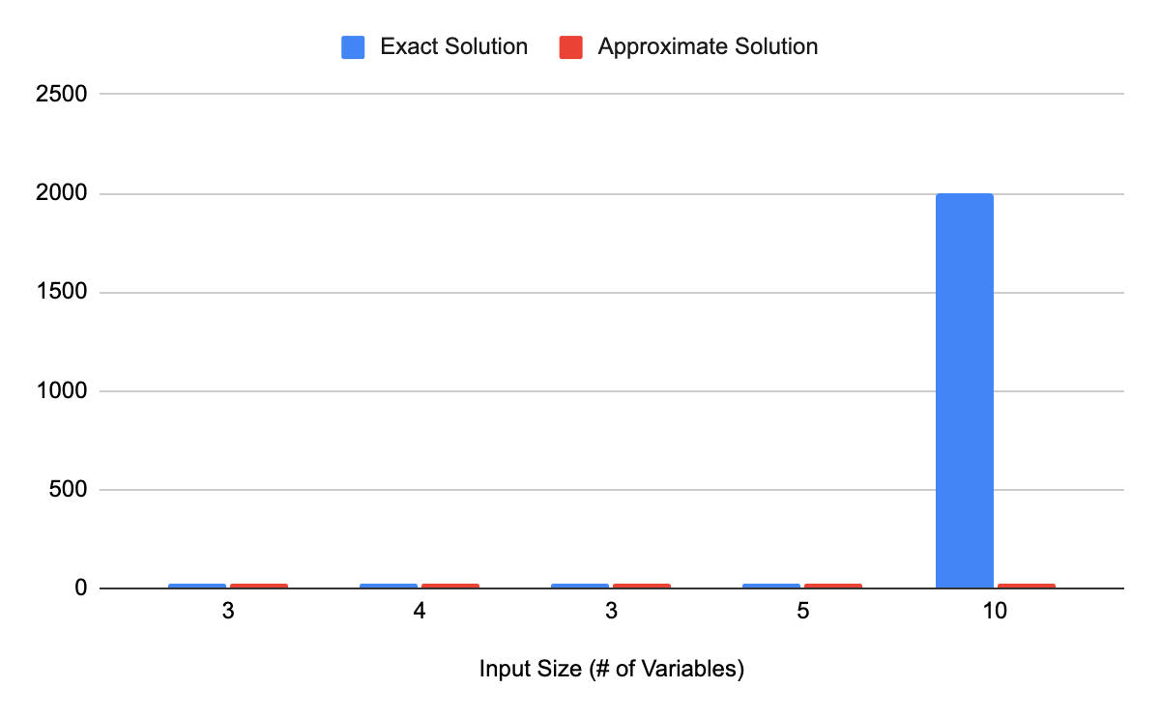
Plot of Input Size vs Runtime (milliseconds

Slide 13
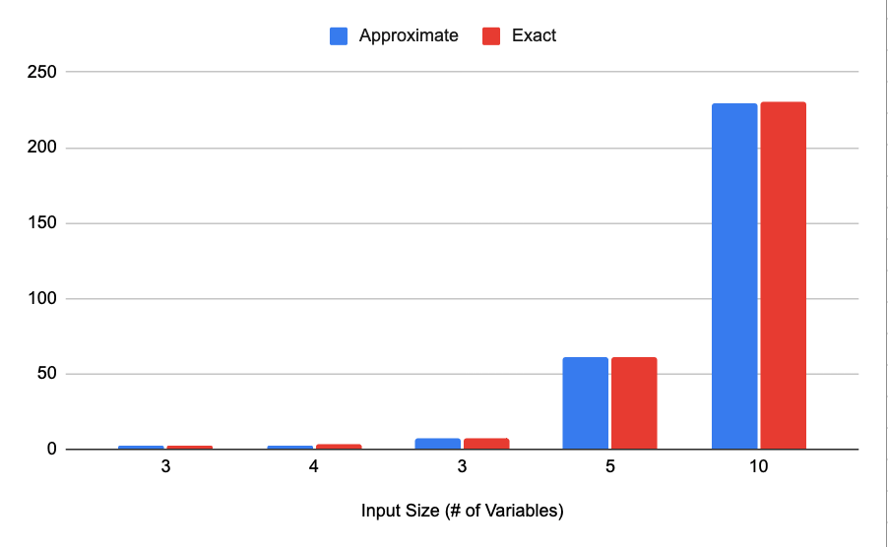
Satisfied Assignments vs Input Size

Slide 14
References
Textbook
https://en.wikipedia.org/wiki/MAX-3SAT
https://digitalcommons.usf.edu/cgi/viewcontent.cgi?article=9113&context=etd
https://homepage.divms.uiowa.edu/~hzhang/c188/notes/ch04d-MSAT.pdf

