Slide 1
Quiz Management System
Johnathan Moroni Sales do Vale Santiago
Muhammad Kashif Jawad
Ambasa Aklilu Teferra
Saikou Yaya Diallo
Moneeba

Slide 2

Introduction
The ‘Quiz Management System’ is a MCQ based system and this project is developed to overcome the time-consuming problem of manual system. Apart from that in current system, checking the answer sheets after taking test, waste the examiners time, so this application will check the correct answer and save the examiner time and carry the examination in an effective manner.
The student can login on the platform, treat their quiz, apply them, and see their results. So, the teacher would also be able to see the results of each student for each quiz.
With the help of this Quiz Management System teacher and students can see their reports of previous quizzes.

Slide 3

Project Objective
The purpose of the project is to build an application to reduce the manual work for managing the MCQ quiz and we will follow to achieve these objectives in this project.
To create an appropriate platform for best managing of MCQ test;
To overcome the time-consuming issues and taking MCQ tests;
To release the marks of the test taker as soon as possible;
To generates the results.

Slide 4
Use Cases
Login
Students' login to the system to take the quiz and/or get a quiz report.
Teacher login to the system to create quizzes and get the student’s report.
Attempt Quiz
The student can attempt the quiz.
Manage Quiz and Questions
The professor can create/edit/delete different quizzes.
The professor can add/edit/delete questions in a quiz.
View Report
a. The professor can see the students' reports of quizzes.
b. Students can view their quizzes report.
5. Register
Students who want to take quizzes must register first.
Professors who want to manage quizzes must register first.

Slide 5
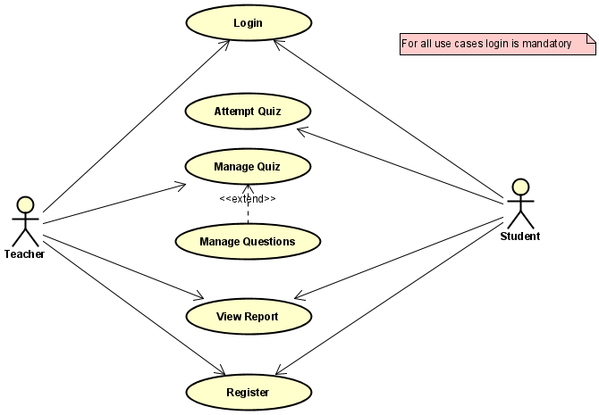
Use case Diagram

Slide 6
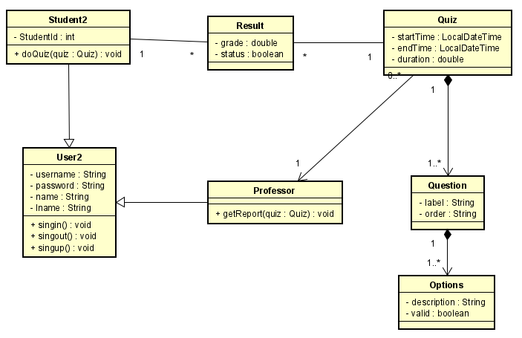
Class Diagram

Slide 7
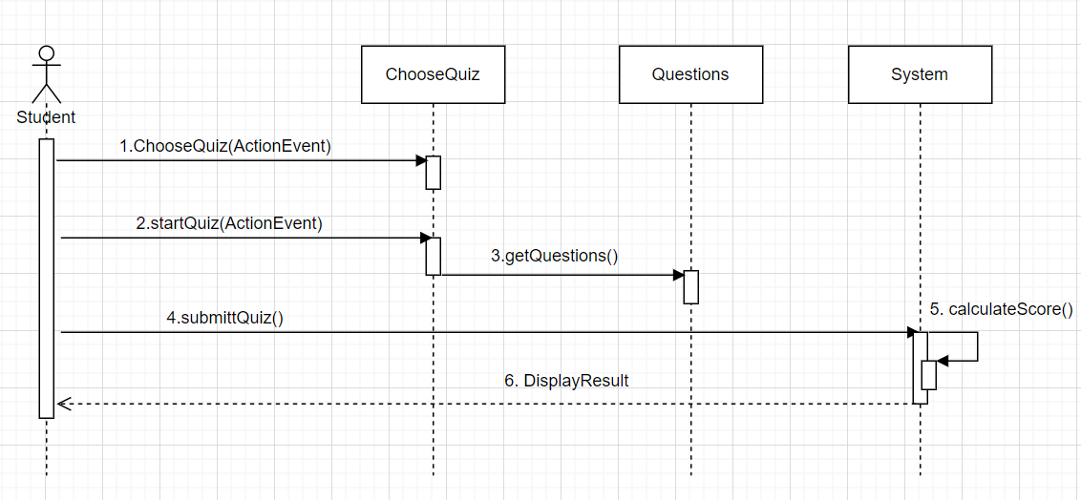
Sequence Diagram

Slide 8
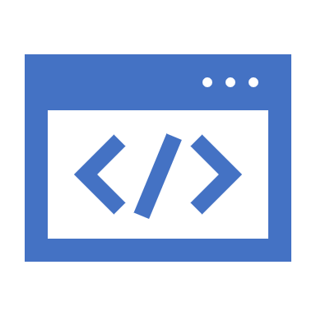
Applied Concepts
Streams
Lambda,
javafx, SceneBuilder
Inheritance,
MVC design pattern
Git hub
Maven

Slide 9

Thank You

