Slide 1
History of Painting

Slide 4
reaches back in time to artifacts from pre-historic humans, and spans all cultures
It represents a continuous, though periodically disrupted tradition from Antiquity.
Developments in Eastern painting historically parallel those in Western painting, in general, a few centuries earlier.
initially serving utilitarian purpose, followed by imperial, private, civic, and religious patronage, Eastern and Western painting later found audiences in the aristocracy and the middle class.

Slide 5
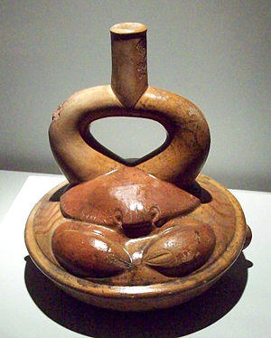
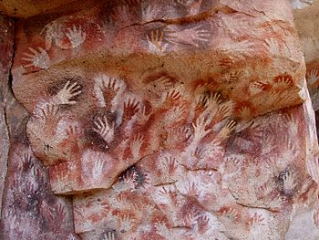
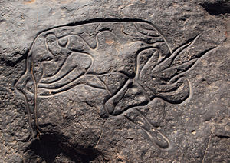
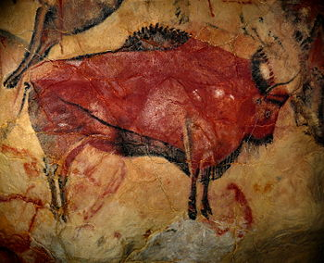
PREHISTORIC ART OF PAINTINGS
Ceramic Moche stirrup spout vessel representing acrustacean.
CAVE PAINTING
Cueva de las Manos (Spanish for Cave of the Hands) in the Santa Cruz province in Argentina
A petroglyphic Saharan rock carving from southernAlgeria depicting an antelope or gazelle.
Cave of Altamira, near Santander, Spain.
Spans All cultures and dates back to the time of the prehistoric men who produced their own artifacts.

Slide 6
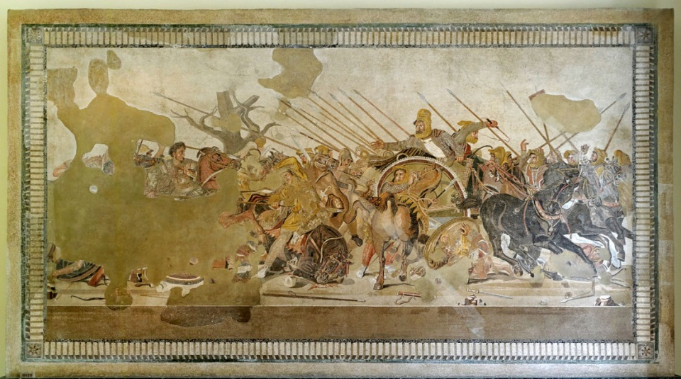
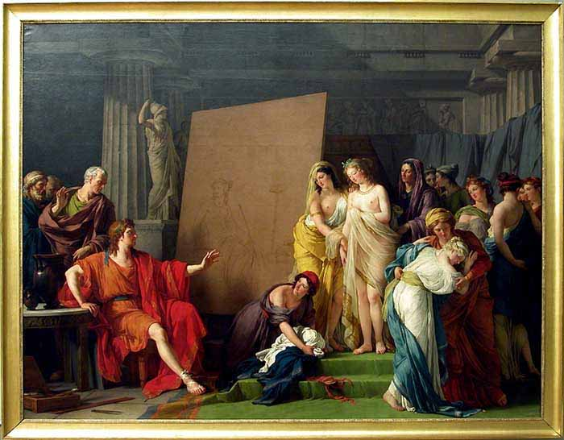
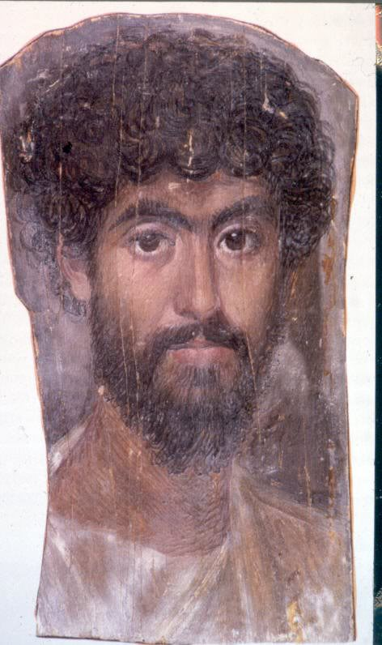
GREEK PERIOD – Ancient Greece had great painters who were then regarded as manual laborers
Reconstruction of a mosaic depiction of the Battle of Issus
Zeuxis et les Filles de Crotone
“Parrhasius” was universally placed in the very first rank among painters.

Slide 7
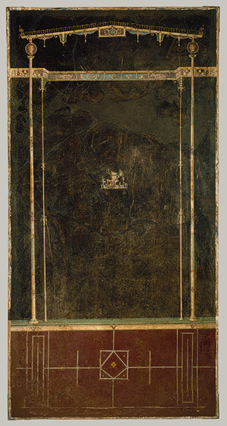
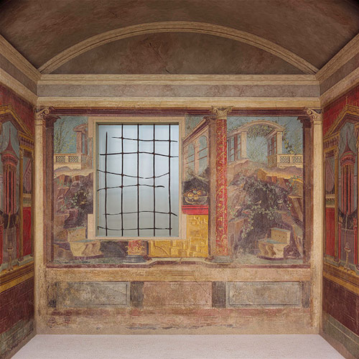
ROMAN PERIOD – Influenced by ancient Greek , Roman painting exhibits important characteristics of its own.
"Black Room"
(bedroom)
Aedicula with small landscape: From the "Black Room" of the Imperial Villa at Boscotrecase, last decade of 1st century B.C.; Augustan Roman Wall painting; Fresco: H. 91 3/4 in. (233.05 cm) Rogers Fund, 1920 (20.192.1)
Fresco wall painting in a cubiculum (bedroom) from the Villa of P. Fannius Synistor at Boscoreale, ca. 40–30 B.C.; Late Republican Roman Plaster

Slide 8
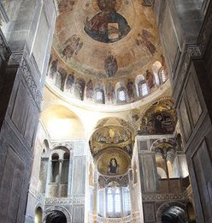
MEDIEVAL PERIOD – The Middle Ages saw the rise Christianity, which brought about a different spirit and aim to paintings style.
The Byzantine Style
Byzantine visual art remained sufficiently static throughout the Middle Ages to allow for the sweeping term Byzantine style (although subtly distinct phases can indeed be discerned)

Slide 9
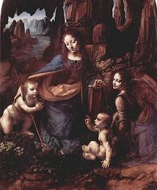
RENAISSANCE PERIOD Considered the golden age of painting, the renaissance spanned from the 14th through the mid 17-th century.
Leonardo da Vinci
Whose surviving works are few, established pyramidal composition as the standard structure of High Renaissance paintings.
Virgin of the Rocks.

Slide 10
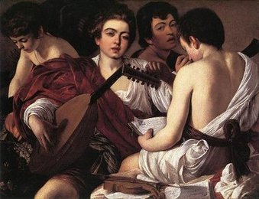
BAROQUE PERIOD Beginning around 1600 until the last years of the 17th century, the baroque period produced paintings with dramatic light and shade, violent composition, exaggerated emotion.
Caravaggio
The most influential painter of the Early Baroque period, and the artist who established tenebrism (the bright illumination of a scene out of darkness) as a common feature of realist Baroque painting. Given its drama-heightening effect, tenebrism is very much a Baroque effect.

