Slide 1


Slide 2

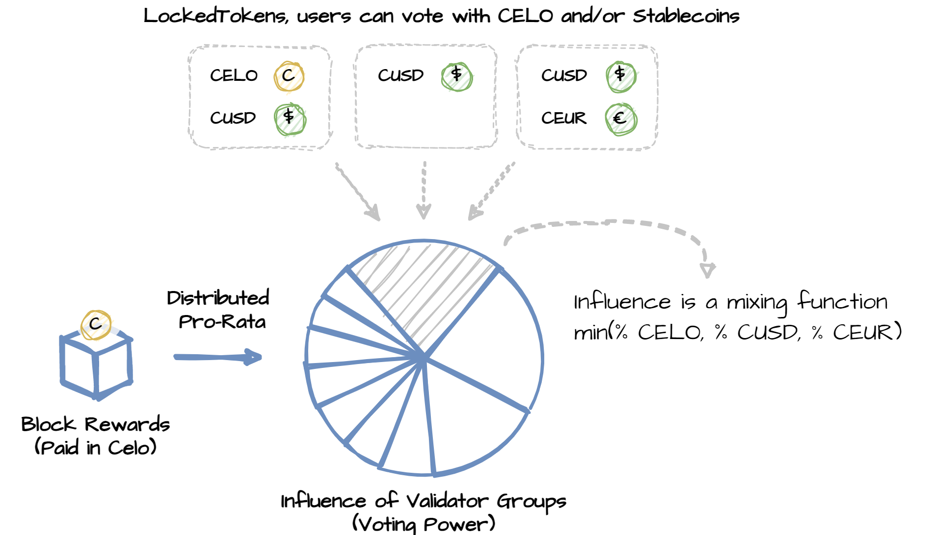
Proof-of-Deposit (DeFi track)

Slide 3
Demonstration Time!
http://hackathon.cambridgecryptographic.com/
We implemented the following:
Modified LockedGold → LockedToken (compatible with any ERC20)
Modified Election → Compatible with multiple LockedToken

