Slide 1


Slide 2

Proof-of-Deposit
Paying Block Rewards as “Risk-Free” Yield on Stablecoins

Slide 3
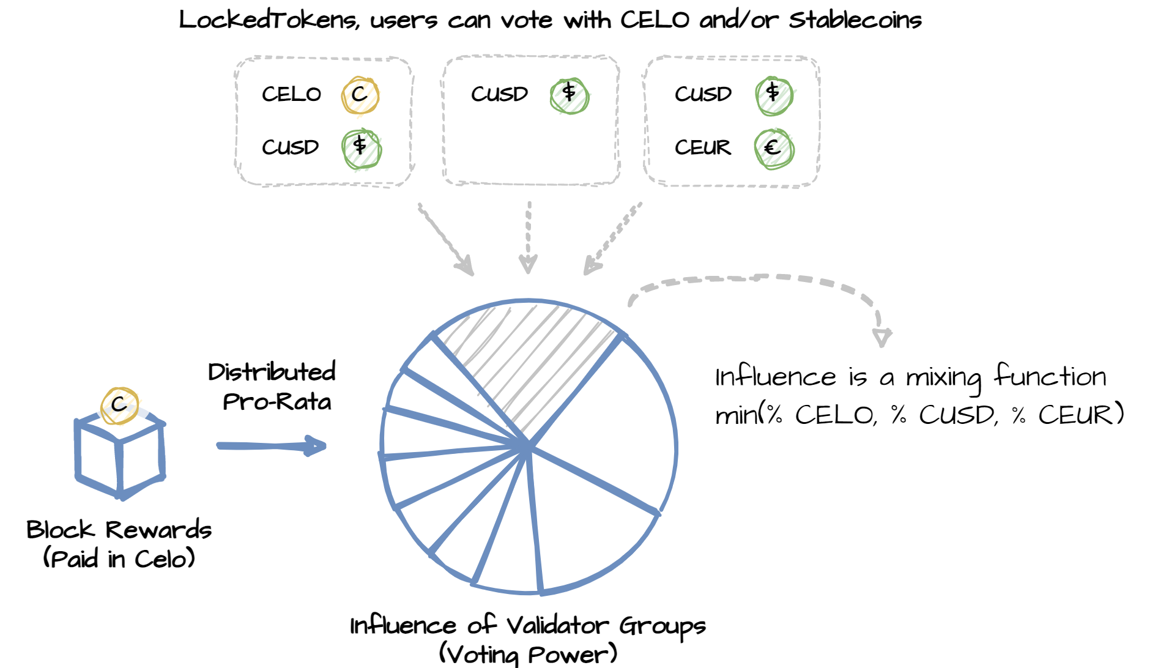
A simple but profound idea…

Slide 4
A simple but profound idea…

Slide 5
A simple but profound idea…

Slide 6
A simple but profound idea…

Slide 7
A simple but profound idea…

Slide 8
A simple but profound idea…

Slide 9
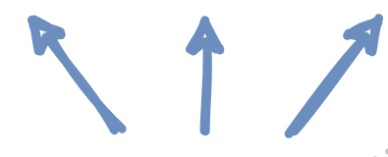
A simple but profound idea…

Slide 10
A simple but profound idea…

Slide 11
What are the benefits?
Taps into the risk-averse userbase
  Those that cannot or do not want take risk with their money
  Regulated custodians/banks
  Non-speculative everyday people
  Increased liquidity = increased stability! Buffer against sell-offs by speculators

Slide 12
What are the benefits?
Not like other DeFi: amplifies demand for CELO and stablecoins
  Yield is "risk-free“. No risk of loss of principal
  Yield is paid from minted CELO and fees from the entire on-chain economy
  Positive feedback loop
    demand for stablecoins (for APY) → demand for CELO (collateral for stablecoin)
    demand for CELO (collateral for stablecoin) → raises price of CELO (increased APY)

Slide 13
What are the benefits?
A novel tool for Central Banks
  Validators can be incentivised to set a “risk-free” rate that supports counter-cyclical monetary policy
  Can raise credibility of CBs of smaller nations! Reduces risk of hyperinflation in the eyes of the international sovereign bond market

Slide 14
Demonstration Time!
http://hackathon.cambridgecryptographic.com/
We implemented the following:
Modified LockedGold → LockedToken (compatible with any ERC20)
Modified Election → Compatible with multiple LockedToken

