Slide 1



Song Similarity Retrieval
Yiannis Savvas & Chaido Poulianou
Course: Multimodal Machine Learning
Athens, Jun. 2024

Slide 2

Agenda
Introduction
Our Approach
Dataset
Architectures/Models
Final representation
Experiments

Slide 3
Introduction
Similarity is subjective
Lot of features
High dimensionality->complex similarity retrieval!

Slide 4
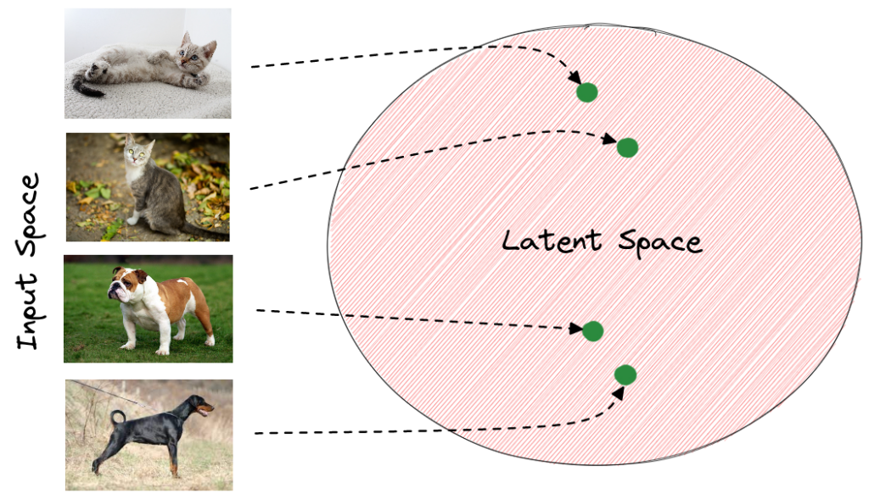
Our approach
Representation learning:
Use of latent space representations to reduce dimensionality
Supervised representation learning:
CNN classifier models:
- Genre
- Emotion
Additional metadata
- Artist, year, energy, dancability, valence, tempo etc…
Autoencoder:
- Final latent representation of all characteristics

Slide 5
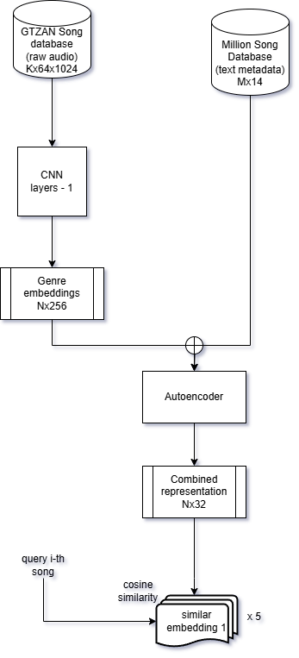
Our approach

Slide 6
Dataset
Genre classification:
GTZAN
Raw audio input 30 second clips
10 labels/genres
100 samples/genre
Total = 1000 samples
Stratified split 80%
Training set = 800
Validation set = 100
Test set = 100
Metadata:
Million Song Database + Spotify API
Raw audio input 30 second clips
1500 raw audio
50000 song metadata -> filtered to 1500 to match audio files

Slide 7
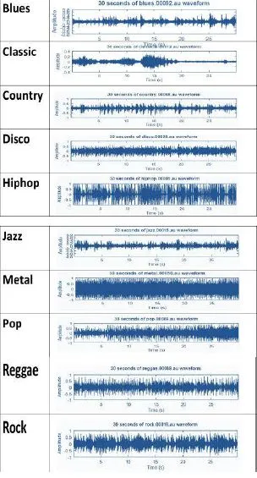
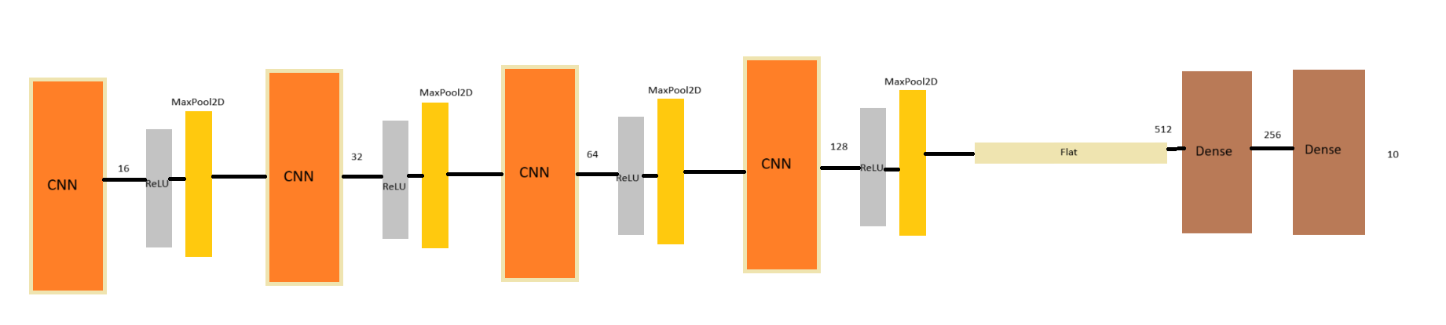
CNN genre classification
Data extraction:
GTZAN raw audio -> librosa -> Mel-spectrogram
Input: Mel-spectogram
Output: Genre Embeddings

Slide 8
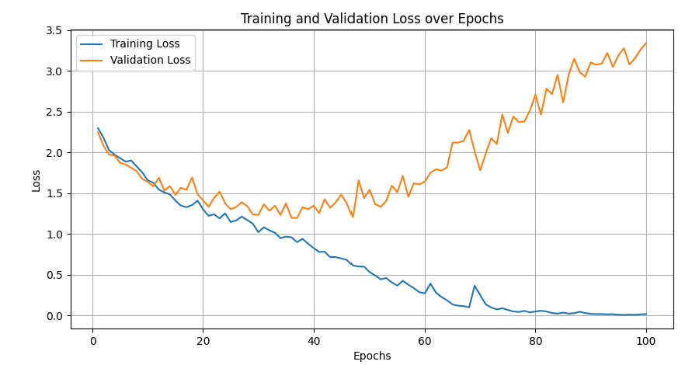
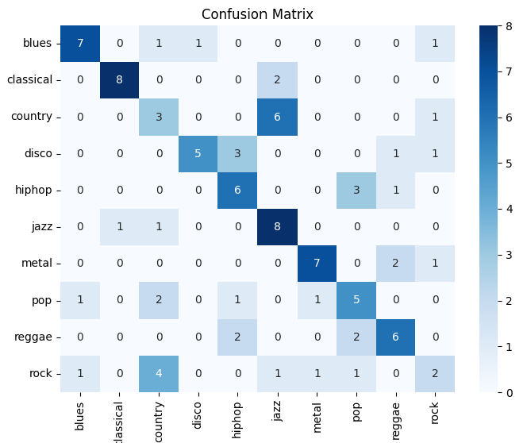
CNN genre classification

Slide 9
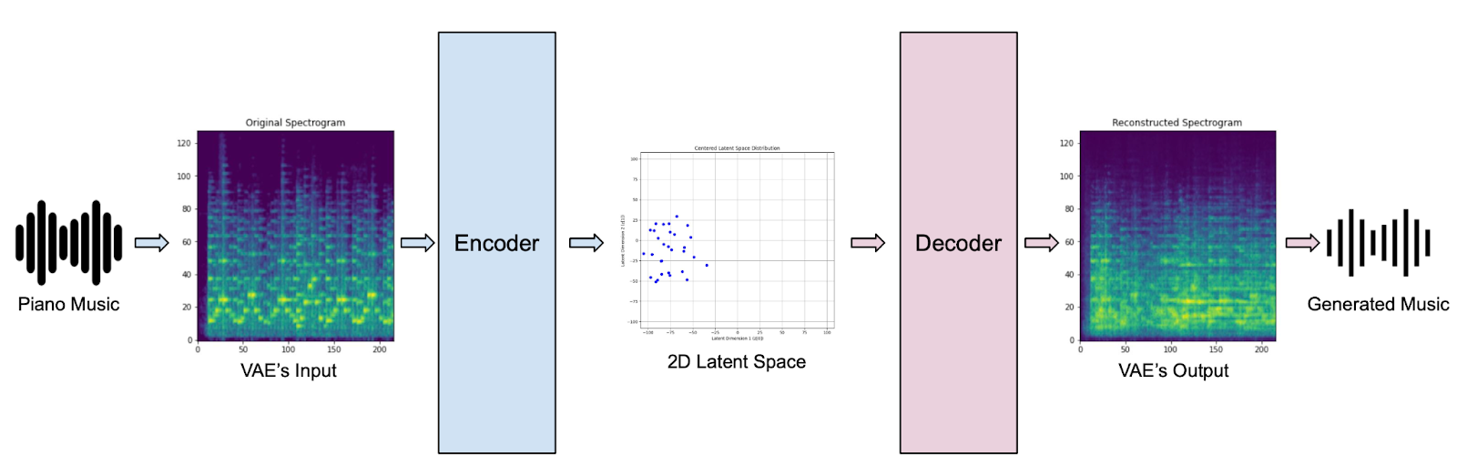
Autoencoder
Input: Concatenation of high-dimensional genre + metadata embeddings
Output: Encoder final layer embeddings
Train to match decoder output as close to input data
Further reduction of dimensionality
Unsupervised dependency discovery
Final refined low-dimension representations

Slide 10
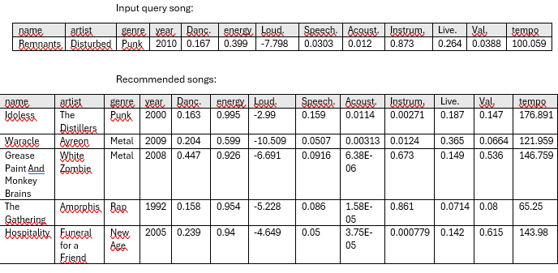
Experiments
Evaluation difficult to quantisize -> human evaluation
Thinks to consider: close to query genre & close to query metadata values & raw audio similar
Cosine similarity
20 experiments, 20 randomly queried songs
Top 5 similar

Slide 11
Thank you!

