Slide 1



Song Similarity Retrieval
Yiannis Savvas & Chaido Poulianou
Course: Multimodal Machine Learning
Athens, Jun. 2024

Slide 2

Agenda
Introduction
Our Approach
Datasets
Architectures/Models
Final representation
Experiments/Retrieval

Slide 3
Introduction
Motivation
Combine different features-elements of audio in a combined representation.
Focus on specific audio characteristics for song retrieval (genre, emotion, metadata).
Create multiple audio representations and perform dimensionality reduction.
Goal
Create a multimodal model that can retrieve similar songs based on a query song.

Slide 4
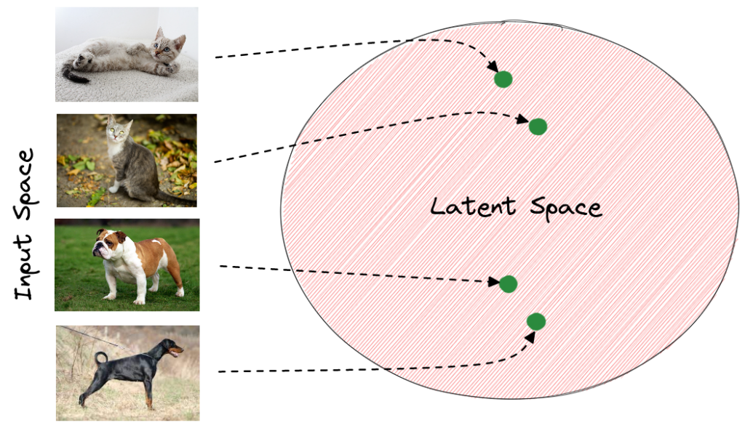
Our approach
Representation learning:
Use of latent space representations to reduce dimensionality
Supervised learning (Classification):
CNN classifier models:
- Genre
- Emotion
Unsupervised learning
Autoencoder
Final latent representation of all characteristics and additional metadata (Artist, year, energy, danceability, valence, tempo)

Slide 5
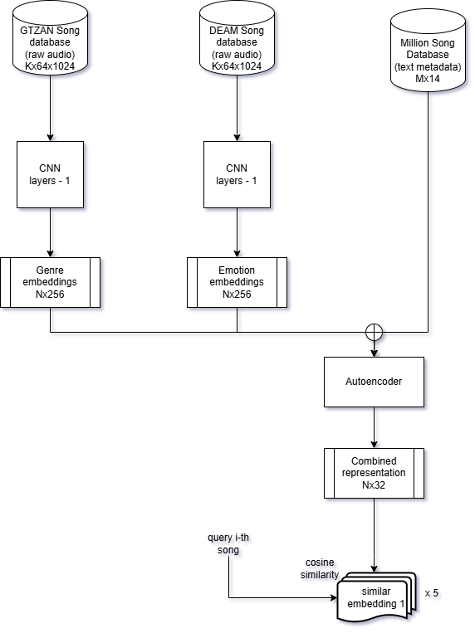
Our approach

Slide 6
Dataset
Emotion classification:
DEAM
Raw audio input 45 second clips + metadata
Extract emotion labels based on valence+arousal
Total = 1744 samples
Genre classification:
GTZAN
Raw audio input 30 second clips
10 labels/genres
100 samples/genre
Total = 1000 samples
Stratified split 80%
Training set = 800
Validation set = 100
Test set = 100
Metadata:
Million Song Database + Spotify API
Raw audio input 30 second clips
1500 raw audio
50000 song metadata -> filtered to 1500 to match audio files

Slide 7
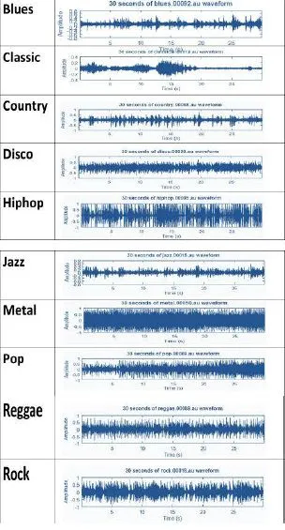
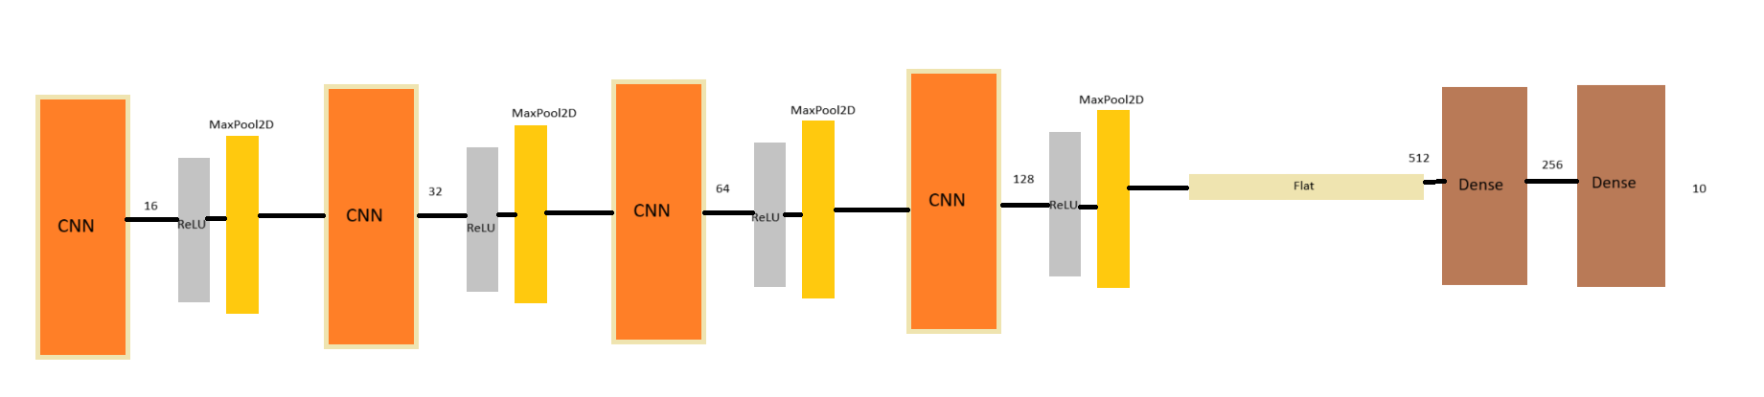
CNN genre classification
Data extraction:
GTZAN raw audio -> librosa -> Mel-spectrogram
Input: Mel-spectogram
Output: Genre Embeddings

Slide 8
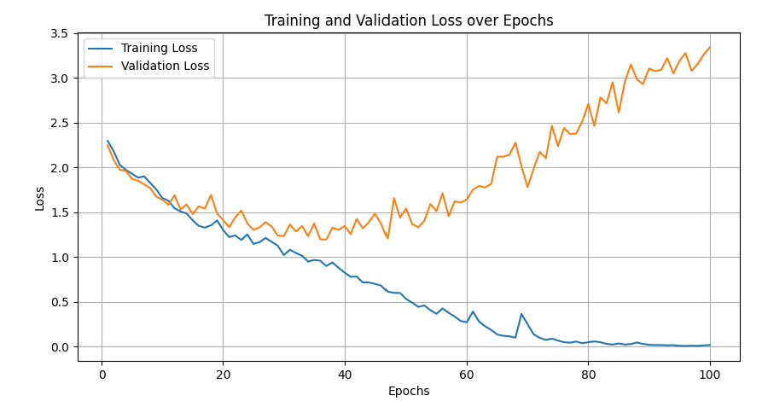
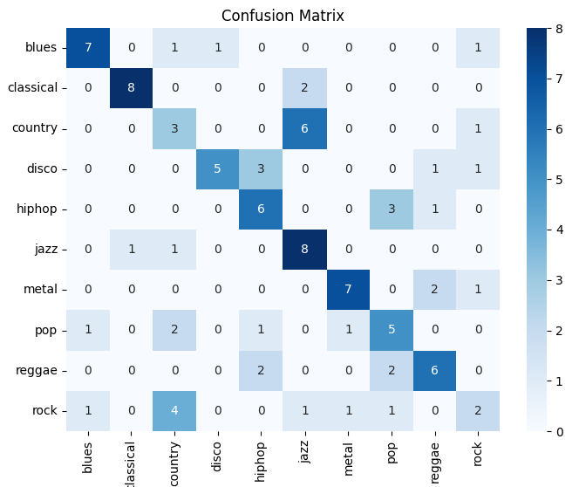
CNN genre classification

Slide 9
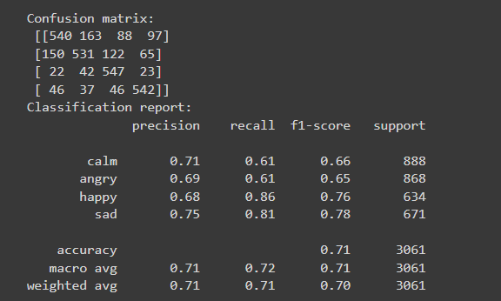
CNN emotion classification
DEAM per song averaged features:
- Classify based on valence + arousal
Imbalanced dataset!
->need to augment weak classes with:
pitch up/ down
noise addition
Train with deep-audio-features library:
-Audio feature extraction/song
- CNN classification on emotion labels
Removing last layer: Emotion embeddings!

Slide 10
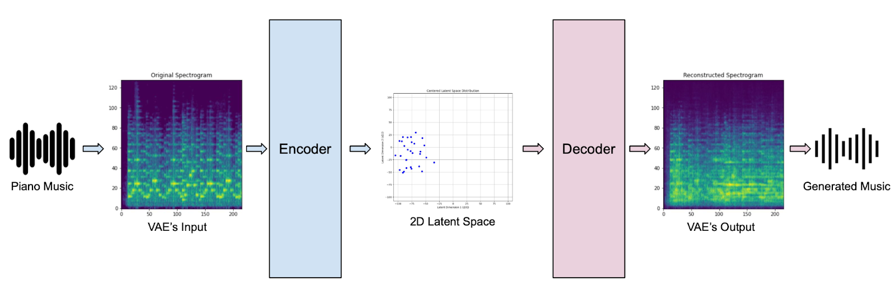
Autoencoder
Input: Concatenation of high-dimensional genre + metadata embeddings
Output: Encoder final layer embeddings
Train to match decoder output as close to input data
Further reduction of dimensionality
Unsupervised dependency discovery
Final feature vector dimensions from 526->64
Final refined low-dimension representations from trained encoder part

Slide 11


Experiments
Evaluation difficult to quantify -> human evaluation by listening
Things to consider: emotion & genre & raw audio similar
Cosine similarity
20 experiments, randomly queried songs, 3 of which are presented in the report
Top 5 similar recommendations
Similar genres, emotion AND instruments
Similar emotions and acoustic features,
even in different genre!

Slide 12
Thank you!

