Slide 1



Machine Learning Project
Music Band Classification
Ιωάννης Σάββας mtn2319
February, 2023

Slide 2





Project description
Goal: Classify 5 bands from a specific subgenre (Progressive metal) using classic machine learning algorithms.
Data: Manually produced 10 seconds wav-files of songs-riffs (Part of a song containing instruments and not voice)
5 Classes
50 instances per class

Slide 3
Data Collection Proccess
Obtain youtube URL link
Insert WAV file into processing software
Export riff (Single Instance for the dataset)
Convert URL to WAV file
Find a riff without voice

Slide 4
Feature Extraction
Set an upper bound time of 10 seconds per wav file.
Feature extraction was performed using PyAudioAnalysis library.
Short-term feature extraction
Short-term features: Frame size = 60ms and frame step = 30ms (50% overlap)
Features include Zero Crossing rate, Spectral features, MFCCs, chroma, delta etc..
Calculate mean and standard deviation for all short-term window features.
Feature Vector consists of 136 features (68 mean and 68 std)

Slide 5
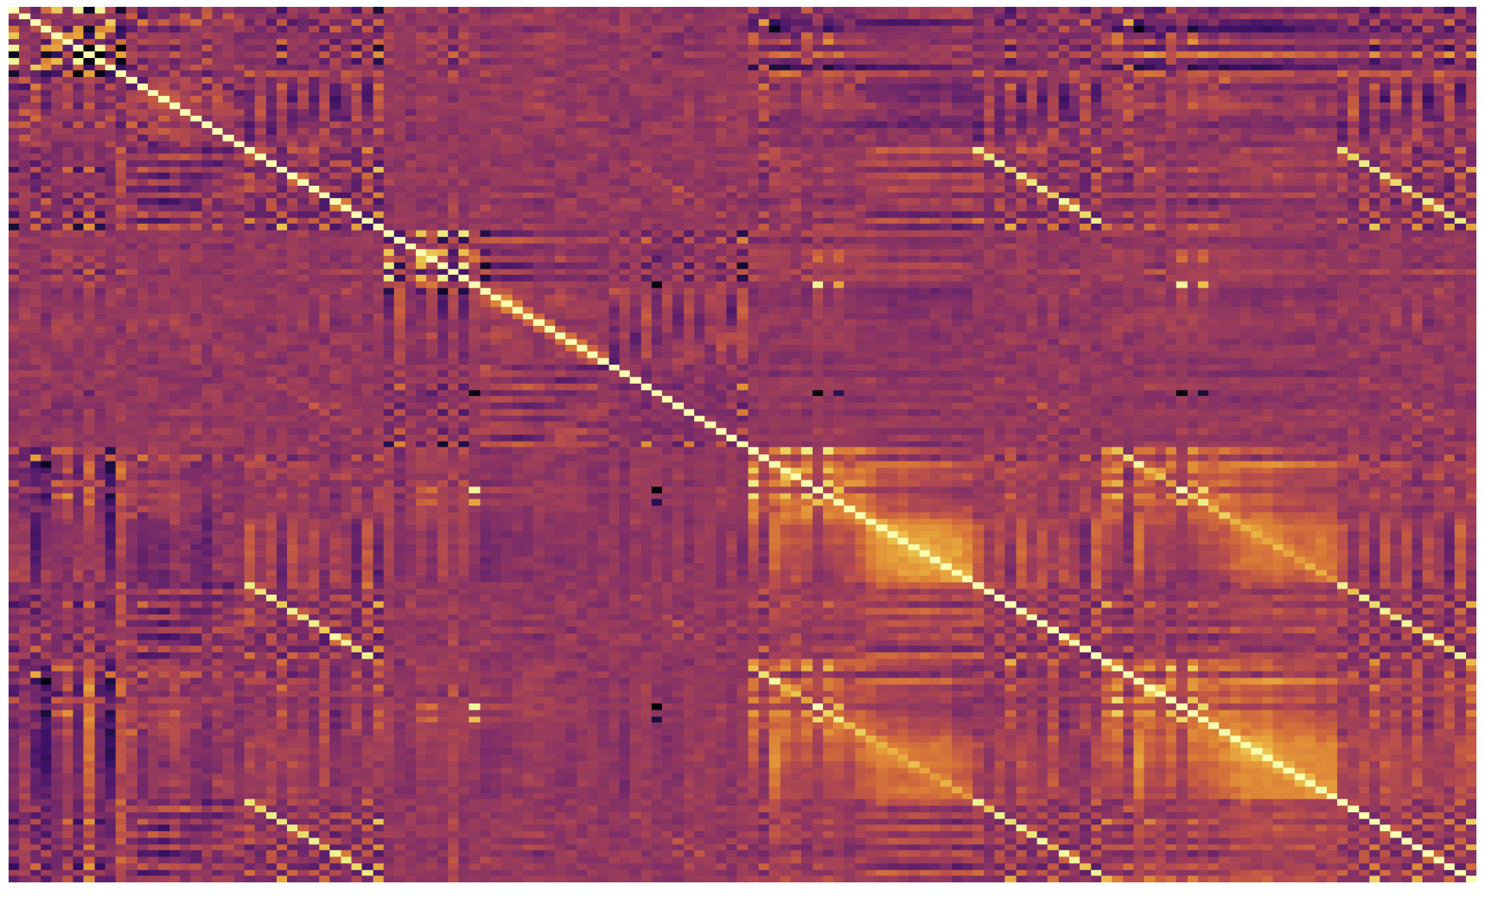
Feature Selection
Calculate Pearson Corellation between features
Set a threshold of 0.85
Delete first feature if PC > 0.85
29 Features dropped
New Feature Vector length = 107

Slide 6
1st approach: Cross validation whole dataset
Test Set
50 Instances
10 Instances per class
Validation
80%
250 Instances
5 Classes (50 each)
Shuffle
Train Model
Stratification
Training Set
200 Instances
40 Instances per class
Scale
Z-score
20%
Repeated Shuffle stratification (80-20 split) on the whole dataset 20 times
Grid-Search, hyperparameter tuning (LR, KNN, SVM)
Grid-Search based on mean F1 macro, also compute std.

Slide 7
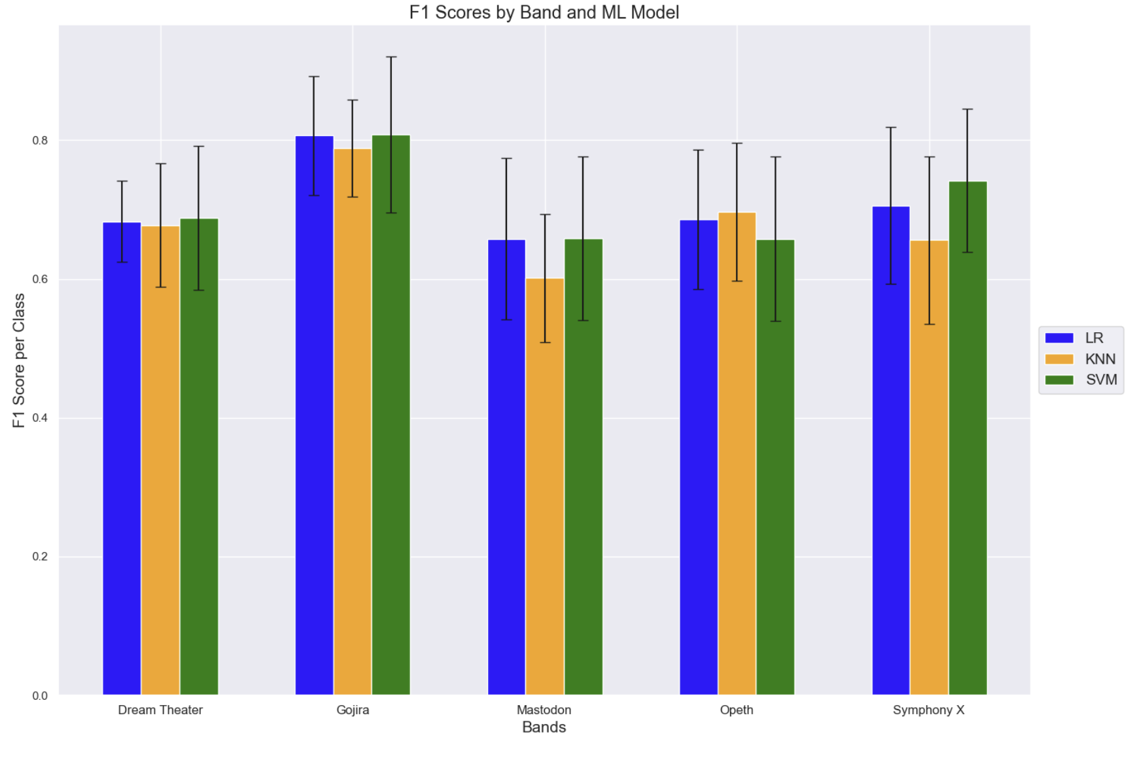
1st approach results
Model | F1 Macro CV
Logistic Regression
KNN
SVM
Generally good results
Try a different approach with a hidden test set.

Slide 8
2nd approach: Train – Test split
Choose songs from chronologically new albums to create a test set
Test data = 70 (14 riffs per label)
Train data = 180 (36 riffs per label)
Perform 1st approach procedure for the training dataset
Make predictions of cross-validated models on the test set

Slide 9
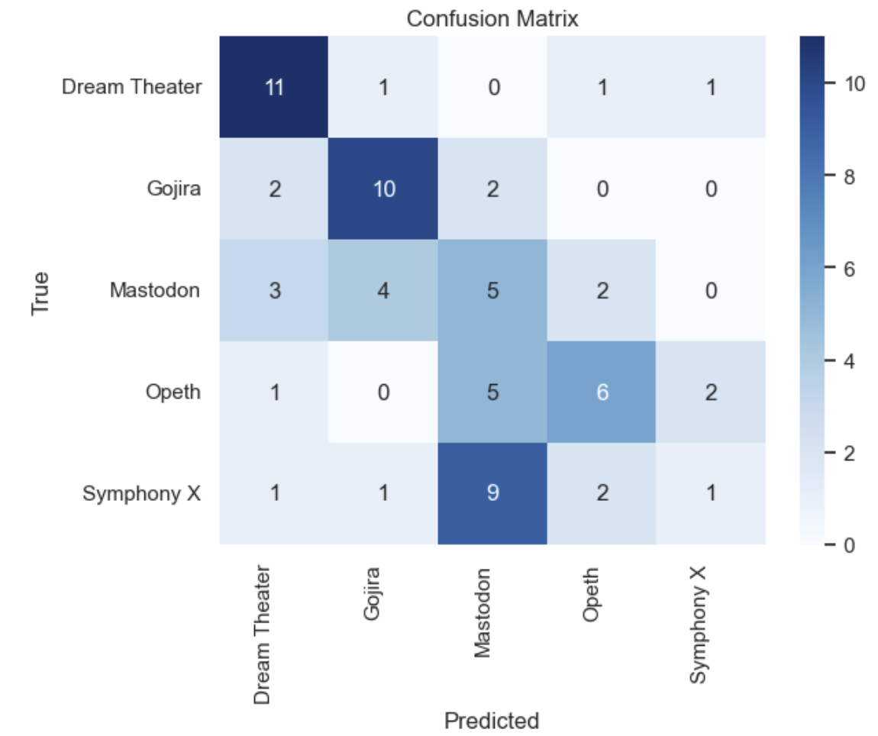
2nd approach results
Logistic Regression Model
F1 per label
Able to identify the first two bands
Moderate-Bad prediction on the 3rd and 4th band.
Unable to predict the last band
5th band is highly confused as the 3rd band.

Slide 10
Conclusions
Hard to classify new progressive metal bands
Confusion between bands (Some bands are influenced by others thus they are similar)
Need of more data (More classes, more instances per class)
Incorporate deep learning for better input-output mapping
Fun project to experiment with

Slide 11
Thank you for your attention!!
Any questions ?

