Slide 1
Cursor AI Hackathon EVENT PRESENTATION
01
ThriveAI
The next financial decision—
explained in the owner’s language.
Burmese-first • deterministic finance • constrained AI
LIVE DEMO • SOURCE
Notes:
Open on the promise: ThriveAI is not another reporting screen. It helps a Myanmar SME owner turn scattered figures into one grounded action, in Burmese or English. Set the expectation that every number remains traceable to deterministic code.
[Sources]
- README.md — product positioning, solution, and live/source links
- docs/pitch-and-qa.md — 90-second pitch and judge Q&A
[/Sources]

Slide 2
THRIVEAI / MYANMAR SME DECISION COPILOT
Revenue is growing. Liquidity is tightening.
Aung Mingalar Distribution looks healthy at first glance. The cash position tells a different story.
Latest revenue
MMK 42.8M
+14% month on month
Receivables
MMK 12.0M
Cash still outside the business
Payables
MMK 9.6M
Near-term supplier pressure
Cash
MMK 4.3M
Only 0.4× payables
The core tension: growth does not guarantee cash readiness.
02
Notes:
Start with the contradiction. Revenue is up, but cash is only MMK 4.3M against MMK 9.6M of payables and MMK 12M of receivables. The owner needs help converting that tension into a sequence of actions, not a celebration of top-line growth.
[Sources]
- README.md — Myanmar SME problem and default distributor golden path
- docs/pitch-and-qa.md — opening contradiction and demo figures
- src/data/profiles.ts — synthetic Aung Mingalar Distribution profile
[/Sources]

Slide 3
THRIVEAI / MYANMAR SME DECISION COPILOT
The job is to make the next action explainable.
ThriveAI turns four fragmented views of the business into a decision path the owner can inspect.
01
02
03
See the facts
Ask naturally
Act with evidence
Revenue, cash, payables, receivables and runway—calculated from the selected profile.
A Burmese, English or mixed-language question expresses the real business concern.
The response ranks approved signals and actions, with traceable values and assumptions.
One answer. Three visible layers: fact → interpretation → action.
03
Notes:
Explain the product as a sequence, not a feature list. The financial engine establishes the facts. The question establishes intent. The answer ranks a bounded set of actions and preserves evidence, so the recommendation can be challenged and explained.
[Sources]
- README.md — solution and golden path
- README.md — deterministic finance and trust boundary
[/Sources]

Slide 4
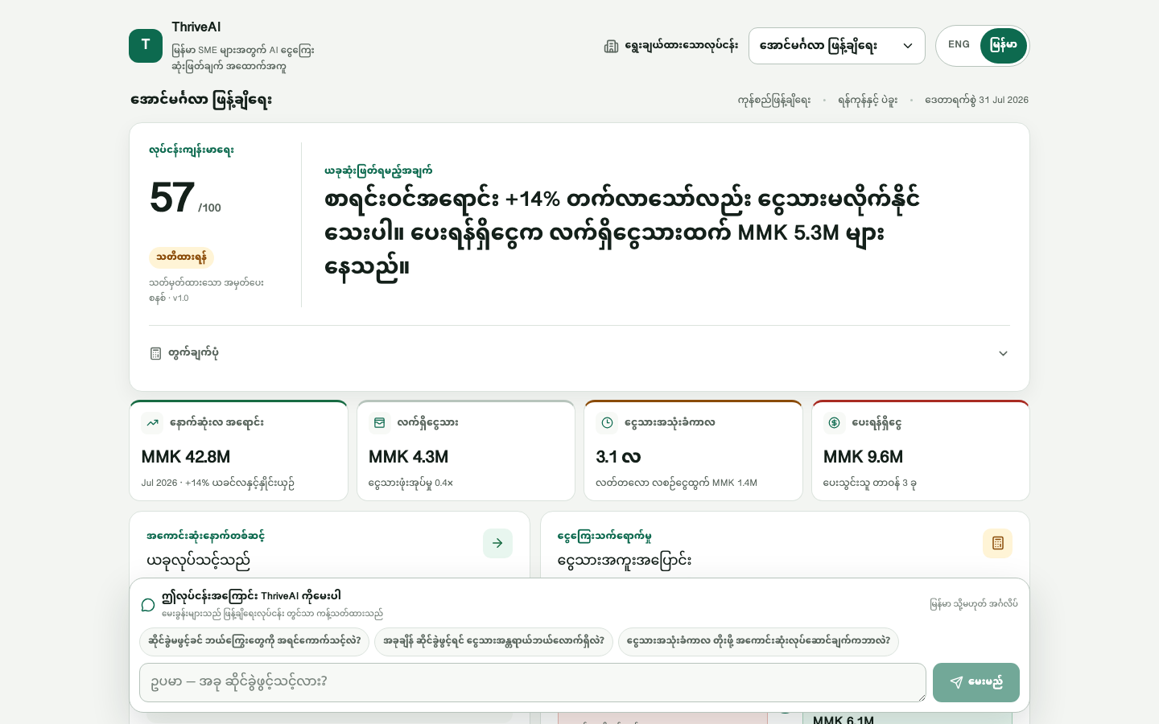
THRIVEAI / MYANMAR SME DECISION COPILOT
One workspace turns evidence into a decision path.
SEE
Deterministic metrics reveal the cash tension.
ASK
The question stays close to the decision.
ACT
Receivables and scenarios turn insight into sequence.
04
Notes:
Walk left to right. The workspace first surfaces deterministic facts, then keeps the question attached to the selected business, then exposes receivable priorities, the Cash Bridge, and editable sensitivity scenarios. The design goal is auditability, not novelty.
[Sources]
- screenshots/thriveai-overview-desktop.png — product evidence captured from the project runtime
- README.md — core features and solution flow
[/Sources]

Slide 5
THRIVEAI / MYANMAR SME DECISION COPILOT
AI interprets intent; code owns every number.
The browser sends only a business ID and an untrusted question. The server rebuilds the evidence boundary.
01
02
03
04
05
06
Synthetic
profiles
Finance
engine
Question +
business ID
AI ranks
approved IDs
Zod + evidence
validation
Bilingual
answer
server-side data
trusted figures
untrusted input
constrained selection
business-scoped
model or fallback
NO CLIENT-SUPPLIED METRICS
NO FREE-FORM NUMBERS
FAIL CLOSED
The route rebuilds facts from the selected profile.
The model selects codes; reviewed copy adds values after validation.
Timeout, malformed output or invalid evidence triggers a labeled fallback.
05
Notes:
This is the core technical argument. AI has a narrow role: interpret intent and rank approved items. TypeScript calculates financial values; the server rebuilds business-scoped evidence; Zod and semantic checks reject unsupported selections. Any failure produces a clearly labeled deterministic fallback.
[Sources]
- README.md — meaningful AI utilization
- README.md — architecture and data flow
- src/lib/ai/prompt.ts — model constraints
- src/lib/ai/analyze.ts — validation and fallback path
[/Sources]

Slide 6
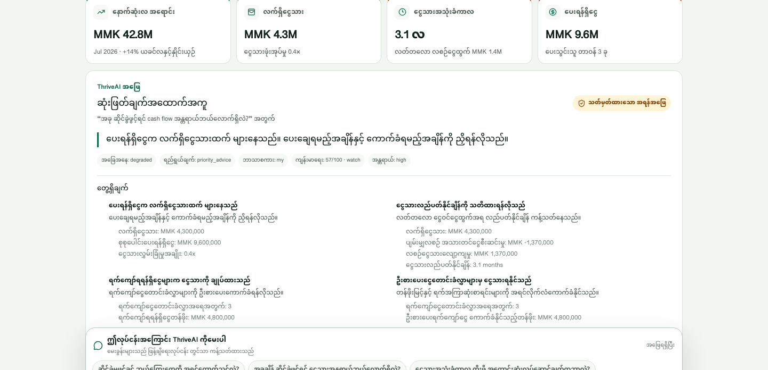
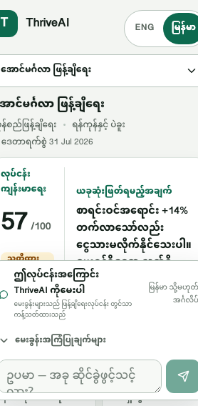
THRIVEAI / MYANMAR SME DECISION COPILOT
Burmese-first interaction, same financial truth.
The UI can localize the decision without changing where the numbers come from.
LABELED FALLBACK
06
Notes:
The screenshot is runtime evidence, not a mockup. The product supports Burmese-first interaction and keeps the same deterministic metrics beneath it. In the deployed build captured here, the answer is honestly labeled as a degraded deterministic fallback; do not present model mode as currently live.
[Sources]
- screenshots/thriveai-ai-answer-desktop.png — Burmese answer and fallback-state runtime evidence
- screenshots/thriveai-overview-mobile.png — responsive mobile runtime evidence
- README.md — Burmese-first interface and defensive AI states
[/Sources]

Slide 7
THRIVEAI / MYANMAR SME DECISION COPILOT
The prototype already proves the core trust model.
The evidence is deliberately narrower than a production claim—but stronger than a concept screen.
3
43/43
6
0
synthetic SME profiles
automated tests passing
editable scenarios
known npm audit findings
Tea shop • fashion • distribution
Finance, AI contracts and isolation
Sensitivity analysis—not forecasts
Production dependencies, audit snapshot
Release gates passed locally: lint • typecheck • tests • production build • responsive runtime smoke
07
Notes:
Be precise about what has been proved. The system has three synthetic profiles, 43 passing tests, six editable sensitivity scenarios, and a clean production-dependency audit snapshot. Local lint, typecheck, build, and responsive runtime smoke checks passed. This validates the prototype trust model, not bank production readiness.
[Sources]
- README.md — verification evidence and limitations
- package.json — project quality gates
- tests/ and src/lib/ai/__tests__/ — finance and AI contract tests
[/Sources]

Slide 8
THRIVEAI / MYANMAR SME DECISION COPILOT
Prototype boundaries are explicit, not buried.
A credible pilot starts by naming what the demo does not yet prove.
ROLE
DATA
Decision preparation—not underwriting
Synthetic evidence only
No credit, eligibility, pricing or approval decision is made.
No real SME, customer, transaction or UAB system data is used.
DEMO STATUS
METHOD GAP
Live AI is falling back
Liquidity logic needs one correction
The deployed route currently returns a labeled deterministic fallback.
Scheduled payables must be included before the Cash Bridge supports a readiness claim.
Trust is the product: fix the method, harden the endpoint, then test with consented data.
08
Notes:
Use this slide to protect credibility. The prototype is not a lending system and uses synthetic data. The deployed AI route is currently in deterministic fallback. Most importantly, the current Cash Bridge omits scheduled payables from its headline ending-cash equation; that must be corrected before claiming expansion readiness.
[Sources]
- README.md — explicit limitations and responsible-use boundary
- docs/pitch-and-qa.md — value to a bank and non-underwriting position
- src/lib/finance/cash-bridge.ts — current Cash Bridge inputs
- src/data/profiles.ts — scheduled distributor payables used in audit
[/Sources]

Slide 9
THRIVEAI / MYANMAR SME DECISION COPILOT
A UAB pilot should earn trust in three gates.
Move only when the evidence, controls and owner experience clear the previous gate.
GATE 1
GATE 2
GATE 3
Validate
Pilot
Integrate
Correct the liquidity method. Review Burmese copy and finance assumptions with SME and accounting specialists.
Run with consented, de-identified SME inputs under rate limits, access controls, audit logs and human review.
Add approved data adapters, secure tenancy, observability and policy controls—without letting AI own the ledger.
Decision-quality benchmark
Safe, useful conversations
Operational readiness
Principle: consent before data • controls before scale • evidence before recommendation
09
Notes:
Propose gates, not a speculative calendar. Gate one fixes the method and validates language and finance assumptions. Gate two proves safe utility using consented, de-identified inputs under operational controls. Gate three adds approved integrations only after decision quality and governance are demonstrated.
[Sources]
- README.md — limitations and production requirements
- docs/pitch-and-qa.md — future real-data controls and scale path
[/Sources]

Slide 10
THE OPPORTUNITY
Make every SME conversation
start with evidence.
Validate a consented, non-underwriting pilot with UAB’s SME, finance and risk stakeholders—then scale only what proves useful and safe.
FOR THE OWNER
FOR UAB
FOR THE PRODUCT
A clearer next action in Burmese or English.
A better-prepared, evidence-led SME conversation.
A trust architecture that can mature without handing the ledger to AI.
thriveai-uab.vercel.app • github.com/johnsawmin2015-tech/ThriveAI-UAB
Notes:
Resolve the opening promise. ThriveAI can make SME conversations more concrete by starting from evidence and ending with an explainable action. The next ask is a small, consented, non-underwriting validation pilot—with finance, SME and risk stakeholders involved from the start.
[Sources]
- README.md — product positioning, live deployment, and source repository
- docs/pitch-and-qa.md — value to SME, value to bank, and responsible future path
[/Sources]

