Slide 1
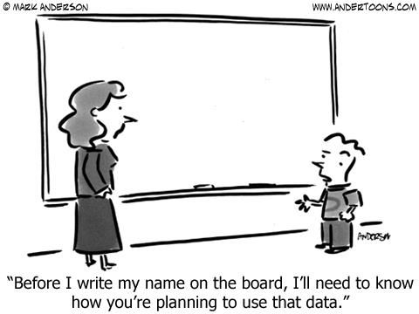

Slide 2
Databases and Privacy
Storing, Organizing and Retrieving Data

Slide 3
What is a Computer Database?
Answer:
An Organized Collection of Data files that may be added to, deleted, modified and reported on

Slide 4
Attributes of all files
Location
Size
Type
Files have information embedded with the data that defines how the data is organized

Slide 5
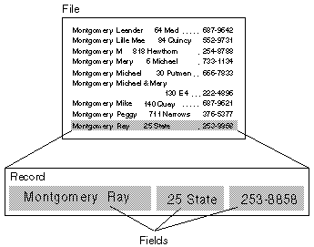
Files, Records, and Fields

Slide 6
The Two Major DBMS Models
Flat File Model
Separate files are linked via physical links (link fields)
Favored where efficiency and performance are highest priorities
Relational Model
Separate files are linked via logical links in the data model
Favored where flexibility and support for ad hoc queries are highest priority

Slide 7
Database Management System Data Structure
Flat file systems use only one file to model and store data
Many database problems will require multiple (but related) files for data modeling
Database structure must always be defined upfront
records and fields must be defined
field data types must be specified

Slide 8
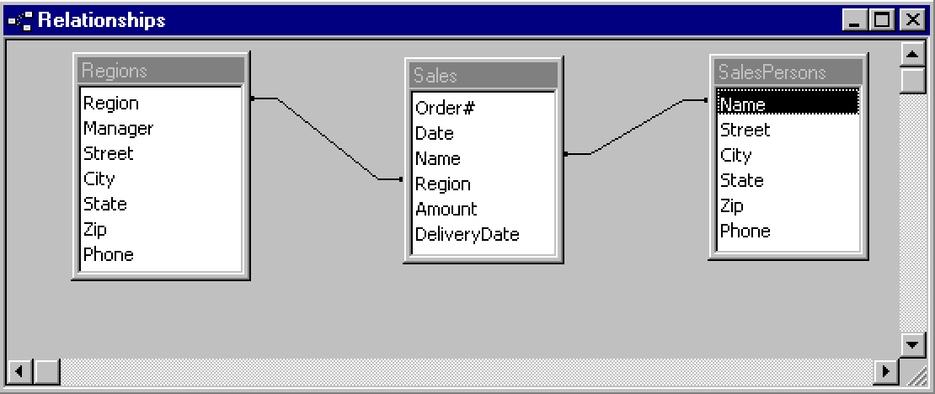
Using Multiple Files
Relationships must be specified when database structure is defined
Logical links are made explicit by linking appropriate fields in different tables

Slide 9
Database Management System Accessing the Data
Forms are often used for entering/viewing data
Queries are constructed to retrieve data satisfying specific criteria
Data can be sorted in multiple nested levels
Reports are constructed (often based on queries)

Slide 10
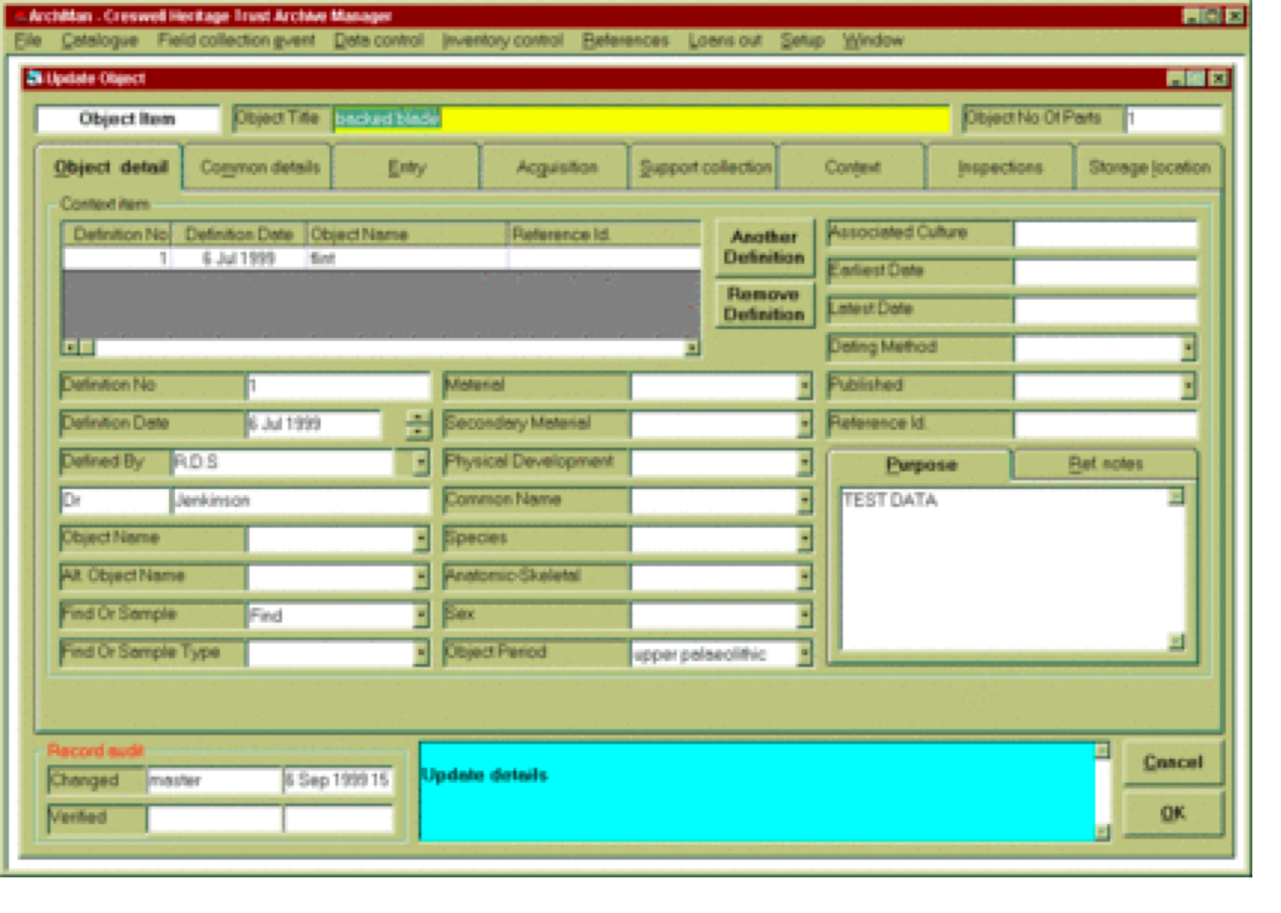
A Form for Entering Fields

Slide 11
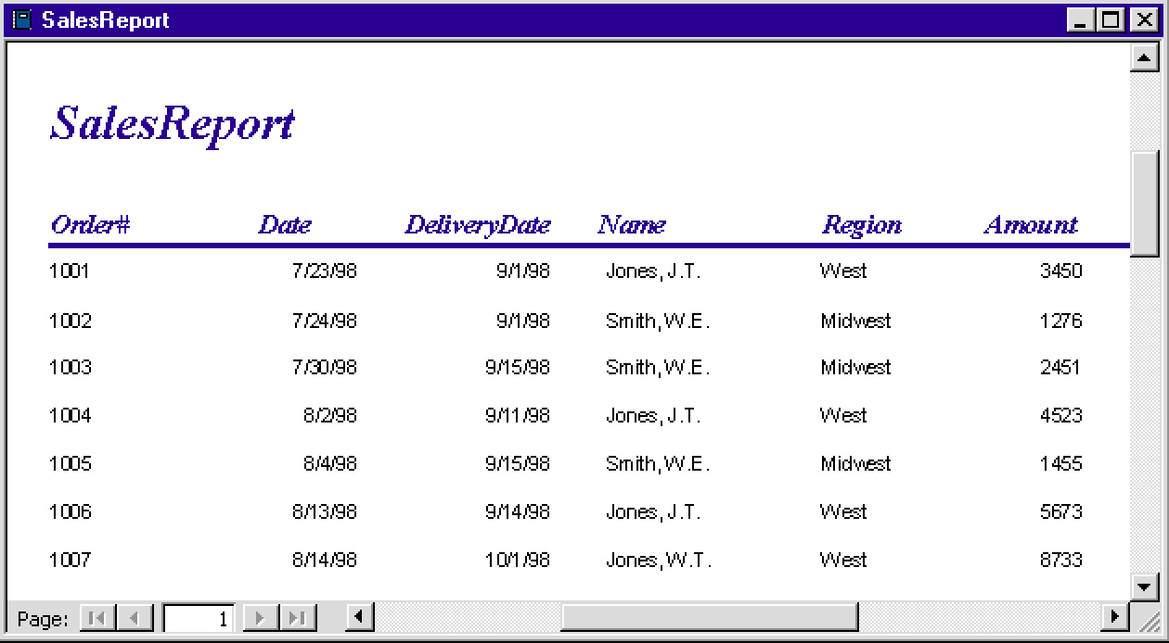
Example Report

Slide 12
Query Languages
Query languages, like programming languages, have specific syntax
These are more user-friendly than most programming languages
SQL (Structured Query Language -- often pronounced “sequel”) is a de facto standard

Slide 13
Query Construction
Queries are structured to retrieve data from specified fields in indicated tables (files) in a database
Retrieved data must satisfy particular search constraints
Boolean operators -- especially logical and and logical or -- allow the construction of multiple search constraint queries

Slide 14
Example Queries -- SQL
SELECT Name FROM Sales WHERE Amount > 5000 AND Region = “West”
SELECT Name FROM Sales WHERE (Amount > 5000 AND Region = “West”) OR (Amount > 2000 AND Region = “Midwest”)

Slide 15
Summary
Databases are Software that manages the storage and retrieval of data dates from the early days of computing
There are two primary database models today: the flat file model and the relational model
The network model provides excellent performance; the relational model provides excellent flexibility
The first step toward creating any database is the definition of the structure of the data to be modeled

Slide 16
Summary (cont’d)
All database management systems provide the ability to define data entry forms and reports for output
Query languages provide user-friendly access to database data
Queries are defined to retrieve data that matches (or satisfies) specified search constraints
SQL has become the de facto standard for query languages

Slide 17
Database Products in Widespread Use
Oracle
Informix
Microsoft Access
Microsoft SQL
MySQL
PostgreSQL

Slide 18
Databases and Individual Privacy

Slide 19
Data to fight crime and terrorism Lessons learned as a result of 9-11
Too much data can be a liability
Data on the same topic kept in different systems
Is not effective unless it is linked together
Sometimes requires filtering to remove “irrelevance”
The highly controversial Patriot Act has expanded the
Scope of data that the Govt. can collect and use on you

Slide 20
Social Significance
Every one of us is profiled in several databases around the country many of which are linked to each other:
Financial, insurance and credit systems
Medical systems
Court, Justice and Crime systems
Retailer systems
Websites
Govt. systems (Municipal, State and Federal)

Slide 21
On Line Privacy
On-Line Privacy is an Oxymoron. If you are connected to a network, chances are that someone, somewhere has the capability to keep track of you.

Slide 22
How private is my credit report?
Credit reports are a gold mine of information about consumers. They contain Social Security number, date of birth, current and previous addresses, telephone number (including unlisted numbers), credit payment status, employment, even legal information about court proceedings

Slide 23
Who has access to my report?
Those considering granting you credit.
Landlords.
Insurance companies.
Employers and potential employers (but only with your consent).
Companies with which you have a credit account for account monitoring purposes.
Those considering your application for a government license or benefit if the agency is required to consider your financial status.
A state or local child support enforcement agency.
Any government agency

Slide 24
Who are the people that store and provide information about you?
Equifax
Experian
Transunion
Link to Equifax:
Equifax Personal Solutions Credit Reports, Credit Scores, Protection Against Identity Theft and more

Slide 25
Financial Services Modernization Act also known as Gramm-Leach-Bliley Act or GLB
Allows banks, insurance companies, and brokerage firms to operate as one. The combined companies have been aptly dubbed "financial supermarkets."
They may promise you such benefits as consolidated account statements and lower fees. But at the same time, the ability of these companies to merge customer data from several sources and even sell it to third parties represents a real risk to your privacy

Slide 26
What are your rights under GLB?
Privacy Policy: Your financial institution must tell you the kinds of information it collects about you and how it uses that information.
Right to Opt-Out: Your financial institution must explain your ability to prevent the sale of your customer data to third parties.
Safeguards: Financial institutions are required to develop policies to prevent fraudulent access to confidential financial information. These policies must be disclosed to you

Slide 27
Opt-Out / Opt-In
"Opt-out" is contrary to the "opt-in" approach preferred by most consumer and privacy advocates.
Opt-in prohibits a financial institution from sharing or selling your data if you do not give your affirmative consent.
With opt-out, you give your implied consent by failing to return the privacy notice sent to you by your financial company. So, if you say nothing, it means "yes, you can share my data."

Slide 28
So What?
If you Opt In, then you can prevent sharing of your details. It may be harder to obtain credit at a competitive price however.
If you Opt Out, then your info is in the financial supermarket and your creditworthiness is easily determined and you get approval
(or disapproval) very quickly for a given amount of credit

Slide 29
GDPR
The General Data Protection Regulation 2016/679 is a regulation in EU law on data protection and privacy for all individual citizens of the European Union and the European Economic Area. It also addresses the transfer of personal data outside the EU and EEA areas.
Imposes large fines on firms that lose or share customer data without specific permissions by the owner.
Google and Facebook being sued as we speak.

Slide 30
A Typical Personal Database Search Service
http://www.intelius.com/

Slide 31
Mobile Spyware
Enables someone to monitor everything that you do on your cellphone, and track all of your movements
Mspy.com

Slide 32
The Social Significance of Databases
Where is this heading?
Watch this ordering Pizza video!
https://www.aclu.org/ordering-pizza

Slide 33
How much data is being generated and accumulated?
https://www.forbes.com/sites/bernardmarr/2018/05/21/how-much-data-do-we-create-every-day-the-mind-blowing-stats-everyone-should-read/#7729e77860ba

Slide 34
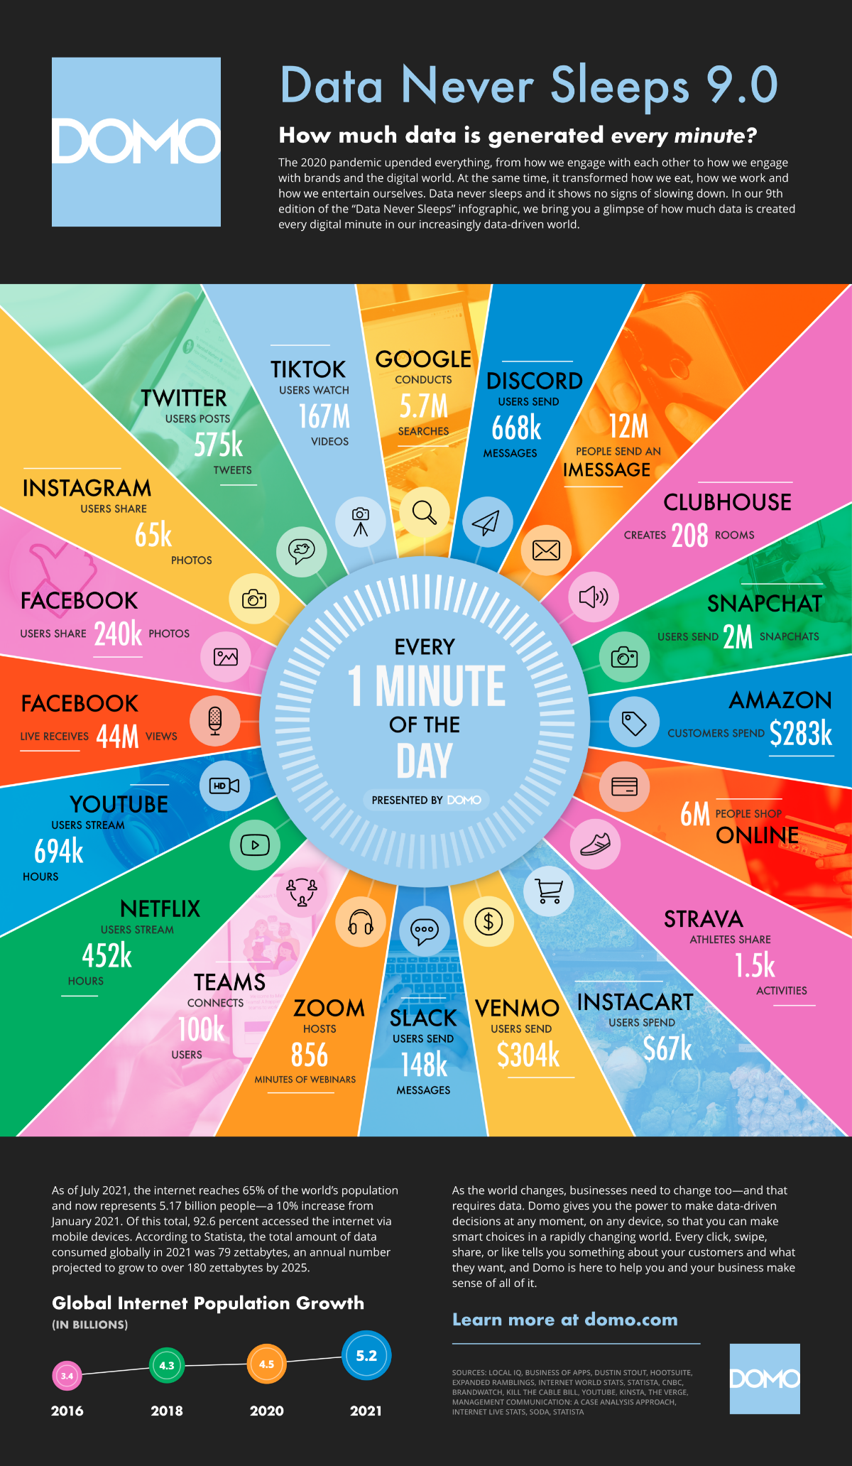

Slide 35
Can Google access my data?
It collects data on what videos you watch, the ads you click, your location, device information, and IP address and cookie data. ... Finally, Google promises that it doesn't sell your data, but rather uses your information to “make ads relevant” while you're browsing the web.

Slide 36
Does Google read your Email?
Make no mistake, Google can and does read your email. And this should cause concerns about security and privacy.
Because Googles servers have access to all of your organization's emails, an attacker that's able to penetrate these servers can also get all of your data.

Slide 37
Does Instagram sell your date?
The study found that Instagram collects 79 per cent of its users' personal data and shares it with third parties, including search history, location, contacts and financial info. “Any information you agree to be gathered by an app when signing up can be analysed for their benefit and even shared

Slide 38
What are Digital Cookies?
And, what do they do?
https://www.youtube.com/watch?v=0LKVad2xj5M

Slide 39
Who owns your data?
This largely depends on what you agreed to when you signed up for various services and applications!

Slide 40
Data Science, What is it?
Data science encompasses preparing data for analysis, including aggregating and manipulating the data to perform advanced data analysis. Analytic applications and data scientists can then review the results to uncover patterns and enable businesses to draw informed insights.
In other word, figuring out how to use your behavior and data for maximum gain and competitiveness

Slide 41
Millionaire !!!

Slide 42
Questions?

