Slide 1
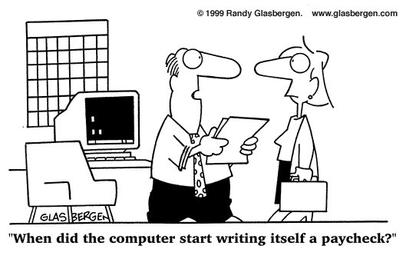

Slide 2
The Family of Computers (Mainframes to Quantum)

Slide 3
The family….
Mainframes
SuperComputers
MiniComputers
Servers
Personal Computers (PCs)
MicroControllers
Quantum Computers
NanoComputers

Slide 4
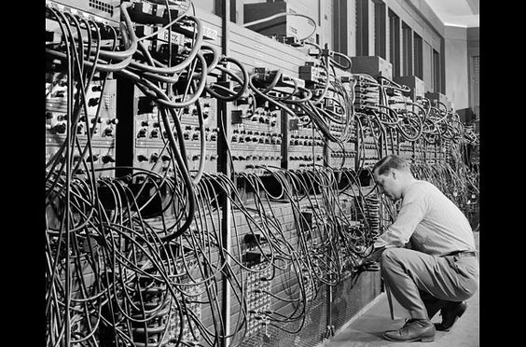
Einiac circa 1947

Slide 5
Mainframes
Nomenclature generally used for very large multi-processor systems capable of supporting hundreds of simultaneous users and programs via dumb terminals
Operates typically in “batch mode”
Timesharing paradigm
Highly centralized data and processing
Hardware optimized for general purpose computing
Capable of running several Operating Systems simultaneously

Slide 6
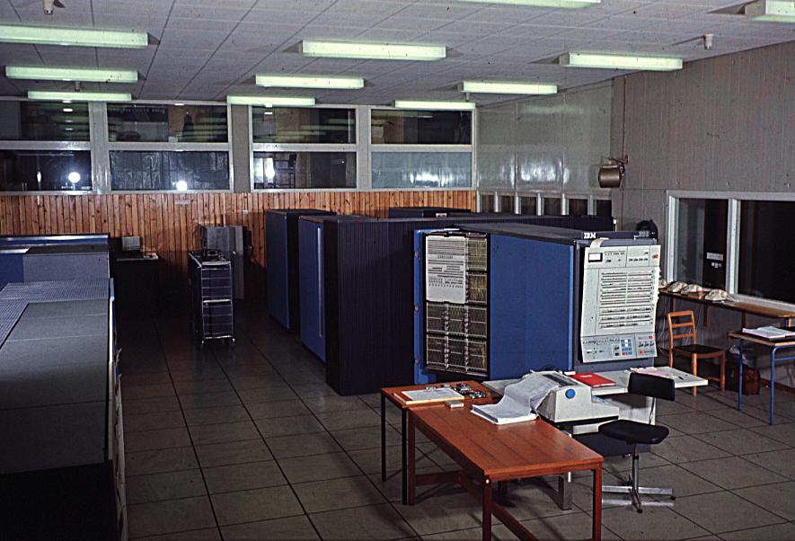

Slide 7
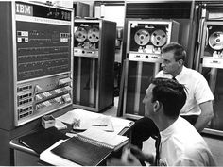
Mainframe Console

Slide 8
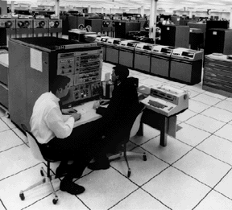
IBM 360 circa 1968 with 50 Megabytes of Storage on each disc!

Slide 9
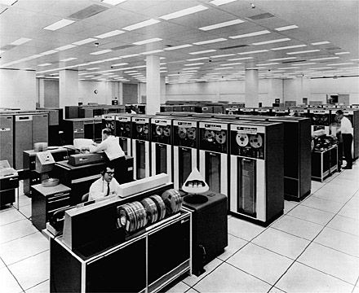
Mainframes used lots of Tapes!

Slide 10
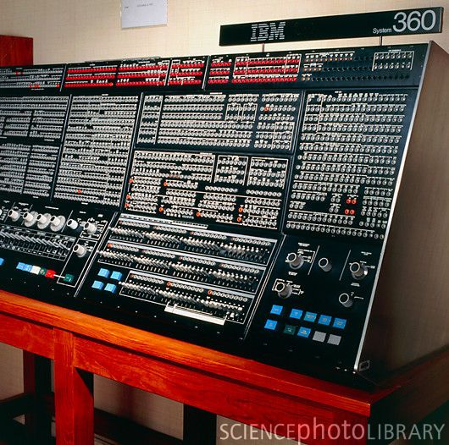
Easy to use control panel!

Slide 11
Some Historical Mainframe Applications
Accounting functions
Ticketing and Reservations
Manufacturing and Inventory Management
Payroll
Database Storage and Retrieval

Slide 12
Mainframes…like the Brontosaurus, became an endangered species
IBM, Univac, Control Data, Honeywell, RCA, GE were all early producers of mainframe systems
Given the need for flexibility and scalability, mainframes are few and far between today
Mainframe functionality is better achieved with a network of smaller computers that distribute the processing

Slide 13
Supercomputers
Machines optimized for certains types of programs, usually involving intense numerical operation as opposed to general purpose computing. These machines were sometimes of the “mainframe” variety and employ many hundreds of parallel processors
Cray Research
IBM
NEC
Fujitsu

Slide 14
Supercomputing
The high-end supercomputer market is
where the world's most challenging
computing problems are addressed
Problems of major economic and
scientific importance were often handled
by high-end supercomputers years
before becoming "tractable" on
less-capable systems.

Slide 15
Supercomputer Performance
A typical performance benchmark is the FLOP (Floating Point Operations per Second, which is multiplication of two large binary numbers)
MegaFlops (Million)
GigaFlops (Billion)
TeraFlops (Trillion)

Slide 16
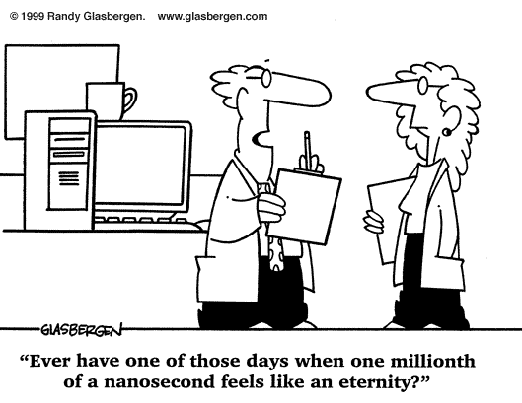

Slide 17
Examples of SuperComputing Applications
Weather analysis/Climate Change
Rocket Science
Encryption/Decryption (code breaking)
Virtual Reality
Nuclear Research
Aerodynamics Simulation
Genetics

Slide 18
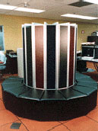
Supercomputers, Cray 1 circa 1980

Slide 19
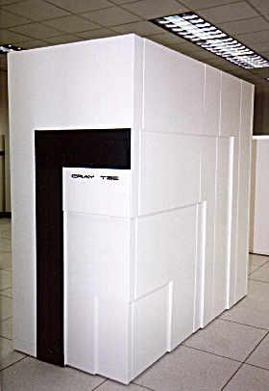
Cray T3 Today, 230 GFLOPs!

Slide 20
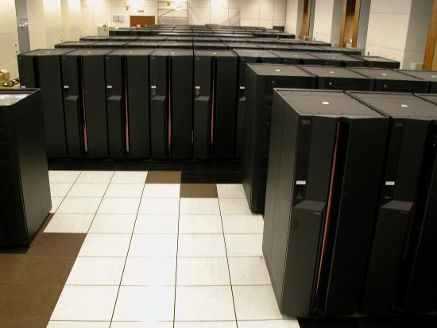
IBM Cluster 1600

Slide 21
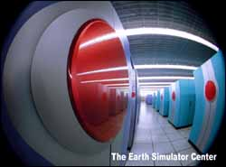
Earth Simulator by NEC

Slide 22
Parallel Processing
Many Machines, especially Supercomputers, use a technique known as parallel processing
It involves breaking a computational problem into parts that can be executed in parallel and processing the parts on a network of machines that can share intermediate results
The NEC Earth Simulator has 640 processing nodes and can achieve 30 Trillion Floating Point operations per second!

Slide 23
MiniComputers
MidSized system that fills the space between Workstations (PCs) and Mainframes.
First introduced in the late 60s by DEC and Data General to bring down the cost of computing from Mainframe prices

Slide 24
Minicomputers
Wide range of size and price points
Scalable compatibility
Became the dominant part of the computer market during the 70s and 80s
Slowly evolved into the machines that today we call “Servers”

Slide 25
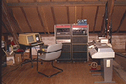
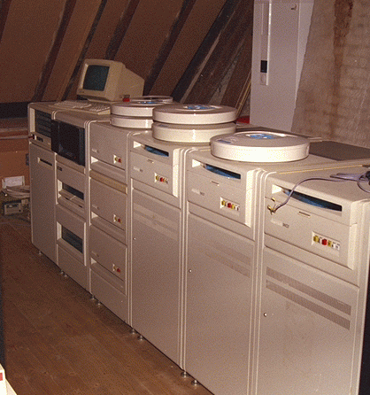
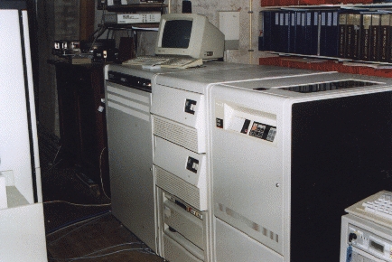
PDP-11 and Vax Minicomputers from Digital Equipment Corp

Slide 26
Servers, the new Minis
Server class computers are the new nomenclature for Minis, whether they are used as servers, or not.
Serving up web pages on the internet has created huge demand for mid-sized, scalable systems
Moore’s law has enabled servers to become very powerful and cost effective tools for configuring scalable computing systems

Slide 27
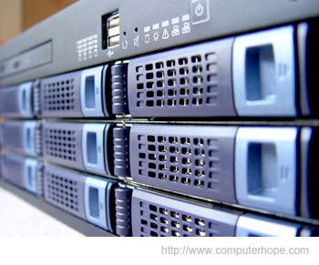
Rack mounted servers

Slide 28
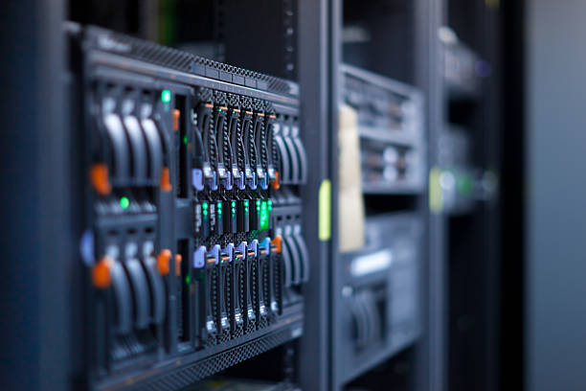
Server Blades

Slide 29
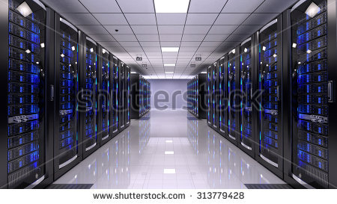
Lots of Servers configured together

Slide 30
PC’s (Personal Computers)
Desktops
Laptops
Typically used as clients or standalone machines
Larger PC’s can also be used as servers
The lines become more blurred over time

Slide 31
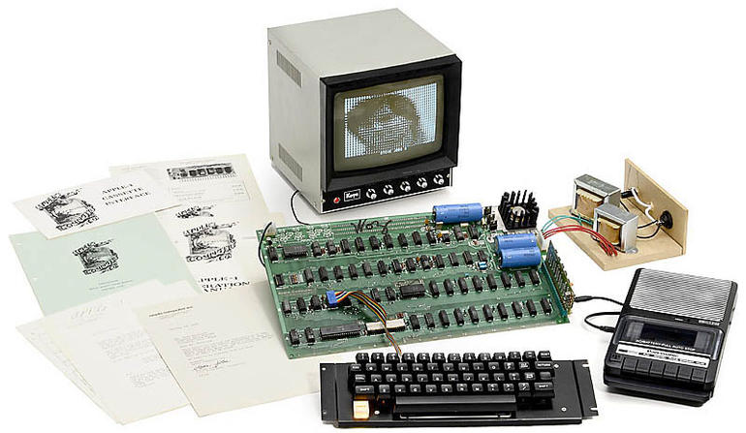
An original, unmodified Apple I computer sold for over $400,000 at auction this year. It originally sold for $666.66 without the b&W monitor!

Slide 32
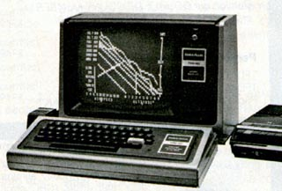
Radio Shack TRS-80, 1978
The first plug and play personal computer available at retail
Programmed in BASIC
Very successful
Very affordable
Limited commercial software
Created a cottage software industry of moonlighting programmers

Slide 33
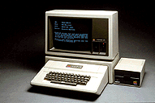
The Apple II - 1980
The first commercially available Apple
Initially sold to Wall St. bankers who wanted the Spread-sheet program called Visicalc which ran on the Apple II
Put Apple on the Map
Several million produced through 1992

Slide 34
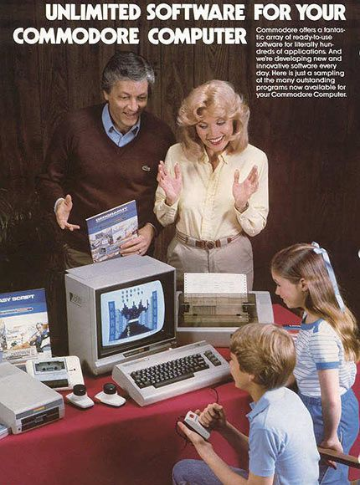

Slide 35
Other types of “PCs”
iPads etc.
PDAs (Personal Digital Assistants)
Game Consoles (Playstation, X-Box)
Programmable Calculators
Smart Phones

Slide 36
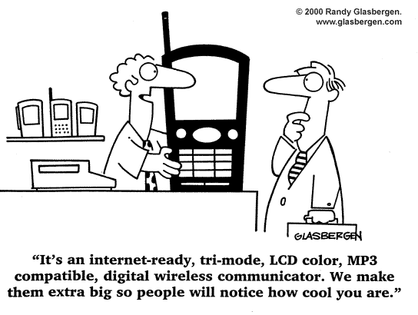

Slide 37
Micro Controllers
Application specific computers of very small size, low cost and limited function
Designed around their application
Simple OS ( often LINUX)
Very cost effective

Slide 38
Typical Micro Controller Applications
Robotics
Automotive
Automation Systems
Appliances
Communications
Timepieces
Computer Peripherals (Disk, Keyboard, Display, CD, etc)

Slide 39
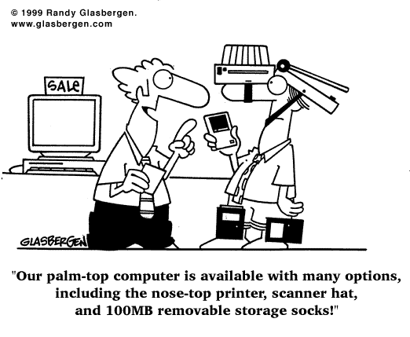

Slide 40
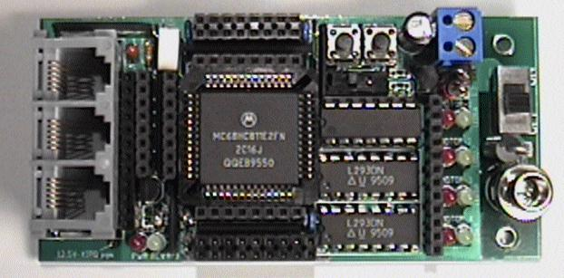
Micro Controllers

Slide 41
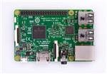
4 GB of Memory
32 GB of Flash Storage
4 USB port
HDMI video output
Sound Chip
Wifi Radio
$39.00 at Amazon!!!
Enlarge
Raspberry Pi
General Purpose Micro Computer

Slide 42
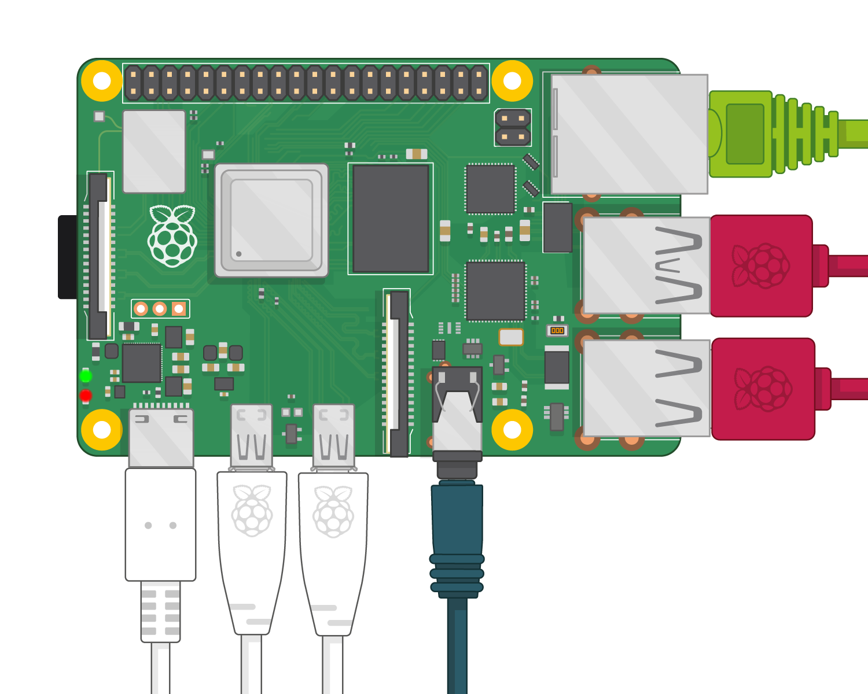

Slide 43
NanoComputing
A nanometer is a billionth of a meter (10^-9) and spans approximately 10 atomic diameters
A nanocomputer is a computer whose fundamental components measure only a few nanometers(<100nm)
Minimum feature size on today’s state-of-the-art commercial integrated circuits measure about 350nm
Over 10,000 nanocomputer components could fit in the area of a single modern microcomputer component (= more speed & density)
Nanotechnology and nanocomputers could introduce many new applications and possibilities

Slide 44

How small is small?

Slide 45
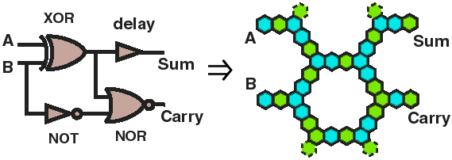
Nanocomputing using biological agents, molecules or atoms

Slide 46
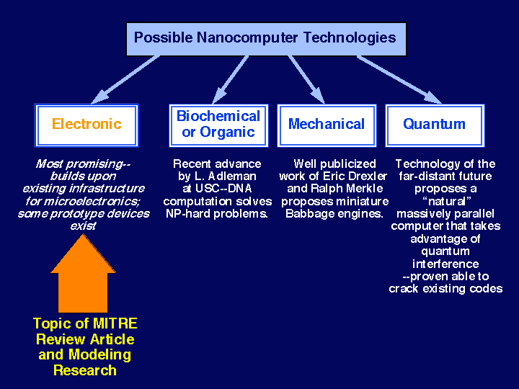
Future Nanocomputer Technologies
Previous Topic
Highlighted regions in figure below are mouse sensitive.
Click to zoom vugraph smaller
If you have comments, questions, suggestions, or contributions for this page, please send e-mail to nanotech@mitre.org
Return to THE Nanoelectronics Home Page

Slide 47
Some Nanocomputing Applications
Micro Miniature Robots
Computers under your skin!
Medicine
Artificial Brains
Invisible Sensors
Supercomputing at the very highest scale

Slide 48
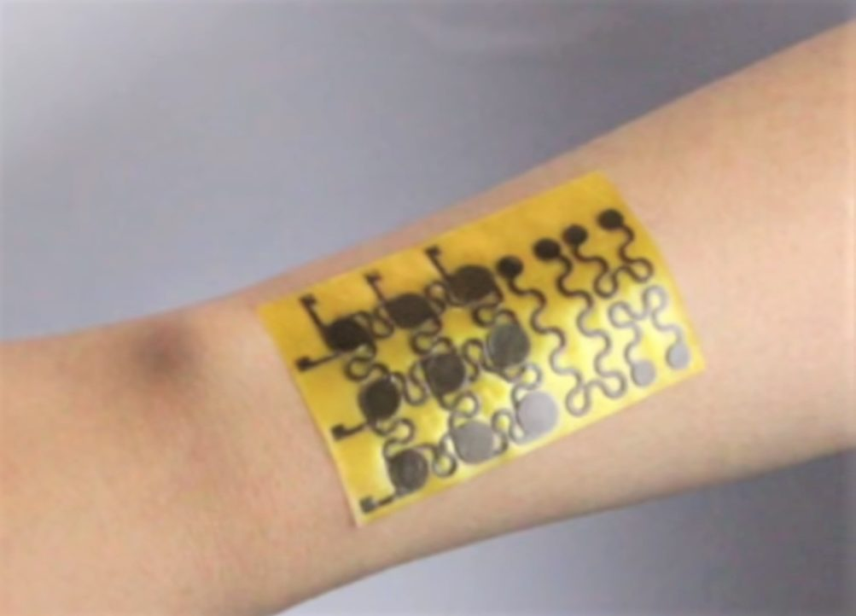
Skin computing!

Slide 49
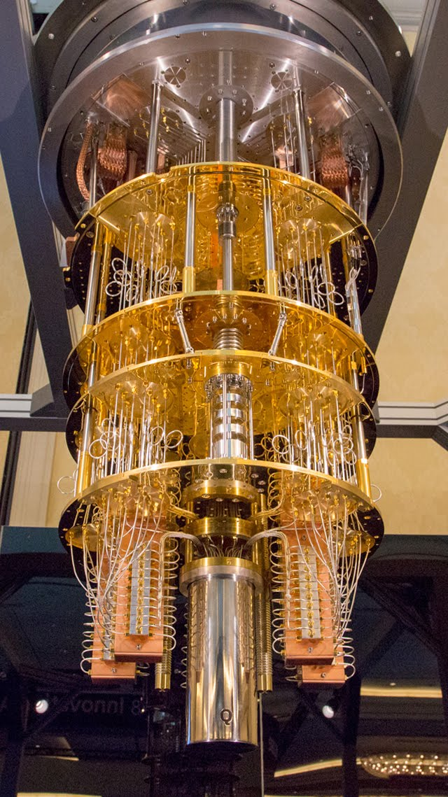
640 × 1139
Google Sites
Recent announcement by Alphabet, Google’s parent company, about early results from their Quantum Computer development.
Google has claimed "quantum supremacy" over the most powerful supercomputers in the world by solving a problem considered virtually impossible for normal machines.
The quantum computer completed the complex computation in 200 seconds. That same calculation would take even the most powerful supercomputers approximately 10,000 years to finish,
Q-BITs can have the value of 0 and 1 at the same time!
Stay tuned as this and other Quantum experiments evolve.
https://www.livescience.com/google-hits-quantum-supremacy.html

Slide 50
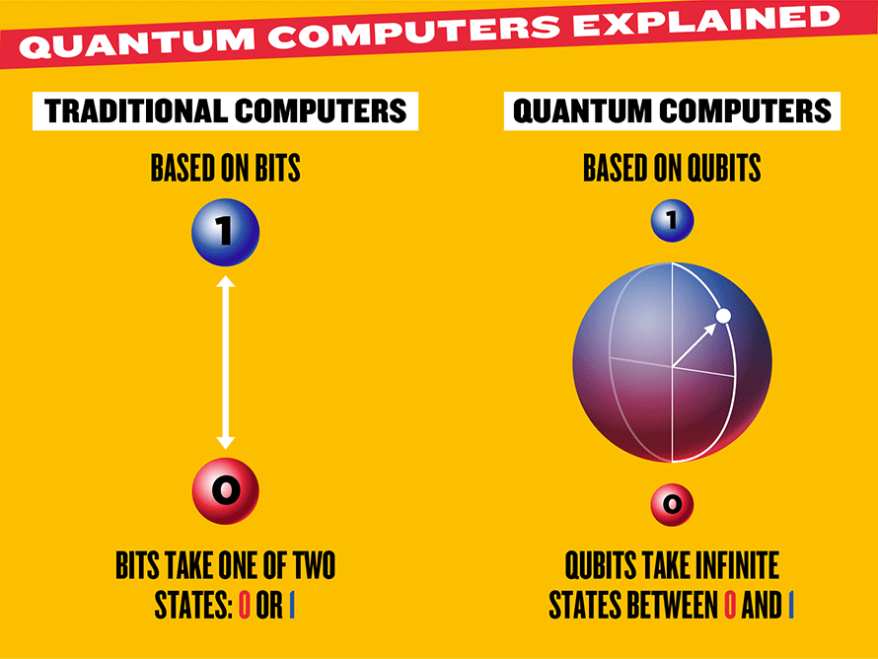
Spooky: Qubits can also exist in two places at once, so could be at 1 and 0 simultaneously.

Slide 51
Questions?

