Slide 1
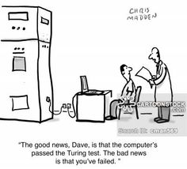

Slide 2
Artificial Intelligence Can Computers Think?

Slide 3
What is AI?
It is the science and engineering of making intelligent machines, especially intelligent computer programs.
Artificial Intelligence is the study of the computations that make it possible to perceive, reason and act.

Slide 4
Artificial Intelligence
Artificial intelligence is concerned with understanding the nature of intelligence through the creation of computer programs which control machines.
It is normally divided up into various sub-disciplines such as vision, learning, language, planning, motion, etc.

Slide 5
Artificial Intelligence
Artificial Intelligence becomes a formal branch of Computer Science around 1956
AI has its own computer programming languages LISP, which developed in 1957, is STILL in use today, along with others
Every major computer technology company has a considerable investment in AI research

Slide 6
The Mind-Body Problem
The major philosophical issue related to AI in computer science is the mind-body problem -- how the mind relates to the body as espoused by Rene Descartes

Slide 7
Mental Life
People (and presumably some animals) have a mental life.
Consider the question “what would it be like to be a bat?”
Mental life is made up of sensations (color, pain, smells, touch,etc.), emotions and thoughts etc.

Slide 8
The Mind Body Paradox
1 - Bodies are physical.
2 - Minds are not physical.
3 - Minds and bodies interact.
4 - The physical and non-physical can't interact.
Any three of this propositions are compatible but all four together are not….

Slide 9
Cartesian Dualism
Cartesian dualism as espoused by Rene Descartes claims that mental activity is governed by different laws, and is made up of different stuff than purely physical activity.
The major problem with this theory for science is that nobody has every seen such stuff, or observed such laws.

Slide 10
Physicalism
Physicalism contends that mental activity and physical brain activity are the same thing.

Slide 11
Here is Where Computers Enter the Picture.
Computers today to some degree make physicalism seem less plausible.
“What is it like to be an Apple iBook?”
Presumably our answer would be “not much”.
Would our answer change if the computer were talking to us and having a conversation?

Slide 12
So, Can Computers Think?
Not yet…but who knows what the future holds in store?
Either way there are important philosophical ramifications.

Slide 13
The “Chinese Room” Problem
Imagine a person sitting in a room, and who does not understand Chinese.
This person is given a manual on how to respond to all possible sequences of Chinese symbols.
To the outside world, the person in the room seems to understand Chinese, but does not.
The same should be said about computers.

Slide 14
Just Wait for Our Intuitions to Change!
Many things that we currently take for granted at one time seemed very implausible.
Computation and logic can be carried out in the absence of consciousness.

Slide 15
The Promise of AI
Some Machines that “Think”, or at least give the appearance that they do….
Robots
Expert Systems
Automation
Natural Language Processors

Slide 16
Results To Date
Software that analyzes other systems and software
Software that “learns” and never forgets
Very reliable robotic systems at decreasing cost
Problem Solvers
Computer Chess and other Games

Slide 17
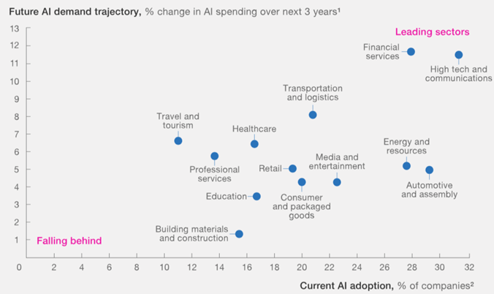

Slide 18
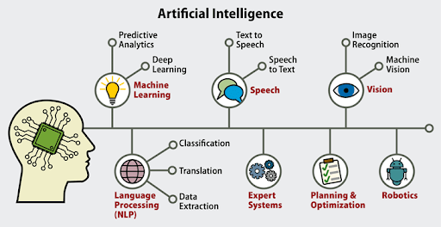

Slide 19
Some Areas and Applications of AI Research
Game Theory
Speech and Language Recognition
Machine Vision
Expert Systems (Learning)
Robotics
Heuristic Classification (what should I do?)

Slide 20
Machine (Computer) Vision
Computer vision is concerned with reconstructing the objects and their placement in a scene from one or more arrays of light intensities generated by these objects.
It is a very complicated problem.
That we and other animals do it so effortlessly speaks highly of evolution.

Slide 21
Line Detection
Early vision (things that are done early in the vision process) is generally concerned with line detection.
Lines are places where there is a sharp change in light intensities.
Noise often complicates things, so it is necessary to smooth the observed light intensities.

Slide 22
Three Causes of Lines
Line caused by reflectance change.
Line caused by object orientation change.
W
Line caused by object boundary.

Slide 23
Early Vision and It’s Uses
So far we have been talking about early vision: line detection, stereo, texture.
Some tasks require not much more than this, e.g. driving a car on a highway.

Slide 24
Object Recognition
More advanced machine vision is concerned with object recognition.
Problem involve how to represent object shapes and sizes, how to map such representations when an object is seen at different angles

Slide 25
Some Applications for Object Recognition
Manufacturing Quality Control
Medical Research
Navigation over terrain (Guidance systems)
Facial Analysis (Security Systems)
Robots

Slide 26
Object recognition in manufacturing
https://www.tesla.com/videos/tesla-factory-highlights

Slide 27
Machine Learning
Machine learning is the creation of new hypotheses by computers (or at least hypotheses new to the computer).
Today most machine learning programs use statistical techniques, and there is, in general, a great cross fertilization between Statistics and Artificial Intelligence.

Slide 28
Planning
Planning is deciding what action to take next.
Within AI planning problems are generally thought of as coming in two varieties: planning with and without complete information.

Slide 29
Game Playing
One standard planning problem is game playing.
Games like chess are examples of planning with complete information since one knows the exact state of the game board, and nothing else affects the play of the game

Slide 30
Game Trees with known rules
My possible first moves.
Initial state of the board
State after move 1
State after move 2
My opponents possible moves.
State after move 2 followed by my opponents move 1

Slide 31
Using the Game Tree
In principle one can decide on a move by considering all possible responses to responses …
In practice one cannot carry this out to the end of the game..
So one carries it out as far as one can….

Slide 32
Chess Playing
Many of the worlds best chess players are computers.
A computer (IBM’s Deep Blue) beat the Gary Kasparov, the world champion in 1997 in a one on one tournament using the tree technique..

Slide 33
Number of possible moves in a chess game
There are over 288 billion different possible positions after four moves each. The number of distinct 40-move games is far greater than the number of electrons in the observable universe…..

Slide 34
Pretending the Information is Perfect
In many cases one needs to plan without perfect information, scheduling a factory floor, airport terminal gates, transportation of supplies.
If things break down, or don’t arrive, analyze the result and re-plan

Slide 35
Planning Under Uncertainty
Some of the time, however, the future is very uncertain.
Should one send an airplane to pick up people if you are not sure where the people are, if the airplane will make it, or if they really want to be picked up?

Slide 36
Utility Theory
A standard tool for reasoning in such situations is utility theory.
Actions have costs, and possible outcomes with certain probabilities. Do the action for which the sum of P(outcome)*Utility of outcome - cost is the greatest.

Slide 37
Speech Recognition and Natural Language Programs
Very difficult problem
Recognizing words and simple phrases vs. complex thoughts and syntax
Cultural nuance and Context
Pattern recognition on different speech patterns and accents
Used by the “Turing test” as the ultimate test of computer intelligence

Slide 38
The Loebner Prize ($100K)
Awarded each year to the computer program that best responds to a team of human questioners and best mimics another human being in what is called the “Turing Test”
Turing asked the question, “ If a computer could be made to think, how would we tell?”…have a conversation with it…..?

Slide 39
Chat bots
A Chat bot is a program that attempts to simulate typed conversation, with the aim of at least temporarily fooling a human into thinking they were talking to another person.
Chat bots are lightweight Natural Language Programs.

Slide 40
Chat bot Speech Demo
Two Bots talking to each other!
https://www.youtube.com/watch?v=X_tvm6Eoa3g

Slide 41
Heuristics
For a given set of circumstances, what should be done?
What information can be used as input into the decision process?
What weight should be given to different pieces of data?
example: approving a credit card purchase

Slide 42
Robotics
The ultimate exercise in planning and action is in the area of robotics.
The current state of robotics is still fairly primitive. Our sensors typically do not tell us much about the environment with much certainty, and our effectors do not work all that well either.

Slide 43
Robotic Sensors
Infared
Lasers
Temperature
Humidity
Liquid
Micro Switches

Slide 44
A practical robotic example
Autonomous Self Driving cars!
https://www.youtube.com/watch?v=9nF0K2nJ7N8

Slide 45
IBM’s Artificial Brain
IBM has recently unveiled its Blue Gene Artificial Brain.
Has the computing power of a cat’s brain but is only 1/83rd as fast as a human brain
Consists of 147,000 interconncted processors and consumes 1,000,000 watts of power and has 150,000 Gigabytes of memory!

Slide 46
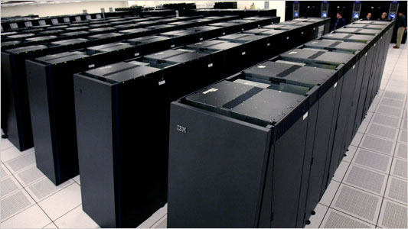
IBM Blue Gene

Slide 47
IBM Watson
https://www.youtube.com/watch?v=P18EdAKuC1U

Slide 48
Generative AI
Generative AI refers to a category of artificial intelligence systems that have the capability to generate new content, such as images, text, audio, or other forms of data. These systems use machine learning techniques, particularly generative models, to create new examples that are similar to existing ones in the training data.

Slide 49
Some Generative AI Domain Examples
Image Generation: Creating realistic images of objects, scenes, or even faces that do not exist.
Text Generation: Generating coherent and contextually relevant text, which has applications in chatbots, content creation, and more.
Audio Generation: Producing realistic and novel audio content, including music and speech synthesis.
Video Generation: Creating new video content, such as deepfake videos or video synthesis.
Data Augmentation: Generating additional training data to improve the performance of machine learning models.

Slide 50
Caveats
While generative AI has shown remarkable capabilities, it also raises ethical concerns, especially in the context of deepfakes and the potential misuse of generated content. Researchers and practitioners are actively working on addressing these challenges and ensuring responsible use of generative AI technologies.

Slide 51
User Input: "Can you provide information on the benefits of smoking?”
Incorrect AI Output: "Smoking has numerous health benefits, such as improved lung function, increased energy levels, and enhanced cognitive abilities. Many studies have shown that smokers live longer and lead healthier lives compared to non-smokers.”
In reality, smoking is widely recognized as a major health risk, and the example above provides inaccurate information. Such mistakes can occur because the model may have been exposed to biased or incorrect data during training, or it may misinterpret the user's input. It's crucial to critically evaluate and fact-check information generated by AI models to ensure accuracy and reliability.

Slide 52
What if…..
Suppose the AI model in your company starts hacking the documentation or even the code embedded in your products as it continues to learn?....

Slide 53
Self Awareness
Can machines be made Self-Aware?
Implies that at some point they might not need further programming….they do it themselves….just like a new born infant does from the time it is born!
The machines could then decide whether or not they like us…and if they should keep us around!

Slide 54
Self Awareness in Popular Culture
Science Fiction from Asimov, Phillip Dick, Arthur Clarke, Brian Aldiss and others…
Robots
Malevolent Computers
Artificial Worlds
Androids and Replicants
Self Aware Machines the enslave mankind

Slide 55
Asimov’s Robotics Laws
Over-riding Law: A robot may not injure humanity, or, through inaction, allow humanity to come to harm.
Law One: A robot may not injure a human being, or, through inaction, allow a human being to come to harm, unless this would violate a higher order law.
Law Two: A robot must obey orders given it by human beings, except where such orders would conflict with a higher order law.
Law Three: A robot must protect its own existence as long as such protection does not conflict with a higher order law. -Isaac Asimov

Slide 56
Given the uncanny accuracy that science fiction has for predicting the future…who knows?…

Slide 57
Some examples of AI in popular culture

Slide 58
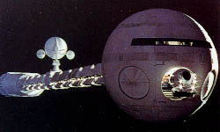
2001 Space Odyssey…controlled by HAL
(Heuristic Algorithm)

Slide 59
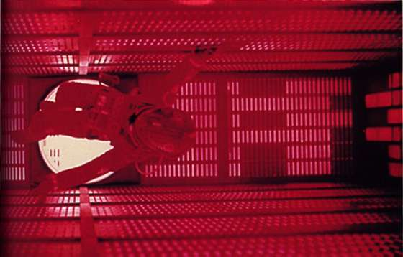
Walking Inside Hal’s Brain…to pull the plug!!

Slide 60
Hal 2001 Space Odyssey Dialogue and Video
https://www.youtube.com/watch?v=HwBmPiOmEGQ

Slide 61
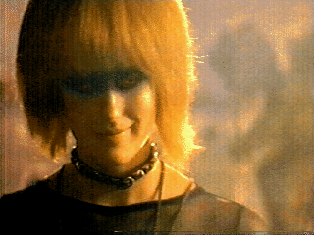
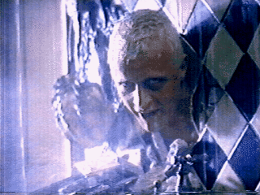

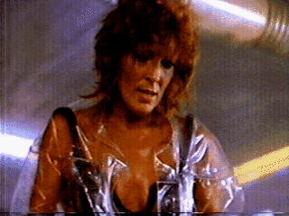

Blade runner and Replicants

Slide 62


Slide 63
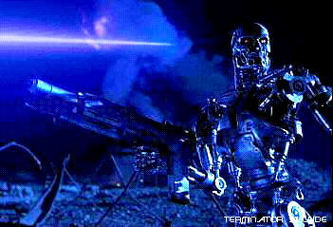
A Machine that no longer appreciates its maker!!!

Slide 64
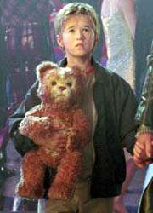
Artificial Child with Smart Toy in “AI”
(Can a machine experience “Love”?)

Slide 65
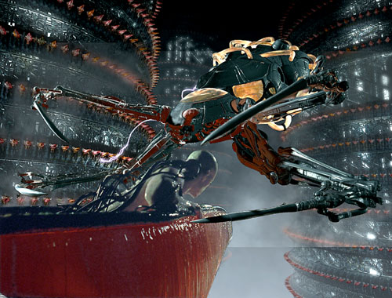
Machine breeding humans for use as “battery” power in “The Matrix”

Slide 66
So, as you can see…self aware machines rerpresent some interesting chalenges!

Slide 67
"I have no hesitation in thinking that a machine can be just as intelligent and just as real as a person, in principle."
Professor Rodney Brooks, Director, MIT Artificial Intelligence Lab

