Slide 1
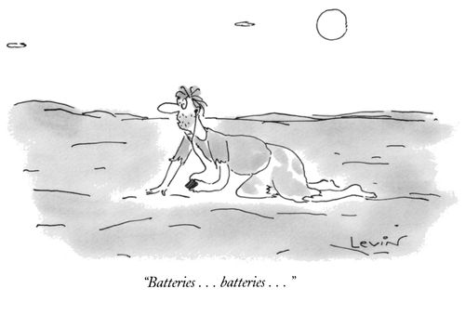
Digital Audio

Slide 2
Digital Audio Turning sound into bits, and bits back into sound

Slide 3
Introduction to Sound
Sounds are vibrations that travel though the air or some other medium
A sound wave is an audible vibration that travels through air or water.
The loudness or intensity of a sound is measured in Decibels (dB).
The frequency of a sound is measured in Hertz (Hz). 1000 Hertz=Kilohertz (kHz)

Slide 4
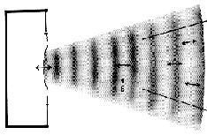
Properties of Sound
Sound is caused by the disturbance of air molecules by an object that sets those molecules in motion. Those molecules travel in waves.

Slide 5
SOUND WAVE PROPERTIES
Amplitude
Frequency
Timbre (Harmonics or complexity)

Slide 6
Amplitude (Intensity of Sound)
Threshold of hearing
0 dB
Leaves rustling in the breeze
20 dB
A quiet restaurant
50 dB
Busy Traffic
70 dB
Vacuum cleaner
80 dB
Threshold of pain
120 dB
Jet at takeoff
140 dB

Slide 7
Frequency (Pitch)
Frequency is the most fundamental quantitative unit of sound. When we talk about the radiation of sound, we are talking about an energy transfer in the molecules of air resulting in a moving high pressure (compression) zone traveling at 1130 feet/second. For this sound to have a major significance, it must be composed of multiple high and low pressure zones following each other. The time between the intervals of high pressure zones defines a cycle, and frequency is defined as the number of cycles per second expressed in
Hertz (Hz) and KiloHertz (Hz)
For example a Concert A played on a piano is 440 Hz

Slide 8
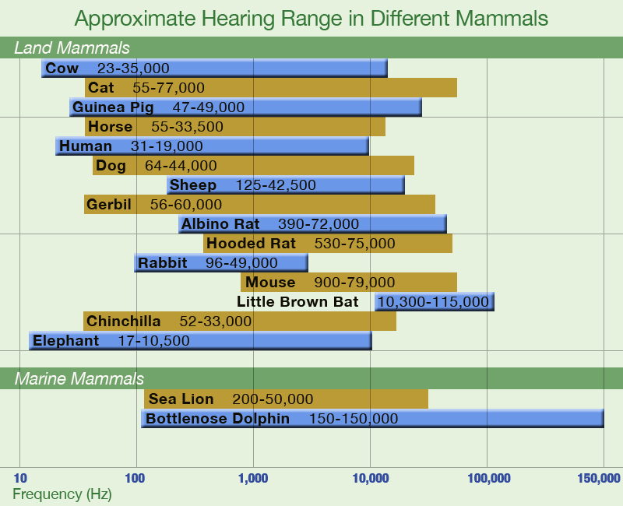
The Range of Human Hearing
20 Hz to 20 000 Hz (20 kHz
Normal Conversation –
1 kHz to 4 kHz
Dogs can hear up to 35 kHz (ultrasound)
http://www.vanderbilt.edu/exploration/resources/shapematters_range_800.jpg

Slide 9
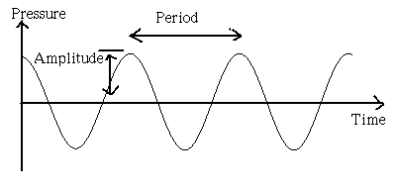
Representation of a “pure” tone
Variations of air pressure over time for a Sine Wave

Slide 10
Timber/Pitch
Sounds have another perceptual attribute: that of timbre or tone quality. We may describe sounds as being tinny, full, brassy, trumpet-like, etc.
Timbre is defined as that attribute of a sound that allows us to differentiate between two sounds of the same pitch, intensity and duration

Slide 11
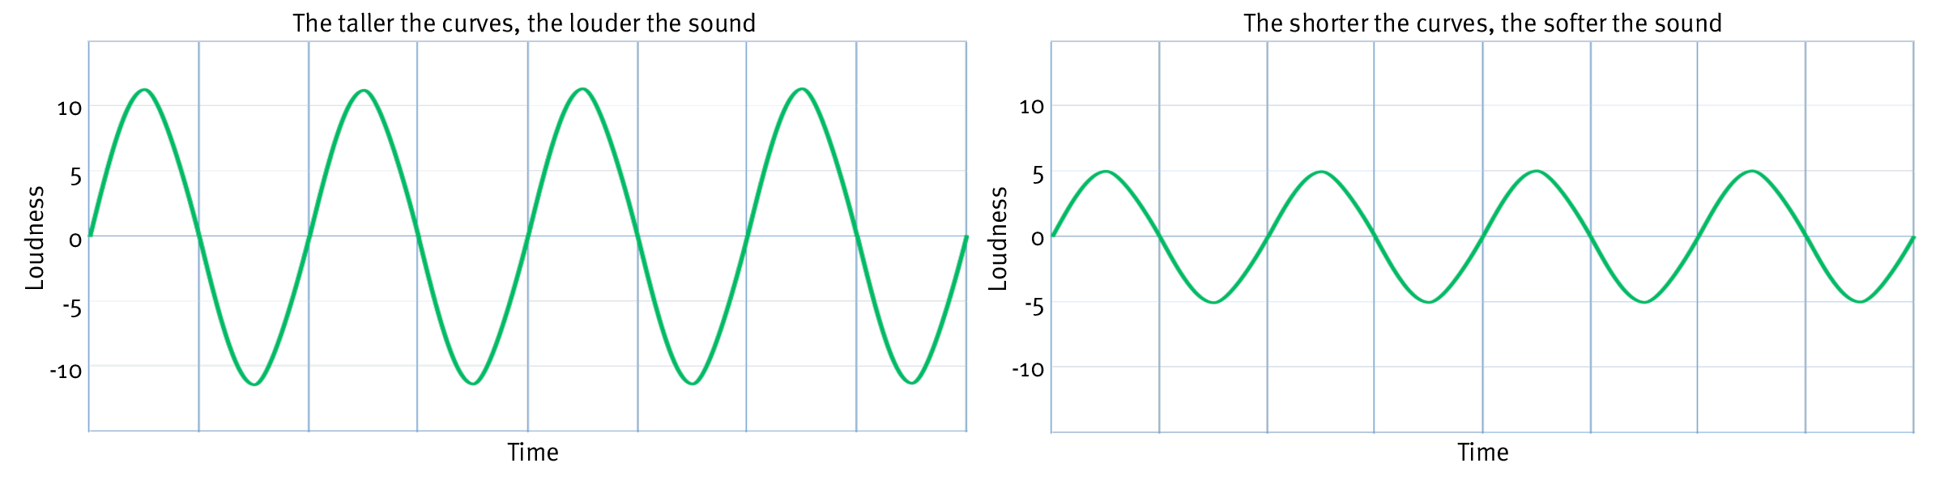
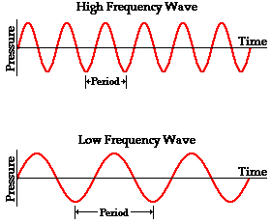
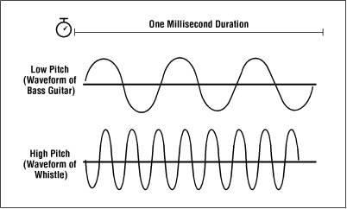
AMPLITUDE
FREQUENCY
PITCH

Slide 12
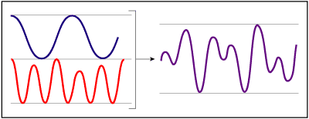
Complex tones as the result of multiple sounds occurring at the same time

Slide 13
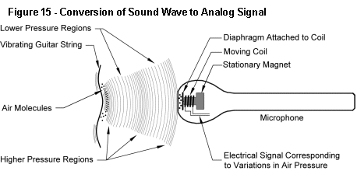
Capturing Sound Waves

Slide 14
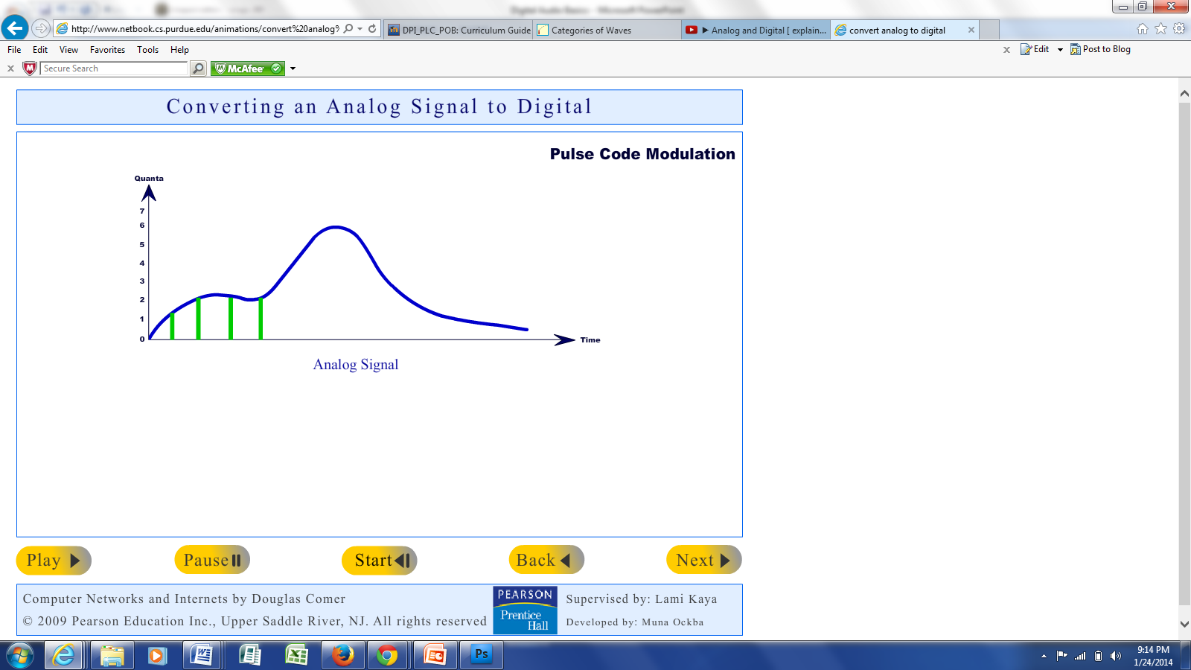
Converting Analog Sound to Digital Sound
Analog sound is a continuous phenomena, such as speaking or an electrical pulse from an instrument.
Computers can only deal with discrete information, so analog sound must be converted to digital, which is called sampling.
Sampling converts electrical energy to binary code (1’s and 0’s) that is readable by computers.
Click to View Sampling Animation

Slide 15
Digital Audio - What is it?
Really a method to capture and transform audio signals for the purpose of storage, transmission, manipulation, and playback
Digital Approximation of the real event and sound waves
Requires A/D and D/A Converters
Devices used to change analog to digital and back again.
These are generally found on computer sound cards
A/D converters perform sampling of waveforms
D/A converters convert digital data back into a waveform
Employ various forms of encoding and decoding the bit stream using CODECS (Compressor/De-compressors)

Slide 16
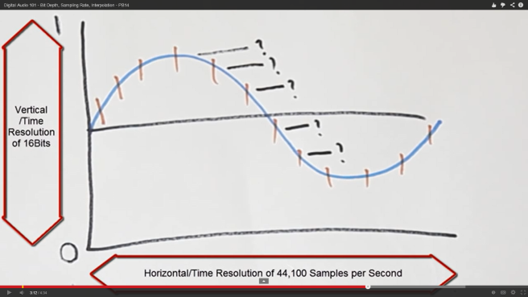
Sampling
Sample Rate: The rate or frequency at which a sound is sampled to digitize it. Measurements of a sound wave over time measured in Hz (cycles/sec).
48 kHz: standard for digital audio
CD audio is sampled at 44.1 kHz
Bit Rate (Depth): ﻿﻿the number of computer bits that are conveyed or processed per unit of time.
Normally expressed in kilobits per second (kbps).
A higher bit means generally means better quality (resolution).
16 bit: 65,536
24 bit: 16,777,216
Digital Audio 101 - Bit Depth, Sampling Rate, Interpolation

Slide 17
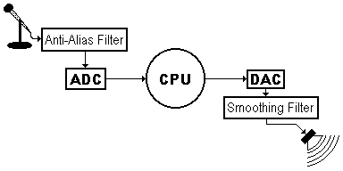
Analog/Digital Conversion
Microphone converts sound into an electrical signal .
ADC periodically measures (samples) the amplitude of the analog signal, sending a stream of numbers to CPU.
DAC converts a stream of numbers into a stepped analog signal.
Smoothing filter removes staircase shape from signal.
A Basic Digital Audio Setup
Acoustical to Electrical to Digital (numerical) and back

Slide 18
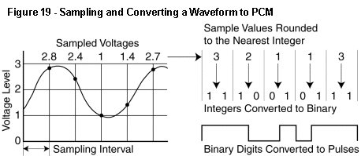
Sampling and Converting a Wave to Digital
Converting a wave to Digital

Slide 20
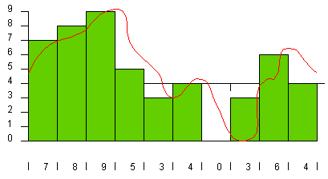
Low Quality Sampling (low-res)

Slide 21
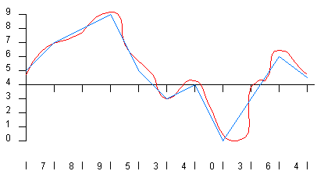
Low Quality Results

Slide 22
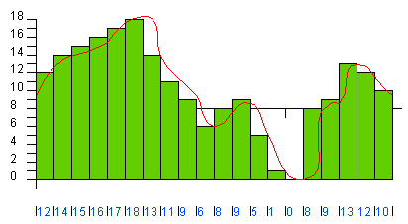
Higher Quality

Slide 23
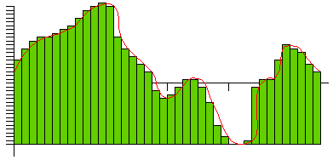
Even higher quality

Slide 24
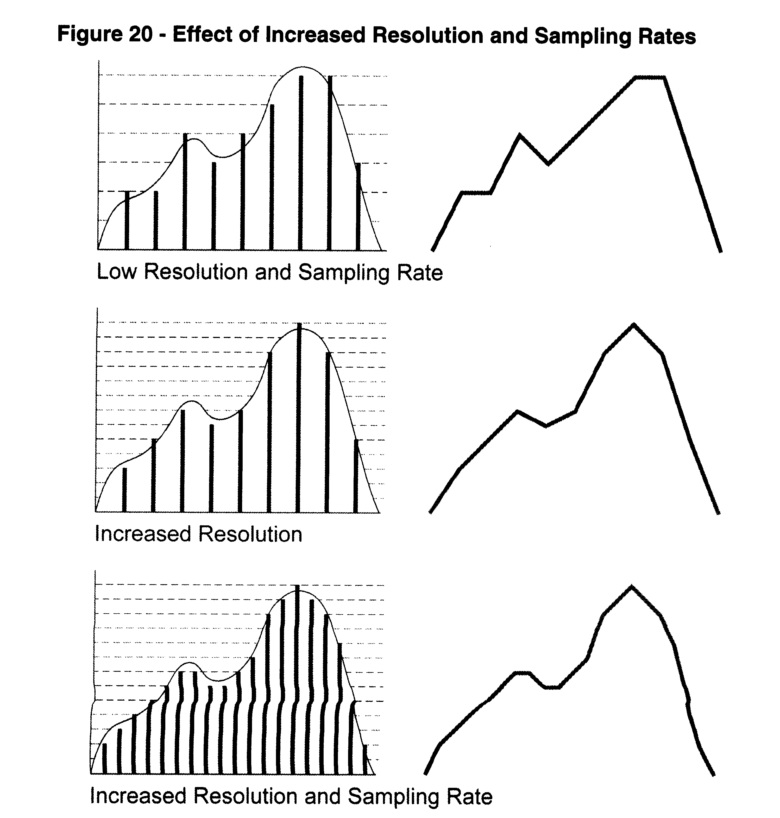
Achieving Higher Quality Sound

Slide 25
Buzzword: Sampling Rate
The number of times each second the computer stores information about the sound wave. Compact discs store audio that is sampled at 44.1 kilohertz (kHz). The new DVD format is capable of a maximum of 96 kHz sampling and most computer sound cards can sample at a maximum of 48 kHz. The higher the sampling rate the better the sound quality that will be heard on playback (up to a point)

Slide 26
Buzzword: Bit Rate
Bit Rate: Computers use a binary numbering system of “ones and zeros”. These numbers can be combined into longer strings of numbers in sets, described as “bits”. Compact discs are recorded with a bit length of 16. Again, the higher the bit length, the better the sound quality due to the higher resolution available

Slide 27
Buzz Word: Compression
Computers can use different schemes to eliminate repetitive information when storing data. In the case of recorded sound, these compression schemes can take on many forms that will be dealt with later in this document. Audio on a compact disc is not compressed and gives the user the highest sound quality; when working with the Internet, sound must be compressed to make a smaller file for downloading.

Slide 28
The Nyquist Theorem
This theorem holds that in order to preserve a reasonable representation of a waveform it must be sampled at least twice at its highest frequency
Since the limits of human hearing are around 22khz (22,000 cycles per second), the sampling for CDs was established at 44.1 khz….

Slide 29
How much data on a CD?
One thing about the CD's sampling rate and precision is that it produces a lot of data. On a CD, the digital numbers produced by the ADC are stored as bytes, and it takes 2 bytes to represent 65,536 gradations. There are two soundstreams being recorded (one for each of the speakers on a stereo system).
A CD can store up to 74 minutes of music, so the total amount of digital data that can be stored on a CD is
44,100 samples/(channel*second) * 2 bytes/sample * 2 channels *
74 minutes * 60 seconds/minute = 783,216,000 bytes
or 176400 bytes or 1,411,200 bits per second!

Slide 30
CD’s and your Computer
CD standard is 16 bits at 44.1 KHz .
Using CD Ripper software, you can take digital data from the CD which is in .cda format and convert it to .wav or MP3 format all in the digital domain
Not dependent upon the sound card capabilities
The sound file contains all the music but the vast number of samples makes such files big
Approx: 10 Mbytes per stereo minute

Slide 31
One Minute of Digital Audio Comparison
“CD” Quality
44 KHz | 16 bit Stereo | 10.3 MB
44 KHz | 8 bit Stereo | 5.18 MB
“FM” Radio Quality
22 KHz | 16 bit Stereo | 5.18 MB
22 KHz | 8 bit Stereo | 2.59 MB
“AM” Radio Quality
11 KHz | 16 bit Stereo | 2.59 MB
11 KHz | 8 bit Stereo | 1.29 MB

Slide 32
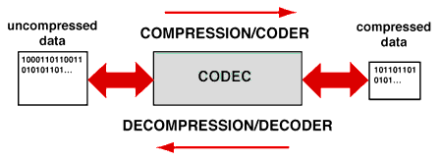
Digital Compression Concepts
Compression techniques are used to replace a file with another that is smaller
Decompression techniques expands the compressed file to recover the original data -- either exactly or in facsimile
A pair of compression/decompression techniques that work together is called a codec for short

Slide 33
What is MP3? (Motion Pictures Experts Group Layer 3)
MP3 is a compression system developed specifically for music. It had its birth as a result of the desire to send music over the internet
It reduces the amount of data on a CD without “hurting” the sound of the music too much
It actually achieves a data reduction of about 90%!
It achieves this dramatic reduction by eliminating things that our ears don’t hear very well
soft sounds that are masked by louder sounds
frequencies that are outside of our hearing range
frequencies that we don’t hear well
advanced compression techniques

Slide 34
MP3 Takes Advantage of the theory that
There are certain sounds that the human ear cannot hear.
There are certain sounds that the human ear hears much better than others.
If there are two sounds playing simultaneously, we hear the louder one but often cannot hear the softer one

Slide 35
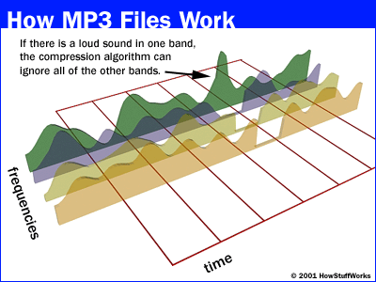
MP3 is a Lossy Compression System

Slide 36
MP3 Files continued
MP3 files are an average of 3-5 megabytes vs. CD
files of 30 megabytes for the same song
Easy to transmit over the internet
Easy to store on portable devices
They are an approximation of the original CD which in turn is a reasonable approximation of the real sound

Slide 37
Digital Format Comparison
CD Standard = 16 Bits at 44.1Khz
Professional Digital Recording Standards
16 or 24 Bits at 44.1Khz, 48Khz, 96Khz
Wav – Probably the most common format and used by windows programs to capture CD music to a hard drive. Real representation or “Pits to Bits” but files are large
MP3 – About 1/10 the size, 1meg/stereo minute compared to 10meg for the original and called near CD quality
WMA – New windows format that boasts higher quality than MP3 with similar sample rates or same quality with lower sample rate and smaller file sizes
MP4 – A new standard that allows for synchronized video and audio and can compete with WMA. It is non-proprietary

Slide 38
Editing Digitized Sound
Digital sound editing is part of a larger field called digital signal processing
Once sound is digitized, it is in discrete numerical format
Numerical transformations on this data can be used to:
change the sound’s pitch
change the sound’s amplitude
add echoes and other special effects
cut and paste entire passages
Overlay multiple instruments and voices

Slide 39
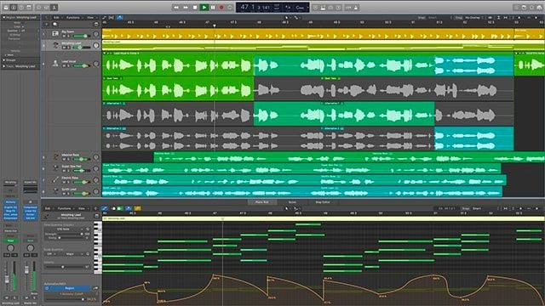
Free Audio Mixing Software! Try it for free: https://www.audacityteam.org/

Slide 40
Audio Speech Synthesis
Speech synthesis involves creating speech from written text
Analysis of written text focuses on breaking the text into phonemes
English employs approximately 50 basic phonemes
Rules allow a speech synthesis program to evaluate alternate pronunciations appropriate for the context
Such rule-based phoneme analysis produces excellent speech synthesis results

Slide 41
Speech Recognition
Speech recognition attempts to interpret digitized speech for meaning
The task is complicated by the differences among speakers and even the different ways a given speaker might pronounce the same word depending on mood, context, etc.
Some success has been achieved by tailoring/training a program to recognize a particular speaker
Some reasonably successful voice activation systems have been produced where vocabulary is limited to small number of words
Speech recognition remains a very challenging problem

Slide 42
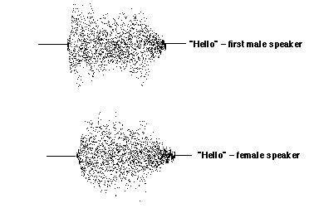
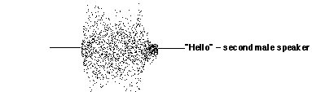
Speech Recognition Illustrating the Difficulties

Slide 43
Summary
Digital sound is produced by sampling sound waves over time
A digital sound file consists of sampled amplitudes at a number of discrete times within a given time interval
The number of samples per second is called the sample rate
The number of bits devoted to storing individual sampled amplitudes is called the resolution of the digitized sound: 8-bit, 16-bit and higher resolutions are used depending on the kind of sound being digitized
Fidelity will be largely determined by the sample rate and resolution

Slide 44
Tutorial and Demo on Digital Audio
https://www.joelstrait.com/digital_audio_primer/

Slide 45
Questions?

