Slide 1
Lecture 13
Digital Video !
With a Primer on CODECs

Slide 2
The first Motion Picture, ever…..
https://www.youtube.com/watch?v=Bmuo45NR6qE&list=PLJzUz1J8lJczfHYWLr1Lupm-FO_o9tCFz

Slide 3
The Very First Videos (Movies) made in the U.S.
Circa 1895
https://www.youtube.com/watch?v=QRgymD_CO8k

Slide 4

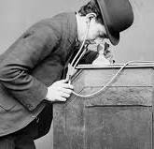
Kinetoscope viewer
Kinetoscope, forerunner of the motion-picture film projector, invented by Thomas A. Edison and William Dickson of the United States in 1891. In it, a strip of film was passed rapidly between a lens and an electric light bulb while the viewer peered through a peephole.

Slide 5
Film is designed around multiple sizes
8mm Home movies
16mm Industrial
35mm Theatre
70mm Super Wide, IMAX

Slide 6

35mm Theatre Film…
Save

Slide 7
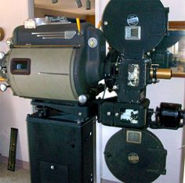
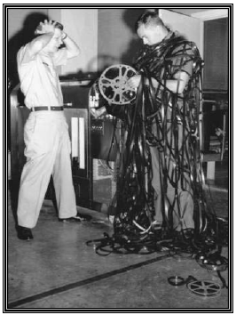
35 MM Theatre Film Projector

Slide 8
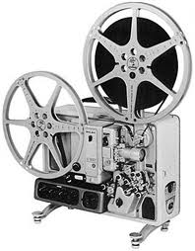
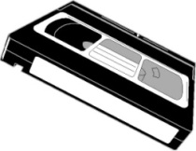





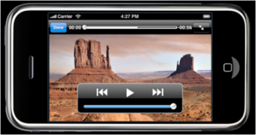
Digital Video TimeLine
Video Timeline
MPEG
‘60’s-70’s
’70’s-80’s
‘90’s- 2000’
2003
2005
2009
2018
Improved Accessibility
Increased Technical Complexity

Slide 9
Film vs. Video
Film captures motion at 24 frames (Images) per second
Video typically operates at 30 frames per second
Video inherits many of its characteristics from broadcast television, developed in the 1930’s – 40’s

Slide 10
Video Starts off as Analog Information
Just as in Imaging, the original information contained in video is analog by nature
Intensity
Color
Speed / Motion (30 Frames per Second)
Digital technology allows us to convert it to bits, store it and manipulate it much easier than its analog counterpart

Slide 11
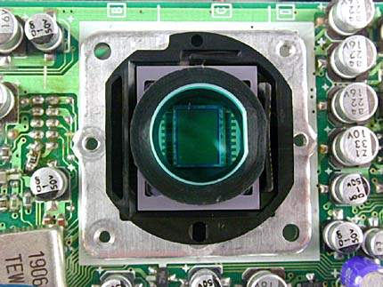
The CMOS Video Imager
CCD
500,000 to 30,000,000 Pixels

Slide 12

RED DSMC2 $54,500.00 35,200,000 Pixels!

Slide 13
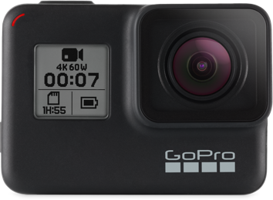
GoPro Black $399.00 12,000,000 Pixels
HERO 7 Black

Slide 14
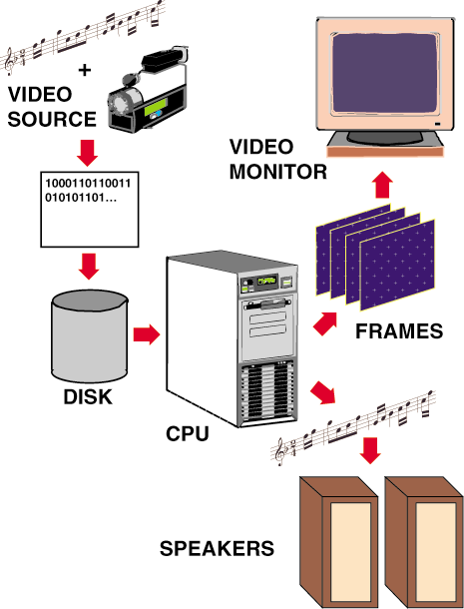
Producing Digital Video
Video capture
Editing
Playback
Notes:
2

Slide 15
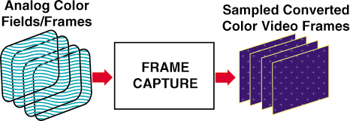
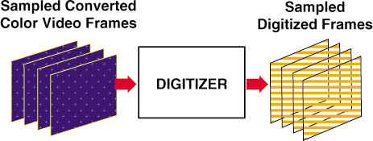
Converting the Video Frame to Bits
Think of Video Frames as individual Images, stacked front to back
110001100011111100000011100001100000011111000000000001111111111000000000

Slide 16
DVD – Digital Versatile Disk
Up to 133 minutes of medium resolution video, with 720 dots of horizontal resolution X 480 dots of vertical resolution (The video compression ratio is typically 40:1 using MPEG-2 compression.)
Soundtrack presented in up to eight languages using 5.1 channel Dolby digital surround sound
4.7Gb of storage total per disk

Slide 17
Blu-Ray High Definition DVD
10 times the capacity of std DVD
Higher resolution:
Up to 1920X1080 dots of resolution
Up to 50GB of storage!
Uses a blue laser as opposed to a red one (shorter wavelength)
The current high def standard

Slide 18
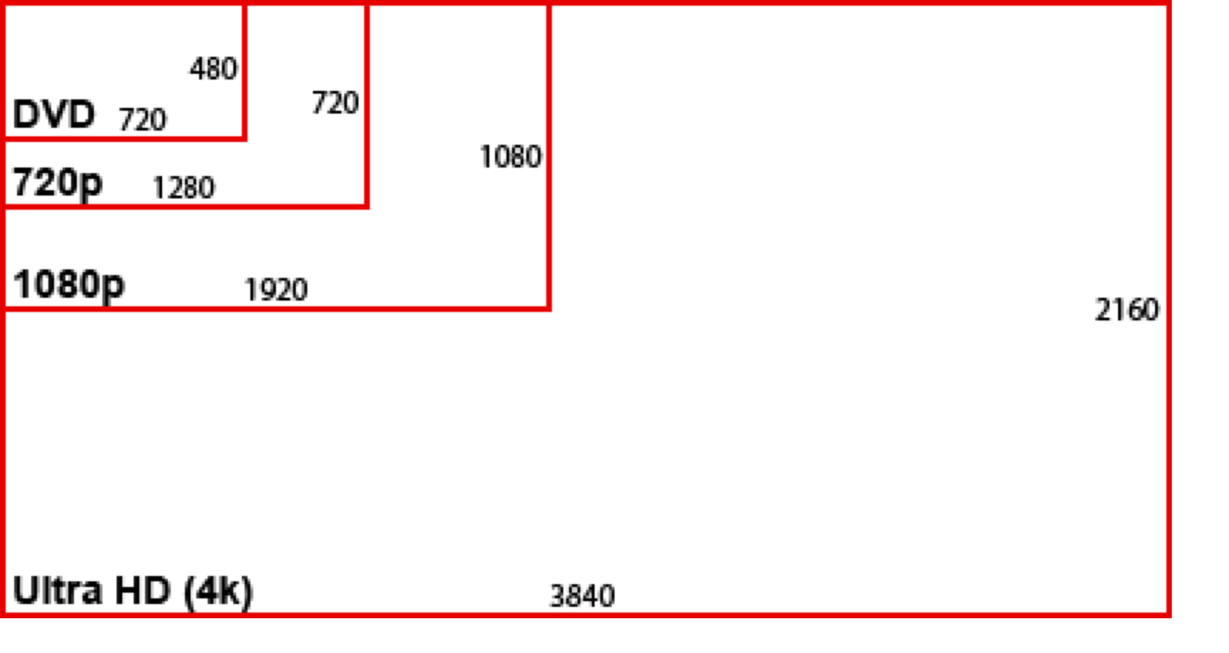
Video Aspect Ratios

Slide 19
Advantages and Disadvantages of Digital Video
Advantages
Scalable to different playback systems
Random access to frames
Easy to Edit
More playback options
Potential for interactivity
Disadvantages
High playback and storage requirements
( Who Cares!!)
Notes:
3

Slide 20
Video Resolution
Standard definition video was typically delivered at 440 X 320 or 720 X 480 depending upon whether it was broadcast, stored on VHS videotape or standard DVD
High definition video is delivered at:
1280 × 720 pixels,
Or 1920 × 1080 pixels,
Or 3840 x 2160 pixels
3-5 fold increase in pixel resolution…lot’s more data…
How is it possible that we can afford to transmit this over cable, satellite and over the air given this drastic increase in resolution

Slide 21
But, there is soooo much data!
If we didn’t have a way to efficiently compress all of the information in the video frames, we would quickly run out of cost effective storage capacity for consumer applications.
Thus the need for
Compression/Decompression

Slide 22
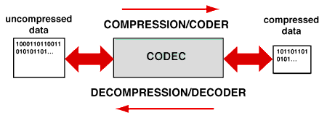
Digital Compression Concepts
Compression techniques are used to replace a file with another that is smaller
Decompression techniques expands the compressed file to recover the original data -- either exactly or in facsimile
A pair of compression/decompression techniques that work together is called a codec for short
Notes:
2

Slide 23
Redundancy
Data compression is possible because many messages (images, etc.) are redundant, and they can theoretically be reconstructed from a smaller set of bits.

Slide 24
Types of Data Compression
We can divide up data-compression techniques in many different ways:
Lossy as opposed to lossless compression
Syntactic as opposed to semantic compression.

Slide 25
Assumptions
One way to look at data compression techniques is to ask what fact about the world they assume.
Syntactic techniques make very broad assumptions, semantic techniques can depend on very specific ones.

Slide 26
Run Length Encoding (RLE)
Achieves modest savings with a Syntactic method
Based on the assumption that redundancy is is present in certain repetitions of ASCII characters or numbers
ABBCCDDDDDDDDDEEFGGGGG becomes
ABBCCD#9EEFG#5

Slide 27
Image Compression
The basic assumption of image compression is that pixel intensity values do not change much between neighboring pixels.
So record, say, the center pixel, and work out in a spiral. For each new pixel, just record the difference between it and the previous one.

Slide 28
JPEG
JPEG is set of lossy image compression standards.
JPEG combines a lossy scheme much like the one we just described, and then further compresses the data using a lossless scheme. If we have a long string of 0’s (no change) this could be represented by a pointer back to a previous such string or the use of Run Length Encoding
JPEG results in some loss of detail due to averaging as well as slight discoloration

Slide 29
Video Compression: Coping with Large Files
Video Compression is an encoding process that filters the original file in several successive stages
Without powerful compression we would NOT be able to produce CDs, DVDs, Streaming or Video Downloads over the Internet
Notes:
4

Slide 30
Types of Codecs
Codecs that upon decompression always reproduce the original file exactly are called lossless codecs
Codecs that reproduce only an approximation of the original file upon decompression are called lossy codecs
Codecs that take approximately the same amount of time to compress and decompress a file are referred to as symmetric codecs
By contrast, codecs that feature simple fast decompression but significantly slower compression are called asymmetric codecs
Notes:
3

Slide 31
Codec Methods
Syntactic encoding methods attempt to reduce the redundancy of patterns in a file without any regard to the type of information represented
Semantic methods consider special properties of the type of information represented to reduce nonessential information in a file
Hybrid methods combine both syntactic and semantic methods
Notes:
5

Slide 32
Compressing Video
Video compression employs both spatial and temporal compression techniques
spatial techniques compress individual frames
temporal methods compress data in frames over time
QuickTime and AVI (Audio Video Interleaved) are two popular (and incompatible with each other) compression formats used on PCs
Notes:
8

Slide 33
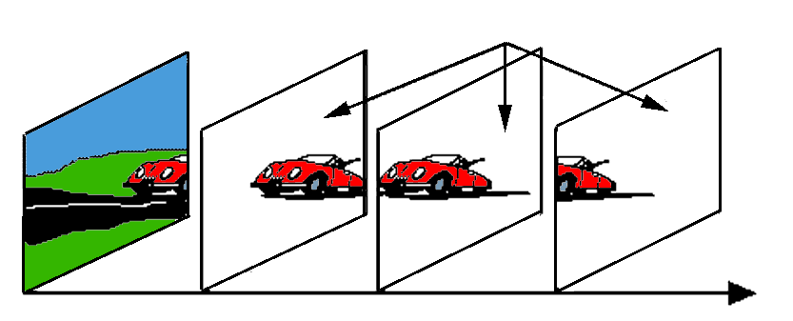
Temporal Compression in Video
Lossy strategies for eliminating redundancy of information between frames employ temporal compression -- referred to as interframe compression
Sequence of frames are considered together
key frames
difference frames
Notes:
10

Slide 34
Other Brute Force Methods for Reducing Demands
Frame rate adjustment
slow it from 30 to 24 fps
Lower resolution on individual frames
sometimes hard to notice by average viewer
Notes:
5

Slide 35
MPEG 2- The Mother of all Video Compression!….so far
Uses : Temporal and Spatial Redundancy
Basically it predicts what subsequent frames of video are going to be based on previous and future frames
It encodes that knowledge such that only one out of 12 frames has a complete set of digital binary information….the others have a combo of binary and vector information
40:1 Compression Ratio…..makes DVDs possible

Slide 36
MP4 Compression
MP4 is a popular video format used to share, download, and stream video content. In addition to video, the format can store audio, images, and also subtitles
MP4 provides strong compression, which is lossy but retains high video quality. This makes it highly suitable for streaming and downloading videos over the Internet. It can package multiple media types including video, audio, images, and 3D imagery, together with complex metadata, making it possible to deliver navigation and other interactive elements to viewers.

Slide 37
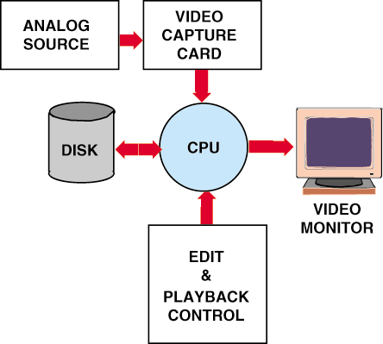
The Desktop Video System Basic Components
Analog Source
Video Capture Card
CPU
Secondary Storage
Monitor
Edit and Playback Control
Notes:
6

Slide 38
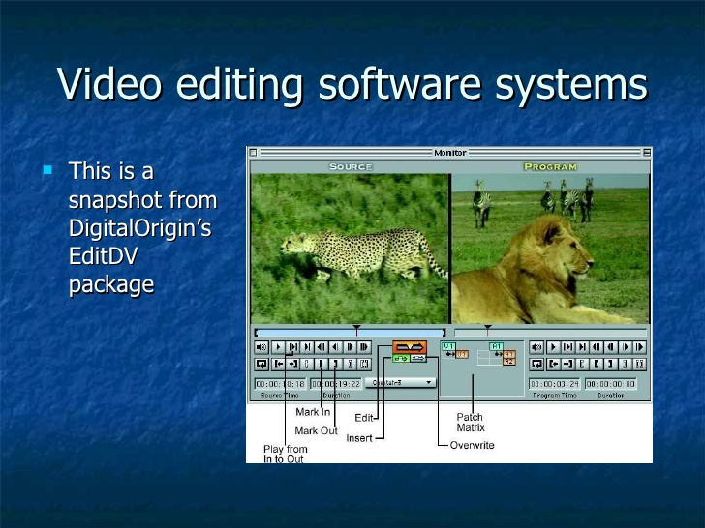

Slide 39
Editing Digital Video
Clip Logging
Assembling
Transitions
dissolves
wipes, etc.
Rotoscoping
Frame Editing (Digital Effects)
Compositing
keying
titling
Notes:
9

Slide 40

Compositing…..First we have a Mountain

Slide 41
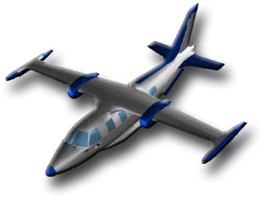
We create a digital airplane

Slide 42

Mountain and Plane…..Together !!

Slide 43
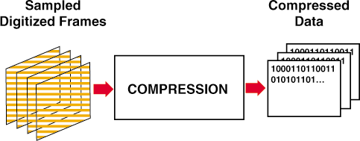
Digital Video The Entire Process Illustrated
Notes:
8

Slide 44
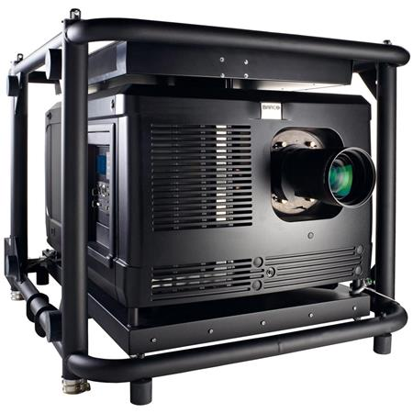
Digital Cinema
Has replaced traditional film in all major movie theatres
Movies are shipped in encrypted memory packs or downloaded to the theatres
Ensures that every viewing is at the same level of quality
Prevents counterfeiting and theft

Slide 45
So What does Digital Video make possible?
Anyone can produce, direct, shoot, edit and publish a hi-def video
Portability
Self publishing over the net
Video on Demand
Downloading
Streaming
Purchasing
And it gets cheaper every day!

Slide 46
Summary
Digital video is:
scalable
allows unlimited editing
has interactive potential
Digital video can be produced with desktop systems
Flexible editing and playback options are major advantages
Storage requirement is biggest challenge
But, Remember Moore’s Law !!

Slide 47
Don’t Be Afraid of the Technology
Take the Plunge!

Slide 48




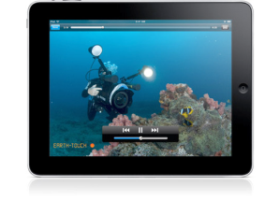
Digital Video 101
Digital Video Workflow
Step 1:
Produce a Great Video
Step 2:
Encode Files
Step 3:
Store
Files
Step 4:
Deliver a Great Video to Any Device

Slide 49
Questions?

