Slide 1
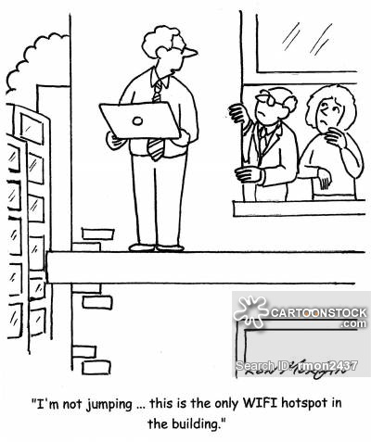

Slide 2
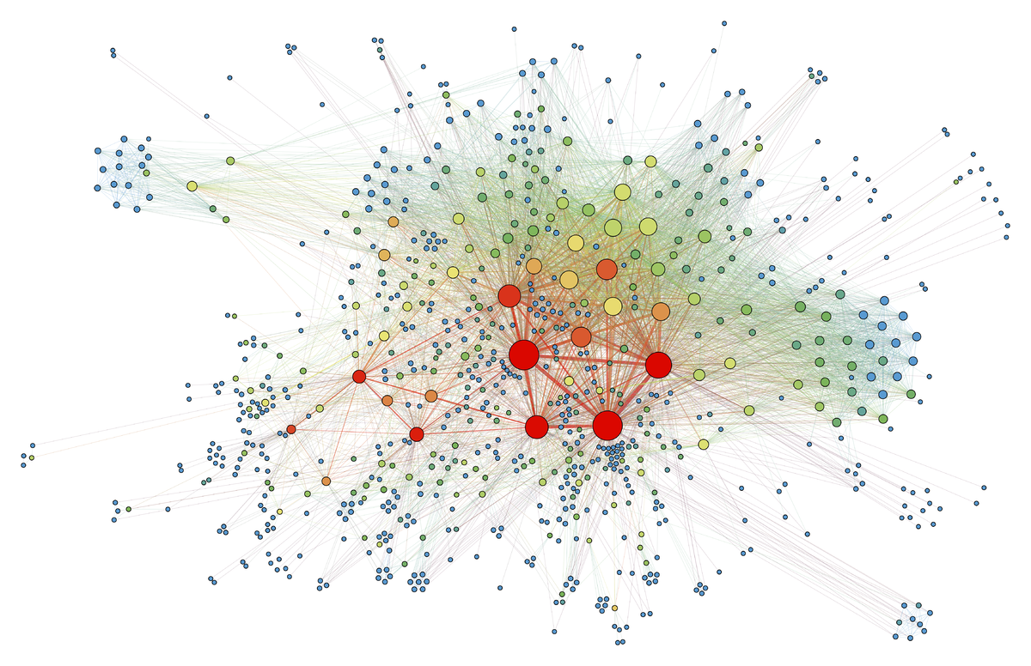
Data Network Basics

Slide 3
What is a Data Communications Network?
It is an infrastructure that contains connection nodes and transmission pathways which allow the reliable exchange of data between connected parties

Slide 4
Underlying Trends in Networks Today
The industry has evolved from a multitude of proprietary standards to the wholesale adoption of widely accepted standards
This has resulted in the ability of practically anyone to connect to the large public networks available without having to engage in special engineering
It has dramatically reduced the overall cost of deploying and operating networks

Slide 5
Shannon’s Data Communciation Model -- Six Components
An information source generates a message
A transmitter encodes the message as a signal
The signal is transmitted over a communications channel -- a medium that bridges the distance between the transmitter and the receiver
A source of noise is usually present in the communication channel -- this is a random element that modifies the encoded signal in unpredictable ways
The receiver extracts a signal from the communications channel and converts it back into the form of a message
The destination receives the message

Slide 6
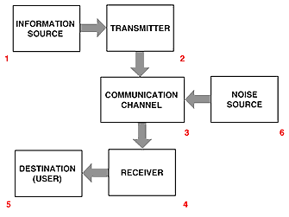
Shannon’s Model Illustrated
The six components of a data communications system:

Slide 7
Transmitting and Receiving using Modems
In data communications, data may be transmitted as either analog or digital (discrete) signals
Analog signals are composed of waves
repeating waveforms are modulated (altered) to encode information
Digital data must be translated into modulated analog signals for transmission and the signal must be translated back into digital data at the receiver
Special devices called modems (modulate/demodulate) are used to perform these translations

Slide 8
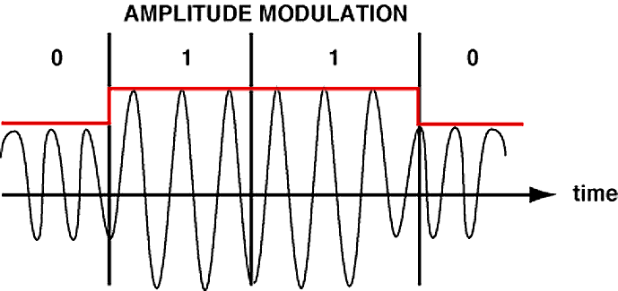
Translating Digital Data using amplitude modulation

Slide 9
Frequency Modulation
Copyright Gr Knott 1999
0 0 0 0 1 1 1 1 1 space 0 1 1 1 1 10 space
The diagram shows how the carrier varies in frequency corresponding to the data being transmitted

Slide 10
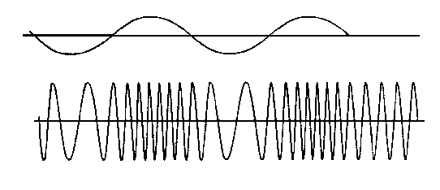
Modem Functionality
Modulate
1001
MODEM
MODM
MODEM
1001
Demodulate

Slide 11
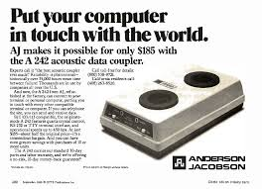

Slide 12
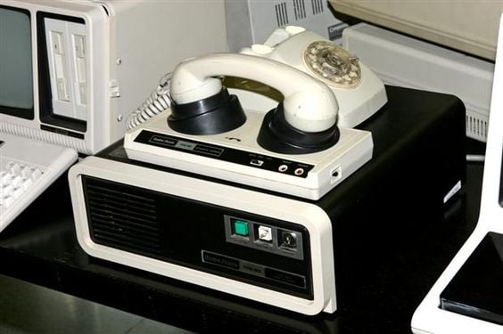
Before we had real modems we had this.
Acoustic Coupler and Modem circa 1975

Slide 13
Noise
In the transmission of information errors are thought of as noise.
The term comes from the early days of radio, where the transmission errors literally resulted in a noisy radio broadcast.
Noise is viewed as a (typically) random process.

Slide 14
Error Detection
Today’s communications systems usually incorporate error detection
This is achieved by adding additional data to a message that is calculated by the sum of all the bits in the message
When a message is received the sum is recalculated and compared to the received message. If it matches, no errors were present.
sum

Slide 15
Encoding Information
We encode analog information into digital for four reasons:
We need to represent it somehow in binary
We may need to compress the message size.
We may need to protect privacy and security.
We may need to detect (and possibly correct) error caused by noise

Slide 16
Channel Properties
Bandwidth - how much information can travel through it in a given amount of time. We often measure this in megahertz, but more intuitively we use bits/second.
Latency, how long does it take to get from one end to another.
Signal to noise ratio (SNR). The ratio of signal to noise expressed in decibels

Slide 17
Properties of Networks
Distance (geographical size)
Media (what carries the messages)
Signal (how is the information passed through the media).
Switching (handling many users )
Topology (the physical configuration of the network)

Slide 18
Distance
A local area network (or LAN) is typically confined to a single organization spread over a distance that can be easily walked.
A wide area network (or WAN) is typically serving multiple entities, and is spread much farther.
An internet is a network that includes multiple LANs and WANs

Slide 19
Media
We distinguish between bounded media (Often called Terrestrial) and wireless media..
Typical bounded media include
Twisted pair wire (about 10 megabits/sec)
Coaxial cable (about 50 megabits/sec)
FiberOptics (about 10 gigabit/sec)
Wireless media include:
Radio
Infared
Laser

Slide 20
Switching
One needs to switch between the messages of various users. Two basic method types:
Circuit switching - a connection is established between users until the message is complete. Your voice telephone works on this principle
Packet switching - messages are broken up into packets and multiple messages and packets are being carried at the same time over different paths

Slide 21
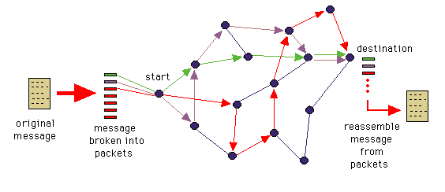
Packet Switching Example

Slide 22
Local and Wide Area Networks

Slide 23
Uses of LANs
Wide-area networks are primarily used for communication. Local-area networks are also used for local communication as well as resource sharing, including:
Printers
Computing and Web servers
File servers

Slide 24
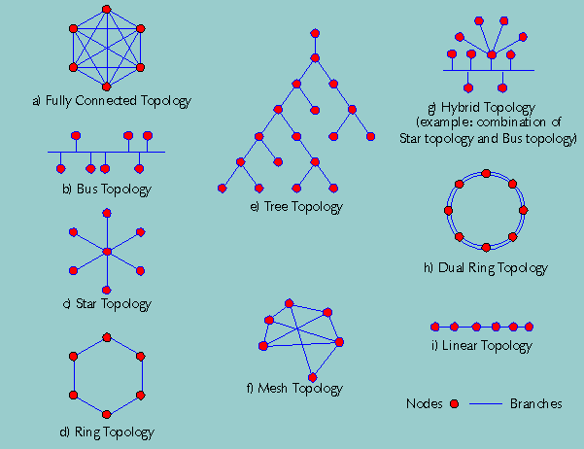
Network Topologies

Slide 25
LAN Topology
The topology of a LAN is the way the computers are connected together. There are several common configurations:
Star
Bus
Ring

Slide 26
Ethernet Switching
Ethernets use bus or ring topologies.
To send a message, wait for an idle moment and send it.
All machines constantly listen to the network for messages addressed to them.
If someone else picks the same moment to send we have packet collision.

Slide 27
Ethernet Packet Collision
Should packet collision occurs, both parties must re-send
But they must choose the moment randomly, or else they will re-collide
Packet collision limits the number of messages that can be send on ethernet LANs and determines the variable latency experienced by the users

Slide 28
Ethernet Bus
Internet
Swi
tch
Router
100 Mbps
Clients

Slide 29
Complicated LANs
LANs tend to grow. The Brown computer science LAN now has about 250 machines attached to it.
To handle this sort of traffic (and reduce the number of collisions) the LAN has been broken up into several sub-LANs.
Sub-LANs can be connected by switches and routers.

Slide 30
Switches and Routers
Switches allow messages to pass between one sub- LAN and another.
A switch simply notes if the recipient of the message is in the LAN, and if so, allows the message to cross over.
A router is used when there is more than one way to route the message and must be used to access the internet Wide Area Network

Slide 31
Interconnected Lans
Server
Swi
t
ch
Internet
switch
Server
Router
Clients
(PCs)

Slide 32
Hubs, Switches and Routers?
https://www.youtube.com/watch?v=1z0ULvg_pW8

Slide 33
Symmetry
Symmetric Networks are those where the data in both directions is more or less the same.
Asymmetric networks are characterized by a large difference between data in one direction vs. the other……Web Traffic, File Transfers(FTPs), etc.

Slide 34
Intranets
An Intranet is a closed network that has group of defined users
(Intra-organizational)
Intranets exist for businesses, universities, trade organizations, etc.
Most Intranets are also connected to the Internet

Slide 35
Network Nodes
Nodes are a location on a network where there is an aggregation of connections
Internet nodes are also those places where many smaller networks are actually connected to the Internet

Slide 36
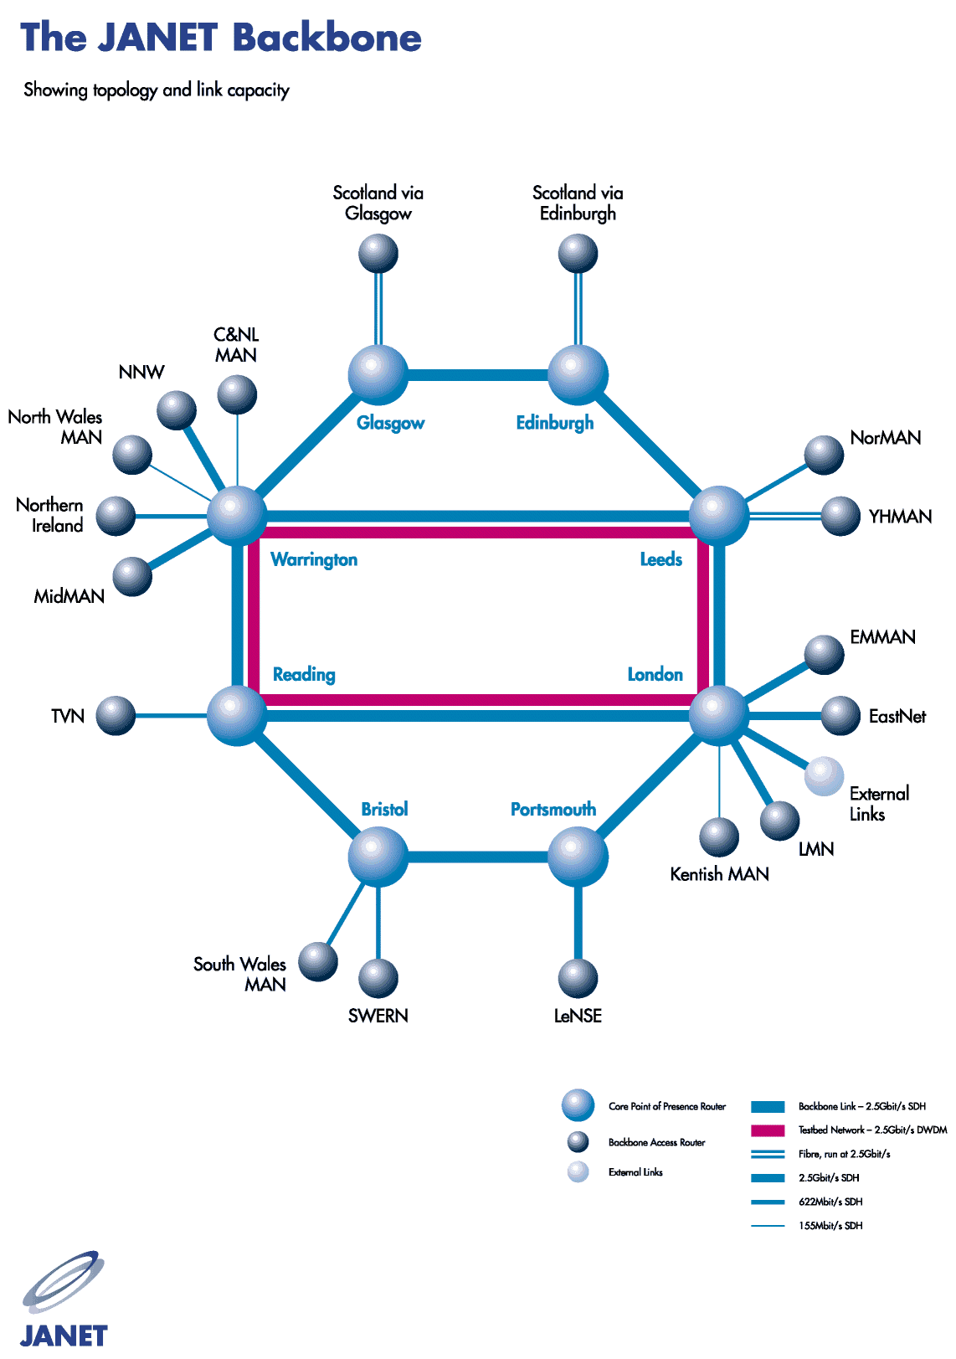

Slide 37
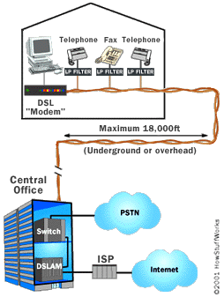
Digital Subscriber Loop - DSL
Allows high speed data to share the same wires as regular voice telephone service.
Developed for consumer internet access as an alternative to dialup

Slide 38
Voice and Video over IP (VOIP)
VoIP is a technology that allows telephone calls to be made over computer networks like the Internet. VoIP converts analog voice signals into digital data packets and supports real-time, two-way transmission of conversations using the Internet Protocol (IP)
Skype, Vonage, Ooma, WhatsApp, Facetime Zoom, etc:

Slide 39
Wireless Media
Infrared is good between fixed locations. It is also not bothered by noise.
Lasers are also excellent point to point systems with limited range
Radio frequency networks are more flexible and allow the participants to be mobile and move while they communicate

Slide 40
Wireless Networks
Radio data networks are the fastest growing type of network technology today.
This model is much like the terrestrial LANs we know and love except that it is total portable and works without cables and wall jacks!

Slide 41
Common Types of Data Wireless
WiFi (802.11b/g) High speed wireless with range up to 200 feet or so. Speeds up to 100mbps
BlueTooth – Personal Area Network with range of up to 30 feet
GPRS/3G/4G/5G – Wide area data network used in conjunction with cellular telephone services
VSAT – Small antenna satellite technology used for high speed data communication over very large distances

Slide 42
Mobile Wireless Networks aka…Cell Phones
Originally invented by Motorola in cooperation with AT&T in early 1970’s
Huge increase in usage as a result of the rapid adoption of cellphones worldwide (> 2.5 Billion subscribers and growing at double digit rates)
Two dominant cellphone technologies
GSM (Global system for mobile communications) (80%)
CDMA (Code Division Multiple Access) (20%)
Both technologies incorporate data along with voice and messaging
The cellphone system would not be possible without very sophisticated computing systems to enable it

Slide 43

The Original Cellphone – Motorola Dynatac 8000X
Cost $100 Million to Develop
First phones cost over $4K !! Motorola Dynatac
½ hour talk time
10 Hours to charge
Weighed almost 4 pounds

Slide 44
Cell phone history trivia
In 1978 AT&T commissioned Mackenzie research to project the market for cell phones in the U.S.
Mackenzie estimated that the total market by the year 2000 would be 1 million units
Today there are over 200 million cellphone subscribers in the U.S. alone and still growing
Mackenzie’s research did not anticipate the precipitous drop in handset cost which would make cell phones popular with consumers as opposed to businesses alone

Slide 45
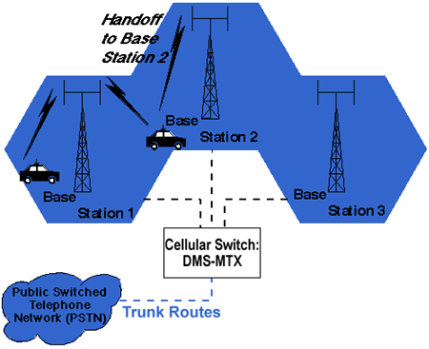
Cell phone topology

Slide 46
4th Generation and 5th Generation Wireless 4G and 5G
4G is the current mobile wireless standard
10 times faster than 3G
5-15 Mbps download, peak 50 Mbps
Enables full motion video
5G is the latest emerging standard
Still under deployment
Speeds over 1 Gbps!
Faster than typical cable connections

Slide 47

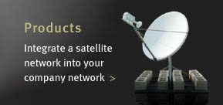
Satellite VSATs
Satellite in Geo Stationary orbit
VSAT dish <1 meter diameter
Very Small Apeture Terminal

Slide 48
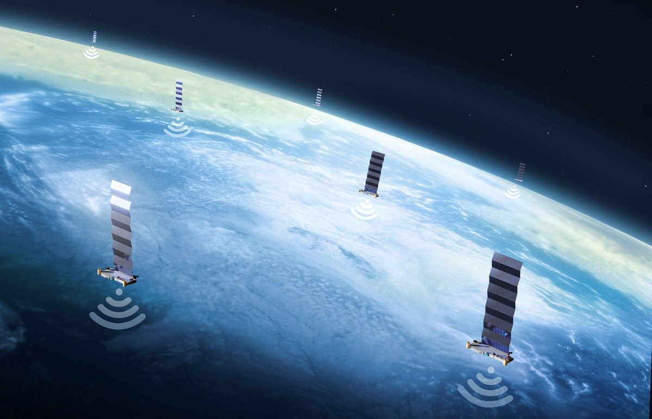
Starlink is launching 40,000
Low earth orbit satellites to provide Internet
access from everywhere on earth

Slide 49
Questions??
More reading:
https://computer.howstuffworks.com/router.htm

Slide 50
Millionaire Time!

