Slide 1
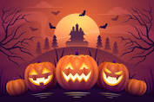

626 × 417
How to think like a Computer Programmer

Slide 2
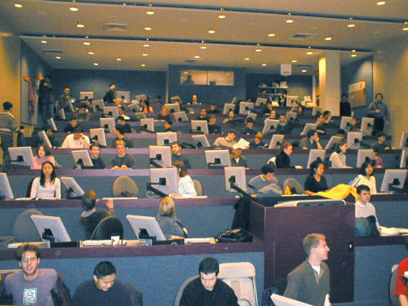
What is Computer Science?
Not using a computer
Not just programming
A field at the intersection of Math, Engineering, and all of the other sciences

Slide 3
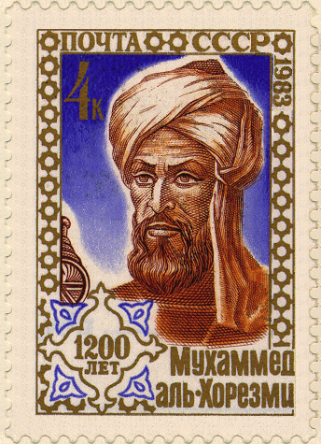
The Algorithm
Fundamental inventions in formal thinking:
Formal Logic (Athens, ~4 C. AD)
Mathematical Proof (Greece, ~585 AD)
Secular Observation of Nature (~600 AD)
Arabic Numerals, including Zero (India, ~8 C. AD)
Algebra (al-Khwarizmi, ~810 AD)
Probability (late 1500's)
Scientific Method (early 1600s)
Now: The Algorithm

Slide 4
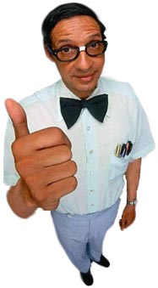
Computer Scientists
Who are Computer Scientists?
Computer Scientists study lots of things
e.g., "What are Algorithms Theoretically Capable of?“
Can Machines Think?
Today we're going to look at the applied version: Programming

Slide 5
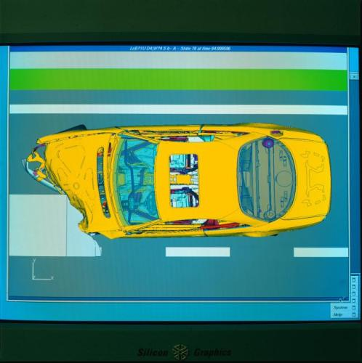
Computer Science as the New Literacy
The modes of thought that come from CS are influencing a huge number of fields
Modeling & Simulation
We can create all sorts of worlds inside the computer to work with

Slide 6
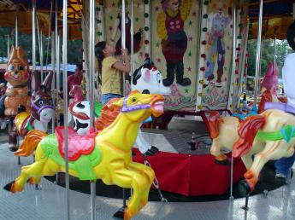
What does a computer do?
Computers internally just keep doing the same thing over and over:
Get the next instruction
Do whatever it says
Go back to step #1
But its internal instructions are in binary -- too hard for people to understand easily

Slide 7
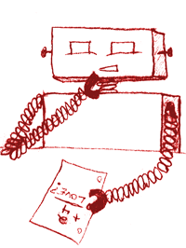
Natural Languages
Computers don’t understand English
Need to deal with
Ambiguity
Redundancy
Literalness
So, we express what a computer should do in a formal language

Slide 8
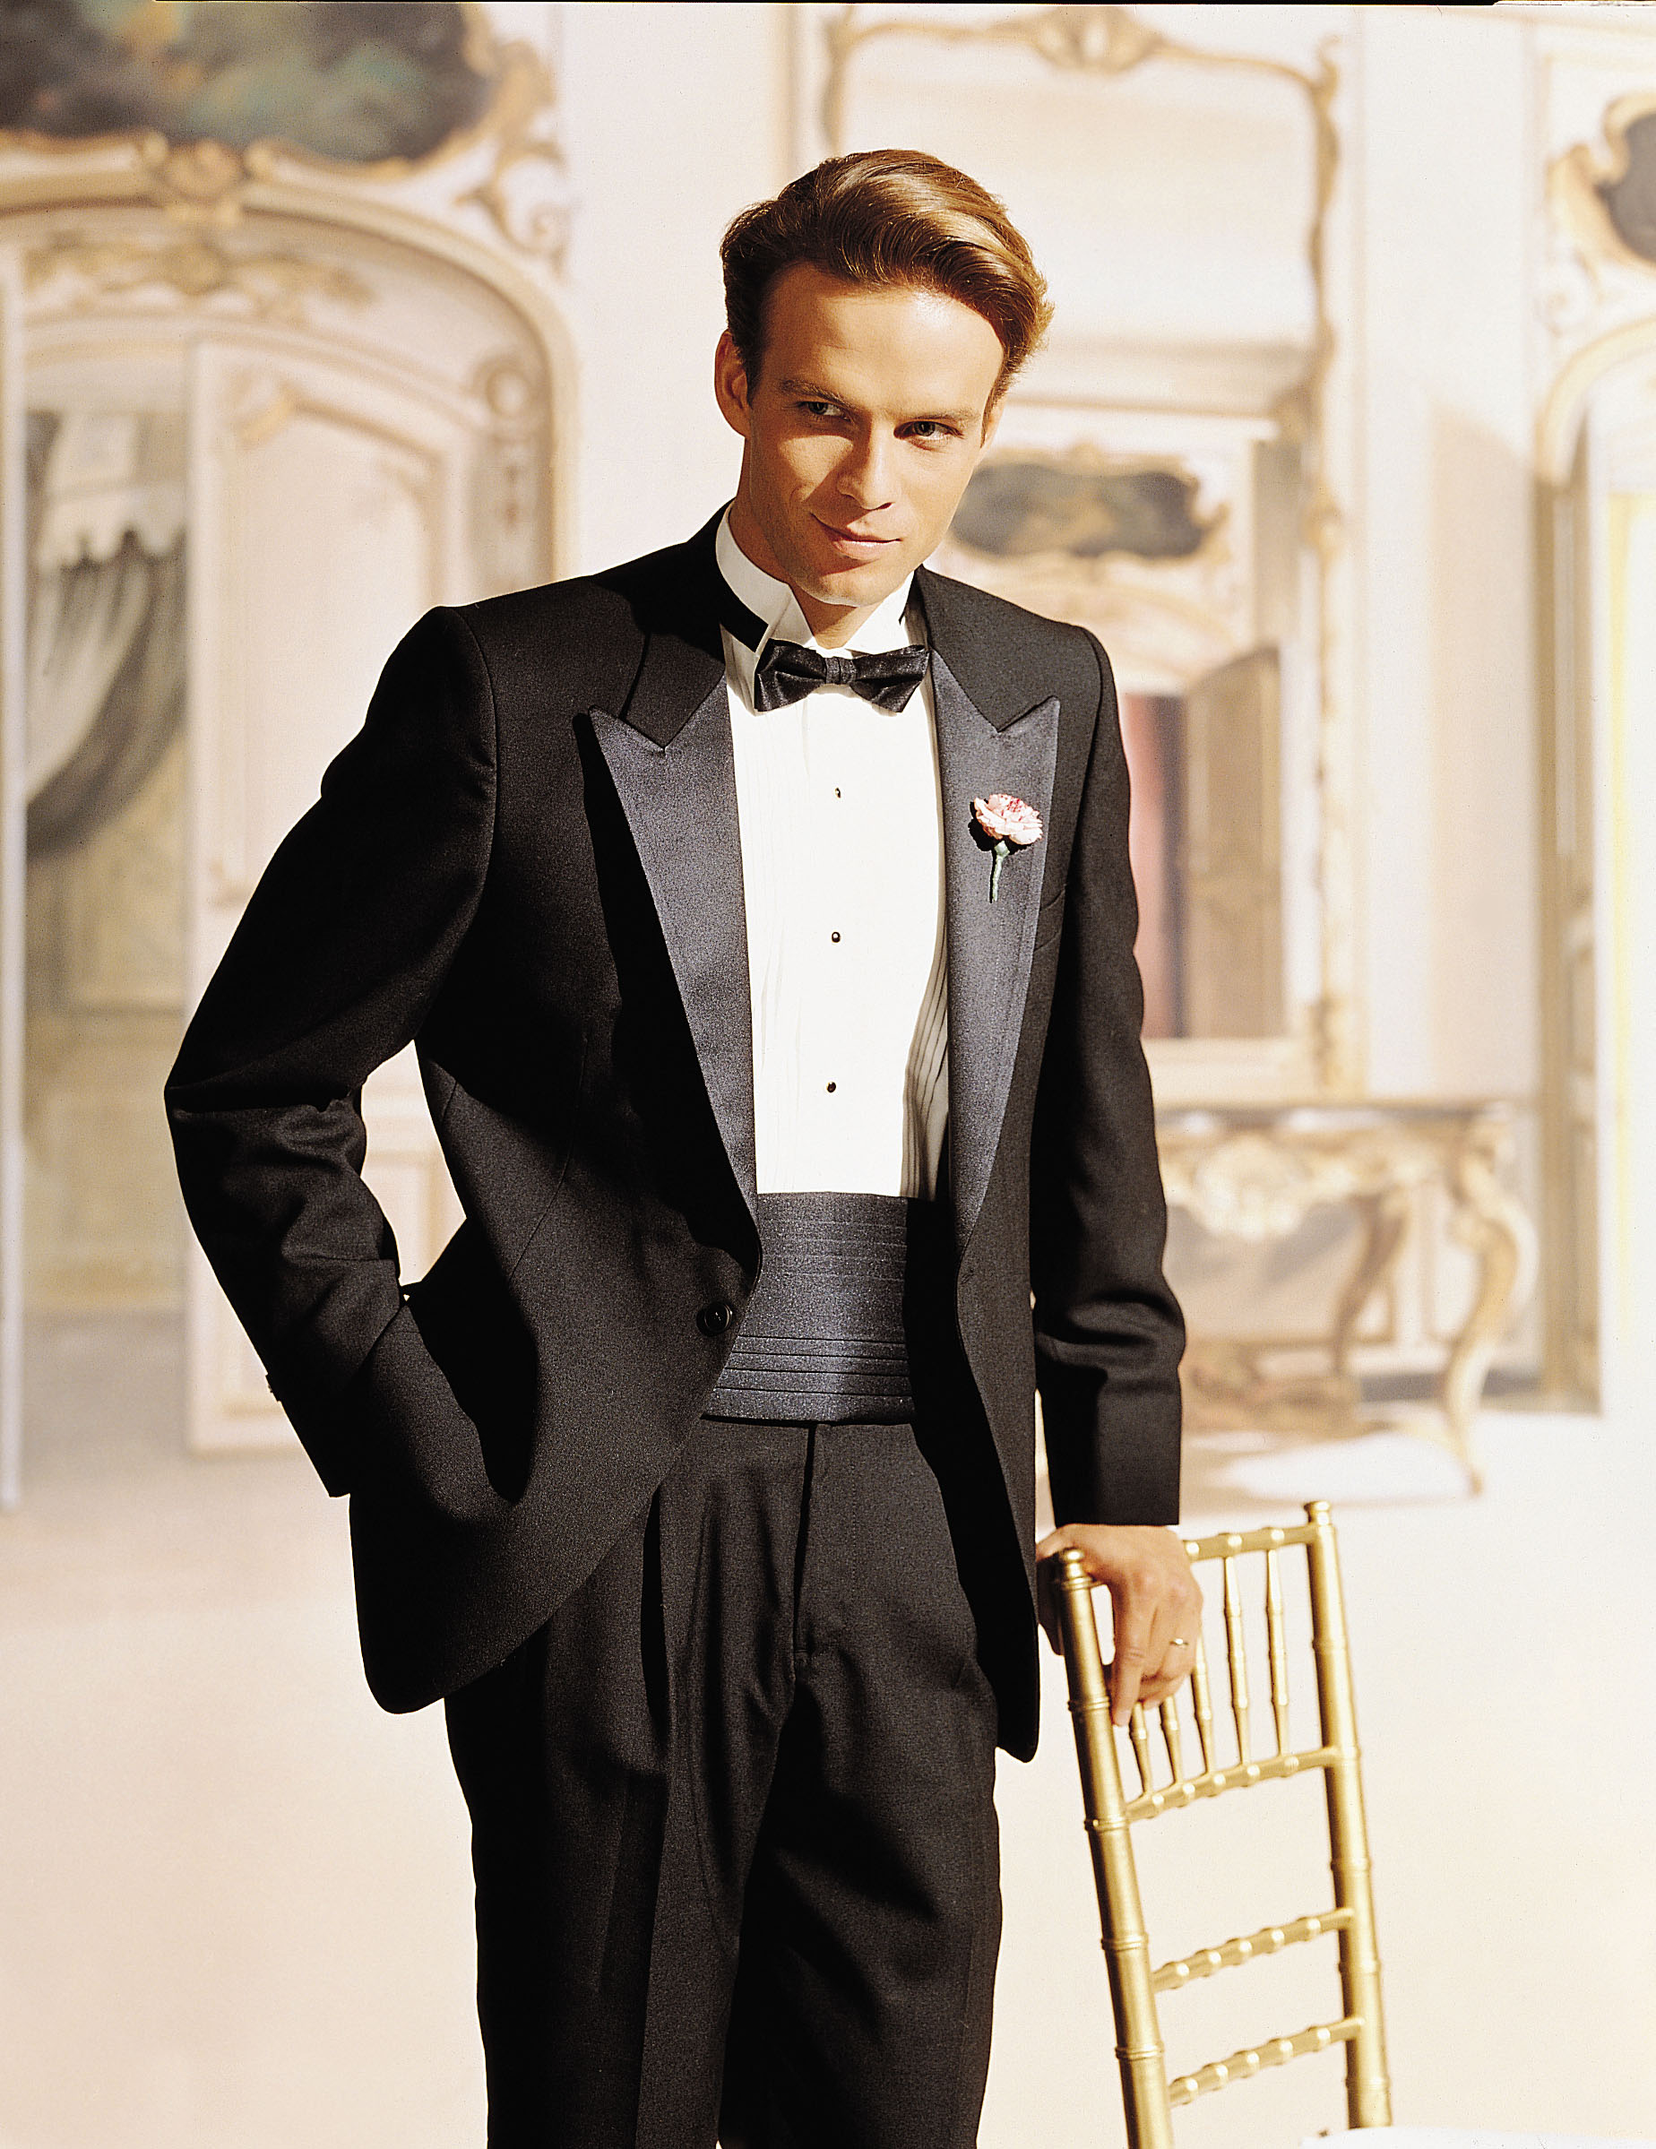
Formal Languages
A program usually just a document -- a written list of instructions
You saw some of this with HTML -- A markup language is sort-of a programming language
Poetry: Ambiguity and metaphor are important
Prose: Literalness and structure important
Program: Formal, precise structure

Slide 9
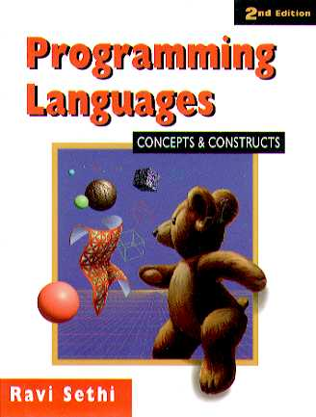
Programming Languages
Some simple ones are built in to programs you use every day
Excel is a programming language (and contains another)
Word Macro Language
There are also General Purpose Programming Languages
Java, Python, C, etc.

Slide 10
Simplifying how we instruct the machine
Matrix::Compute(double* values, int size) { for(int i=0; i<size; i++) { for(int j=0; j<size; j++) { if(i<j && values[i*size+j]<0.0) values[i*size+j] = values[j*size+i]; values[i*size+j] = 2*values[i*size+j]; }
High-level language
r
Interpreterr
1001010101101011010101010010101010111101 0000110101001110101011101011000110101001 0011010101010101010101101111010101010100 1111010101010101110101010101101110101011 0110101101011101000101010000101010101100 0100001010101010111110101010101011111111
Machine Code

Slide 11
Pseudocode
There are lots of details to programming languages
We’ll also use something called “pseudocode”
Most of the way to a programming language
Excludes some details
With some plain English mixed in

Slide 12
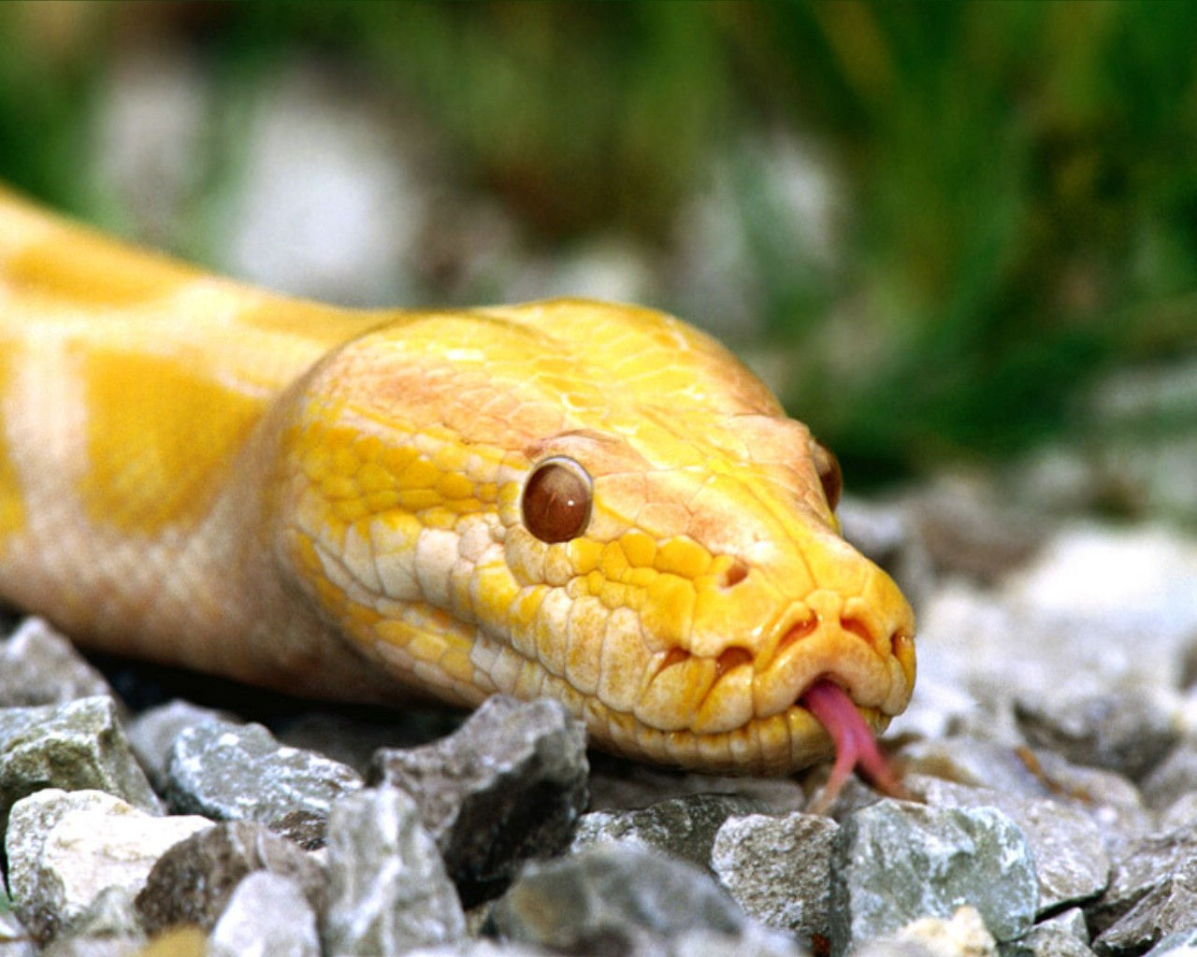
Some Core Concepts
(A quick taste of what you'll be learning in Python)
State
Expressions
Variables
Control

Slide 13
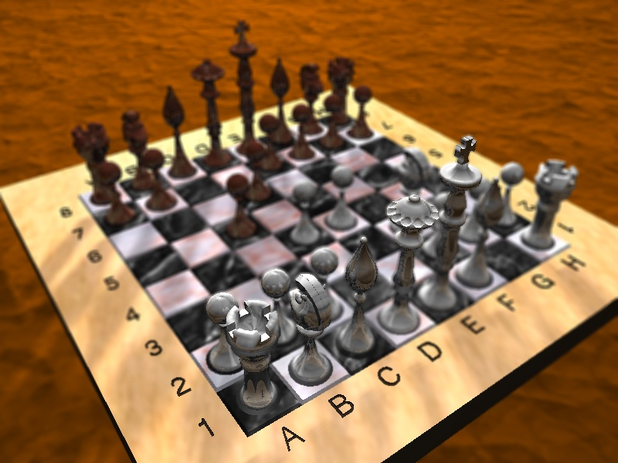
State

Slide 14
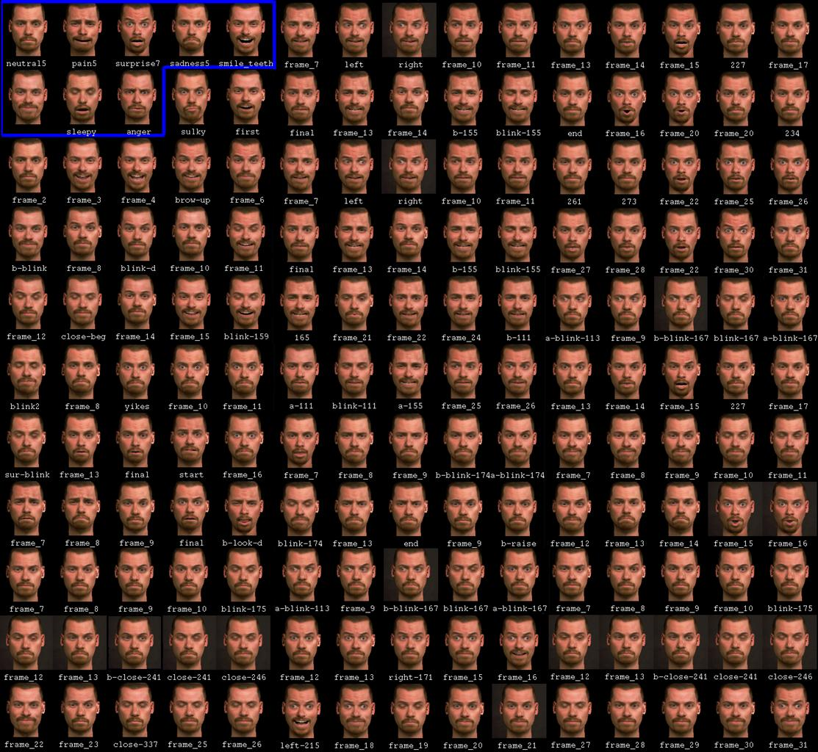
Expressions
> print “Hello”
Hello
> print (5+3) 8
>print (5*5-2) 23

Slide 15
Variables
Not exactly like Algebra
In Algebra x=5 (or 5=x) expresses a truth
In a program, x=5 updates something in the computer’s memory
(and 5=x wouldn’t work: it’s not a valid statement)
> x=0
> print (x)
0
> x=5
> print (x)
5

Slide 16
Control Structures
Lets you make decisions
if(x>5):
print (“x is big”)
Else:
print (“x is small”)

Slide 17
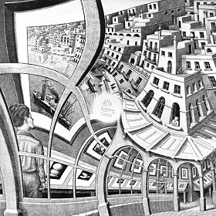
Programs
“The computer programmer is a creator of universes for which he alone is responsible. Universes of virtually unlimited complexity can be created in the form of computer programs.”

Slide 18
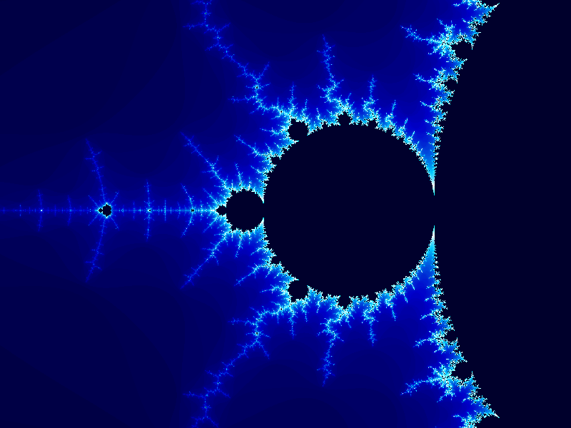
Complexity
Controlling complexity is the essence of computer programming
-Brian Kernigan

Slide 19
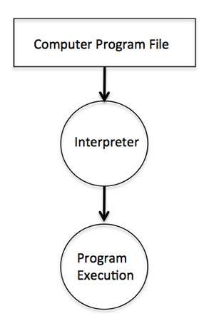
The Process

Slide 20
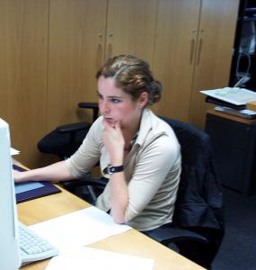
But what do you DO?
Design
Requirements
Use cases
Pseudocode
Formal Code
Test
Debug

Slide 21
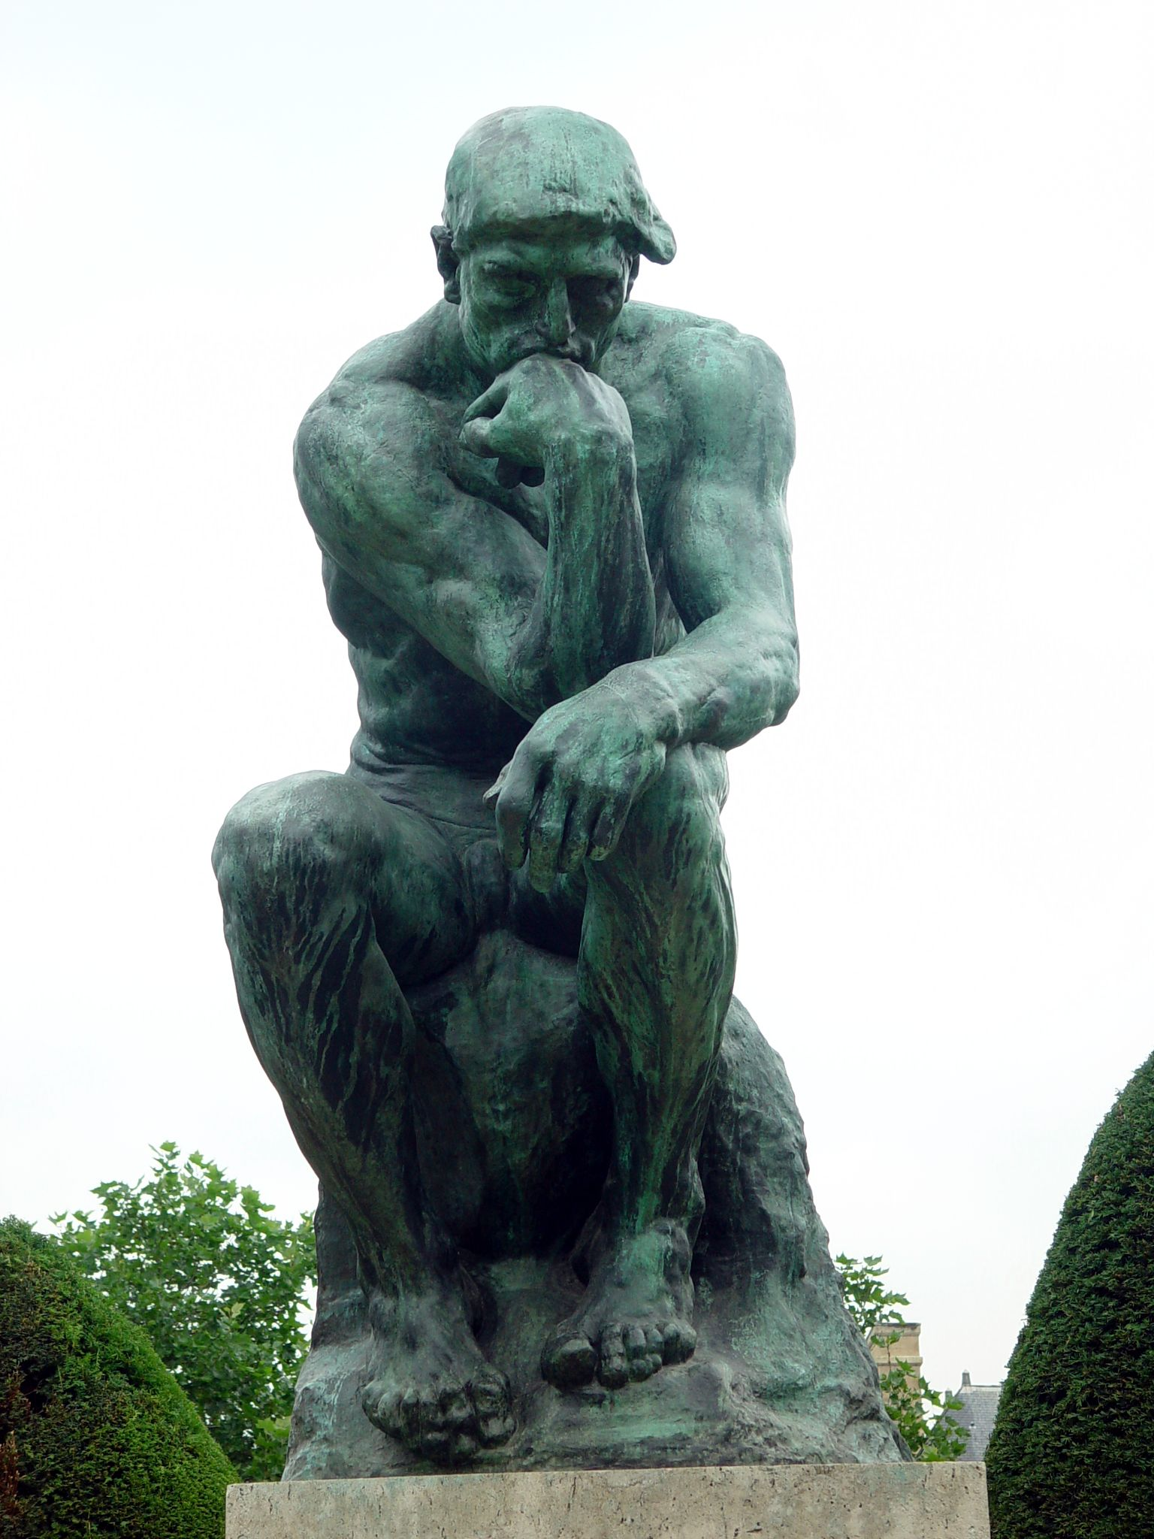
Design
Most programming is not done sitting in front of a computer
You need to really understand what the program will do
How it interacts with the user
And how it is structured internally

Slide 22
Mostly, when you see programmers, they aren't doing anything. One of the attractive things about programmers is that you cannot tell whether or not they are working simply by looking at them. Very often they're sitting there seemingly drinking coffee and gossiping, or just staring into space. What the programmer is trying to do is get a handle on all the individual and unrelated ideas that are scampering around in his or her head. Charles M Strauss

Slide 23
Test
Testing a complicated program is difficult
Some people write the tests before the programs
“Programming is like sex, one mistake and you have to support it for the rest of your life.”

Slide 24
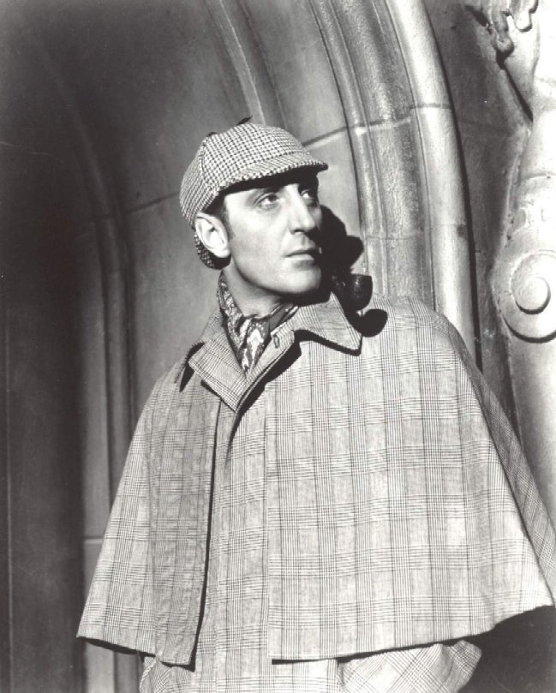
Debug
At the beginning, much of your time
In many ways more challenging than coding
When you have eliminated the impossible, whatever remains, however improbable, must be the truth. – Sherlock Holmes

Slide 25
Beginning Python

Slide 26
What is Python?
A REAL Programming Language!
Developed in 1990 by Guido Van Rossum in the Netherlands
Named after Monte Python’s Flying Circus!
Openly available at no charge!
Freely distributed on the Web
Lot’s of Libraries of Python Routines available
Increasingly popular for writing scripts for the Web

Slide 27
How does Python work?
It is an INTERPRETED Language, (Like HTML and Java) so that it is easy to write and execute programs in an interactive mode
It has a very clear and easy Syntax
It is portable so it runs on many different Operating Systems and Machines (Windows, MacOS, Linux, Unix, etc)

Slide 28
What are we going to do with Python in CS2?
Learn some basic commands and capabilities of the language
Printing data, evaluating expressions, inputting data, variables, loops, decisions, functions, boolean expressions
Learn how to use the programming environment (Interactive Development Environment)
Learn how to write simple but useful programs

Slide 29
What tools will you require?
You will need the Python Interpreter and programming environment
The Lab instructions will show you how to set up the development environment for Python

Slide 30
General Conventions
Python is Case Sensitive!…Be Careful!
Anything you name (variables, etc) must be referred to exactly as initially typed
Python Commands are always in lowercase!
Comments can be inserted anywhere by using a “#” before the comment text
Some commands require indentation to work properly

Slide 31
Variables
You can think of variables as labeled jars that store different types of data. While there are several kinds of variables, today we're only going to look at two:
String Variables
Number Variables

Slide 32
String Variables
Strings are literal collections of text characters
Strings must be enclosed in either single or double quotes
Strings may be manipulated by a variety of operators (repetition, concatenation, etc)
Concatenation example
word = “abc”
word = word + “def”
print (word) you will get: abcdef

Slide 33
More String Operations
String Repetition
word = “Yo! ”
print (word* 5)
Results in Yo!Yo!Yo!Yo!Yo!

Slide 34
String Variables
String - A string variable is a string of alphanumeric characters and allowed symbols that are contained within quotation marks. For example, "Hello world, I'm 102 years old today!" is an example of a string.
Strings are basically used for storing text
Example: greeting = “Good Morning Sunshine!”

Slide 35
Number Variables
Number - A number variable couldn't be more straightforward because all number variables store are numbers. You don't store them within quotes like strings. Instead, numbers can just be written as they are. If you want to store the number 9 in a variable, you just write 9
Example: my_bank_balance = 9
or…. pi=3.14

Slide 36
Our First Program
A program that prints a greeting!
print (“Hello, World!”)
When this program runs, it outputs… Hello, World!
The text inside of the quotes in the program is referred to as a String, or String Variable

Slide 37
Another way to achieve the same result
greeting = “Hello, World!”
print (greeting)
The output is Hello, World!
Note that we assigned the variable name greeting with the value of the literal string inside of the quotes.

Slide 38
Expressions
Another more complicated program:
print (“2 plus 2 is”, 2+2)
print (“3 times 3 is”, 3*3)
print (“35 divided by 5 is”, 35/5)
The output will be: 2 plus 2 is 4 3 times 3 is 9 35 divided by 5 is 7

Slide 39
Operations on Numbers
Operation Symbol Example
Exponentiation ** 5 ** 2 == 25
Multiplication * 2 * 3 == 6
Division / 14 / 3 == 4 14 / 3.0 == 4.6666
Remainder % 14 % 3 == 2
Addition + 1 + 2 == 3
Subtraction - 4 - 3 == 1

Slide 40
More Variable Assignment Examples
value = 4*8
net_price =4.56
repeat_word = “word” * 5
Variables are created and recognized dynamically, that is when they appear in your program with a value assigned to them
Variables must be assigned before you refer to them otherwise an error will occur
The values that are assigned to variables in Python are called Objects, each object having a reserved place in memory with a pointer connecting it to the assigned variable

Slide 41
Variable manipulation
Variables can be used in conjunction with themselves to affect certain operations;
Example:
speed=3
speed=speed+4
speed=speed*3
print (speed)
WHAT is the output of this program?

Slide 42
Printing variables
Variables may be printed by themselves or in succession
Example
number = 9
bignumber = 55
print (number)
print (bignumber)
print (number , bignumber)
(puts them on the same line)

Slide 43
Inputting Data into your program
We will focus on user input which is the simplest type and suitable for our purposes
Input command syntax is:
speed = input (“enter speed “)

Slide 44
Ok, so let’s write a simple program with the stuff that we have covered so far
# A simple program to check our travel progress
name = input ("enter your name: ")
speed = input ("enter your average speed: ")
time = input ("enter your exact travel time in hours: ")
print (name) + " your distance travelled is exactly " ,(speed*time), " miles”
print "Travel safely!!! The End"

Slide 45
Python Demo

Slide 46
“That's what's cool about working with computers. They don't argue, they remember everything and they don't drink all your beer.”

Slide 47
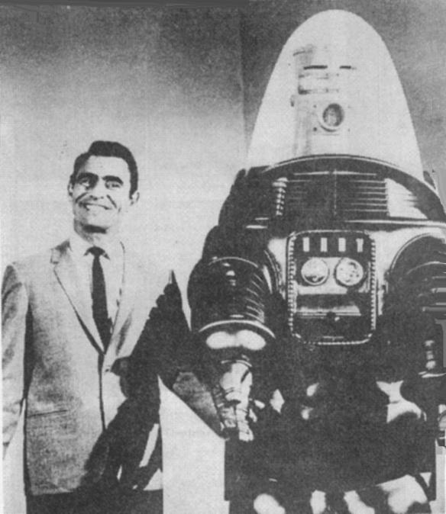
PB&J
Robot…

Slide 48
QUESTIONS?

