Slide 1
Lecture 8 Legal Issues in Computing

Slide 2
Some of the Dominant Legal Issues in Computing
Ownership
Intellectual Property Protection (IP)
Anti-Trust and Unfair Competition
File Sharing
Fraud
Negligence
Privacy (Covered later in Databases)

Slide 3
Ownership
When you write a piece of software or design a unique webpage, who owns it?
Answer: You Do!!
Who gets to decide who can use it and for what purpose?
Answer: You Do!!

Slide 4
What are some of your options?
You can give unrestricted free usage of it, otherwise known as Freeware or Shareware
You can license it, for a fee, with restrictions on its use
You can sell it, lock stock and barrel and transfer ownership altogether

Slide 5
Most common ownership model is licensing model
Typical restrictions may include:
Copy restrictions
Limited to certain number of computers
Limited to certain number of users
Limited in Time and must be renewed
Limited Geography of use
Limited Functionality

Slide 6
How do you protect your IP?
Copyright registration
Trademark registration
Patents ( for unique invention)
Copy protection
On-line registration for every new installation
Protect the source code!
Audits

Slide 7
Copyrights
Protects the arrangement of your design including the text, the graphics, the industrial design
Sometimes hard to prove infringement in a lawsuit and often left up to “interpretation” and common sense

Slide 8
TradeMark
A form of copyright which protects your public brand image and associated design of things like Logos and advertising material
McDonald’s Golden Arches is a classic example of this….

Slide 9
Patents
Reserved for protecting unique innovations and inventions that represent a “new” approach to solving a problem or creating a product or process
Takes a formal process of searches, filings and disclosures
Approximately 18 month process minimum and $5-10K in cost
Patents expire after 17 years in most cases

Slide 10
The Famous Apple vs. Microsoft lawsuit over Windows
Apple introduces the first commercial computer using a GUI, in 1983, based on pioneering work done by Xerox
Microsoft was set to introduce Windows 1.0 in 1985 and entered into an agreement with Apple to license and sub-license certain aspects of the GUI interface
In return, Apple was granted use of certain Microsoft products for its computers

Slide 11
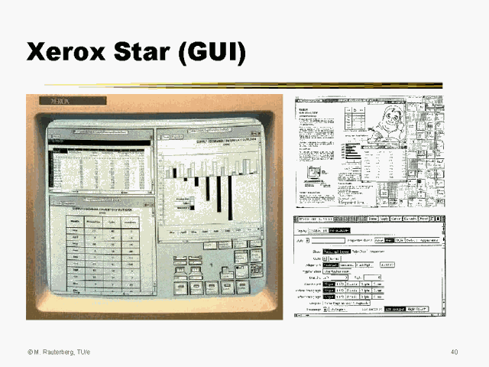

Slide 12
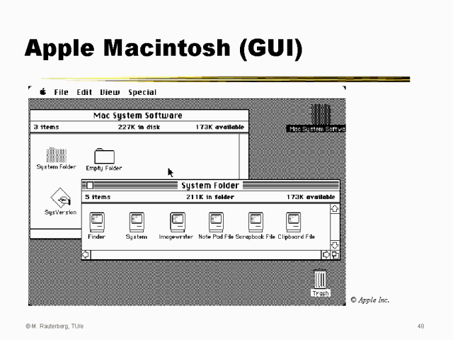

Slide 13
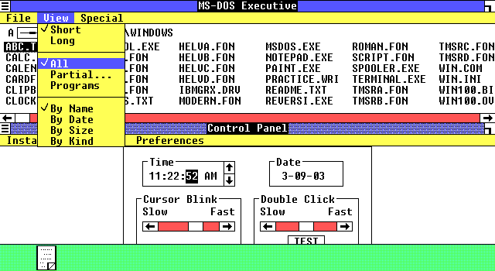
Windows 1.0 GUI
 | Desktop with applications in Windows 1.01. The screenshot has an extra border (remove) and wrong aspect ratio (correct).

Slide 14
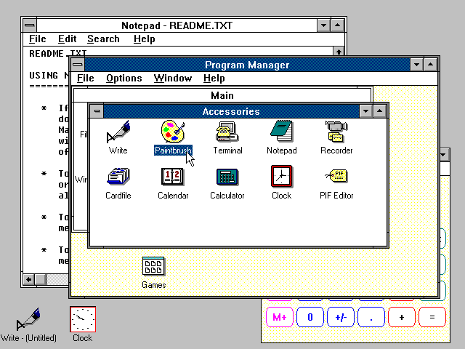
Windows 3.0

Slide 16
Apple vs. Microsoft
In 1988 Apple files a $5.5Billion lawsuit claiming patent infringement and breach of contract
At issue was Apple’s contention that Microsoft exceeded the terms of the license and used parts of the design that were not included in the license
And, Xerox then sues Apple claiming that its IP was infringed by Apple!

Slide 17
Apple vs. Microsoft
On September 19, 1994, the U.S. Court of Appeals upheld by a 3-0 vote a Federal District Court’s 1992 ruling that Microsoft’s Windows and displays (or graphical user interfaces) did not violate Apple’s copyrights in its Macintosh screen display
the District Court ruled that over 90 percent of Windows was within the scope of the original 1985 license agreement
It concluded that the remaining elements, such as various icons, were primarily graphical symbols representing generic ideas or purely functional components of the program, or were insufficiently original to merit copyright protection
A major flaw in Apple’s case was that Xerox was the inspiration for both Apple and Microsoft’s efforts

Slide 18
The GUIs are the problem!
Copyright law essentially protects the original expression of ideas in tangible form, such as books, artwork, music and computer software, from unauthorized copying, distribution or modification. It does not apply to ideas.
While it is well-settled that copyright protections extend to computer software, the extent to which copyright law protects screen displays has been the subject of much litigation, with many courts reaching varied results

Slide 19
Anti-Trust

Slide 20
Sherman Anti-Trust Act of 1890
Every contract, combination in the form of trust or otherwise, or conspiracy, in restraint of trade or commerce among the several States, or with foreign nations, is declared to be illegal.
Every person who shall monopolize, or attempt to monopolize, or combine or conspire with any other person or persons, to monopolize any part of the trade or commerce among the several States, or with foreign nations, shall be deemed guilty of a felony

Slide 21
Standard Oil
The Sherman Act was legislated in response to John D. Rockefeller’s attempts to monopolize the emerging oil industry through his company, Standard Oil
His son, John D. Rockefeller Jr., was a Brown alumnus and major benefactor to the University

Slide 22
U.S. versus IBM
By the 1960’s IBM dominated the computer industry with a >60% market share
In January 1969, the government began a sweeping antitrust investigation into IBM's dominance and attempted to break it into smaller companies that would compete against one another

Slide 23
U.S versus IBM
During the six most critical years of the trial, from 1975 to 1980, the parties called 974 witnesses and read 104,400 pages of transcripts
The 13-year investigation, which required IBM to retain 200 attorneys at one point, fizzled in the early '80s as the computing landscape shifted from mainframes to personal computers. The government abandoned the tainted effort entirely in 1982, as clones of the IBM PC eroded Big Blue's dominance

Slide 24
U.S. versus IBM
With IBM, the Justice Department was trying to hit a moving target, but the target had moved so much there was no point in shooting anymore--so they dropped the case
People who worked for IBM in the '80s and early '90s said the company routinely fell victim to "pricing death strategy"--a reluctance to lower prices below cost, even on products that weren't selling--to avoid what the government would call predatory pricing
Viewed today, the Government’s case against IBM appears ludicrous to many in retrospect

Slide 25
U.S versus Microsoft
In 1998 the Federal govt. filed a massive lawsuit against Microsoft which charged that it was in violation of anti-trust laws by having engaged in
Predatory conduct
Bundling
Exclusionary Contracts
As relates to the deployment of Microsoft Internet
Explorer at the expense of Netscape, a competing product

Slide 26
U.S. vs. Microsoft
Predatory Conduct
The lawsuit claims that Microsoft, by giving away Internet Explorer for free, is exercising unfair advantage against Netscape, which sells its browser. By doing so, Microsoft is drying the revenue of Netscape, driving the company out of business

Slide 27
U.S. vs. Microsoft
Bundling
Microsoft not only gave Internet explorer for free; it also started closely linking Windows to Internet explorer. The lawsuit claims that, by closely bundling Internet Explorer with Windows operating system, Microsoft has significant advantage over its rivals

Slide 28
U.S. vs. Microsoft
Exclusionary Contracts
The lawsuit claims that, by forcing Internet service providers (ISPs) to distribute Internet Explorers with their products, instead of other browser, and in turn providing a link in Windows to these ISPs, Microsoft has used its monopoly to take unfair advantage against the competition.
By providing discounts and incentives to manufacturers and Internet service providers Microsoft takes advantage and uses that advantage to gain monopoly in the browser market

Slide 29
Blood in the Water!
Sensing blood in the water, many additional lawsuits were filed by Microsoft’s competitors, by State attorney generals and several foreign governments, including the EEU.
At this time Microsoft has avoided a breakup of the Company but has had to make considerable concessions as part of settling some of the suits.
If Microsoft was a French company, there would be a statue of Bill Gates on the Champs Elysee!

Slide 30
Politics and Anti-Trust
The use of Anti-Trust suits by the Government is very related to the politics of the administration in power at the time.
The Microsoft suit was brought during the Clinton administration
Microsoft has dodged a lot of very serious bullets and remedies since the Bush administration has been in office

Slide 31

Anti-Trust Against Apple
Various lawsuits around the world have been filed against Apple for restriction of content associated with its iPod, iPhone and iPad products when using the iTunes and iPhone App Store.
Additionally there were cases pending against Apple and AT&T for restrictions on the purchase and operation of the iPhone

Slide 32

Anti-trust against
Evolving the Google Identity - Google Design.
Google Design.
Google being sued by the Justice Dept. for anti-trust related to its search engine which has been ruled to constitute a “Monopoly”
Sued by Epic Games for controlling payments related to downloads
Sued over the dominance of its advertising engine used on the Web

Slide 33
File Sharing
The legal debate centers on the issue of whether you have the right to share copyrighted material with other parties as opposed to making copies for your own personal use.

Slide 34
File Sharing Lawsuits
The Recording Industry Association of America filed many lawsuits against people trading unauthorized music online, including lawsuits against 69 people who allegedly used university networks to download music
Recent cases levied a fine of over $100K against a woman that shared files over Kazaa.

Slide 35
Brown U. Response
Brown University issued a statement reacting to the lawsuits: "Brown University has not yet received notice of the lawsuits announced today by the RIAA. If the University is served with a subpoena that meets the requirements of the law, Brown will comply as fully as possible. Until the University is served, however, it does not know the extent of the RIAA action. Any Brown student found in violation of the law will also be subject to University disciplinary action."

Slide 36
Debate rages on over swapping of music and videos
Despite the growth of legitimate, paid music-downloading services online, the legal, moral and economic debate over free music and video swapping shows no sign of being resolved soon.

Slide 37
IP Litigation involving Apple Inc.
A Very, Very long list in which Apple is both plaintiff and defendants at various times
It is fair to say that Apple has spent 100s of millions of dollars on litigation around its products, intellectual property and trade practices
http://en.wikipedia.org/wiki/Apple_Inc._litigation

Slide 38
Apple and Trademarks
Between just 2008 and 2010 Apple filed over 350 complaints over the improper use of its trademarks,
iPod, iPad, iTouch, iPhone, Apple and Safari

Slide 39
Apple vs. Samsung
In 2011 Apple alleged that Samsung used some of its IP in its Galaxy III cell phone
Apple was simultaneously suing Motorola for similar patent infringement
Known as the Mobile Patent Wars aimed at the incredible success of Android in the market, owned by Google

Slide 40
Apple vs. Samsung
Apple’s actions against Samsung eventually spread to 50 different lawsuits across more than a dozen countries
Samsung and Google countersued Apple in almost all cases
In August 2012 a U.S. Court held for Apple and assessed $1B in damages against Samsung

Slide 41
Apple vs. Samsung
Apple requested that Samsung be forced to stop selling its Galaxy Android based phones in the U.S. while the appeals are pending.
Largest single damages award in recent history.

Slide 42
So who is winning?
Apple has been largely successful against Samsung, with the bulk of rulings and court decisions going in Apple’s favor. Apple has also struck a blow against companies (like Motorola) using predatory licensing on standards-essential patents to seek bans on competing products, and can perhaps claim a moral victory with Samsung outright admitting some of its products copied Apple technology.

Slide 43
What have they actually won?
A settlement reached in 2018 appears to have prevailed after a slew of appeals
A jury awarded Apple $500M in damages
“And if I had to characterize it, it didn’t really accomplish anything,” said Brian J. Love, a Santa Clara University law professor who tracked the case. “Close to a decade of litigation, hundreds of millions of dollars spent on lawyers, and at the end of the day, NO products were removed from the market”

Slide 44
The Cost of Litigation
Who pays for these hundreds of IP lawsuits?
Ans: We Do! It’s built into the price of selling the product.

Slide 45
Read more here…..
https://www.nytimes.com/2018/06/27/technology/apple-samsung-smartphone-patent.html

Slide 46

Software enabled Fraud

Slide 47
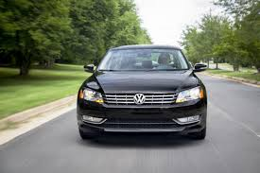
Volkswagon DieselGate !!
640 × 426

Slide 48
Volkswagen admits 11 million diesel cars have sneaky software installed !!!!

Slide 49
Possibly the most expensive Computer enabled fraud ever…so far
VW falsified emissions data for turbo diesel cars when they were being measured on the test station
Software changed the engine parameters and performance when car was actually being driven on the road and the car emissions increased substantially in real driving as opposed to testing
This deception was intentional and approved by senior managers at VW.
The fraud was initially discovered by student scientists at West Virginia U. who were comparing the performance of various turbo diesel cars as part of a research project.

Slide 50
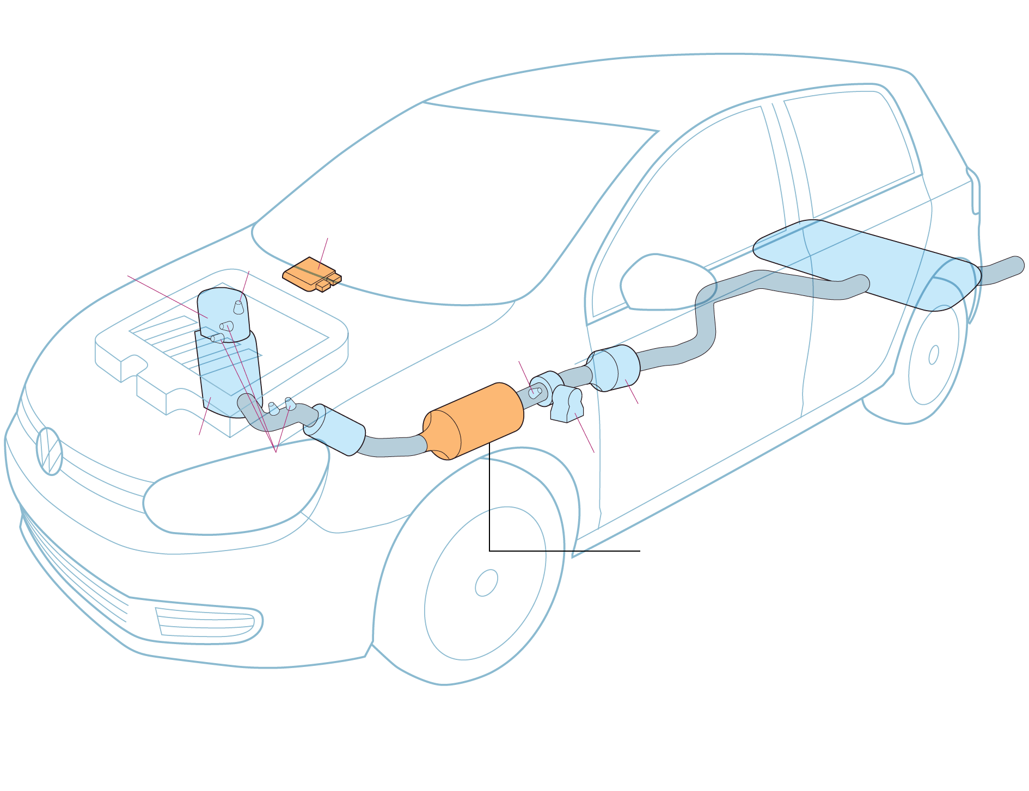
Anatomy of the VW Fraud
Controller
Nitrogen Oxide Capture Device

Slide 51
Consequences of “Dieselgate”
Over 11 million cars worldwide and half a million in the U.S. are implicated in the deception
VW has pledged $30B to rectify the problem and compensate owners!
In addition they have agreed to a $2.8B fine imposed by the U.S. Govt.
Criminal indictments have been handed down in Germany against senior leadership that is implicated in the scandal
VW stock lost over 50% of its value but has recovered
Similar issues are under investigation against Audi, Volvo, Renault, Fiat and Hyundai diesels

Slide 52

You can read the whole
story in detail here:
https://www.caranddriver.com/news/a15339250/everything-you-need-to-know-about-the-vw-diesel-emissions-scandal/

Slide 53
Negligence

Slide 54
Boeing 737 Max Airliner
In order to compete with the latest Airbus NEO airliner, Boeing decided to evolve the venerable 737, instead of designing a plane from scratch
In so doing, they selected new, more efficient turbofan engines which required that the engines be mounted in different location on the wing.
When they tested the new design they discovered that under some circumstances the nose of the aircraft would elevate, thereby increasing the possibility of a stall condition

Slide 55

Changing the engine position changes the flight characteristics of the plane

Slide 56
The solution - MCAS
Maneuvering Characteristics Augmentation System (MCAS)
MCAS was a new software module that compensated for the plane’s undesirable nose up condition
Boeing purposely failed to disclose the presence of MCAS, which ultimately led to two crashes, one in Indonesia and the other in Ethiopia with the loss of over 300 lives.
All 737 MAX aircraft were grounded for 18 months as a result and Boeing’s overall liability was estimated at $19B
The Federal Aviation Administration was also found to be complicit in Boeing’s behavior as they let Boeing self certify the 737 MAX

Slide 57
Read all about it…
https://simpleflying.com/boeing-737-max-story/

Slide 58
Questions?

