Slide 1
Capstone Project
Ideal location for Indian Restaurant in Dublin

Slide 2
Introduction/Business Problem
Stakeholders have hired me to investigate of into which neighbourhood in the city of Dublin is the best to open Indian Restaurant. As a data scientist, I’ll be developing a model to get some recommendation on which are to most ideal locations to invest.
I will be taking a city (Toronto), which is similar to Dublin in many ways. Toronto is also more developed in some categories, which Dublin is hoping to do in coming years. So these are one of the reasons investors are interested in opening a restaurant.
With the growing diverse population, a Indian Restaurant investment will be ideal setup if I am able to pin-point which are the best Neighbourhood to open this venture.

Slide 3
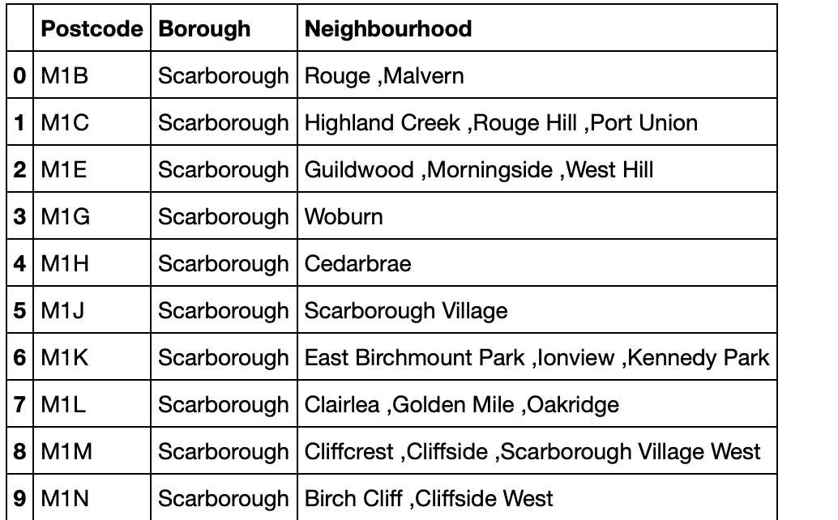
Data
Web scrapping to obtain the data that is in the table of postal codes from https://en.wikipedia.org/wiki/List_of_postal_codes_of_Canada:_M

Slide 4
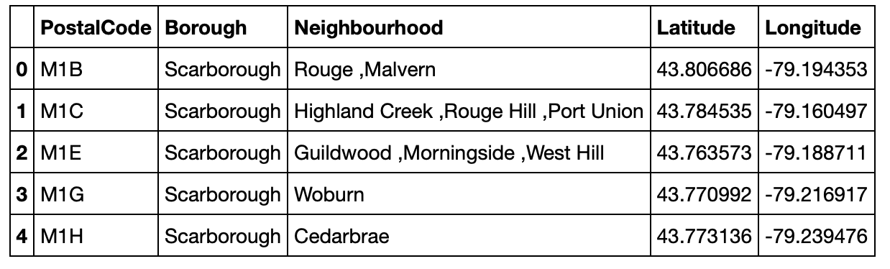
Get the latitude and longitude for each postcodes from http://cocl.us/Geospatial_data
Combine both datasets to contains Latitude and longitude for neighbourhoods.

Slide 5
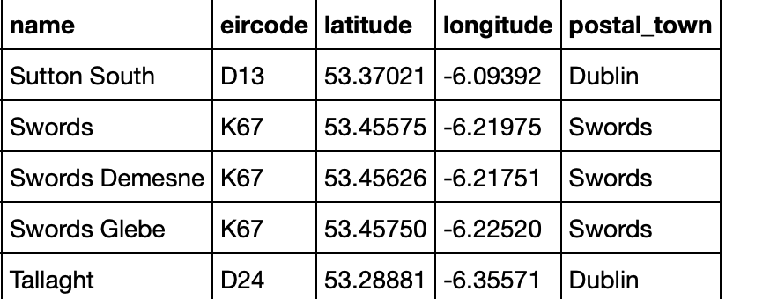
Downloaded Dublin town names with longitude and latitude from https://www.irelandtownslist.com

Slide 6
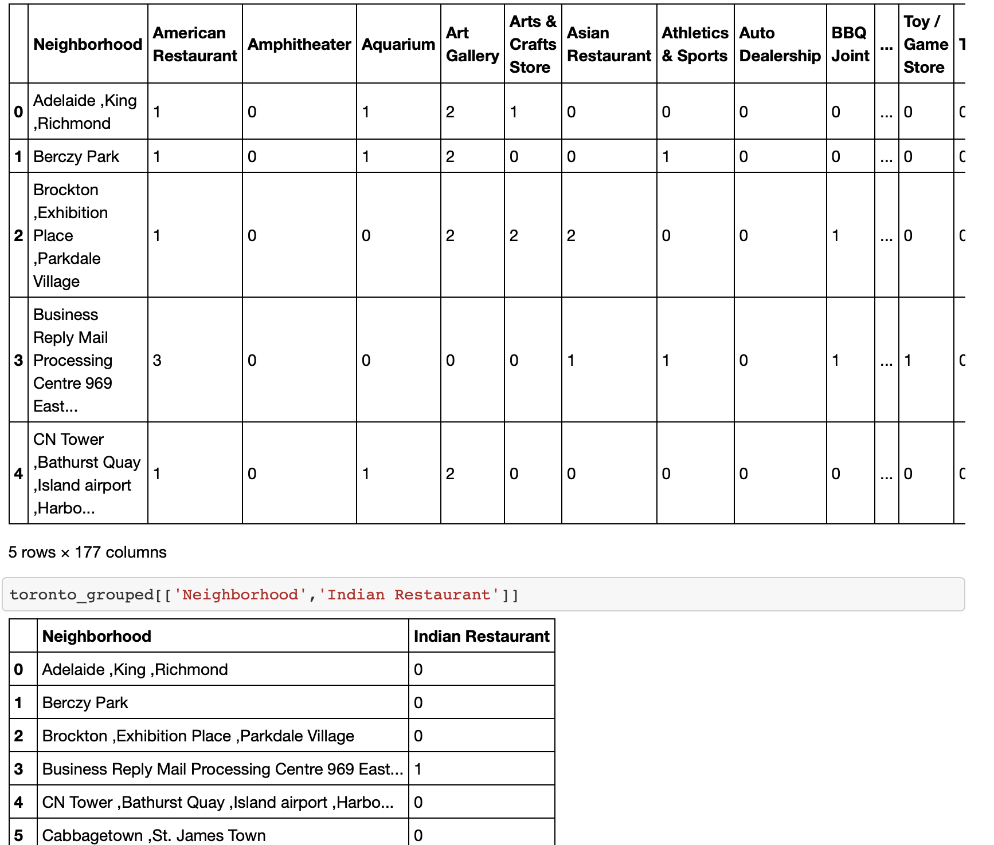
Using Foursquare API, we will get nearby venues to each neighbourhood and will also group it by ‘Indian Restaurant’.

Slide 7
Create a model that uses number of venues in neighbourhoods except Indian restaurants inputs and number of Indian restaurant as outputs. We’ll be building predictive model with SVR algorithm.
Then use Dublin neighbourhood as target to predict 10 ideal locations to start Indian Restaurant

Slide 8
Methodology
Used the following steps:
Learn how other venues around the Indian restaurant in a big city such as Toronto.
Build a model that can pride number of Indian Restaurants given the environmental venues information.
Predict number of Indian restaurant in Dublin.
Compare current existing numbers and recommend ideal locations.

Slide 9
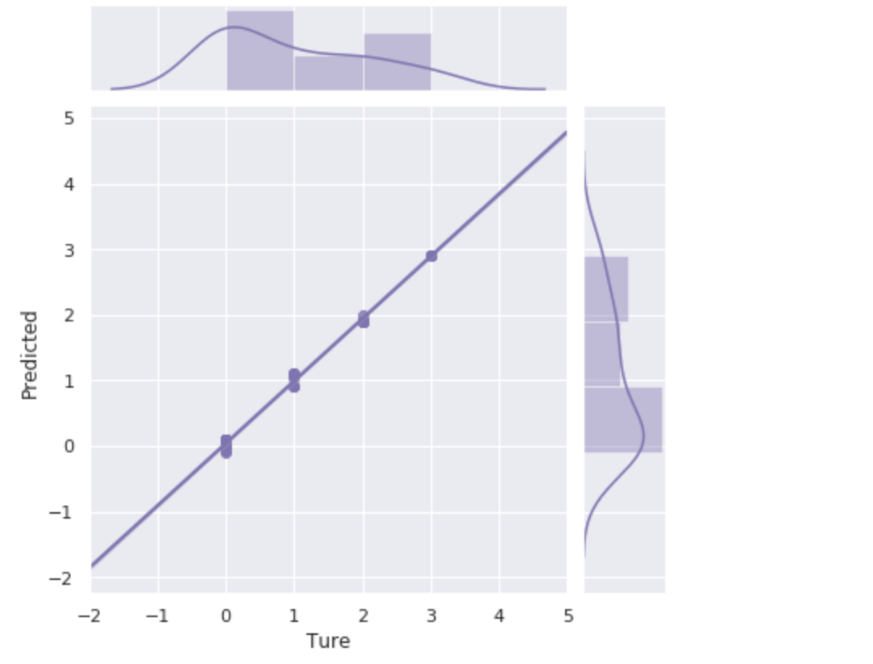
Build Model
Create a model that uses number of venues in neighbourhoods except Indian restaurants inputs and number of Indian restaurant as outputs. We’ll be building predictive model with SVR algorithm.
Train the dataset the plot prediction from the model and true values

Slide 10
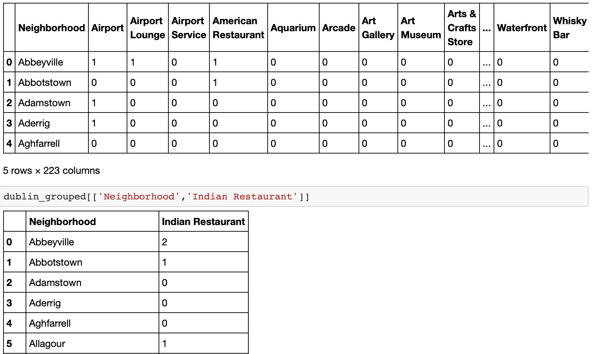
Use foursquare API and get venue information for Dublin towns similar to Toronto

Slide 11
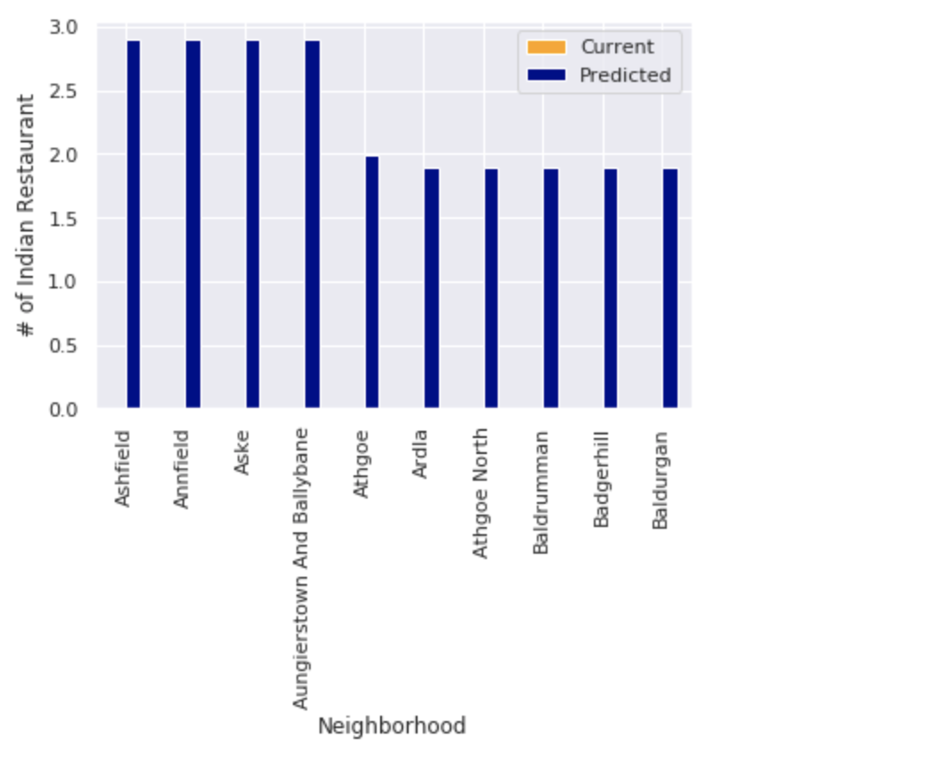
Predicted locations using the model
Using this model, it provided best 10 ideal location in the city of Dublin for our investors to start an Indian Restaurants.

Slide 12
Conclusion
Using Foursquare API we extracted venue locations for both cities
SVR algorithm was used to build the model
The model was able to get the investors the top ideal locations for starting an Indian Restaurant.

