Slide 1


16CS207: Formal Languages and Automata Theory
(FLAT)
P.Ramadoss
Assistant Professor,
Department of Information Technology,
VFSTR (Deemed to be)University,
Guntur, Andhra Pradesh.

Slide 2
Textbook
Introduction to Automata Theory, Languages and Computation.
By J.E. Hopcroft, and Ullman
^{2rd} Edition
Pearson/Prentice Hall India, 2007.
Notes:
Cpt S 317: Automata & Formal Languages
School of EECS, WSU

Slide 3
Automata Theory
Automata (singular: automation) are abstract models of machines that perform computations on an input by moving through a series of states.
At each state of the computation, a transition function determines the next conﬁguration on the basis of a finite portion of the present state.

Slide 4
Automata Theory
An automaton has a mechanism to read input, which is string over a given alphabet. This input is actually written on an input tape /file, which can be read by automaton but cannot change it.
Input ﬁle is divided into cells each of which can hold one symbol. Automaton has a control unit which is said to be in one of finite number of internal states. The automation can change states in
a deﬁned way.

Slide 5
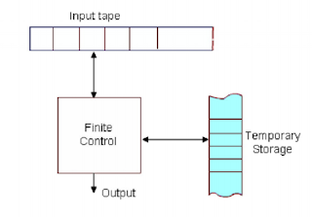
Finite Automata
Fig: Diagrammatic representation of a
generic automation

Slide 6
Finite automata
A finite automata consists of a finite memory called input tape, a finite non empty set of states, an alphabet, a read-only head, a transition function which defines the change of configuration, an initial state and a finite-non empty set of final states.
Input tape is divided into cells and each cell contains one symbol from of which can hold one symbol.

Slide 7
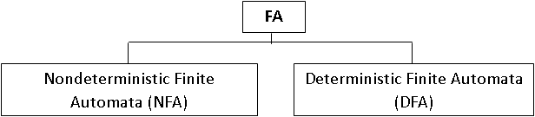
Types of Finite Automata:
Note: Both NFA and DFA are capable of recognizing what regular expression can denote.

Slide 8
Deterministic Finite Automata(DFA)
Definition
A deterministic ﬁnite automaton is defined by a quintuple (5-tuple): A = (Q, ∑, 𝛿, qo, F).
Where,
Q = Finite set of states,
∑= Finite set of input symbols,
𝛿= A transition function that maps Q X ∑ → Q
qo: A start state; qo∈Q
F= Set of ﬁnal states; F ⊆ Q.

Slide 9
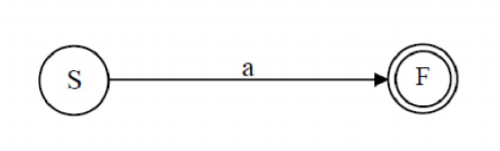
A transition function 𝛿 that takes as arguments a state, an input symbol and returns a state.
In our diagram, is represented by arcs between states and the labels on the arcs.
If s is a state and a is an input symbol then 𝛿(p,a) is that state q such that there are arcs labeled ‘a’ from p to q.

Slide 10

General Notations of DFA:
There are two preferred notations for describing automata.
1. Transition Diagrams
2. Transition Tables
1. Transition Diagrams
A transition diagram for a DFA A = (Q, ∑, 𝛿, qo, F). is a graph
defined as follows:
For each state is node represented by circle.
(q is State)
Notes:
Cpt S 317: Spring 2009
School of EECS, WSU

Slide 11


General Notations of DFA:
A start stat is represented by a circle with preceding arrow labeled at start.
Final state is marked by a double circle (q is Final State)
(q is Final State)
Notes:
Cpt S 317: Spring 2009
School of EECS, WSU

Slide 12
General Notations of DFA:
For each state q in Q and each input a in ∑ , if 𝛿(q, a) = p
then there is an arc from node q to p labeled a in the
Transition diagram.
If more than one input symbol cause the transition
from state q top then arc from q to p is labeled by a list
of those symbols.
𝛿(q,a)=p
Notes:
Cpt S 317: Spring 2009
School of EECS, WSU

Slide 13
Example #1
Build a DFA for the following language:
  L = {w | w is a binary string that contains 01 as a substring}
Steps for building a DFA to recognize L:
  ∑ = {0,1}
  Decide on the states: Q
  Designate start state and final state(s)
  δ: Decide on the transitions:
“Final” states == same as “accepting states”
Other states == same as “non-accepting states”
Notes:
Cpt S 317: Spring 2009
School of EECS, WSU

Slide 14

DFA for strings containing 01
What makes this DFA deterministic?
1
0,1
start
0
1
q₀
q₁
q₂
Accepting
state
Q = {q₀,q₁,q₂}
∑ = {0,1}
start state = q₀
F = {q₂}
Transition Table
symbols
0
1
q₀
q₁
q₀
states
q₁
q₁
q₂
*q₂
q₂
q₂
Notes:
Cpt S 317: Spring 2009
School of EECS, WSU

Slide 15
Language of a DFA
A DFA A accepts string w if there is a path from q₀
to an accepting (or final) state that is labeled by w
i.e., L(A) = { w | δ(q₀,w) ∈ F }
I.e., L(A) = all strings that lead to an accepting
state from q₀
Notes:
Cpt S 317: Spring 2009
School of EECS, WSU

Slide 16
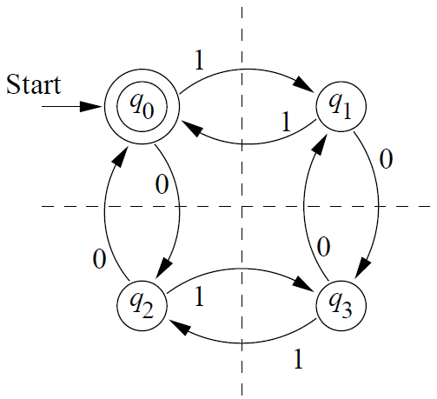
Example #2
DFA accepting all and only strings with an
even number of 0's and an even number of 1's.
Notes:
Cpt S 317: Spring 2009
School of EECS, WSU

Slide 17
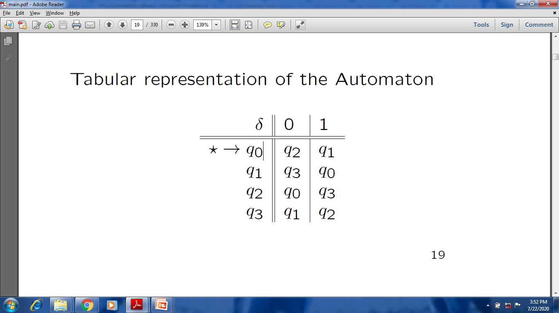
Transition Table
Q = {q₀,q₁,q_{2,} q₃}
∑ = {0,1}
start state = q₀
F = {q₀}
Notes:
Cpt S 317: Spring 2009
School of EECS, WSU

Slide 18
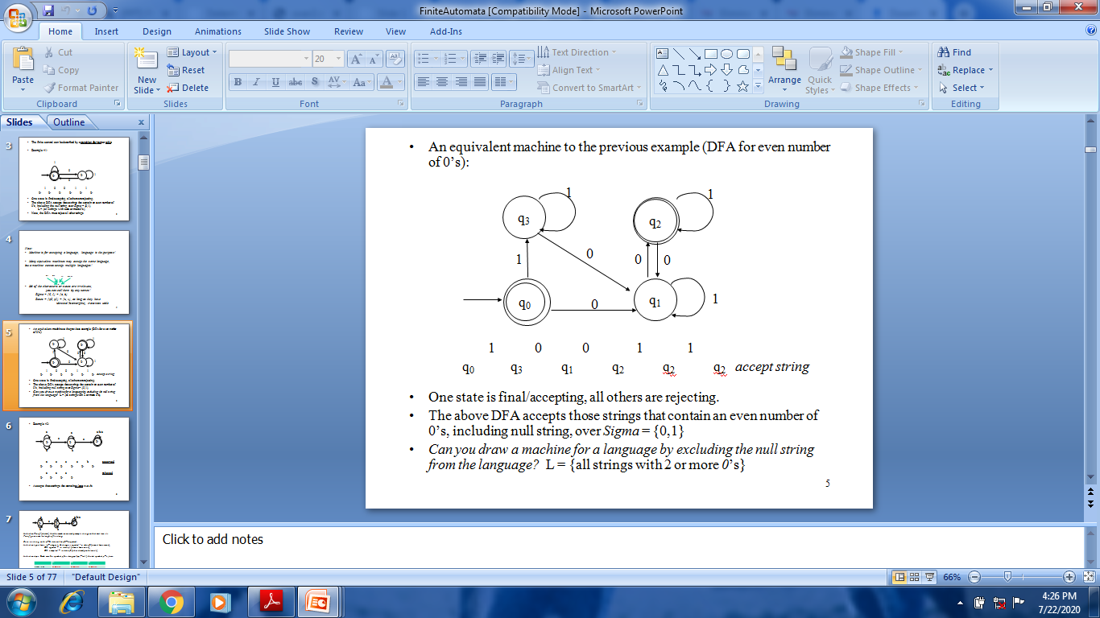
Example #3
DFA accepting all and only strings with an even number of 0's.
Notes:
Cpt S 317: Spring 2009
School of EECS, WSU

Slide 19
Transition Table
δ | 0 | 1
 | q₁ | q₃
 | q₂ | q₁
 | q₁ | q₂
* | q₁ | q₃
q₀
q₁
q₂
q₃
Notes:
Cpt S 317: Spring 2009
School of EECS, WSU

Slide 20
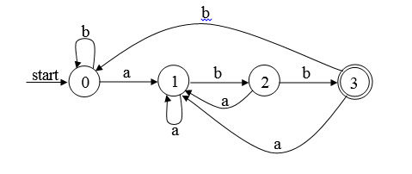
Example: The following figure shows a DFA that recognizes the language (a|b)*abb

Slide 21
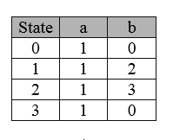
Example: The following figure shows a DFA that recognizes the language (a|b)*abb
The Transition Table is:

Slide 22
Non-deterministic Finite Automata (NFA)
A Non-deterministic Finite Automaton (NFA)
consists of:
  Q ==> a finite set of states
  ∑ ==> a finite set of input symbols (alphabet)
  q₀ ==> a start state
  F ==> set of accepting states
  δ ==> a transition function, which is a mapping
  between Q x ∑ ==> subset of Q
An NFA is also defined by the 5-tuple:
  {Q, ∑ , q₀,F, δ }
Notes:
Cpt S 317: Spring 2009
School of EECS, WSU

Slide 23
How to use an NFA?
Input: a word w in ∑*
Question: Is w acceptable by the NFA?
Steps:
  Start at the “start state” q₀
  For every input symbol in the sequence w do
  Determine all possible next states from all
    current states, given the current input symbol
    in w and the transition function
  If after all symbols in w are consumed and if
  at least one of the current states is a final state
  then accept w; Otherwise, reject w.
Notes:
Cpt S 317: Spring 2009
School of EECS, WSU

Slide 24
NFA for strings containing 01
Why is this non-deterministic?
What will hapen if at state q₁
an input of 0 is received?
0,1
0,1
start
0
1
q₀
q₁
q₂
Final
state
symbols
0
1
q₀
{q₀,q₁}
{q₀}
states
q₁
Φ
{q₂}
Q = {q₀,q₁,q₂}
Σ = {0,1}
start state = q₀
F = {q₂}
Transition table
*q₂
{q₂}
{q₂}
Regular expression: (0+1)*01(0+1)*
Notes:
Cpt S 317: Spring 2009
School of EECS, WSU

Slide 25
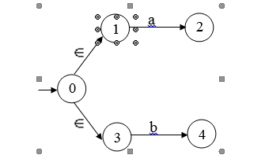
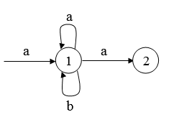
Non-Deterministic Finite Automata (NFA)
NFA: means that more than one transition out of a state may be possible on a same input symbol.
Also a transition on input ɛ (ɛ-transition ) is possible

Slide 26
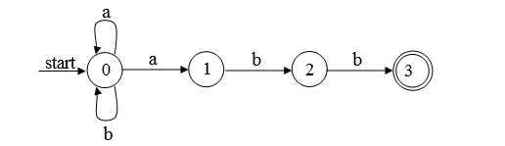
Example #1 : The NFA that recognizes the language (a | b)*abb is shown below:

Slide 27
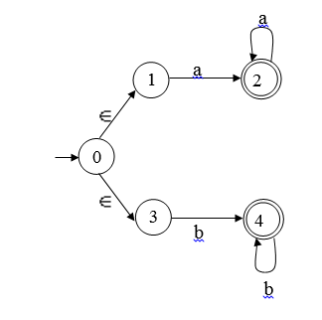
Example #2 The NFA that recognizes the
language aa*|bb* is shown below:
a

Slide 28
Language of an NFA
An NFA accepts w if there exists at least one path from the start state to an accepting (or final) state that is labeled by w.
L(N) = { w | δ (q₀,w) ∩ F ≠ Φ }
Notes:
Cpt S 317: Spring 2009
School of EECS, WSU

Slide 29
Differences: DFA vs. NFA
But, DFAs and NFAs are equivalent in their power to capture langauges !!
DFA
All transitions are deterministic each transition leads to exactly one state.
Accepts input if the last state visited is in F
Sometimes harder to construct because of the number of states.
4. Practical implementation is feasible
NFA
Some transitions could be non-deterministic A transition could lead to a subset of states
Accepts input if one of the last states is in F
Generally easier than a DFA to construct
4. Practical implementations limited but emerging (e.g., Micron automata processor)
Notes:
Cpt S 317: Spring 2009
School of EECS, WSU

Slide 30
Summary
DFA
  Definition
  Transition diagrams & tables
Regular language
NFA
  Definition
  Transition diagrams & tables
DFA vs. NFA
Notes:
Cpt S 317: Spring 2009
School of EECS, WSU

Slide 31
Exercise
1.Give DFA’s accepting the following strings over
the alphabet {0,1}:
a) The set of all strings beginning with 101.
b) The set of all strings containing 1101 as a substring.
c) The set of all strings with exactly three consecutive 0’s.
Notes:
Cpt S 317: Spring 2009
School of EECS, WSU

Slide 32
THANK YOU
Notes:
Cpt S 317: Spring 2009
School of EECS, WSU

