Slide 1
19IT212 - Formal Languages & Automata Theory and Compiler Design

Slide 2
Introduction to Automata Theory UNIT-1 II B.TECH – II SEMESTER SUB.CODE: 19IT212

Slide 3
COURSE OBJECTIVES
This course introduces the concepts of design Deterministic finite Automata, Non-Deterministic finite Automata, lexical analyzer, parser, code generation and code optimization techniques. The objective of this course is to enable the student to acquire the knowledge of various automata and various phases of compiler.

Slide 4
COURSE OUTCOMES
Apply different finite state machines for
solving a given language.
2. Understand the different phases of
compiler with various examples.
3. Apply different Parsing and optimization
techniques in the design of compiler.
4. Analyze and compare various translators
to select optimum.
5.Design a compiler for simple programming
languages.

Slide 5
TEXT BOOK:
1. Hopcroft and Ullman, “Introduction to
Automata Theory, Languages and
Computation”,2nd edition, Pearson/Prentice
Hall India, 2007.
2. Aho, Ullman and Ravisethi, “Compilers
Principles, Techniques and Tools”, 2nd
edition,Pearson Education, 2014.
3. Sipser, “Introduction to Theory of
computation”, 2nd edition, Thomson, 2016.

Slide 6
Characteristics of Natural Languages:
• In most of the situations – meaning depends on
the context.
• They are developed for communication among
the Human beings.
• Human beings are capable or trained to interpret
a sentence depending on the situations.
• Where as, Machine are not in Context.
• Machine will not be able to interpret depending
on the situation.

Slide 7
Characteristics of Formal Languages:
Meaning of a word or sentence does not depend on the context.
• Words and sentences have only one meaning
irrespective of the context.
• They are simple.
• Easy to write Compilers and Interpreters
• They are precise in their meaning.
• With this Machine do what they are instructed to
do

Slide 8
Why Study Automata Theory?
Finite automata are a useful model for many important kinds of software and hardware:
Software for designing and checking the
behavior of digital circuits.
2. The lexical analyzer of a typical compiler, that
is, the compiler component that breaks the
input text into logical units.
3. Software for scanning large bodies of text,
such as collections of Web pages, to find
occurrences of words, phrases or other
patterns.

Slide 9
What is Automata Theory?
Study of abstract computing devices, or “machines”.
Automaton = an abstract computing device
Note: A “device” need not even be a physical hardware!

Slide 10
Introduction to Automata Theory
Automata theory : The study of abstract
computing devices, or ”machines”.
Before computers (1930), A. Turing studied an abstract machine (Turing machine) that had all the capabilities of today’ s computers (concerning what they could compute).

Slide 11
Finite Automata:Some Applications
Software for designing and checking the
behavior of digital circuits.
Lexical analyzer of a typical compiler.
Software for scanning large bodies of text
(e.g., web pages) for pattern finding.
Software for verifying systems of all types that have a finite number of states (e.g., stock market transaction, communication/network protocol)

Slide 12
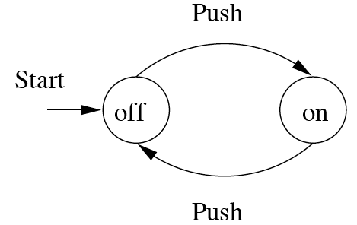
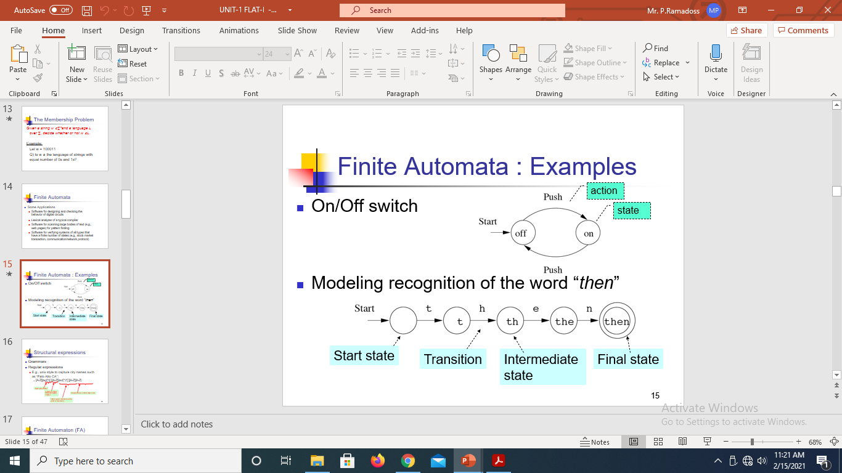
Finite Automata:Some Example
On/Off switch
Modeling recognition
of the word “then”

Slide 13
Alphabet
An alphabet is a finite, non-empty set of symbols
We use the symbol ∑ (sigma) to denote an alphabet
Examples:
Binary: ∑ = {0,1}
All lower-case letters: ∑ = {a,b,c,..z}
Alphanumeric: ∑ = {a-z, A-Z, 0-9}
DNA molecule letters: ∑ = {a,c,g,t}
The set of all ASCII characters

Slide 14
Powers of an alphabet
If ∑ is an alphabet, we can express the set of all strings of a certain length from that alphabet by using the exponential notation:
∑^{k}: the set of strings of length k, each of whose is in ∑.

Slide 15
Powers of an alphabet
∑^{0 :} {ε }, regardless of what alphabet ∑ is. That is ε is the only string of length 0
If ∑= {0,1},then:
1. ∑¹ ⁼ {0,1}
2. ∑² ⁼ {00, 01, 10, 11}
3. ∑³ ={ 000, 001, 010, 011, 100,
101, 110, 111 }

Slide 16
Powers of an alphabet
Let ∑ be an alphabet.
∑^{k} = the set of all strings of length k
∑* = ∑⁰ U ∑¹ U ∑² U …
∑⁺ = ∑¹ U ∑² U ∑³ U …

Slide 17
Powers of an alphabet
Note: confusion between
1. ∑ is an alphabet; its members 0
and 1 are symbols.
2. ∑¹ is a set of strings; its members
are strings (each one of length 1)

Slide 18
Strings
A string (or sometimes a word) is a finite sequence of symbols chosen from some alphabet
Example: 01101 and 111 are strings from the binary alphabet ∑ = {0, 1}
Empty string: the string with zero occurrences of symbols.
Empty string is ε (or “epsilon”)
This string is denoted by Q and may be chosen from any alphabet

Slide 19
Strings
Examples of strings:
∑ = {a, b}
Strings derived from ∑ are…..
….. ε , a, b, aa, ab, ba, bb, aaa, aab, aba, ..
∑ = {0, 1}
Strings derived from ∑ are…..
….. ε , 0, 1, 00, 01, 10, 11, 000, 001, 010, ..

Slide 20
Strings
Examples of strings:
∑ = {a}
Strings derived from ∑ are…..
….. ε , a, aa, aaa, aaaa, aaaaa, aaaaa, ....

Slide 21
Functions on Strings
Length : to find the length of a string Operator used | |
Example: 01101 has length 5
There are only two symbols (0 and 1) in the string 01101, but 5 positions for symbols
Notation of length of w: |w|
Example: |011| = 3 and |ε | = 0

Slide 22
Functions on Strings
Examples of Concatenation of a string
• x = good, y = student
Concatenation operation x||y or xy
xy = goodstudent
Examples of Reversal of a string
• (abc)^{R} = cba
• x= ab, y=cd, (xy)^{R} = dcba
• x^{R} y^{R} =badc

Slide 23
Functions on Strings
Defn: A string s is a proper substring of a string t iff s is a substring of t and s ≠t
Examples:
S = good then proper substrings are ..
..... ε, g, go, goo only

Slide 24
Kleen star
∑*: The set of all strings over an alphabet ∑.
{0, 1} * = {ε, 0, 1, 00, 01, 10, 11, 000, . . .}
∑* = ∑⁰ U ∑¹ U ∑² U …
The symbol ∗ is called Kleene star and is named after the mathematician and logician Stephen Cole Kleene.

Slide 25
Kleen star
∑⁺ = ∑¹ U ∑² U ∑³ U …
Thus: ∑* = ∑⁺ ∪ {ε}

Slide 26
Concatenation
Define the binary operation . called concatenation on ∑* as follows:
If a1a2a3 . . . an and b1b2 . . . bm are in ∑* , then
a₁a₂a₃ . . . a_{n}. b₁b₂ . . . b_{m} =
a₁a₂a₃ . . . a_{n}b₁b₂ . . . b_{m}

Slide 27
Concatenation
Thus, strings can be concatenated yielding another string:
If x are y be strings then x.y denotes the
concatenation of x and y, that is, the string
formed by making a copy of x and following
it by a copy of y

Slide 28
Concatenation-Examples
1. x = 01101 and y = 110
Then xy = 01101110 and
yx = 11001101
For any string w, the equations ε w = w ε = w hold.
That is, ε is the identity for concatenation
(when concatenated with any string it yields
the other string as a result)

Slide 29
Languages
Defn.: A language is (finite or infinite) set of strings over a finite alphabet Σ
Example if Σ = { a } following languages can be derived
• Language L1= {a, aaa, aaaaa, aaaaaaa,.......}
• Language L2= {ε, aa, aaaa, aaaaaa,.......}
• Language L3= {a, aaaaa, aaaaaaaaa,.......}
• Language L4= {a, aaa, a7, a9 , a13 , ....}
Note: number of languages that can be derived even from singe alphabet set is INFINITE

Slide 30
Languages
Let L = {w ϵ {a, b}* : all string begin with a}
L={a, ab, aab, abbbb, ...}
Strings not in L are:
{b, ba, ε, bbbbb, baaaaaa,
…..}
Let L = {w ϵ {a}* : |w| is even}
L={ε, aa, aaaa, aaaaaa,
aaaaaaaa, ..}
Strings not in L are:
{a, aaa, aaaaa, aaaaaaa, …..}
//odd no of a’s

Slide 31
Languages
L(M) is the notation for a language defined by
a machine M.
The machine M accepts a certain set of
strings, thus a language.
L(G) is the notation for a language defined by a
grammar G.
The grammar G recognizes a certain set of
strings, thus a language.

Slide 32
Languages
Examples:
Let L be the language of all strings consisting of n 0’s followed by n 1’s: L = {ε , 01, 0011, 000111,…}
Let L be the language of all strings of with equal number of 0’s and 1’s:
L = {ε , 01, 10, 0011, 1100, 0101, 1010, 1001,…}

Slide 33
Important operators on languages: Union
The union of two languages L
and M, denoted L ∪M, is the set
of strings that are in either L,
or M, or both.
Example
If L = {001, 10, 111} and
M = {ε, 001} then
L ∪ M = {ε, 001, 10, 111}

Slide 34
Important operators on languages: Concatenation
The concatenation of languages L and M,
denoted L.M or just LM , is the set of strings
that can be formed by taking any string in L
and concatenating it with any string in M.
Example:
If L = { 001, 10, 111 } and
M = {ε, 001} then
L.M = { 001, 10, 111, 001001, 10001, 111001 }

Slide 35
Important operators on languages: Concatenation
Example:
If L = { 001, 10, 111 } and
M = {ε, 001} then
L.M = { 001, 10, 111, 001001, 10001, 111001 }

Slide 36
Important operators on languages: Closure
The closure of a language L is denoted L*
and represents the set of those strings that
can be formed by taking any number of
strings from L, possibly with repetitions
(i.e., the same string may be selected more
than once) and concatenating all of them.

Slide 37
Important operators on languages: Closure
Examples:
If L = {0, 1} then L is all strings of 0 and 1
If L = {0, 11} then L * consists of strings of 0
and 1 such that the 1 come in pairs,
E.g., 011, 11110 and ε. But not 01011 or 101.

Slide 38
Grammar in Automata
A Grammar is a 4-tuple such that
G = (V , T , P , S)
Where
V = Finite non-empty set of non-terminal
symbols
T = Finite set of terminal symbols
P = Finite non-empty set of production rules
S = Start symbol

Slide 39
Grammar in Automata
A Grammar is mainly composed of two basic elements-
1. Terminal symbols
2. Non-terminal symbols
Terminal symbols are those which are the constituents of the sentence generated using a grammar.
Terminal symbols are denoted by using small case letters such as a, b, c etc.

Slide 40
Grammar in Automata
2. Non-Terminal Symbols-
Non-Terminal symbols are those which take part in the generation of the sentence but are not part of it.
Non-Terminal symbols are also called as auxiliary symbols or variables.
Non-Terminal symbols are denoted by using capital letters such as A, B, C etc.

Slide 41
Grammar Example
An example grammar is G = (V, T, P , S) where
V = { S, A } T = { 0, 1 }
and the productions, P , are:
S → 0A | 0
A → 10A
This grammar corresponds to the regular
expression 0(10)*
which in-turn corresponds to the
deterministic finite automata.

Slide 42
Examples of Grammar
Consider a grammar G = (V , T , P , S) where-
V = { S } // Set of Non-Terminal symbols
T = { a , b } // Set of Terminal symbols
P = { S → aSbS ,
S → bSaS,
S → ∈ } // Set of production rules
S = { S } // Start symbol
This grammar generates the strings having equal number of a’s and b’s

Slide 43
Examples of Grammar
Consider a grammar G = (V , T , P , S)
where-
V={ S, A , B } // Set of Non-Terminal symbols
T= { a , b } // Set of Terminal symbols
P = { S → ABa ,
A → BB ,
B → ab ,
AA → b } // Set of production rules
S = { S } // Start symbol

Slide 44
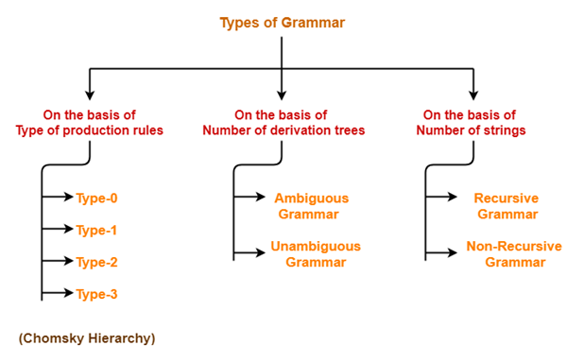
Types of Grammars

Slide 45
Grammars
Equivalent Grammars-
Two grammars are said to be equivalent if they generate the same languages.
Example-
Consider the following two grammars-
Grammar G1-
S → aSb / ∈
Grammar G2-
S → aAb / ∈
A → aAb / ∈

Slide 46
Grammars
Both these grammars generate the same language given as-
L = { a^{n} b ^{n} , n >= 0 }
Thus, L(G1) = L(G2)
Since both the grammars generate the same language, therefore they are equivalent.

Slide 47
Grammars
Grammar Type | Grammar Accepted | Automaton
Type 0 | Unrestricted grammar | Turing Machine
Type 1 | Context-sensitive grammar | Linear-bounded automaton
Type 2 | Context-free grammar | Pushdown automaton
Type 3 | Regular grammar | Finite state automaton

Slide 48
Types of Grammar:
Type - 0 Grammar
Type-0 grammars generate recursively enumerable languages. The productions have no restrictions. They are any phase structure grammar including all formal grammars.
They generate the languages that are recognized by a Turing machine.

Slide 49
Type - 0 Grammar :
The productions can be in the form of α → β where α is a string of terminals and non terminals with at least one non-terminal and α cannot be null. β is a string of terminals and non-terminals.
Example
S → ACaB
Bc → acB
CB → DB
aD → Db

Slide 50
Type - 1 Grammar
Type-1 grammars generate context-sensitive languages. The productions must be in the form α A β → α γ β
where A ∈ N (Non-terminal) and
α, β, γ ∈ (T ∪ N)* (Strings of terminals and non-terminals)
The strings α and β may be empty, but γ must be non-empty.

Slide 51
Type - 1 Grammar
The rule S → ε is allowed if S does not appear on the right side of any rule. The languages generated by these grammars are recognized by a linear bounded automaton.
Example
AB → AbBc
A → bcA
B → b

Slide 52
Type - 2 Grammar
Type-2 grammars generate context-free languages.
The productions must be in the form A → γ
where A ∈ N (Non terminal)
and γ ∈ (T ∪ N)* (String of terminals and non-terminals).
These languages generated by these grammars are be recognized by a non-deterministic pushdown automaton.

Slide 53
Type - 2 Grammar
Example
S → X a
X → a
X → aX
X → abc
X → ε

Slide 54
Type - 3 Grammar
Type-3 grammars generate regular languages. Type-3 grammars must have a single non-terminal on the left-hand side and a right-hand side consisting of a single terminal or single terminal followed by a single non-terminal.

Slide 55
Type - 3 Grammar
The productions must be in the form
X → a or
X → aY
where X, Y ∈ N (Non terminal) and
a ∈ T (Terminal)
The rule S → ε is allowed if S does not appear on the right side of any rule.
Example
X → ε
X → a | aY

Slide 56
REGULAR LANGUAGES
A regular language is a language that can be
expressed with a regular expression or a
deterministic or non-deterministic finite
automata or state machine. A language is a set
of strings which are made up of characters
From a specified alphabet, or set of symbols.
Regular languages are a subset of the set of
all strings.

Slide 57
REGULAR LANGUAGES
Regular Grammar : A grammar is regular if it
has rules of form A→ a or A→ aB or A→ ɛ
where ɛ is a special symbol called NULL.
Regular Languages : A language is regular if it
can be expressed in terms of regular
expression.

Slide 58
Closure Properties of Regular Languages
Union : If L1 and If L2 are two regular
languages, their union L1 ∪ L2 will also be
regular.
For example, L1 = {a^{n} | n ≥ 0} and L2
= {b^{n} | n ≥ 0}
L3 = L1 ∪ L2 = {a^{n} ∪ b^{n} | n ≥ 0} is also
regular.
Intersection : If L1 and If L2 are two regular
languages, their intersection L1 ∩ L2 will also
be regular.
For example,
L1= { a^{m} b^{n} | n ≥ 0 and m ≥ 0 } and
L2= { a^{m} b^{n} ∪ b^{n} a^{m} | n ≥ 0 and m ≥ 0 }
L3 = L1 ∩ L2 = {a^{m} b^{n} | n ≥ 0 and m ≥ 0} is also regular.

Slide 59
Closure Properties of Regular Languages
Concatenation : If L1 and If L2 are two regular
languages, their concatenation L1.L2 will also
be regular.
For example,
L1 = {a^{n} | n ≥ 0} and L2 = {b^{n} | n ≥ 0}
L3 = L1.L2 = {a^{m} . b^{n} | m ≥ 0 and n ≥ 0} is
also regular.
Kleene Closure : If L1 is a regular language, its
Kleene closure L1* will also be regular.
For example,
L1 = (a ∪ b)
L1* = (a ∪ b)*

Slide 60
Closure Properties of Regular Languages
Complement : If L(G) is regular language, its
complement L’(G) will also be regular.
Complement of a language can be found by
subtracting strings which are in L(G) from all
possible strings.
For example,
L(G) = {a^{n} | n > 3}
L’(G) = {a^{n} | n <= 3}

Slide 61
THANK YOU

