Slide 1


Volatility Fund – Bond Future
September 2019 – Confidential

Slide 2
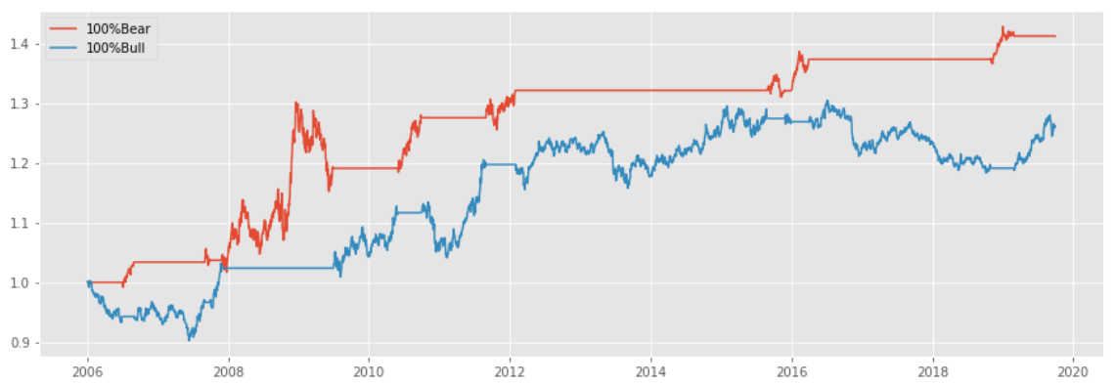
Bond Future Performance by Trend
id | ann_ret | max_dd | m_sharpe | sharpe | dvol | mvol
100%Bear | 2.46% | 11.49% | 0.56 | 0.53 | 4.98% | 4.68%
100%Bull | 1.87% | 7.04% | 0.53 | 0.37 | 4.84% | 4.7%

Slide 3
Bond Future Strategies
Trend | Dstat 5/95 | Weight
Bear | All | 25%
Bull | All | 75%
Trend | Dstat 5/95 | Weight
Bear | Dstat Down | 75%
 | Dstat Normal | 25%
Bull | Dstat Down | 125%
 | Dstat Normal | 75%
Trend | Dstat 5/95 | Weight
Bear | Dstat Down | 75%
 | Dstat Normal | 25%
Bull | Dstat Down | 125%
 | Dstat Normal | 75%
 | Dstat Up | 25%

Slide 4
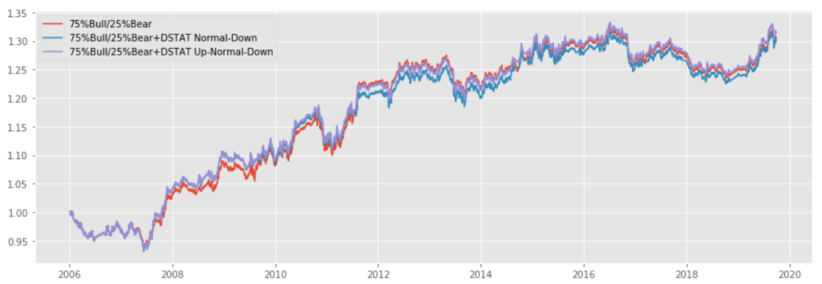
Bond Future Performance (SPX DSTAT 05/95)
id | ann_ret | max_dd | m_sharpe | sharpe | dvol | mvol
75%Bull/25%Bear | 1.89% | 7.03% | 0.54 | 0.52 | 3.84% | 3.69%
75%Bull/25%Bear+DSTAT Normal-Down | 1.87% | 7.04% | 0.53 | 0.51 | 3.92% | 3.73%
75%Bull/25%Bear+DSTAT Up-Normal-Down | 1.95% | 7.04% | 0.55 | 0.53 | 3.93% | 3.74%

Slide 5
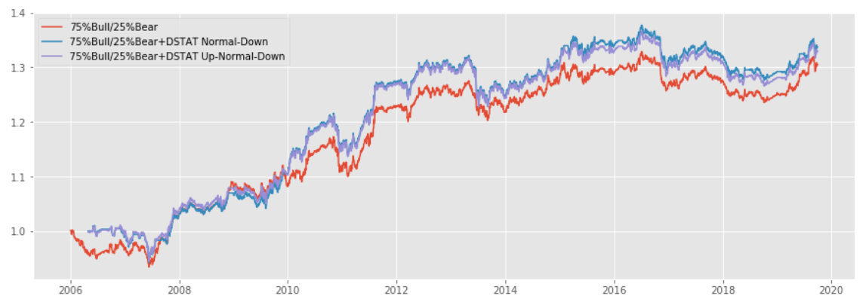
Bond Future Performance (Bond DSTAT 05/95)
id | ann_ret | max_dd | m_sharpe | sharpe | dvol | mvol
75%Bull/25%Bear | 1.89% | 7.03% | 0.54 | 0.52 | 3.84% | 3.69%
75%Bull/25%Bear+DSTAT Normal-Down | 2.12% | 7.33% | 0.62 | 0.58 | 3.88% | 3.62%
75%Bull/25%Bear+DSTAT Up-Normal-Down | 2.07% | 7.34% | 0.6 | 0.57 | 3.9% | 3.64%

Slide 6
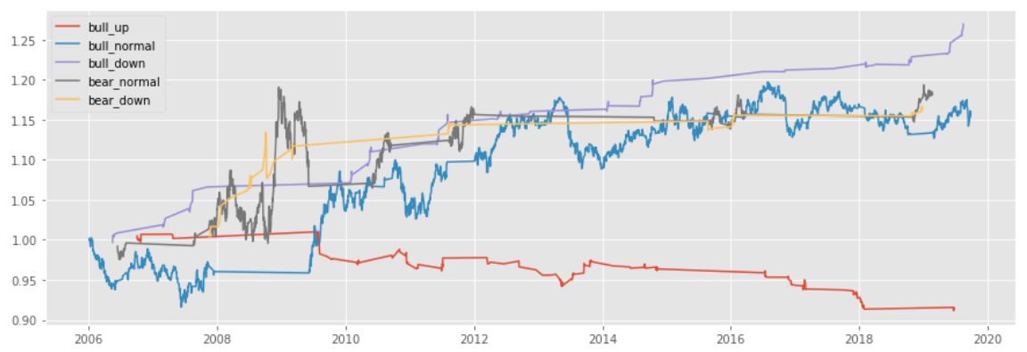
Bond Future Performance of by Regime (SPX DSTAT 05/95)

Slide 7
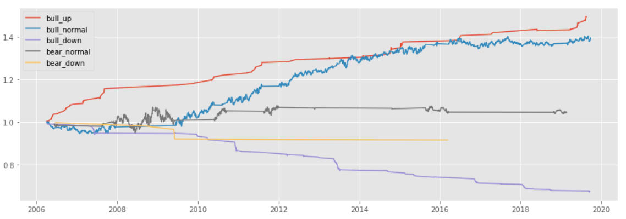
Bond Future Performance of by Regime (Bond DSTAT 05/95)

Slide 8
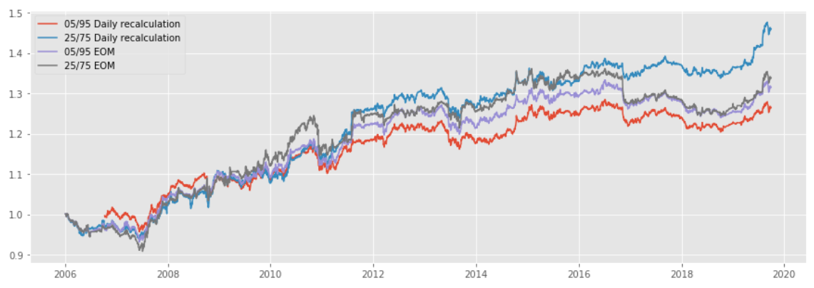
Bond Future Performance by DSTAT Quantile and Frequency (SPX DSTAT)
id | ann_ret | maxdd | m_sharpe | sharpe | dvol | mvol
05/95 Daily Recalculation | 1.77% | -6.25% | 0.51 | 0.49 | 3.92% | 3.78%
25/75 Daily Recalculation | 2.7% | -5.95% | 0.71 | 0.64 | 4.49% | 4.01%
05/95 EOM | 1.95% | -7.04% | 0.55 | 0.53 | 3.93% | 3.74%
25/75 EOM | 2.07% | -9.36% | 0.51 | 0.47 | 4.75% | 4.33%

Slide 9
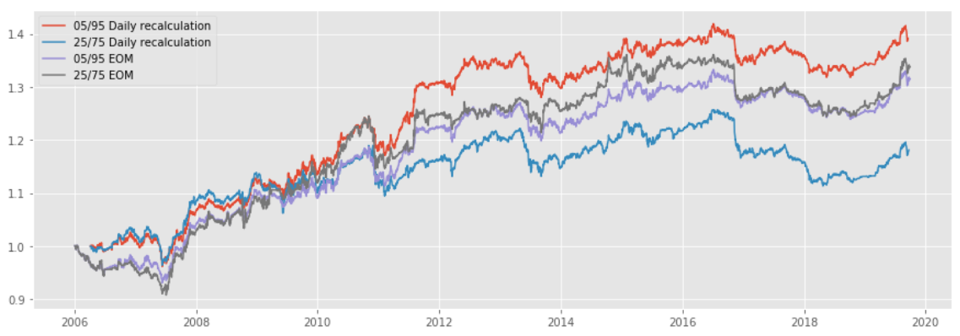
Bond Future Performance by DSTAT Quantile and Frequency (Bond DSTAT)
id | ann_ret | maxdd | m_sharpe | sharpe | dvol | mvol
05/95 Daily Recalculation | 2.4% | -7.12% | 0.68 | 0.65 | 3.93% | 3.75%
25/75 Daily Recalculation | 1.2% | -11.41% | 0.31 | 0.33 | 4.12% | 4.27%
05/95 EOM | 2.02% | -7.37% | 0.6 | 0.57 | 3.9% | 3.64%
25/75 EOM | 1.75% | -8.07% | 0.47 | 0.44 | 4.35% | 4.0%

