Slide 1


IPO ANALYSIS
MAY 2019 – Confidential

Slide 2
Ipo analysis Characteristics
Analysis of the price evolution of large US IPOs (>10 Bln) over the first 6 months trading period.
Symbol | Company | Offer Date | Market Cap (Mio) | IPO price | Volatility 6M (%) | Volatility 0-3M (%) | Volatility 3-6M (%) | 1wk low/high | 1M low/high | 3M low/high | 6M low/high | Variation high/low | Variation IPO/low | Variation IPO/high | 6M price above IPO
WDAY US Equity | WorkDay | 12/10/2012 | 47418 | 28 | 86,1 | 117,1 | 33,8 | [28, 55.4] | [28, 55.4] | [28, 56.2] | [28, 64.5] | 130% | 0% | 130% | YES
NOW US Equity | Service Now | 29/06/2012 | 50644 | 18 | 69,2 | 81,2 | 51,7 | [18, 26.0] | [18, 26.0] | [18, 40.4] | [18, 40.4] | 124% | 0% | 124% | YES
ATHM US Equity | Autohome Inc | 11/12/2013 | 11767 | 17 | 112,9 | 139,4 | 75,7 | [17, 30.1] | [17, 36.6] | [17, 51.8] | [17, 51.8] | 205% | 0% | 205% | YES
DBX US Equity | Dropbox | 23/03/2018 | 10794 | 21 | 70 | 82,8 | 51,8 | [21, 31.0] | [21, 33.3] | [21, 42] | [21, 42] | 100% | 0% | 100% | YES
GDDY US Equity | GoDaddy | 01/04/2015 | 13284 | 20 | 53,3 | 63,6 | 39,8 | [20, 26.5] | [20, 26.5] | [20, 31.8] | [20, 31.8] | 59% | 0% | 59% | YES
PANW US Equity | Palo Alto | 20/07/2012 | 21274 | 42 | 57,8 | 70,1 | 40,9 | [42, 59.0] | [42, 66.5] | [42, 71.8] | [42, 71.8] | 71% | 0% | 71% | YES
V US Equity | Visa | 19/03/2008 | 327535 | 11 | 59,7 | 69,7 | 45,5 | [11, 16.1] | [11, 17.0] | [11, 22.1] | [11, 22.1] | 101% | 0% | 101% | YES
BABA US Equity | Alibaba | 19/09/2014 | 438427 | 68 | 57,5 | 73,4 | 33,5 | [68, 93.9] | [68, 93.9] | [68, 119.2] | [68, 119.2] | 75% | 0% | 75% | YES
SPLK US Equity | Splunk | 19/04/2012 | 20496 | 17 | 118,7 | 162,5 | 43,9 | [17, 36.2] | [17, 36.2] | [17, 36.4] | [17, 39.1] | 130% | 0% | 130% | YES
SPOT US Equity | Spotify Technology | 02/04/2018 | 23986 | 132 | 39,9 | 45,7 | 33,2 | [132, 149.0] | [132, 161.7] | [132, 180.9] | [132, 196.3] | 49% | 0% | 49% | YES
TWTR US Equity | Twitter Inc | 07/11/2013 | 28824 | 26 | 109,8 | 140,5 | 64 | [26, 44.9] | [26, 45.6] | [26, 73.3] | [26, 73.3] | 182% | 0% | 182% | YES
TSLA US Equity | Tesla | 29/06/2010 | 37401 | 17 | 84,5 | 100,2 | 65,2 | [17, 23.9] | [15.8, 23.9] | [15.8, 23.9] | [15.8, 35.5] | 125% | -7% | 109% | YES
CRM US Equity | SalesForce | 23/06/2004 | 119757 | 2,8 | 96,6 | 126 | 53,5 | [2.8, 4.3] | [2.8, 4.3] | [2.4, 4.3] | [2.4, 5.5] | 129% | -13% | 100% | YES
PYPL US Equity | Paypal | 06/07/2015 | 132532 | 36,7 | 34,8 | 38,6 | 30 | [34.5, 36.7] | [34.5, 40.5] | [30.6, 40.5] | [30.6, 40.5] | -24% | -17% | 10% | NO
SNAP US Equity | Snap | 02/03/2017 | 15397 | 17 | 86 | 108 | 55,6 | [17, 27.1] | [17, 27.1] | [17, 27.1] | [11.8, 27.1] | -57% | -31% | 59% | NO
FB US Equity | Facebook | 18/05/2012 | 528976 | 38 | 67 | 67,1 | 65,9 | [31, 38.2] | [25.9, 38.2] | [20.0, 38.2] | [17.7, 38.2] | -54% | -53% | 1% | NO
NFLX US Equity | Netflix | 22/05/2002 | 154973 | 1,1 | 111,1 | 85,8 | 131,3 | [1.1, 1.2] | [0.9, 1.2] | [0.8, 1.3] | [0.4, 1.3] | -69% | -63% | 21% | NO
LYFT US EQUITY | Lyft | 29/03/2019 | 16938 | 72 | - | 80.5 | - | [69.0, 78.3] | [56.1, 78.3] | [48.1, 78.3] | - | - | - | - | -

Slide 3
Ipo analysis Volatility disparity
Volatility tend to be much greater during the first 3 months.
Prices tend to stabilize from 3 to 6 months.
89% of stocks have higher volatility from 0 to 3 months.
Median volatility of IPO over 6 months is 70%.
Median volatility decreases by approx. 40% after 3 months
Median volatility drops from 83% over 0-3 months to 52% over 3-6 months.
 | Volatility 6M (%) | Volatility 0-3M (%) | Volatility 3-6M (%)
Median | 70 | 83 | 52
Change |  |  | -38%
Moyenne | 77 | 92 | 54
Change |  |  | -42%

Slide 4
Ipo analysis Trend evolution
86% of the stocks having a positive return over the first week of trading are trading above IPO price after 6 months.
14/17 stocks had a positive return over a week. In this case, 12 stocks were trading above IPO price at 6 months.
67% of the stocks having a negative return over the first week of trading are trading below IPO price after 6 months.
3/17 stocks had a negative return over a week. In this case, 2 stocks were trading below IPO price at 6 months.

Slide 5
Ipo analysis 6 months return – days to reach high/low
¾ of the stocks have generated a positive 6 months return.
¼ of the stocks have generated a negative 6 months return.
Amongst the 6 months positive return stocks, the lowest (highest) price is reached on average on the 3rd (66th) day with a -2% decrease (110% increase).
Amongst the 6 months negative return stocks, the lowest (highest) price is reached on average on the 86rd (11th) day with a -41% decrease (23% increase).

Slide 6
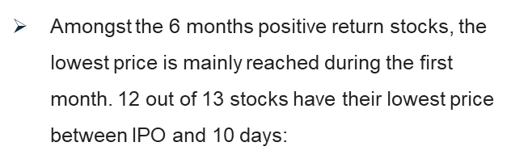
Ipo analysis 6 months positive return – days to reach high/low
Amongst the 6 months positive return stocks, the highest price is distributed between 25-115 days (no obvious trend)

Slide 7
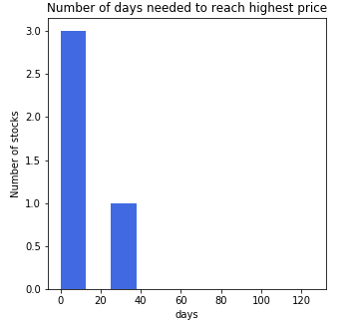
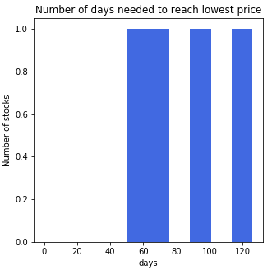
Ipo analysis 6 months negative return – days to reach high/low
Amongst the 6 months negative return stocks, the highest price is reached within the first 2 months.
¾ within the first 10 days (knowing that IPO price is very often the highest price).
Amongst the 6 months negative return stocks, the highest price is uniformly reached during the 3-6 months period.

Slide 8
Ipo analysis Prices evolution over 6 months
Random evolution of the stocks (no obvious pattern correlation)
High volatility in the first 60 days
Mostly positive returns over 6 months
Lyft and Facebook exhibit the same dynamic on the first 2 months.

Slide 9
Ipo analysis Prices evolution over 6 months (NASDaQ return adjusted)
The daily return of the stocks are adjusted by removing the NASDAQ return
Same prices evolution and pattern as without adjusting for NASDAQ since the magnitude or volatility of stock prices are much greater than the one of NASDAQ

Slide 10
Ipo analysis Prices evolution over 6 months (NASDAQ ADJUSTED)
Among recent large tech IPOs LYFT clearly looks similar to Facebook

Slide 11
Ipo analysis Conclusion
Disparity in volatility : high phase of volatility over the first 3 months.
Volatility drops by 40% on average in the 3 to 6 months period.
The first week return implies 6 months price direction.
On average stocks like LYFT (1 week or 1 month negative) reach their low price around 86th days.
On average stocks like LYFT (1 week or 1 month negative) reach their high price around 11th days.
Facebook shows the patterns explained above.
LYFT price dynamic is similar to Facebook during the 38 months.
Forecast : if LYFT keeps behaving like Facebook, it may have not touch is lowest price yet and won’t be trading above IPO price within the next 88 next days.

