Slide 1


Volatility Fund – Tail Analysis
September 2019 – Confidential

Slide 2
We analysed Tail events by looking at :
5% of the worst monthly return on SP in Bull market
Analysis of the DSTAT
5% Drawdown on SP since 1990
Analysis of the SP return before Drawdowns
Performance of DSTAT prediction

Slide 3
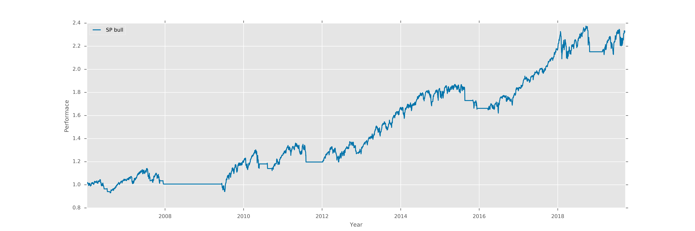
Tail Analysis SP BULL Worst Monthly Return
Monthly Return | -8.85 | -7.19 | -7.05 | -6.58 | -6.32 | -6.27 | -5.09 | -3.89
Year | 2018 | 2011 | 2010 | 2019 | 2015 | 2012 | 2007 | 2018
Month | Oct | Aug | May | May | Aug | May | Nov | Dec

Slide 4
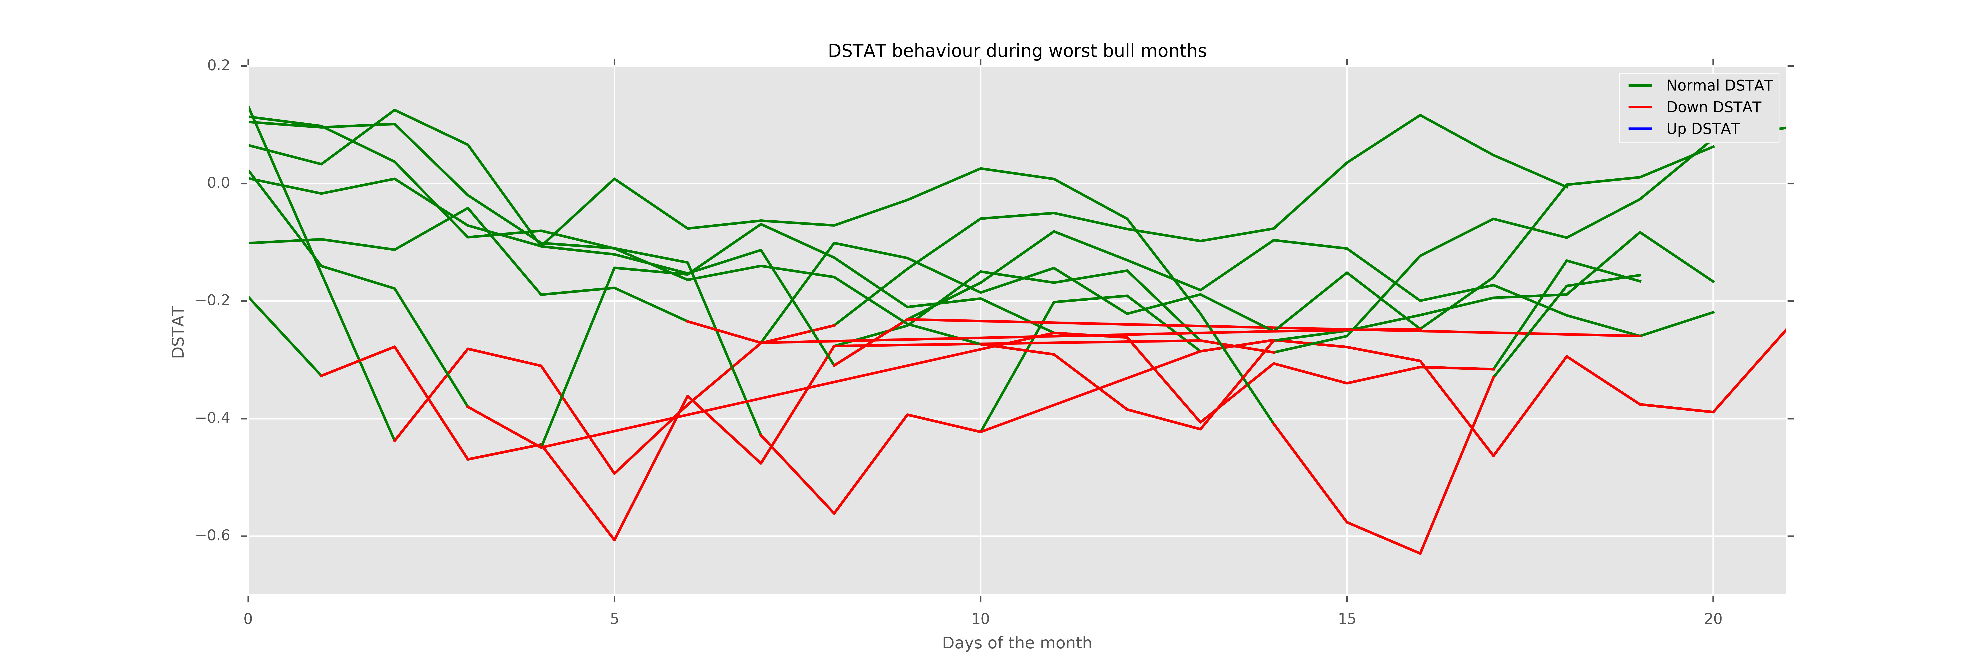
Tail Analysis SP BULL Worst Monthly Return
Monthly Return | -8.85 | -7.19 | -7.05 | -6.58 | -6.32 | -6.27 | -5.09 | -3.89
>1 Down DSTAT activated | True | True | True | True | True | True | True | True
>1 Up DSTAT activated | False | False | False | False | False | False | False | False

Slide 5
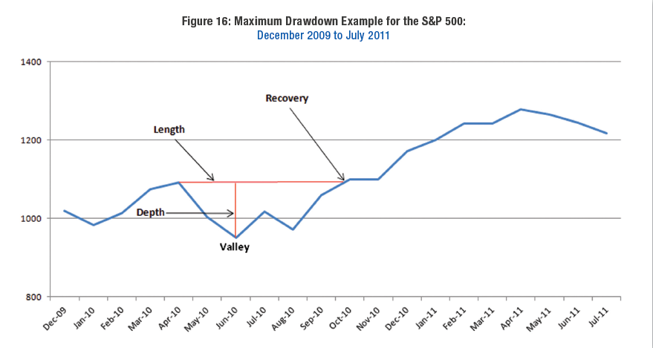
Tail Analysis 5% Drawdowns on SP
How do we define a Drawdown ?
- Take a price p1 and look at the next price p2 s.t p1=p2. This define the Drawdown period.
- The drawdown value is the return between p1 and the minimum peak price in the period.
- The next drawdown period will start after the minimum peak price of the previous drawdown.

Slide 6
Tail Analysis 5% Drawdowns on SP
Start | End | Return | Recovery | Days to reach Min peak | Days for Next DD
2006-05-05 | 2006-09-25 | 7,7% | 98 | 26 | 265
2007-02-20 | 2007-04-16 | 5,9% | 38 | 9 | 140
2007-07-19 | 2007-10-05 | 9,4% | 55 | 19 | 63
2007-10-09 | 2013-03-28 | 56,8% | 1376 | 355 | 179
2009-03-26 | 2009-04-02 | 5,4% | 5 | 2 | 76
2009-06-12 | 2009-07-20 | 7,1% | 25 | 19 | 110
2009-10-19 | 2009-11-11 | 5,6% | 17 | 9 | 83
2010-01-19 | 2010-03-11 | 8,1% | 36 | 14 | 80
2010-04-23 | 2010-11-04 | 16,0% | 136 | 49 | 59
2010-08-09 | 2010-09-20 | 7,1% | 29 | 13 | 180
2011-02-18 | 2011-04-26 | 6,4% | 45 | 17 | 53
2011-04-29 | 2012-02-24 | 19,4% | 207 | 108 | 74
2011-10-28 | 2012-01-10 | 9,8% | 49 | 19 | 138
2012-04-02 | 2012-09-06 | 9,9% | 109 | 42 | 123
2012-09-14 | 2013-01-04 | 7,7% | 75 | 42 | 207
2013-05-21 | 2013-07-11 | 5,8% | 35 | 23 | 216
2014-01-15 | 2014-02-27 | 5,8% | 29 | 12 | 234
2014-09-18 | 2014-10-31 | 7,4% | 31 | 19 | 226
2015-05-21 | 2016-07-11 | 14,2% | 286 | 183 | 201
2016-06-08 | 2016-07-08 | 5,6% | 21 | 13 | 584
2018-01-26 | 2018-08-24 | 10,2% | 146 | 9 | 33
2018-03-09 | 2018-06-12 | 7,3% | 65 | 15 | 180

Slide 7
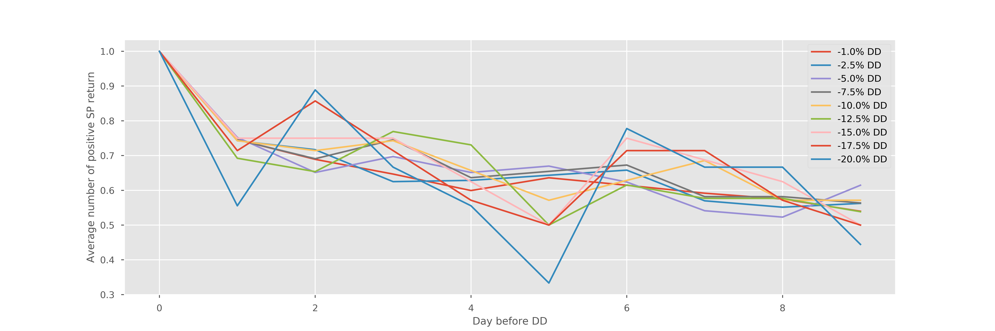
Tail Analysis Analysis around 5% Drawdowns
0D before | 1D before | 2D before | 3D before | 4D before | 5D before | 6D before | 7D before | 8D before | 9D before
100% | 75% | 69% | 65% | 60% | 64% | 61% | 59% | 57% | 54%
100% | 74% | 72% | 63% | 63% | 64% | 66% | 57% | 55% | 56%
100% | 75% | 65% | 70% | 65% | 67% | 62% | 54% | 52% | 61%
100% | 75% | 69% | 75% | 64% | 65% | 67% | 58% | 58% | 56%
100% | 74% | 71% | 74% | 66% | 57% | 63% | 69% | 57% | 57%
100% | 69% | 65% | 77% | 73% | 50% | 62% | 58% | 58% | 54%
100% | 75% | 75% | 75% | 63% | 50% | 75% | 69% | 63% | 50%
100% | 71% | 86% | 71% | 57% | 50% | 71% | 71% | 57% | 50%
100% | 56% | 89% | 67% | 56% | 33% | 78% | 67% | 67% | 44%

Slide 8
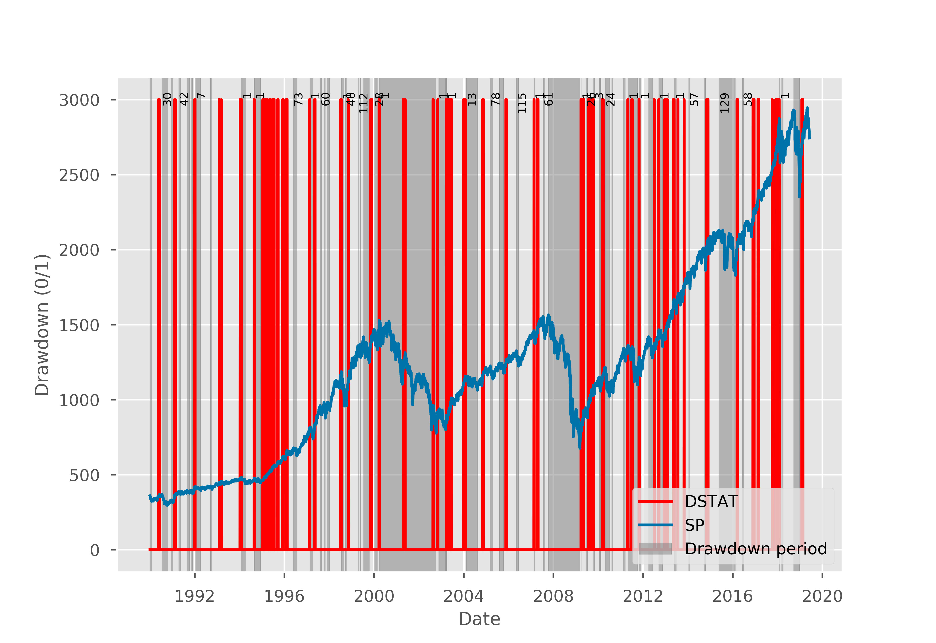
Tail Analysis Gap in Days DSTAT Drawdown prediction

Slide 9
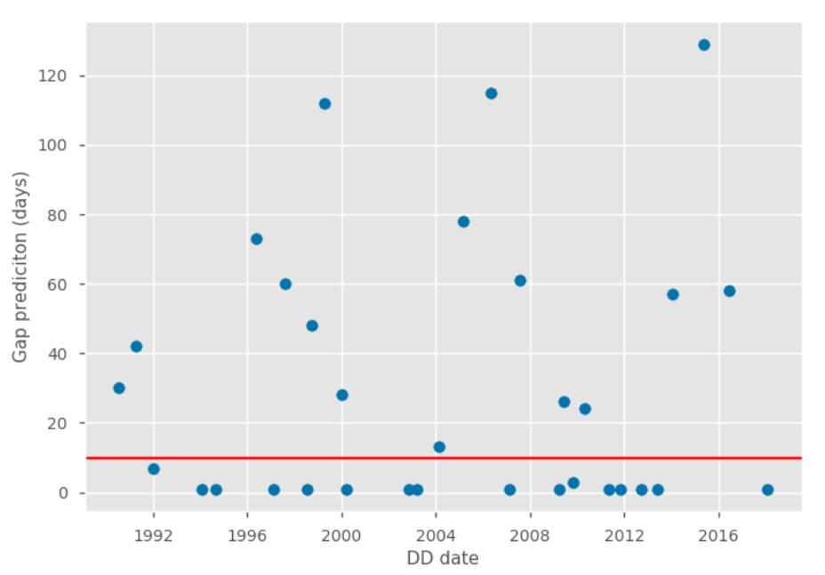
Tail Analysis Gap in Days DSTAT Drawdown prediction

