Slide 1
UE19CS343 – Topics in Deep learning
Project Title :Chatbot Implementation
Project ID: 19
Project Team: Mihir Soni PES2UG19CS232
MD Mushtaq PES2UG19CS226
Suravarjhula Sasira PES2UG19CS415

Slide 2
Outline
Problem Statement
Scope and Feasibility study
Applications/Use cases
Expected Deliverables
Any other information

Slide 3
Problem Statement
The problem statement it to create a Chatbot for laptop related issues using deep learning techniques.
Our goal is to create a user-friendly chatbot that can be used to answer simple question when conversing with customers in a customer service environment.
A majority of customer service requests are usually common requests and as such if it is one of the common reasons it can be directly be solved by the chatbot.
In the case that it isn’t a common request it can be redirected to an agent who can resolve the issue directly.
This will help cut down required manpower and costs for companies by a considerable amount.
We will be using a simple DNN algorithm for this project.

Slide 4
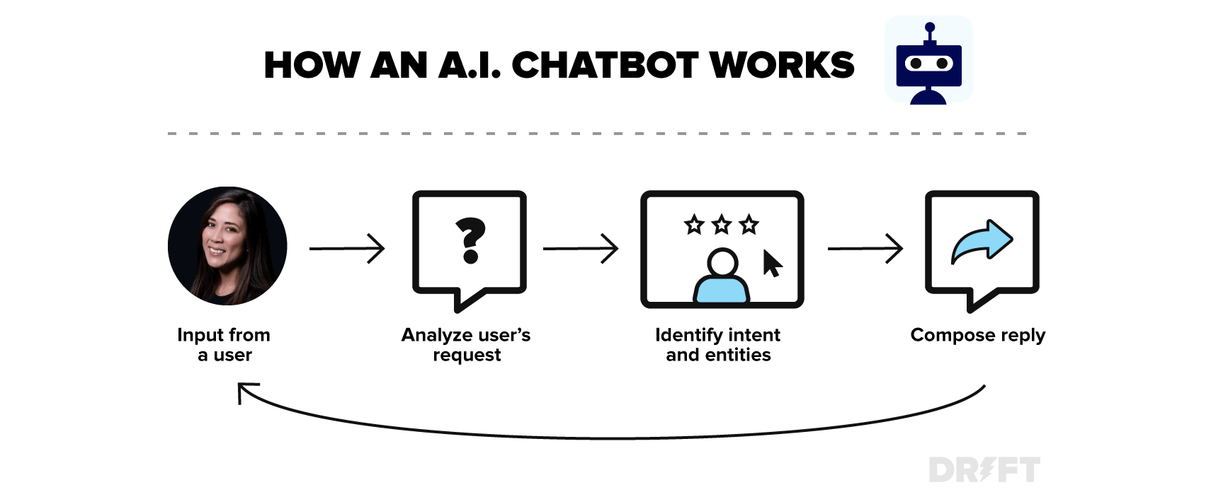

Slide 5
Scope and Feasibility study
Preparation & Understanding the data structure
Data Reshaping: Creating message-response pairs, data cleaning, etc.
Data Preprocessing: Splitting the data into train and validation sets
Select the Type of Chatbot: Generative or retrieval-based
Create a model and begin training
Tracking the training Process
Adding it to an Application
Deploying TensorFlow model
Testing the resultant Chatbot

Slide 6
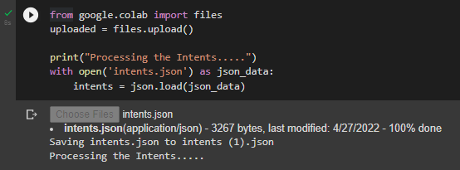
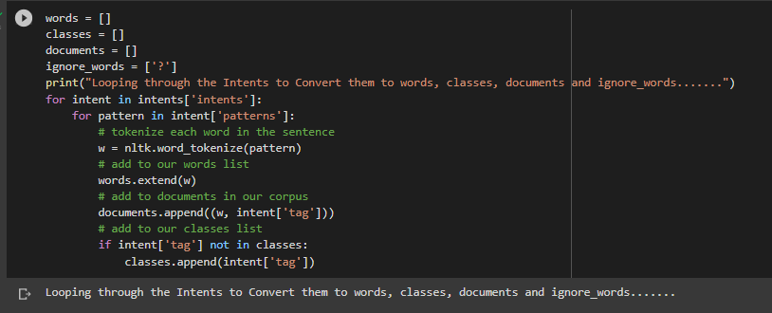
Implementation

Slide 7
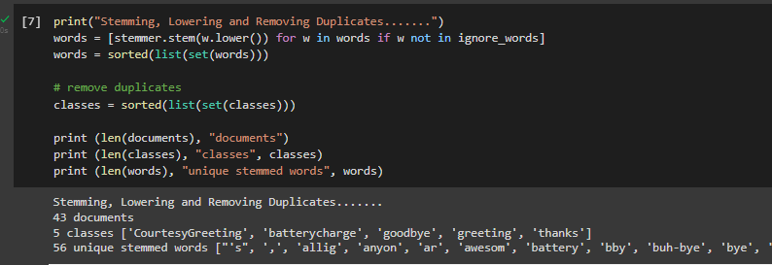
Implementation (Cont..)

Slide 8
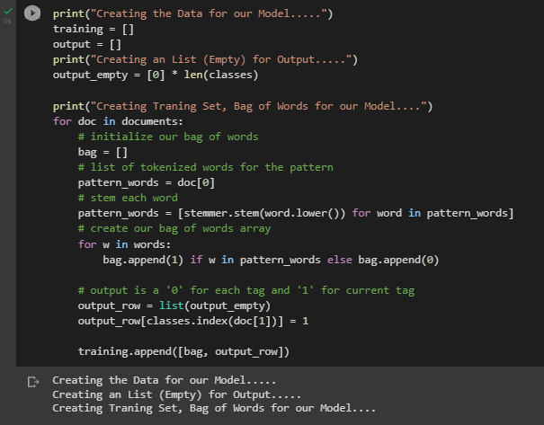
Implementation (Cont..)

Slide 9
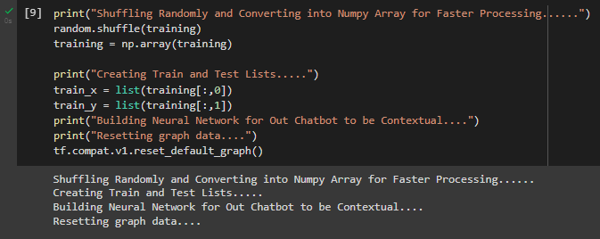
Implementation (Cont..)

Slide 10
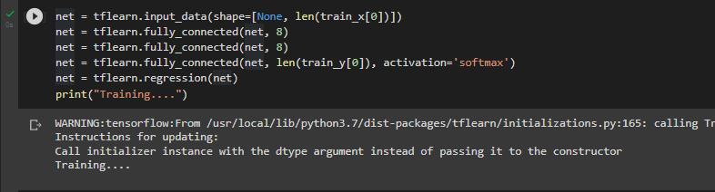
Implementation (Cont..)

Slide 11
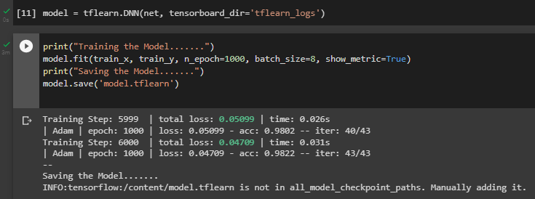
Implementation (Cont..)

Slide 12
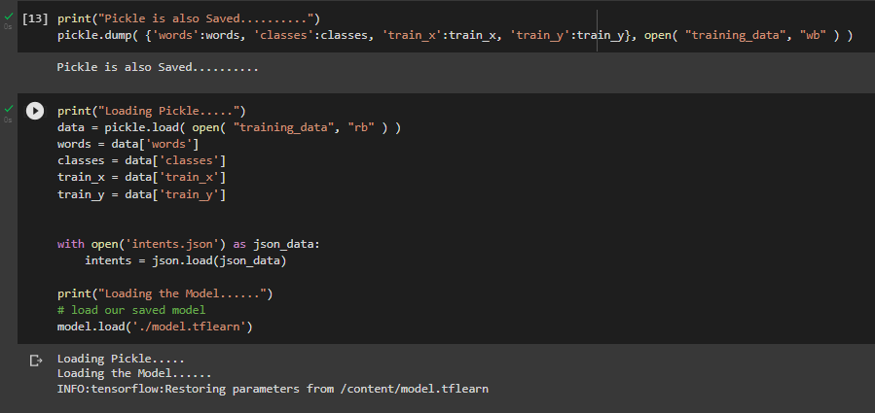
Implementation (Cont..)

Slide 13
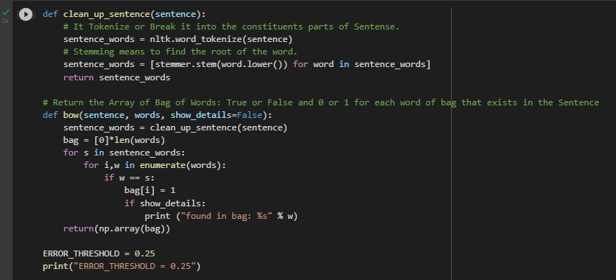
Implementation (Cont..)

Slide 14
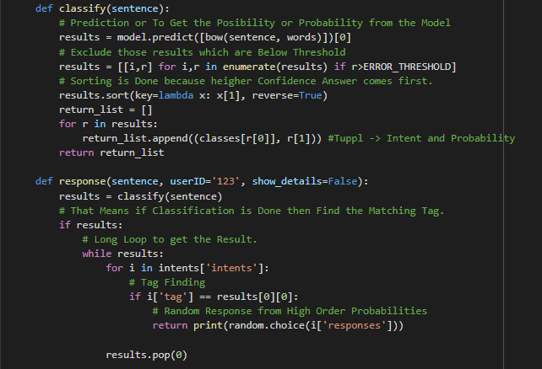
Implementation (Cont..)

Slide 15
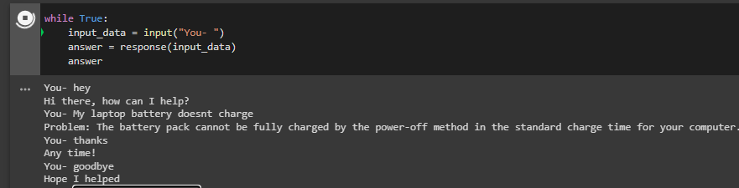
Implementation (Cont..)

Slide 16

Accuracy
We have used a simple DNN in our chatbot with only 3 fully connected dense layers.
Softmax activation function was used.
With this we have achieved 98.22% accuracy, so there was no need for a more complex and possibly more accurate network.

Slide 17
Applications/Use cases
It can be used by companies in the customer service field to reduce manpower and result in significant cost-cuts by having all the common problems faced by the company handled by the Chatbot.
Chatbot can be used to automate multiple functions in a mobile handheld device (Google assistant and Siri are two examples of this).
Can be used to book tickets in a cinema hall in a much more convenient way.

Slide 18
Literature Survey
https://shanebarker.com/blog/deep-learning-chatbot/#4_Select_the_Type_of_Chatbot
https://towardsdatascience.com/how-to-build-your-own-chatbot-using-deep-learning-bb41f970e281
https://github.com/aliannejadi/ClariQ/tree/master/data
http://tflearn.org/examples/
http://tflearn.org/layers/core/
https://github.com/tflearn/tflearn/blob/master/examples/images/convnet_cifar10.py
https://www.analyticsvidhya.com/blog/2021/06/build-your-own-ai-chatbot-from-scratch/

Slide 19
Thank You!

