Slide 1





HTML5 Websockets with Rails and Pusher
Mark Johnson
mark@menumill.com
@logicspin

Slide 2
who?
Mark Johnson
kailua, 1 wife, 2 kids, 2 dogs
ski, surf, travel
developing rails apps since 2005
co-founder at Menumill.com

Slide 3
websocket examples
see: http://pusher.com/examples
demo:
  chat: http://pusher-chat.heroku.com
  gaug.es screencast: http://www.screenr.com/xqo

Slide 4
websocket - what?
WebSocket is a technology providing for:
  bi-directional,
  full-duplex communications channels,
  over a single Transmission Control Protocol (TCP) socket.
HTTP-compatible handshake - default HTTP and HTTPS ports (80 and 443)
The WebSocket protocol defines a ws:// and wss:// prefix to indicate a WebSocket and a WebSocket Secure connection, respectively
source: http://en.wikipedia.org/wiki/WebSockets

Slide 5

why?
HTML5 Web Sockets can provide:
  up to 1000:1 reduction in unnecessary HTTP header traffic
  3:1 reduction in latency
scale!
avoid polling!
save $!
get real(time)
source: http://websocket.org/quantum.html

Slide 6
polling
Use case A:
1,000 clients polling every second: Network throughput is (871 x 1,000) = 871,000 bytes
= 6,968,000 bits per second (6.6 Mbps)
Use case B:
10,000 clients polling every second: Network throughput is (871 x 10,000) = 8,710,000 bytes
= 69,680,000 bits per second (66 Mbps)
Use case C:
100,000 clients polling every 1 second: Network throughput is (871 x 100,000) = 87,100,000 bytes
= 696,800,000 bits per second (665 Mbps)
source: http://websocket.org/quantum.html

Slide 7
websockets
Use case A:
1,000 clients receive 1 message per second: Network throughput is (2 x 1,000) = 2,000 bytes
= 16,000 bits per second (0.015 Mbps)
Use case B:
10,000 clients receive 1 message per second: Network throughput is (2 x 10,000)
= 20,000 bytes = 160,000 bits per second (0.153 Kbps)
Use case C:
100,000 clients receive 1 message per second: Network throughput is (2 x 100,000) = 200,000 bytes
= 1,600,000 bits per second (1.526 Kbps)
source: http://websocket.org/quantum.html

Slide 8
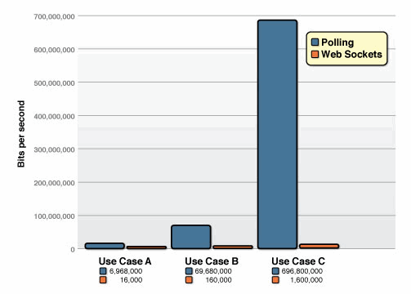
any questions?

Slide 9
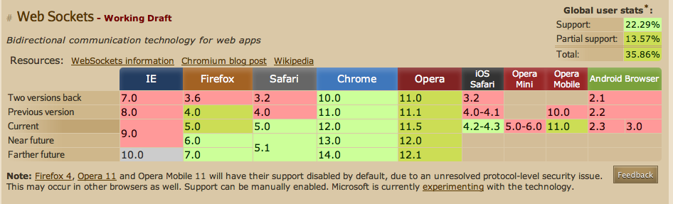
browser support / drawbacks
from: http://caniuse.com/#search=websocket
more: http://pusher.com/docs/browser_compatibility

Slide 10
enter pusher
Pusher is a hosted API for quickly, easily and securely adding scalable realtime functionality via WebSockets to web and mobile apps.

Slide 11
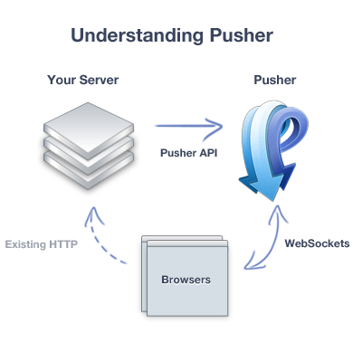
how pusher works

Slide 12
pusher API
Client Libraries - js, ruby, objective-c, .NET, etc
REST API
Client API
Publisher API

Slide 13
Client API
Overview
  Connection
  Channels
  Events
  Presence Events

Slide 14
Connection
Pusher connection is bi-directional and can send and receive messages from the server.
var pusher = new Pusher(applicationKey, options);

Slide 15
Channels
Each application has a number of channels, and every client can choose which channels it connects to.
var channel = pusher.subscribe(channelName);
channel types:
  public
  private
  presence

Slide 16
Events
Events are the primary method of packaging messages in the Pusher system. They form the basis of all communication.
var pusher = new Pusher('API_KEY');
var channel = pusher.subscribe('APPL');
channel.bind('new-price',
function(data) {
// add new price into the APPL widget
}
);

Slide 17
Presence events
Presence channels have a number of pre-defined events that can be bound to in order to notify a connected client about users joining or leaving the channel.
  pusher:subscription_succeeded
  pusher:member_added
  pusher:member_removed

Slide 18
Publisher API
These are run on your server, and generally interact with the Pusher REST API.
require 'pusher'
Pusher.app_id = 'APP_ID'
Pusher.key = 'API_KEY'
Pusher.secret = 'SECRET_KEY'
class ThingsController < ApplicationController
def create
@thing = Thing.new(params[:thing])
if @thing.save
Pusher['things'].trigger('thing-create', @thing.attributes)
end
end
end

Slide 19
lets build one!
demo - build Rails 3.1 app with pusher enabled admin features

Slide 20

we likey
menumill.com demo
use case: digital signage / digital menu boards

Slide 21
other options
  socket.io
  pubnub - handles more messages daily than twitter
  faye - http://faye.jcoglan.com/

Slide 22

Questions/Thanks!
mark@menumill.com
@logicspin

