Slide 1
Log Triage Tool Overview
Johnson Amalraj
Last updated on 30-June-2025

Slide 2
Agenda
Why Log Triage Tool?
Features
How to use
Future Ideas to consider

Slide 3
Why Log Triage Tool?
This tool is designed to assist in triaging and analyzing regression log files efficiently.
Supports multi-user collaboration, exclusion management and session persistence.
Manual log review is time-consuming and error-prone.
A smart triage tool can dramatically reduce debugging time.

Slide 4
Features
Folder-based log loading (*.log, *.log.gz)
Automatic parsing of ERROR, FATAL, WARNING from multiple EDA tools
Tabular view with per-column filtering and multi-column sorting
Exclusion list management and per-row comments
Export to CSV, session save/load
Visualizations: Pie chart, timeline, heatmap
Designed for efficiency, clarity, and collaboration

Slide 5
To Evaluate
use the following command to export to your local folder
svn export https://lon-cad-svn.microchip.com/repo/mpu32verification/MPU_VTOOLS/branches/MUSTANG_ST012_A0/LOG_TRIAGE

Slide 6
Steps to follow
How to use ?
Run Command:
bsub -R "rUsage[RAM=10000]" python3 logtriage.py
Required packages:
PyQt5, matplotlib, psutil, numpy
Package installation steps:
pip3 install <pkg_name>
Requirement: Python 3.7+
Load
Load log folder or saved sessions
View
Filter or sort and view only required details
Exclusions
Apply exclusions, and export/import into any sessions
Comments
Add multi-user comments and save session with comments
Export and visualize
Export summary/session/exclusion into CSV and visualize in charts/heatmap
Save/load
Save/load session

Slide 7
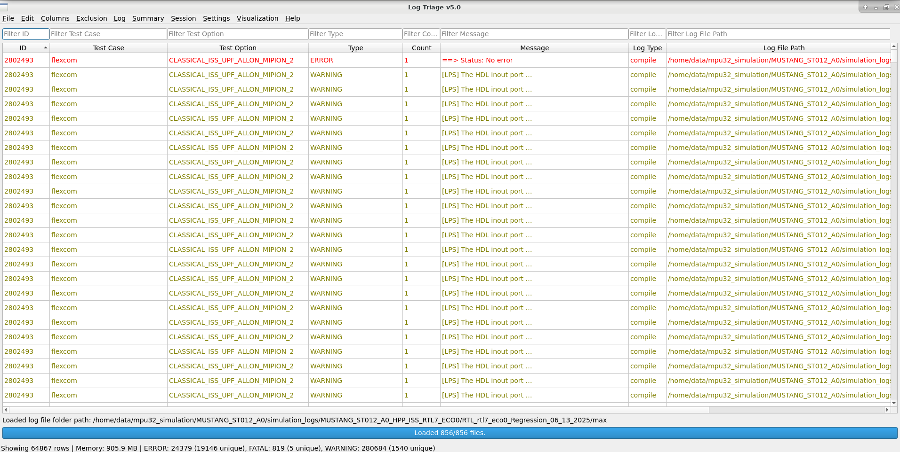
User Interface Overview
Table View: Parsed log messages
Filter Row: Per-column filtering
Menus: File, Edit, Columns, Exclusion, Log, Summary, Session, Settings, Visualization, Help
Status Bar & Progress Bar : It displays the overall count for the loaded log files and loading status of log files

Slide 8
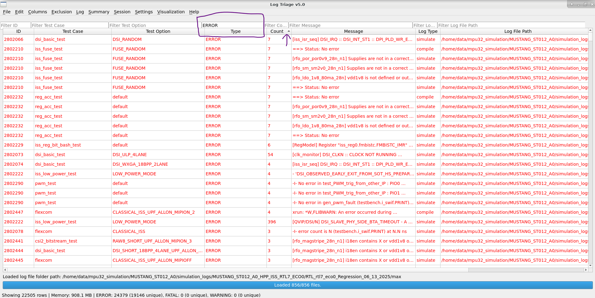
Filtering & Sorting
Filter any column (text, regex, numeric)
Multi-column sorting
Find dialog with regex support
Filter applied on ‘Message’ as ‘ERROR’; ‘Count’ column sorted.

Slide 9
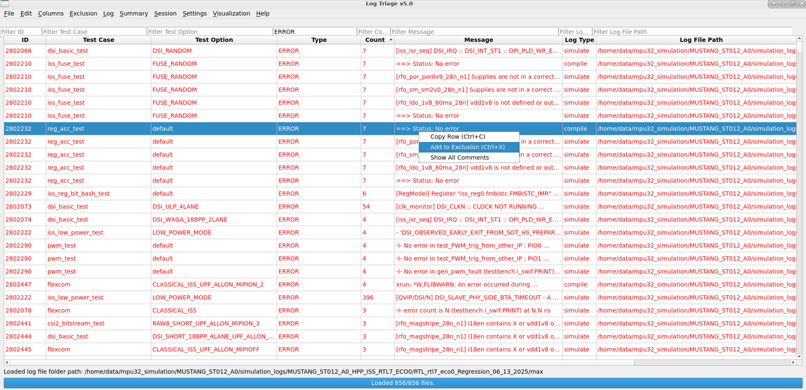
Exclusion
Add messages to exclusion list (Ctrl+X)
View, import, export, clear exclusions
Add/edit per-row comments by double-clicking the Comments cell
Exclusion applied for the selected row

Slide 10
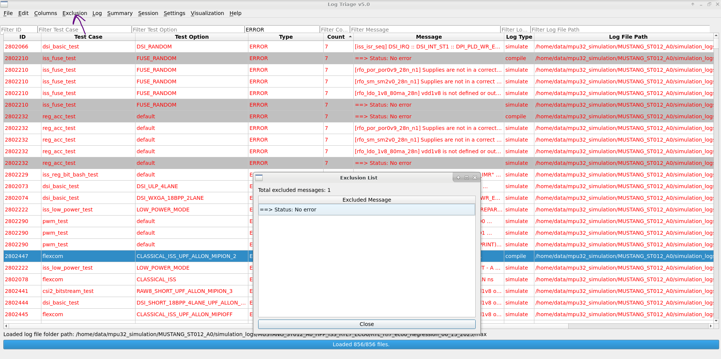
Exclusion (cont…)
After applying exclusion, the row highlighted in grey colour and you can view the excluded messages from Exclusion Menu

Slide 11
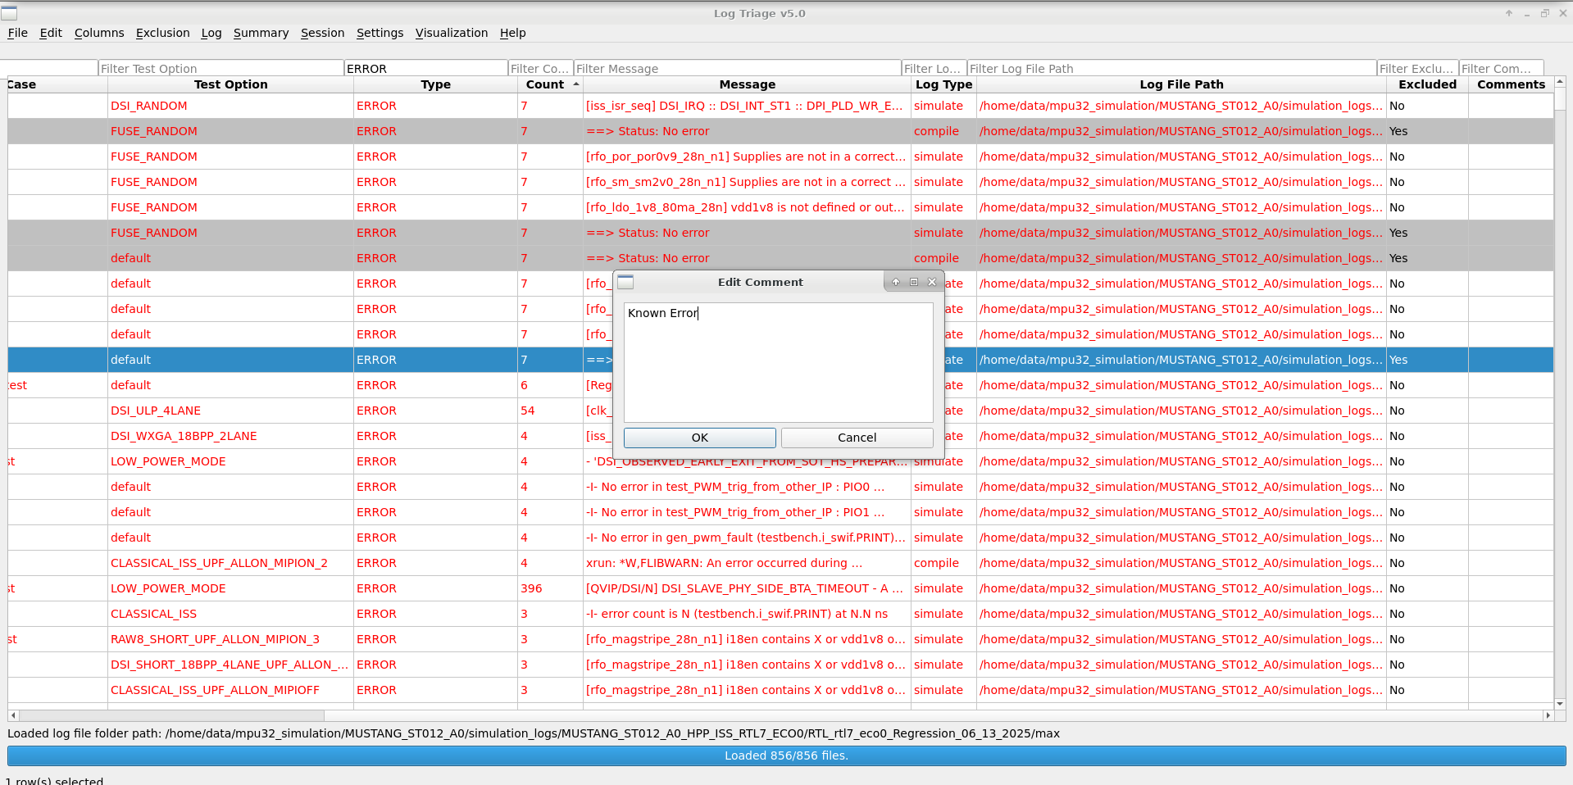
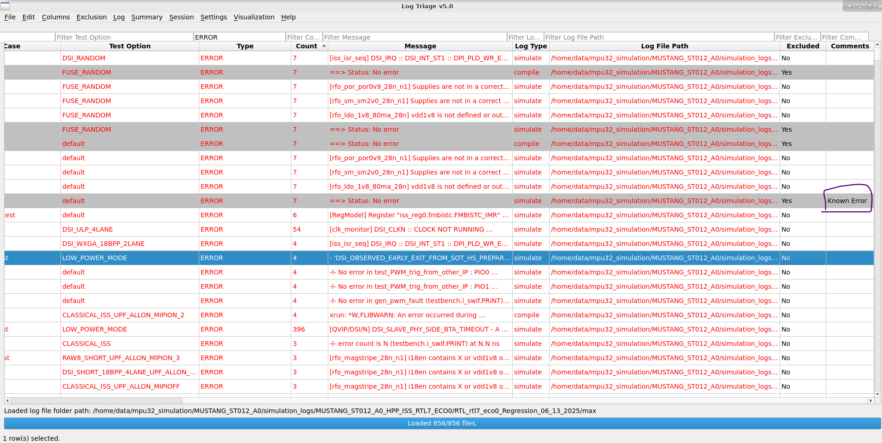
Comments
You can add comments for each row, by double clicking the Comments column.
Added Comments are visible in the column

Slide 12
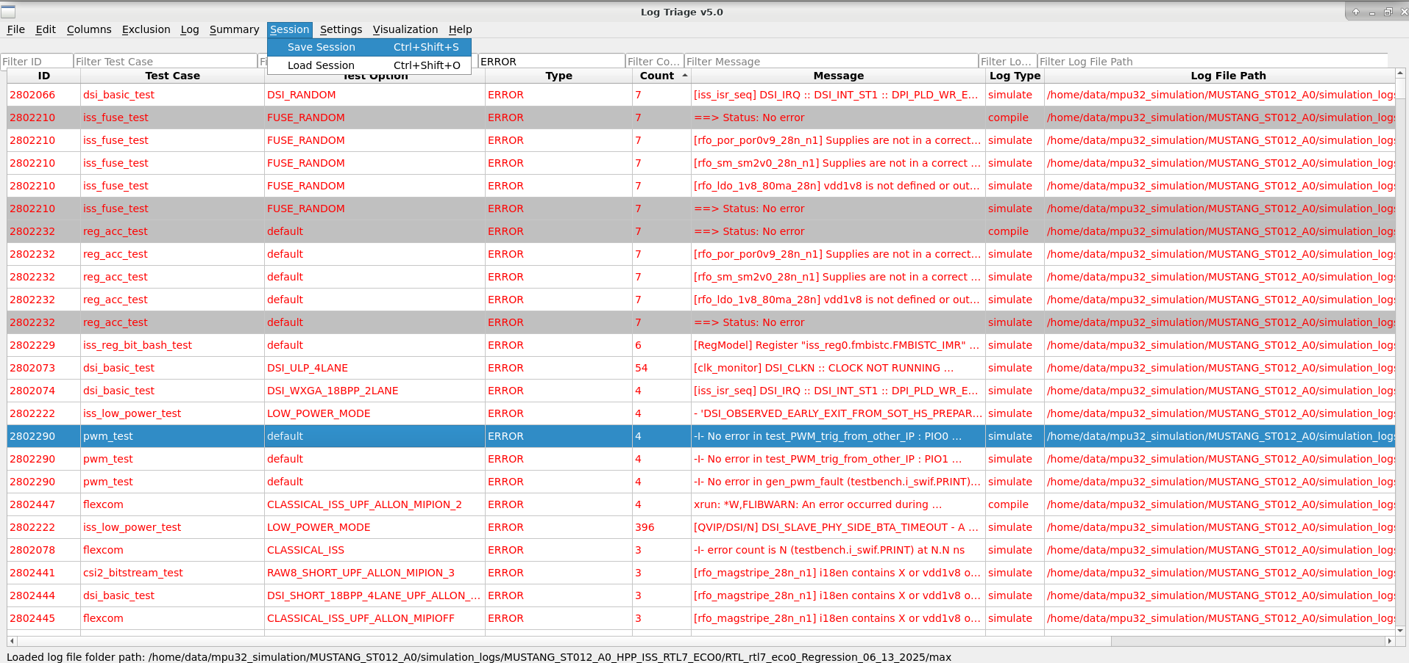
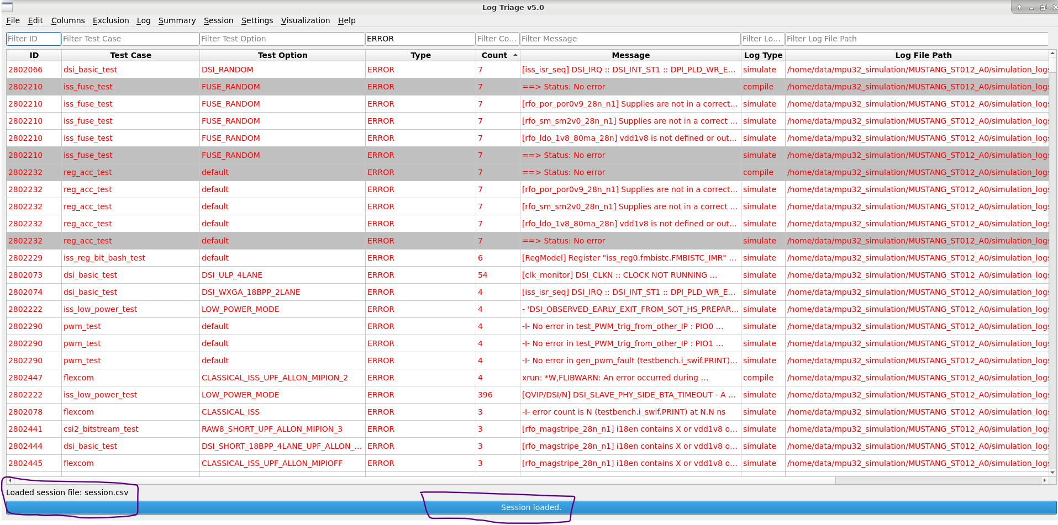
Session Management
Save/load session (includes comments and exclusions)
Session persistence helps in collaborative workflows
You can save the session in *.csv format
You can load the saved session by others, to add your comments/exclusions, and check the status of the regression

Slide 13
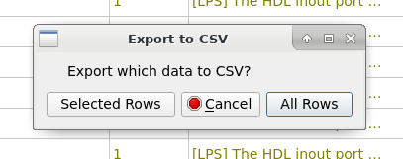
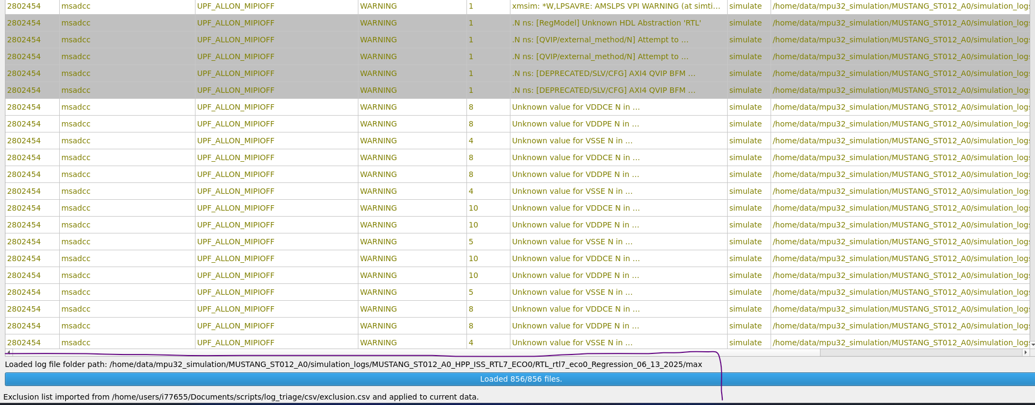
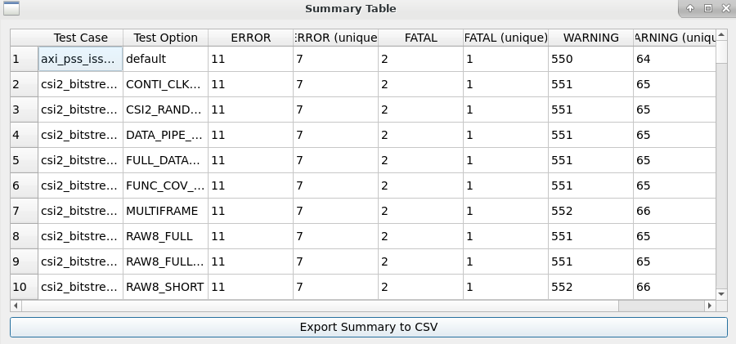
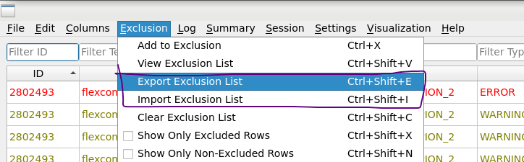
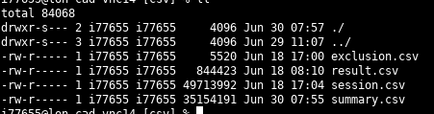
Export & Import
Export filtered/selected rows, summary details and exclusion to CSV
You can import exclusion to the other regression DB, to ease of filtering known Error/Warnings

Slide 14
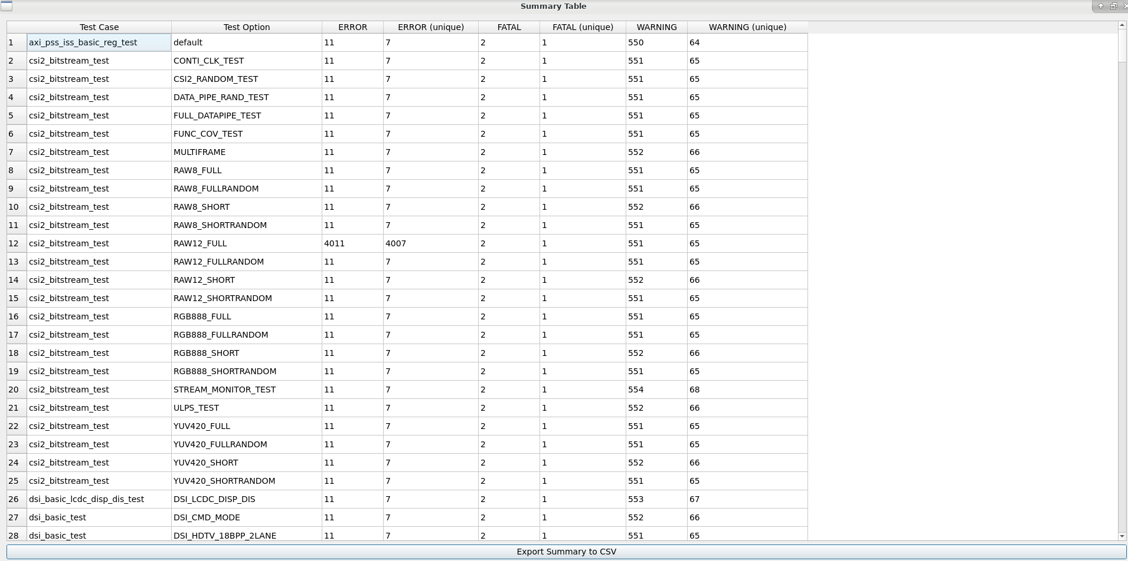
Summary
You can view the overall summary for all test cases as below
The bottom of the tool shows an overview of the loading status and error counts along with the path of the loaded log files

Slide 15
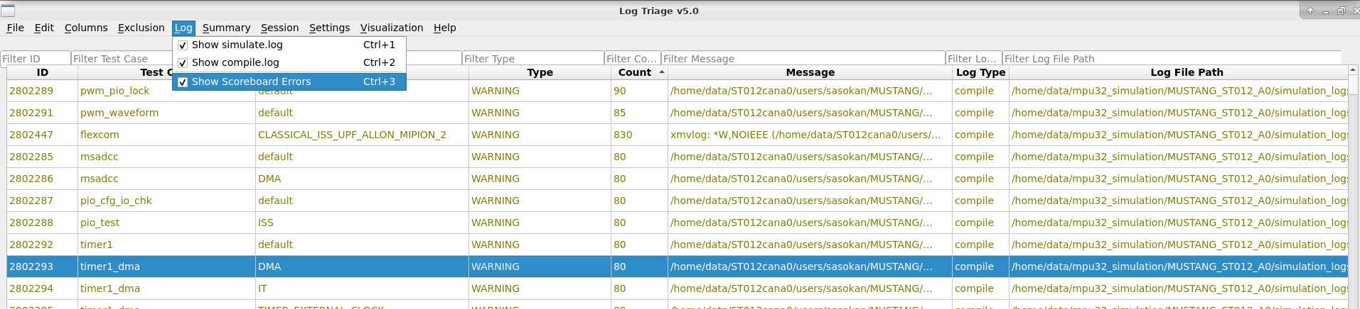
Log File Type and Scoreboard Errors
You can select which log files need to be loaded.
If you don’t want to see scoreboard errors, you can de-select that.

Slide 16
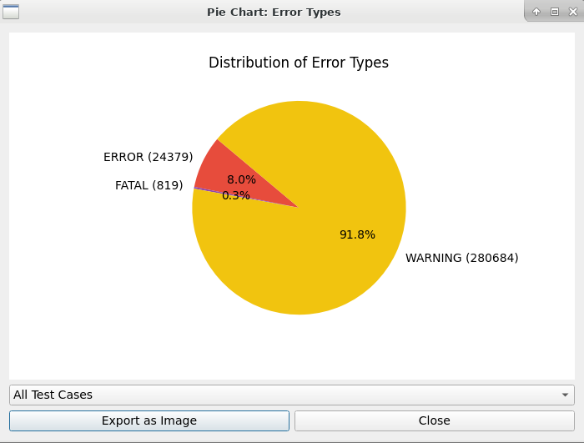
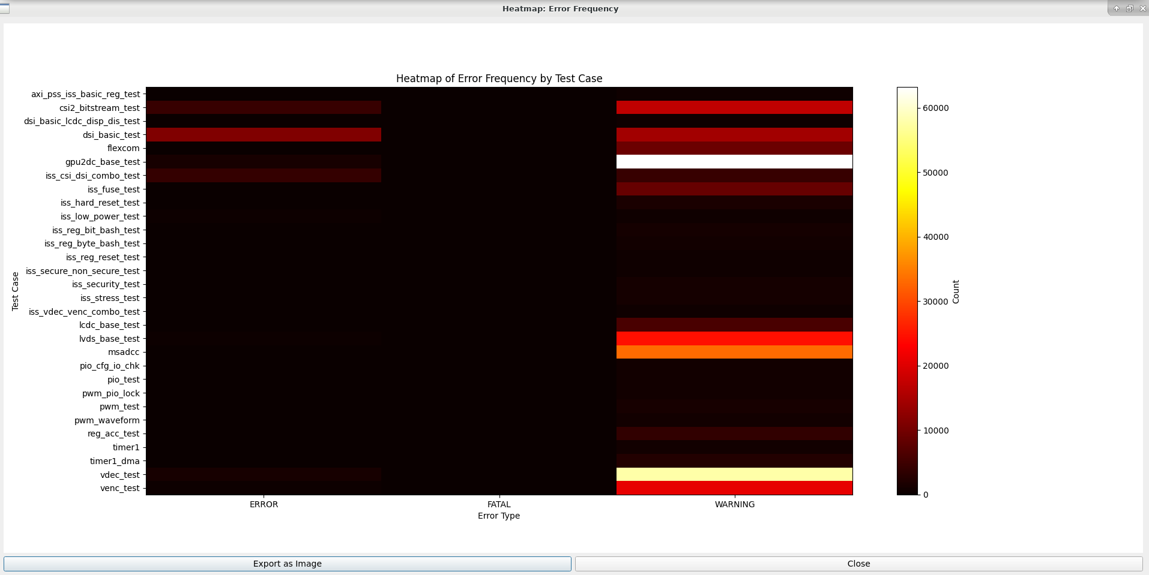
Visualization
Pie Chart: Error type distribution
Heatmap: Error frequency by test case
Useful for identifying trends and hotspots
You can see the charts and Heatmap chart showing error and warnings counts for each test case.
You can export it as png image also

Slide 17
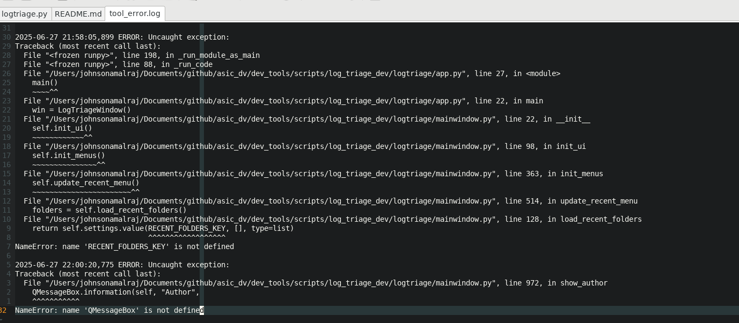
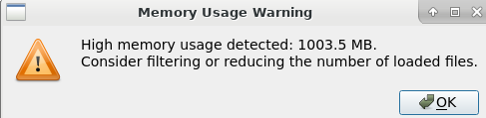
Troubleshooting
Errors logged to tool_error.log
High Memory usage warning (>1GB)

Slide 18
Future Ideas to Consider, Any Suggestions?
Tagging System: Allow users to tag log entries for categorization.
Auto-Triage Suggestions: Use simple heuristics or ML to suggest likely causes or group similar issues.
Integration Hooks: Allow integration with bug tracking tools (e.g., JIRA) or CI/CD pipelines.
Command Line Interface (CLI): For users who prefer scripting or automation.
Comments: When adding comments, apply them to all rows with the same message.
Your feedback and suggestions for improvement are most welcome.

Slide 19
Any Questions?

Slide 20
Thank You
Johnson Amalraj

