Slide 1
Agenda
Critical Rendering Path
Client Side Rendering
Server Side Rendering

Slide 2
Critical Renderring Path
The Critical Rendering Path is the sequence of steps the browser goes through to convert the HTML, CSS, and JavaScript into pixels on the screen.
The critical rendering path includes the Document Object Model (DOM), CSS Object Model (CSSOM), render tree and layout.

Slide 3
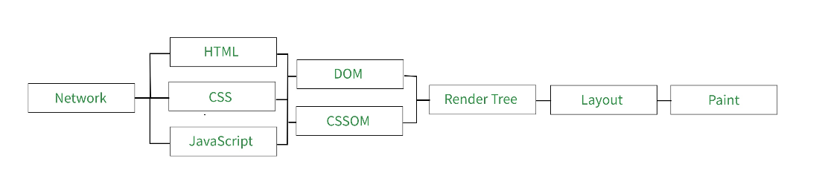

Slide 4
Constructing the DOM Tree
The DOM (Document Object Model) Tree is an Object representation of the fully parsed HTML page. Starting with the root element, <html>, nodes are created for each element/text on the page. Elements nested within other elements are represented as child nodes and each node contains the full attributes for that element

Slide 5
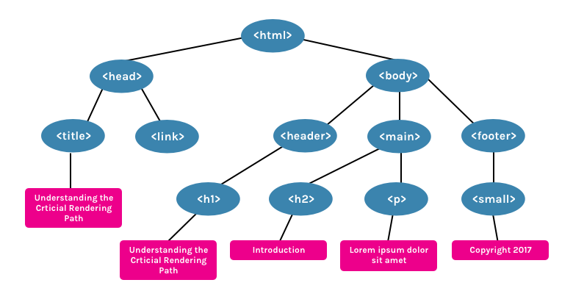

Slide 6
Constructing the CSSOM Tree
The CSSOM (CSS Object Model) is an Object representation of the styles associated with the DOM. It is represented in a similar way to the DOM, but with the associated styles for each node

Slide 7
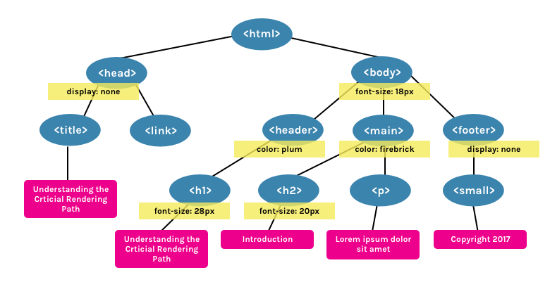

Slide 8
Creating the Render Tree
The Render Tree is a combination of both the DOM and CSSOM. It is a Tree that represents what will be eventually rendered on the page. This means that it only captures the visible content and will not include, for example, elements that have been hidden with CSS using display: none.

Slide 9
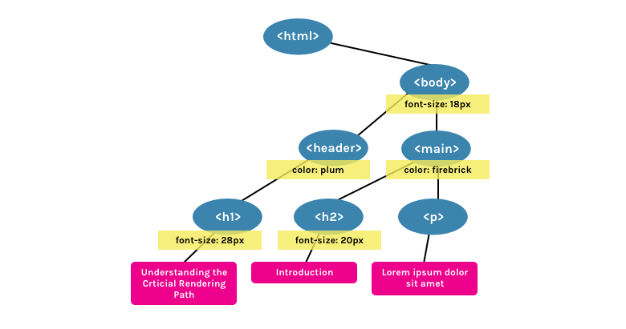

Slide 10
Generating the Layout
The Layout is what determines what the size of the viewport is, which provides context for CSS styles that are dependent on it, e.g. percentage or viewport units. The viewport size is determined by the meta viewport tag provided in the document head or, if no tag is provided, the default viewport width of 980px is used.

Slide 11
Painting
Finally, in the Painting step, the visible content of the page can be converted to pixels to be displayed on the screen.

Slide 12
CRP Recap
Process HTML markup and build the DOM tree.
Process CSS markup and build the CSSOM tree.
Combine the DOM and CSSOM into a render tree.
Run layout on the render tree to compute geometry of each node.
Paint the individual nodes to the screen.

Slide 13
Problems with plain html
Multiple requests to server on navigation
Slow website
Code reusability – Multiple File Load Each For HTML, CSS, JS

Slide 14
What Is a Single Page Application?
A single page application is a single page (hence the name) where a lot of information stays the same and only a few pieces need to be updated at a time.
The SPA only sends what you need with each click, and your browser renders that information. This is different than a traditional page load where the server rerenders a full page with every click you make and sends it to your browser.

Slide 15
Client side rendering
Client-side rendering allows developers to make their websites entirely rendered in the browser with JavaScript. Instead of having a different HTML page per route, a client-side rendered website creates each route dynamically directly in the browser.

Slide 16
Server side rendering
Server-side rendering is where your site’s content is rendered on the web server rather than the browser. This server prepares an HTML file with user-specific data and sends it to the user’s machine.
The browser then interprets the content and displays the page, giving the user a fully rendered HTML page without waiting for JavaScript or CSS files to load.

Slide 17
References
https://github.com/johnson-bhengra-zee/tech-thursday-ssr
https://web.dev/critical-rendering-path/
https://bitsofco.de/understanding-the-critical-rendering-path/
https://www.bloomreach.com/en/blog/2018/what-is-a-single-page-application

Slide 18
Thank You !

