Slide 1
transformer源码阅读
张腾
2021年1月12日

Slide 2
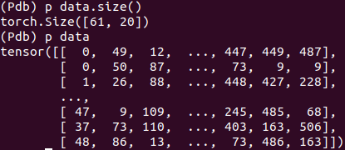
形成字典
{k=word, v=first}
语料(corpus)
token化
batch化^{注}(len*bs)
构建transformer模型^{注}
构建NLLLoss
train
evaluate
export
‘=’(0) | ‘Gameplay’(1) | ‘<eos>’(2) | ‘As’(3) | ‘with’(4) | ‘previous’(5)
‘<unk>’(6) | ‘Chronicles’(7) | ‘games’(8) | ‘,’(9) | ‘Valkyria’(10) | ‘III’(11)
dfd字典（或token）
= = Gameplay = =
As with previous <unk> Chronicles games , Valkyria Chronicles III
注：1. batch化的维度物理意义
注：2. 构建transformer的过程在其他页ppt中展示

Slide 3
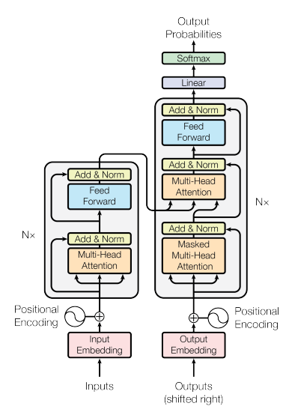

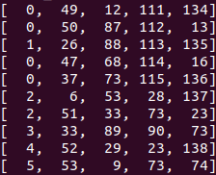
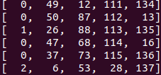
train
模块 | 描述
encoder | nn.Embedding(ntoken, ninp)^{注}:词嵌入word embedding
pos_encoder | PositionalEncoding(ninp, dropout)
transformer_encoder
decoder
log_softmax
data:
train_data:
targets:
https://github.com/pytorch/examples/blob/master/word_language_model/model.py。
注1：后面会有nn.Embedding的详细介绍。

Slide 4
构建transformer模型^{注}
参数 | ntokens | emsize | nhead | nhind | nlayers | dropout
含义 | token的数量 | size of word embeddings | the number of heads | number of hidden units per layer | number of layers | dropout applied to layers
示例 | 18371 | 200 | 2 | 200 | 2 | 0.2

Slide 5
nn.Embedding(ntoken, ninp)
概念：“A simple lookup table that stores embeddings of a fixed dictionary and size.”本质是一个查找表，表里面的内容称之为(word)embedding。至到训练结束，embedding是动态变化(学习)的。
one hot化
. | . | . | .
. | . | . | .
. | . | . | .
. | . | . | .
. | . | . | .
. | . | . | .
. | . | . | .
. | . | . | .
. | . | . | .
. | . | . | .
. | . | . | .
. | . | . | .
1 | 0 | 0 | 0 | 0 | 0 | 0 | 0 | 0 | 0 | 0 | 0
1 | 0 | 0 | 0 | 0 | 0 | 0 | 0 | 0 | 0 | 0 | 0
0 | 1 | 0 | 0 | 0 | 0 | 0 | 0 | 0 | 0 | 0 | 0
1 | 0 | 0 | 0 | 0 | 0 | 0 | 0 | 0 | 0 | 0 | 0
1 | 0 | 0 | 0 | 0 | 0 | 0 | 0 | 0 | 0 | 0 | 0
0 | 0 | 1 | 0 | 0 | 0 | 0 | 0 | 0 | 0 | 0 | 0
0 | 0 | 1 | 0 | 0 | 0 | 0 | 0 | 0 | 0 | 0 | 0
0 | 0 | 0 | 1 | 0 | 0 | 0 | 0 | 0 | 0 | 0 | 0
0 | 0 | 0 | 0 | 1 | 0 | 0 | 0 | 0 | 0 | 0 | 0
0 | 0 | 0 | 0 | 0 | 1 | 0 | 0 | 0 | 0 | 0 | 0
x
所以,nn.Embedding其本质是一个无bias的nn.linear层。

Slide 6
PositionalEncoding(ninp, dropout)

Slide 7
ssrc
PositionalEncoding(ninp, dropout)
linear
q
k
v
scale
view(tgt_len, bs*num_h, head_d)
形变（35, 20, 200）
transpose(0,1)
linear
点乘:bmm(q, k.transpose(1, 2))
mask:attn_output_weights += attn_mask
softmax(X, dim=-1); (40, 35, 35)
x=dropout(x); p=0.2, (40, 35, 35)
注1：python3.8/site-packages/torch/nn/functional.py：L4636
bmm(x, v),(40, 35, 100)

Slide 8
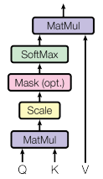
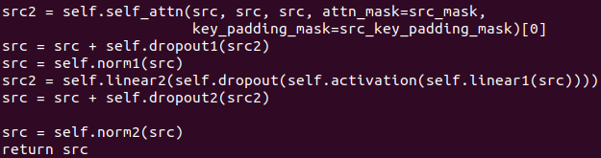
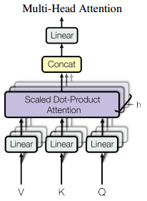
ssrc
PositionalEncoding(ninp, dropout)
self_attn
dropout.2
(layer)norm
x2
ssrc
^{注}
linear
activation(rel
dropout
linear
dropout
norm
ssrc

Slide 9
ssrc
output = self.decoder(output)
self_attn
dropout.2
output(35, 20, 200)
linear
(layer)norm
output(35, 20, ntoken)
x2
ssrc
log_softmax(dim=-1)
linear
activation(rel
output(35, 20, ntoken)
dropout
linear
dropout
norm
ssrc

Slide 10
https://pytorch.org/tutorials/beginner/translation_transformer.html
https://nlp.seas.harvard.edu/2018/04/03/attention.html#batches-and-masking

