Slide 1
Automatically configure O-DU O-RU tool
based on packet analysis
Student:
Supervisor: Ray-Guang Cheng

Slide 2
Introduction

Slide 3
Problem
Interoperability testing of O-RAN equipment often fails due to configuration mismatches. The parameter setup is complex and lacks automation, requiring manual effort and expert knowledge.
Challenge
Each component requires extensive parameter configuration:
OAI CU (27) / OAI DU (112)
LiteOn RU (22)
Debugging relies heavily on experienced engineers interpreting logs and PCAPs, which is time-consuming and hard to scale.
Contribution
A structured debug.yaml dataset is constructed to systematically map log errors to config fixes, enabling automation and knowledge reuse.
Use RAG to retrieve semantically relevant debug cases based on logs or PCAPs.
Notes:
教授建議
1. 你點出兩大挑戰，在貢獻部分，是否有機會更明確的說明你提出什麼方法來解決每一個挑戰？
2. 你要解決的問題，可以用什麼performance metric來量化你的貢獻？

Slide 4
Related Works
Paper | Description
[1] | Prepares extracted intents for transformation into actionable network policies (e.g., JSON requests) Identifies multiple intents in a single user request and separates them with explanations
[2] | Uses semantic similarity retrieval (sentence transformer) to improve context matching Addresses complexity, parameter errors, and high entry barriers in 5G IBN configuration
[3]
Tab 1: Related Work
[1] D. M. Manias, A. Chouman and A. Shami, "Towards Intent-Based Network Management: Large Language Models for Intent Extraction in 5G Core Networks," 2024 20th International Conference on the Design of Reliable Communication Networks (DRCN), Montreal, QC, Canada, 2024, pp. 1-6
[2] A. Mekrache and A. Ksentini, "LLM-enabled Intent-driven Service Configuration for Next Generation Networks," 2024 IEEE 10th International Conference on Network Softwarization (NetSoft), Saint Louis, MO, USA, 2024, pp. 253-257
[3] Y. Beining, S. Alassane, F. Guillaume and C. Sihem, "Generating Commit Messages for Configuration Files in 5G Network Deployment Using LLMs," 2024 20th International Conference on Network and Service Management (CNSM), Prague, Czech Republic, 2024, pp. 1-7
[1] R. Ferrús, "Machine learning-assisted cross-slice radio resource optimization: Implementation framework and algorithmic solution," ITU Journal on Future and Evolving Technologies, vol. 1, no. 1, pp. 1-18, Dec. 2020
[2] V. Sciancalepore, X. Costa-Perez, and A. Banchs, “Rl-nsb: Reinforcement learning-based 5g network slice broker,” IEEE/ACM Transactions on Networking, vol. 27, no. 4, pp. 1543–1557, 2019.
[3] G. Sun, K. Xiong, G. O. Boateng, G. Liu, and W. Jiang, “Resource slicing and customization in ran with dueling deep q-network,” Journal of Network and Computer Applications, vol. 157, p. 102573, 2020
Notes:
修改引用格式
[1] B. Bertenyi et al., “5G NR Radio Interface,” Journal of ICT Standardization, vol. 6, no. 1, pp. 31–58, 2018, doi: https://doi.org/10.13052/jicts2245-800x.613.

Slide 5
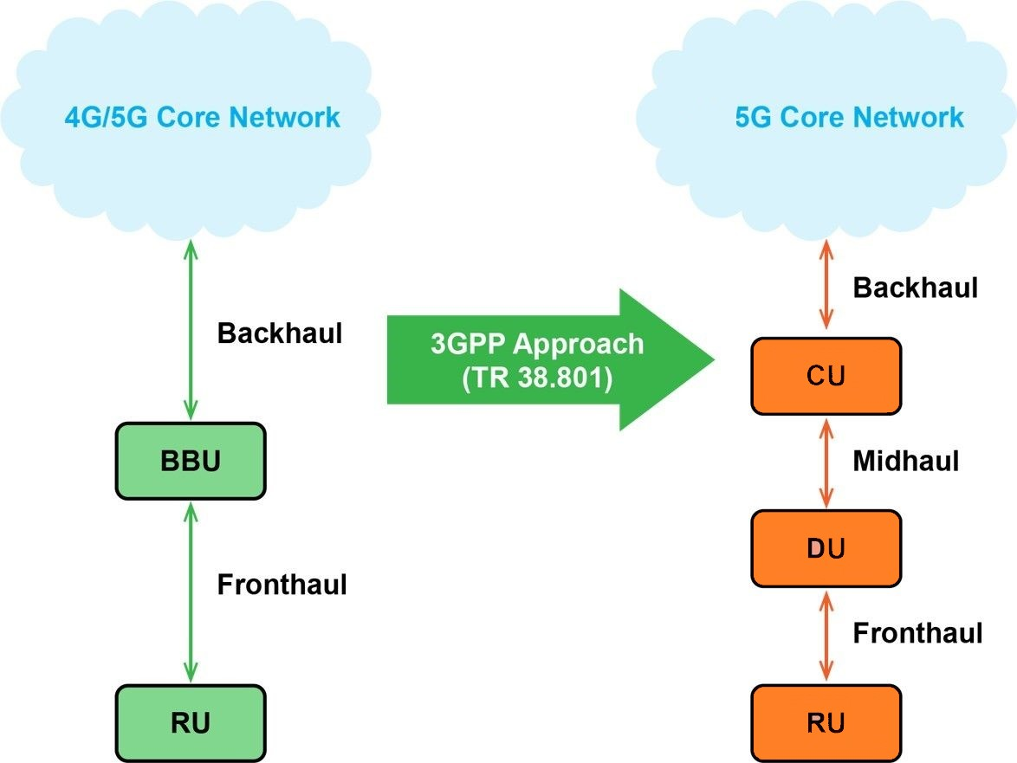
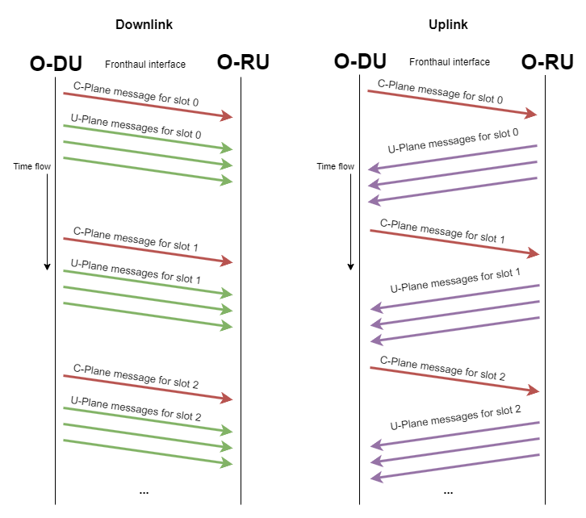
C/U-Plane Data Flow

Slide 6
5G End to end procedure

Slide 7
Performance matrix

Slide 8
System Architecture

Slide 10
Experimental Results
Notes:
先用一張圖說明目前的測試架構，以及各自所使用之軟硬體。
說明VIAVI RIC Test設定的拓樸與參數為何。
根據各個Test Case說明其目的，與測試結果，並且分析。

Slide 11
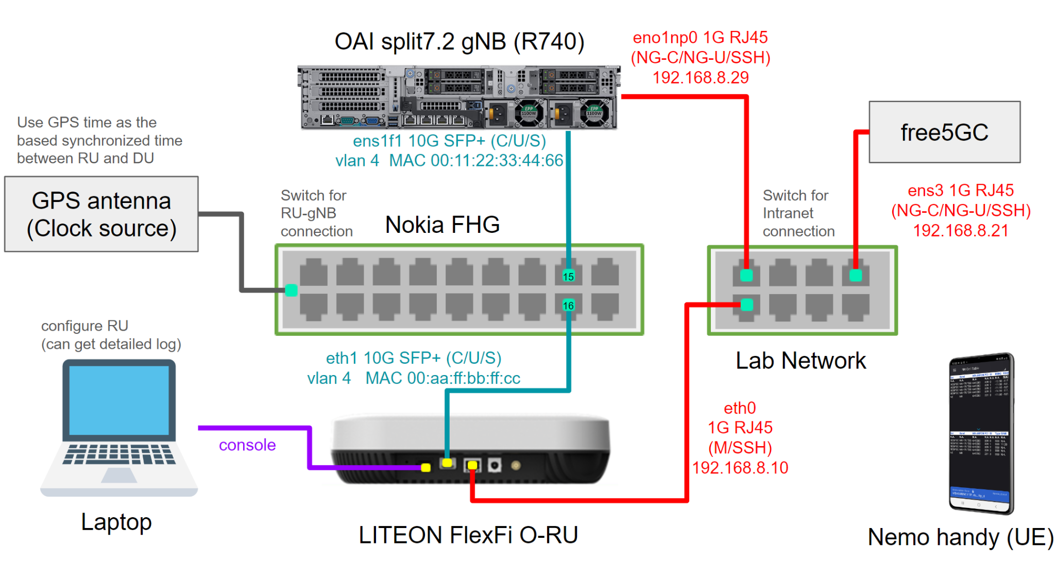
Testing Environment

Slide 12
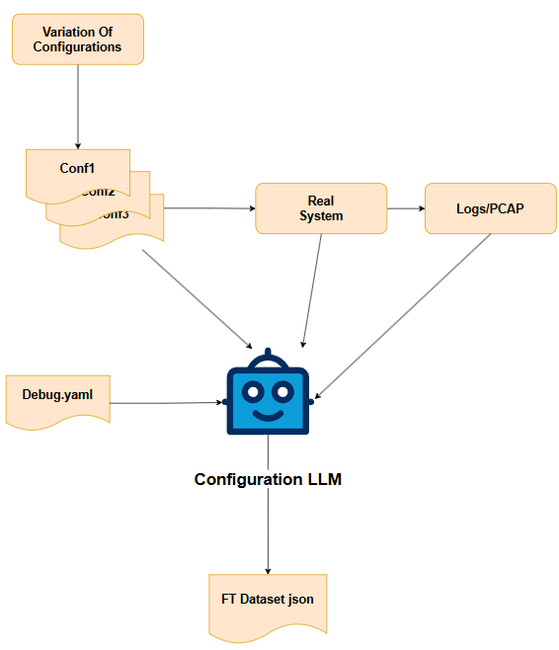
Dataset Generation Process:
Generate multiple .conf configuration files using an automated generator and run them in a real or simulated RAN environment.
After execution, record the logs and error messages returned by the system.
Input the .conf files and corresponding logs into the debug analysis tool to automatically generate corresponding training samples (error type + corrected version).
1
2
3

Slide 13
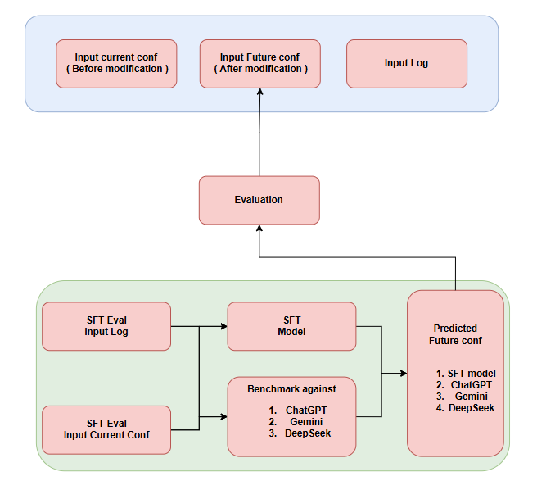
1. Accuracy-1 (ACC1): Structural Correctness
Definition: Whether the output configuration file follows a valid syntax structure (e.g., brackets, indentation, block ordering).
Goal: Assess the model’s ability to generate syntactically correct configuration files.
2. Accuracy-2 (ACC2): Parameter-Level Correctness
Definition: Beyond syntax, whether the model generates correct key-value pairs and values in response to specific errors.
Goal: Measure the model's semantic understanding of configuration errors and its capability to generate valid corrections.
3. Model Reasoning Score (LLM-based Evaluation)
Definition: Use a third-party LLM (e.g., GPT-4) to evaluate the reasoning quality of the model output.
Method: Feed the input config, error log, and model output to the evaluator LLM, which assigns a reasoning score (e.g., 1–5) and provides a brief justification.

Slide 14
Testing Limitation

Slide 15
Situation
Situation 1: Evaluation of Model Size Impact within the Same LLM Family
Situation 2: Evaluation of RAG Performance Across LLMs with Similar Size
Situation 3: Evaluation of Semantic Augmentation in Small vs. Large LLMs
Situation 4: Evaluation of SFT, RAG, and Baseline LLMs on Configuration Error Explanation
Situation 5: Log Duration Impact on Processing Time
Prompt templates reference & scoring method:
Judging LLM-as-a-Judge with MT-Bench and Chatbot Arena
G-EVAL: NLG Evaluation using GPT-4 with Better Human Alignment
Notes:
說明有幾項實驗，分別的目的為何

Slide 16
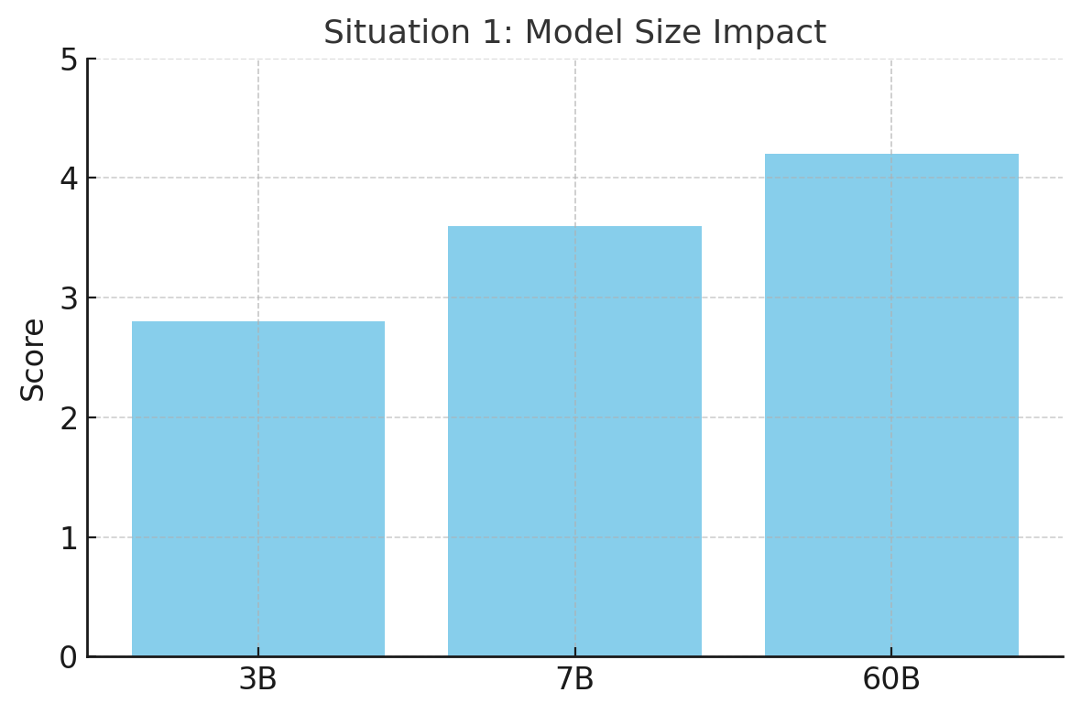
Situation 1: Evaluation of Model Size Impact within the Same LLM Family
Validate:
Does generation quality consistently improve with model size?
Does RAG provide more relative gain to smaller models?
Using which model ?
Using which size ?
LLM Performance Leaderboard
Notes:
PS C:\Users\wasd0> & C:/Users/wasd0/AppData/Local/Programs/Python/Python310/python.exe c:/Users/wasd0/Desktop/test/test.py
01-ai/yi-large
abacusai/dracarys-llama-3.1-70b-instruct
adept/fuyu-8b
ai21labs/jamba-1.5-large-instruct
ai21labs/jamba-1.5-mini-instruct
aisingapore/sea-lion-7b-instruct
baai/bge-m3
baichuan-inc/baichuan2-13b-chat
bigcode/starcoder2-15b
bigcode/starcoder2-7b
databricks/dbrx-instruct
deepseek-ai/deepseek-coder-6.7b-instruct
deepseek-ai/deepseek-r1
deepseek-ai/deepseek-r1-distill-llama-8b
deepseek-ai/deepseek-r1-distill-qwen-14b
deepseek-ai/deepseek-r1-distill-qwen-32b
deepseek-ai/deepseek-r1-distill-qwen-7b
google/codegemma-1.1-7b
google/codegemma-7b
google/deplot
google/gemma-2-27b-it
google/gemma-2-2b-it
google/gemma-2-9b-it
google/gemma-2b
google/gemma-3-12b-it
google/gemma-3-1b-it
google/gemma-3-27b-it
google/gemma-3-4b-it
google/gemma-7b
google/paligemma
google/recurrentgemma-2b
google/shieldgemma-9b
gotocompany/gemma-2-9b-cpt-sahabatai-instruct
ibm/granite-3.0-3b-a800m-instruct
ibm/granite-3.0-8b-instruct
ibm/granite-3.3-8b-instruct
ibm/granite-34b-code-instruct
ibm/granite-8b-code-instruct
ibm/granite-guardian-3.0-8b
igenius/colosseum_355b_instruct_16k
igenius/italia_10b_instruct_16k
institute-of-science-tokyo/llama-3.1-swallow-70b-instruct-v0.1
institute-of-science-tokyo/llama-3.1-swallow-8b-instruct-v0.1
marin/marin-8b-instruct
mediatek/breeze-7b-instruct
meta/codellama-70b
meta/llama-3.1-405b-instruct
meta/llama-3.1-70b-instruct
meta/llama-3.1-8b-instruct
meta/llama-3.2-11b-vision-instruct
meta/llama-3.2-1b-instruct
meta/llama-3.2-3b-instruct
meta/llama-3.2-90b-vision-instruct
meta/llama-3.3-70b-instruct
meta/llama-4-maverick-17b-128e-instruct
meta/llama-4-scout-17b-16e-instruct
meta/llama2-70b
meta/llama3-70b-instruct
meta/llama3-8b-instruct
microsoft/kosmos-2
microsoft/phi-3-medium-128k-instruct
microsoft/phi-3-medium-4k-instruct
microsoft/phi-3-mini-128k-instruct
microsoft/phi-3-mini-4k-instruct
microsoft/phi-3-small-128k-instruct
microsoft/phi-3-small-8k-instruct
microsoft/phi-3-vision-128k-instruct
microsoft/phi-3.5-mini-instruct
microsoft/phi-3.5-moe-instruct
microsoft/phi-3.5-vision-instruct
microsoft/phi-4-mini-instruct
microsoft/phi-4-multimodal-instruct
mistralai/codestral-22b-instruct-v0.1
mistralai/mamba-codestral-7b-v0.1
mistralai/mathstral-7b-v0.1
mistralai/mistral-7b-instruct-v0.2
mistralai/mistral-7b-instruct-v0.3
mistralai/mistral-large
mistralai/mistral-large-2-instruct
mistralai/mistral-medium-3-instruct
mistralai/mistral-small-24b-instruct
mistralai/mistral-small-3.1-24b-instruct-2503
mistralai/mixtral-8x22b-instruct-v0.1
mistralai/mixtral-8x22b-v0.1
mistralai/mixtral-8x7b-instruct-v0.1
nv-mistralai/mistral-nemo-12b-instruct
nvidia/embed-qa-4
nvidia/llama-3.1-nemoguard-8b-content-safety
nvidia/llama-3.1-nemoguard-8b-topic-control
nvidia/llama-3.1-nemotron-51b-instruct
nvidia/llama-3.1-nemotron-70b-instruct
nvidia/llama-3.1-nemotron-70b-reward
nvidia/llama-3.1-nemotron-nano-8b-v1
nvidia/llama-3.1-nemotron-nano-vl-8b-v1
nvidia/llama-3.1-nemotron-ultra-253b-v1
nvidia/llama-3.2-nv-embedqa-1b-v1
nvidia/llama-3.2-nv-embedqa-1b-v2
nvidia/llama-3.3-nemotron-super-49b-v1
nvidia/llama3-chatqa-1.5-70b
nvidia/llama3-chatqa-1.5-8b
nvidia/mistral-nemo-minitron-8b-8k-instruct
nvidia/mistral-nemo-minitron-8b-base
nvidia/nemoretriever-parse
nvidia/nemotron-4-340b-instruct
nvidia/nemotron-4-340b-reward
nvidia/nemotron-4-mini-hindi-4b-instruct
nvidia/nemotron-mini-4b-instruct
nvidia/neva-22b
nvidia/nv-embed-v1
nvidia/nv-embedcode-7b-v1
nvidia/nv-embedqa-e5-v5
nvidia/nv-embedqa-mistral-7b-v2
nvidia/nvclip
nvidia/usdcode-llama-3.1-70b-instruct
nvidia/vila
qwen/qwen2-7b-instruct
qwen/qwen2.5-7b-instruct
qwen/qwen2.5-coder-32b-instruct
qwen/qwen2.5-coder-7b-instruct
qwen/qwen3-235b-a22b
qwen/qwq-32b
rakuten/rakutenai-7b-chat
rakuten/rakutenai-7b-instruct
snowflake/arctic-embed-l
thudm/chatglm3-6b
tiiuae/falcon3-7b-instruct
tokyotech-llm/llama-3-swallow-70b-instruct-v0.1
upstage/solar-10.7b-instruct
utter-project/eurollm-9b-instruct
writer/palmyra-creative-122b
writer/palmyra-fin-70b-32k
writer/palmyra-med-70b
writer/palmyra-med-70b-32k
yentinglin/llama-3-taiwan-70b-instruct
zyphra/zamba2-7b-instruct

Slide 17
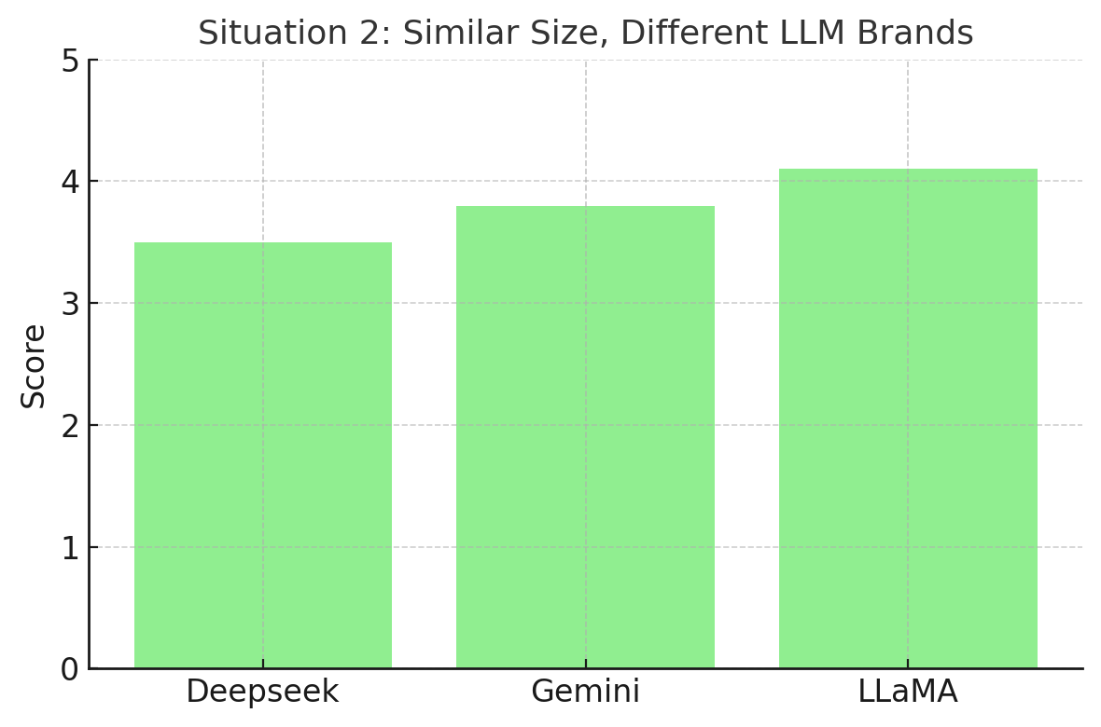
Situation 2: Evaluation of RAG Performance Across LLMs with Similar Size
Validate:
Are there significant differences in RAG effectiveness across model brands?
Which model shows the most improvement when RAG is applied?

Slide 18
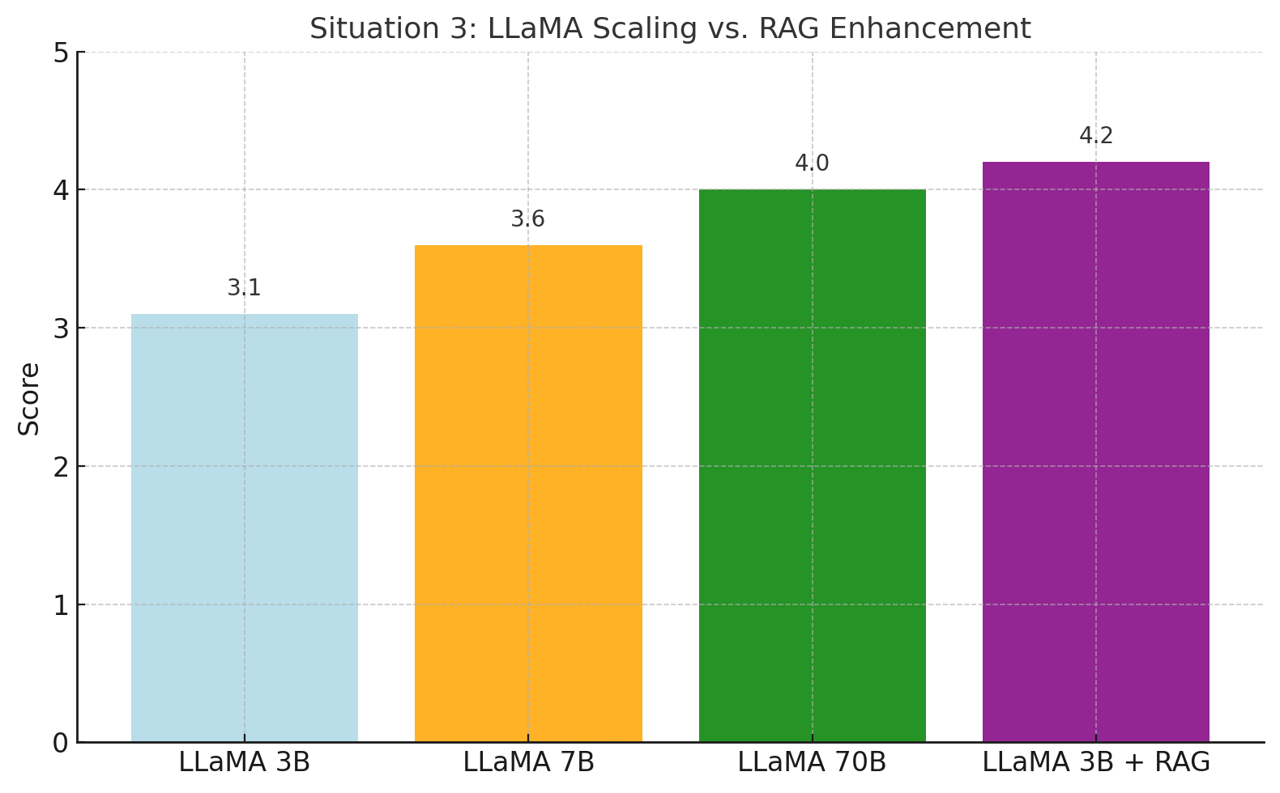
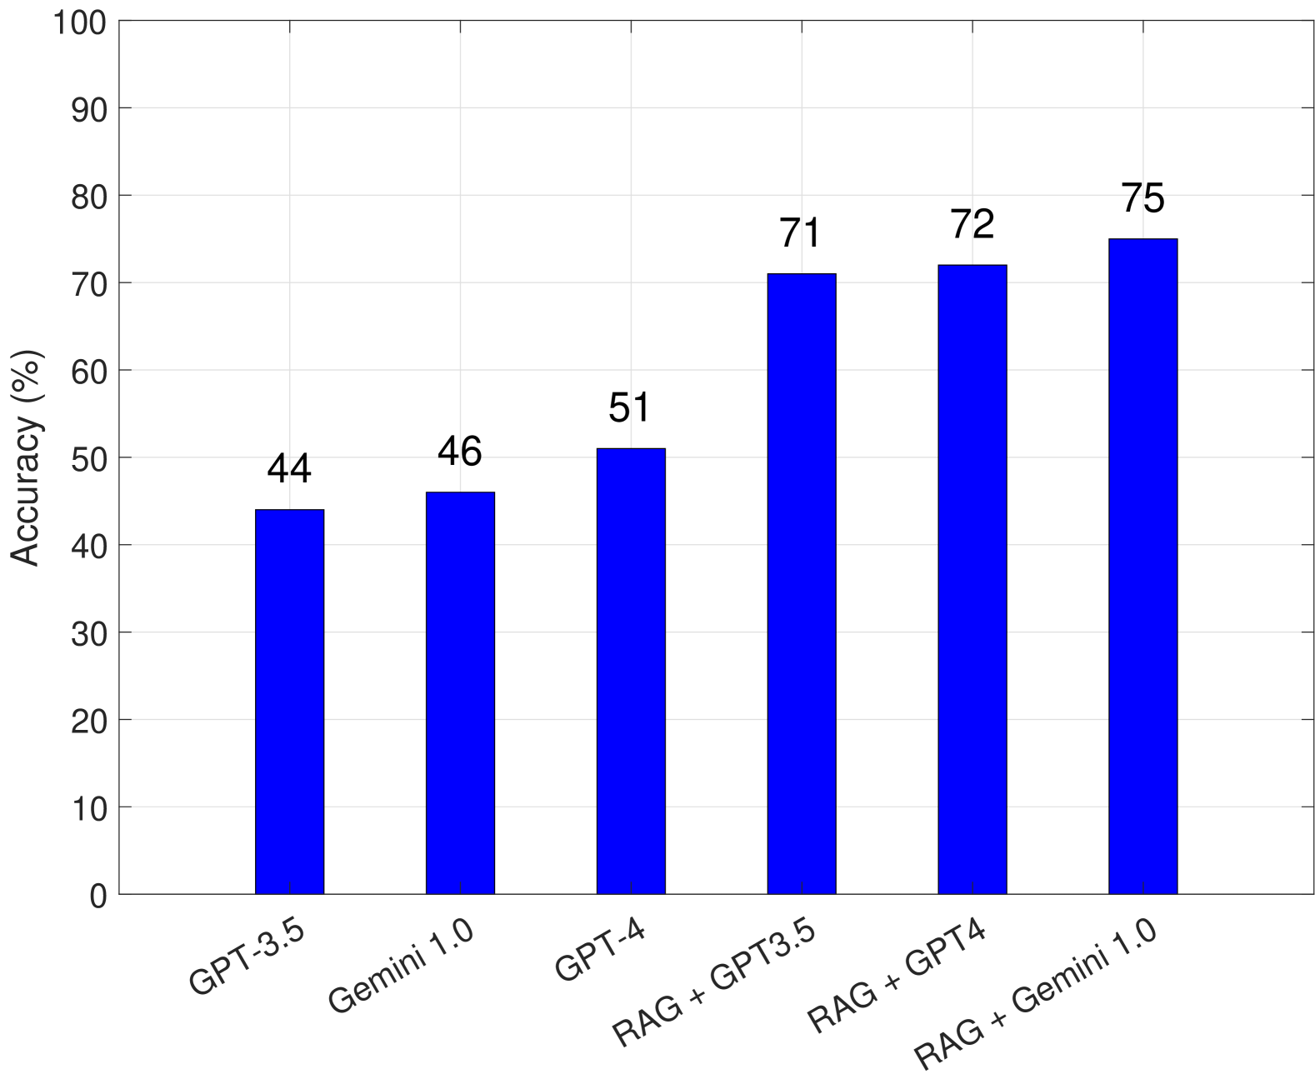
Situation 3: Evaluation of Semantic Augmentation in Small vs. Large LLMs
Validate:
Can small models with RAG outperform large models without RAG?
Is the marginal benefit of RAG greater for small models?
Reference

Slide 19
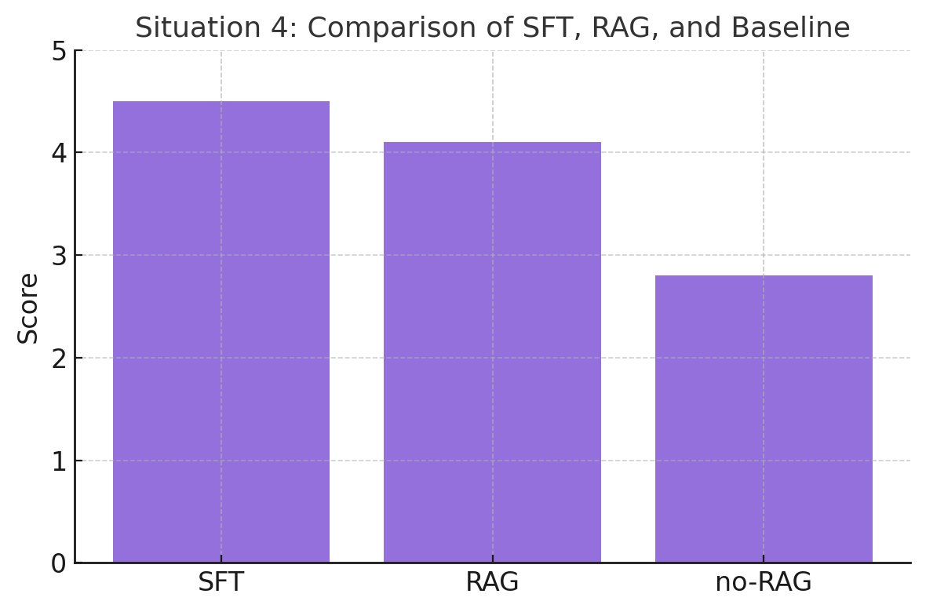
Situation 4: Evaluation of SFT, RAG, and Baseline LLMs on Configuration Error Explanation
Validate:
Can small models with RAG outperform large models without RAG?
Is the marginal benefit of RAG greater for small models?

Slide 20
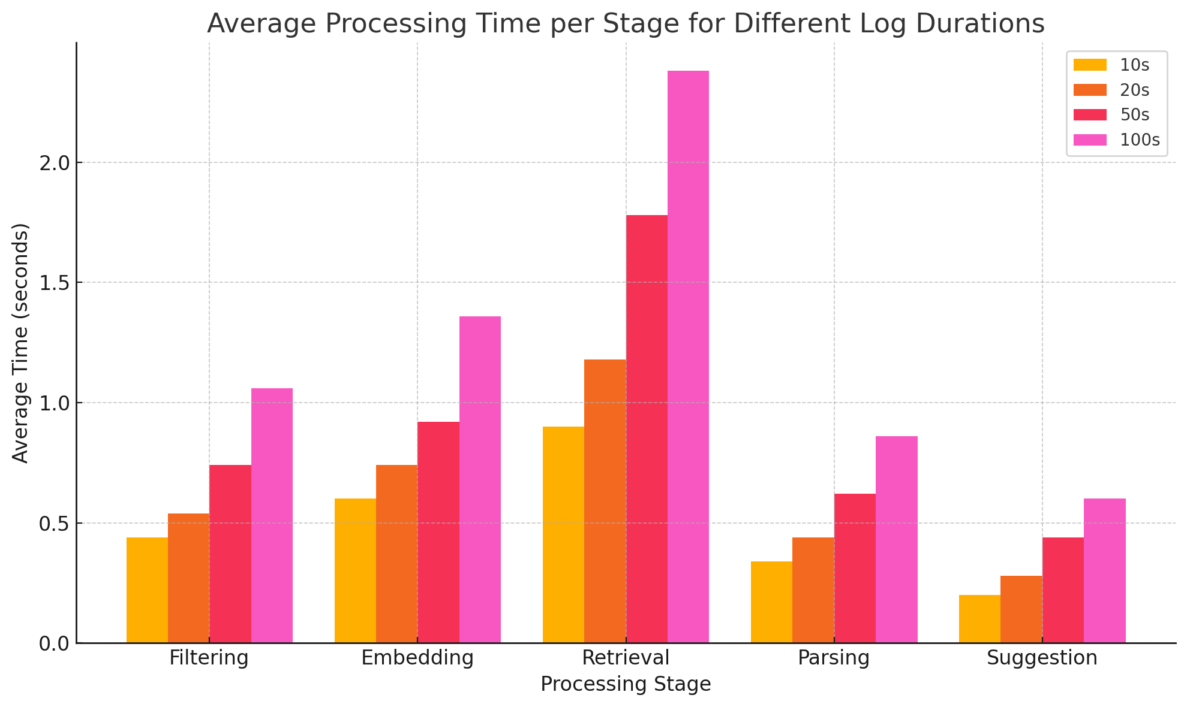
Situation 5: Log Duration Impact on Processing Time
Validate:
Measure how processing time scales with log length for both stages.
Analyze whether different error types require different log durations.

Slide 21
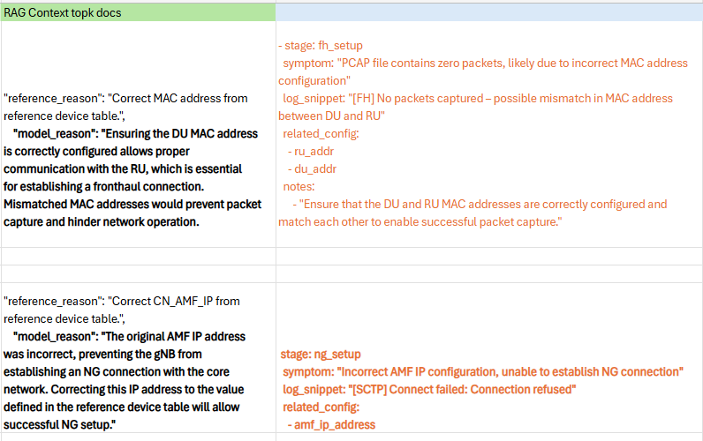
Comparative experiments
show that, compared to a non-RAG LLM, our system demonstrates significantly better performance in terms of error correction accuracy and response reliability.

Slide 22
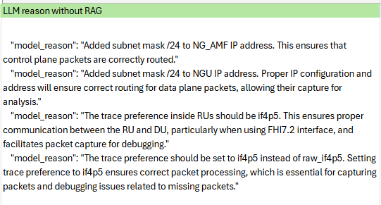
Common Issues Without RAG Support
Hallucination errors
Incorrect suggestions
Ignoring actual log content
Invalid configuration output

Slide 24
other thing
Notes:
先用一張圖說明目前的測試架構，以及各自所使用之軟硬體。
說明VIAVI RIC Test設定的拓樸與參數為何。
根據各個Test Case說明其目的，與測試結果，並且分析。

Slide 25
Defining the prompt component
Emphasized atomic chunk design in embedding. ( Low priority )
Johnson will study chunk size, overlap, and expand SFT examples. ( Low priority )
Proposed metrics using debug data and evaluated by context and answer relevance.
Johnson aims to finalize the framework and involve interns.

Slide 26
Use other LLMs to score them to assess whether they are reasonable. Johnson will be responsible for this part of the framework.
The process of automatically creating YAML was discussed, and the need to create a JSON file containing multiple records was emphasized to facilitate debugging.
Johnson will complete the relevant framework and hand it over to interns to help speed up the relevant process

Slide 27
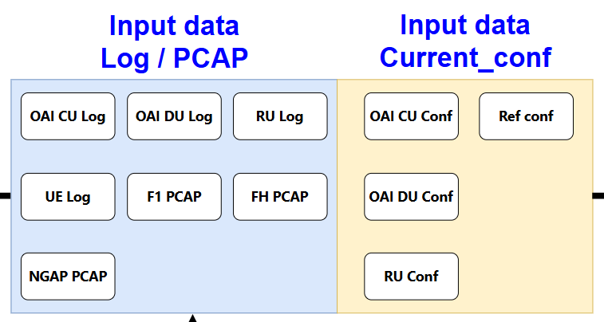
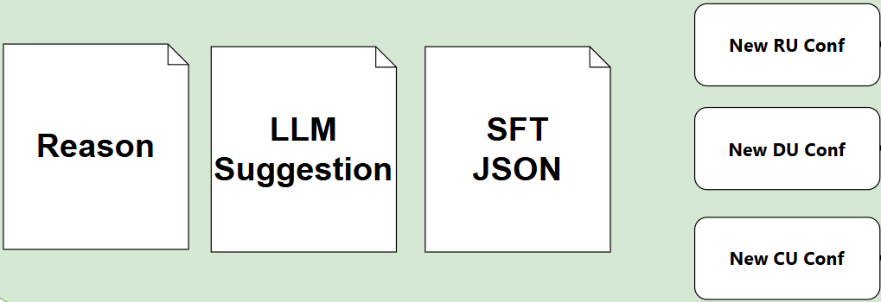
Problem Definition
Input: A set of CU / DU / FH logs and the original configuration file.
Objective: Automatically generate a modified configuration file that results in successful CU/DU/RU integration.
Output data

Slide 28
SYSTEM MODEL - Output

Slide 29
Experimental Validation
Test samples include error conf, multiple log, PCAP files, covering common failure scenarios such as:
Incorrect AMF IP configuration
Cell search failures
F1 setup failures
……
Evaluation metrics include the following:
Context Relevance: Measures how semantically relevant the retrieved context is to the query
Answer Relevance: Measures whether the LLM’s response addresses the user's actual need
Groundedness: Verifies whether the response is based on retrieved context rather than hallucination
Other LLM evaluation criteria, such as helpfulness, clarity, and consistency

Slide 30
Comparative experiments
show that, compared to a non-RAG LLM, our system demonstrates significantly better performance in terms of error correction accuracy and response reliability.

Slide 31
Common Issues Without RAG Support
Hallucination errors
Incorrect suggestions
Ignoring actual log content
Invalid configuration output

Slide 32
CONCLUSION
Proposes an automated tool integrating LLM and RAG that analyzes logs and PCAPs to dynamically adjust configuration files for successful O-RAN (CU/DU/RU) integration.
The system features a full pipeline of log parsing, semantic retrieval, suggestion generation, and configuration modification, significantly reducing manual debugging efforts.
A core component, debug.yaml, was developed to store structured entries including error symptoms, log snippets, related config parameters, and recommended fixes.
The dataset is modular and highly extensible, enabling continuous updates with new error cases and easy version maintenance.
Beyond retrieval, debug.yaml functions as a knowledge repository, promoting reuse and long-term knowledge transfer.

Slide 33
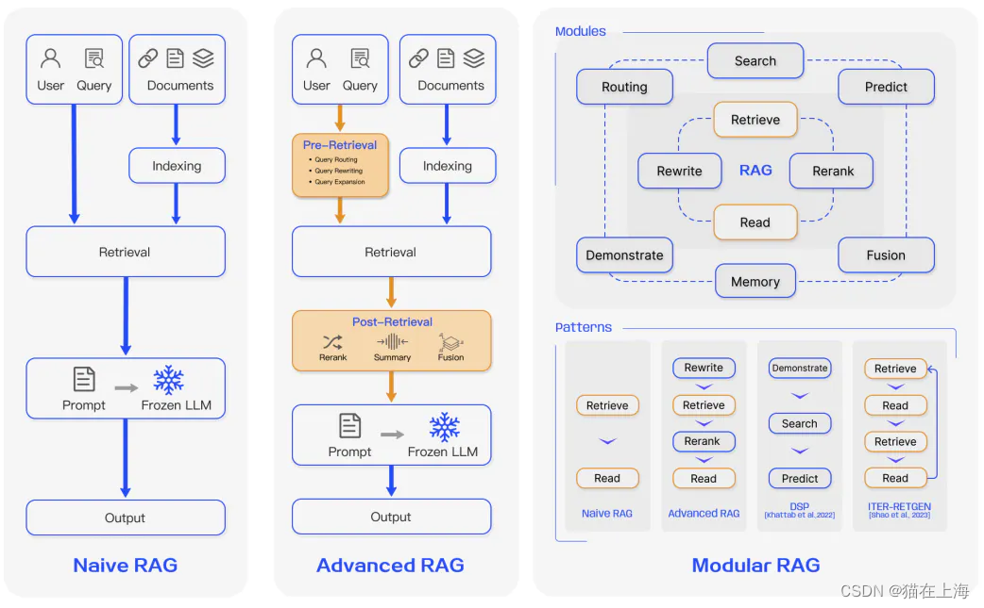
Future work - RAG Improvements
Upgrade the Naive RAG (simple embedding-based retrieval with context concatenation) to Advanced RAG, such as:
Multi-stage retrieval: Coarse-to-fine filtering using an initial retriever followed by a reranker
Chunk filtering and dynamic length adjustment: Select optimal context length and granularity based on query semantics
Multi-source fusion: Combine multiple types of inputs (logs, config files, PCAPs) for richer contextual grounding
Structure-guided generation: Inject configuration schema (e.g., YAML, JSON trees) to guide LLM response
Retrieval-conditioned decoding: Use retrieved snippets as control prompts to steer generation toward factual relevance

Slide 34
Future work - SFT
Model : LLaMa-1B
GPU resource : NIV ?
Method ?
LoRA
P-tuning v2
Freeze
Training data : 1000

Slide 36
What's your target?
Proposes an automated tool integrating LLM and RAG that analyzes logs and PCAPs to dynamically adjust configuration files for successful O-RAN (CU/DU/RU) integration.
The system features a full pipeline of log parsing, semantic retrieval, suggestion generation, and configuration modification, significantly reducing manual debugging efforts.
A core component, debug.yaml, was developed to store structured entries including error symptoms, log snippets, related config parameters, and recommended fixes.
The dataset is modular and highly extensible, enabling continuous updates with new error cases and easy version maintenance.
Beyond retrieval, debug.yaml functions as a knowledge repository, promoting reuse and long-term knowledge transfer.

Slide 37
Comparative experiments
show that, compared to a non-RAG LLM, our system demonstrates significantly better performance in terms of error correction accuracy and response reliability.

Slide 38
Common Issues Without RAG Support
Hallucination errors
Incorrect suggestions
Ignoring actual log content
Invalid configuration output

Slide 39
Experimental Validation
Test samples include error conf, multiple log, PCAP files, covering common failure scenarios such as:
Incorrect AMF IP configuration
Cell search failures
F1 setup failures
……
Evaluation metrics include the following:
Context Relevance: Measures how semantically relevant the retrieved context is to the query
Answer Relevance: Measures whether the LLM’s response addresses the user's actual need
Groundedness: Verifies whether the response is based on retrieved context rather than hallucination
Other LLM evaluation criteria, such as helpfulness, clarity, and consistency

Slide 40
INTRODUCTION
Problem:
gNB and RU integration is "time-consuming and labor-intensive"
Challenge:
gNB and RU settings are very complex, requiring professional skills to interpret PCAP and Log
This study proposes an automated tool combining LLM and RAG to address the challenges of configuration errors and manual debugging in 5G O-RAN system integration.
Traditional integration requires extensive manual effort and domain knowledge, with configuration errors often causing integration failures.
A modular, extensible, and reusable integrated debug knowledge base was developed to effectively reduce the knowledge barrier and maintenance effort for future users.

