Slide 1
Bubble Sort Algorithm
Explanation with an Example
Sivamani Pittala

Slide 2
Introduction to Bubble Sort
Definition of Bubble Sort
Key Characteristics
Use Cases

Slide 3
Algorithm Steps
1. Iterate over the array multiple times.
2. Compare adjacent elements and swap if needed.
3. Continue until no swaps are needed in a pass.

Slide 4
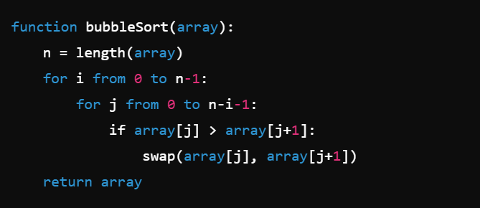

Slide 5
Example: Initial Array
Initial Array: [64, 34, 25, 12, 22, 11, 90]

Slide 6
Iteration 1
Compare 64 and 34, swap.
Compare 64 and 25, swap.
Compare 64 and 12, swap.
Compare 64 and 22, swap.
Compare 64 and 11, swap.
Compare 64 and 90, no swap.
Resulting Array: [34, 25, 12, 22, 11, 64, 90]

Slide 7
Iteration 2
Compare 34 and 25, swap.
Compare 34 and 12, swap.
Compare 34 and 22, swap.
Compare 34 and 11, swap.
Compare 34 and 64, no swap.
Resulting Array: [25, 12, 22, 11, 34, 64, 90]

Slide 8
Iteration 3
Compare 25 and 12, swap.
Compare 25 and 22, swap.
Compare 25 and 11, swap.
Compare 25 and 34, no swap.
Compare 34 and 64, no swap.
Resulting Array: [12, 22, 11, 25, 34, 64, 90]

Slide 9
Final Iterations
Continue comparing and swapping until sorted.
Final Sorted Array: [11, 12, 22, 25, 34, 64, 90]

Slide 10
Summary
Summary of Bubble Sort
Time Complexity: O(n^2)
Space Complexity: O(1)
Questions?

