Slide 1
Dialogflow + LineBot LineBot +Ｄatabase

Slide 2
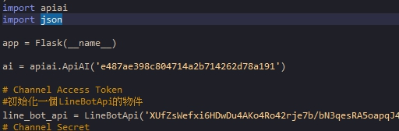
Dialogflow + LineBot

Slide 3
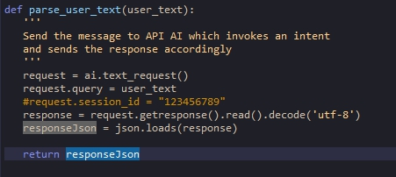
Dialogflow + LineBot

Slide 4
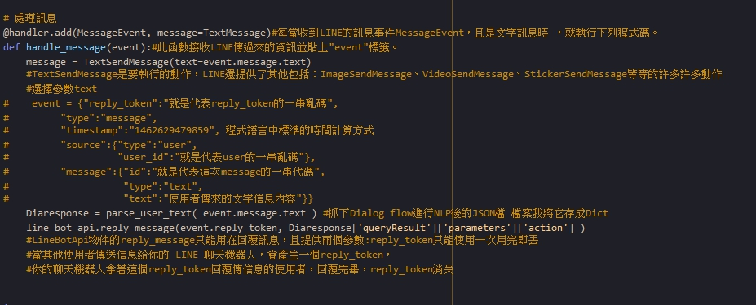
Dialogflow + LineBot

Slide 5
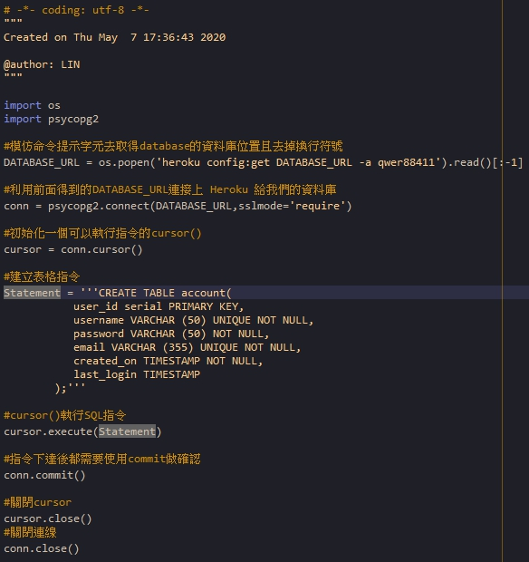
Database簡單練習(CREATE)

Slide 6
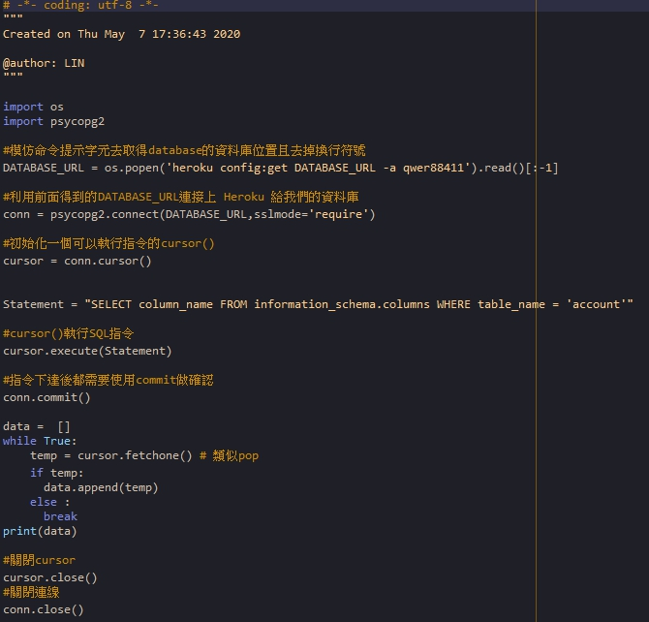
Database簡單練習(SELECT)

Slide 7
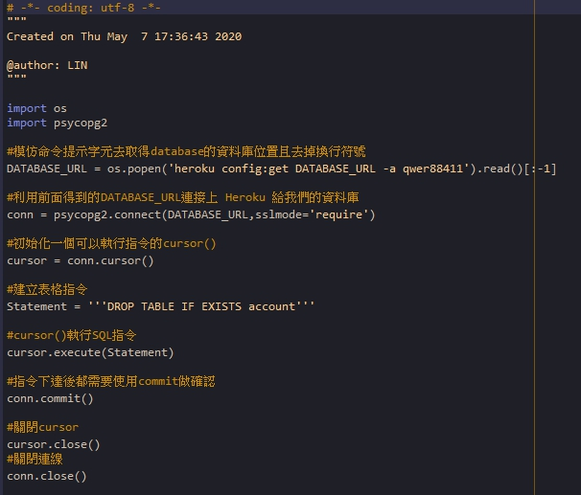
Database簡單練習(DROP)

Slide 8
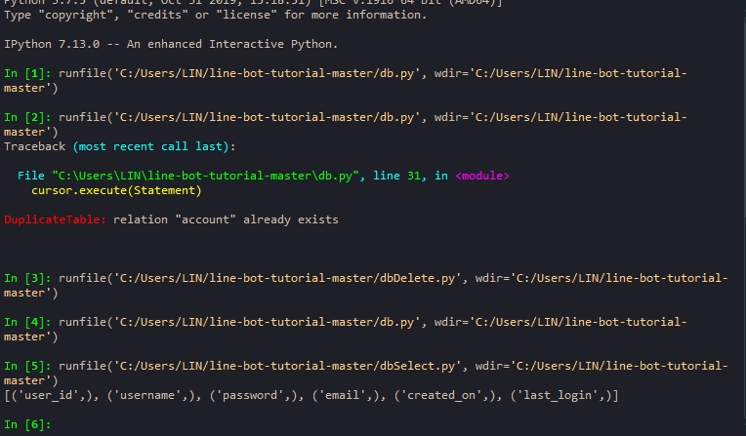
Database簡單練習(結果)

