Slide 1

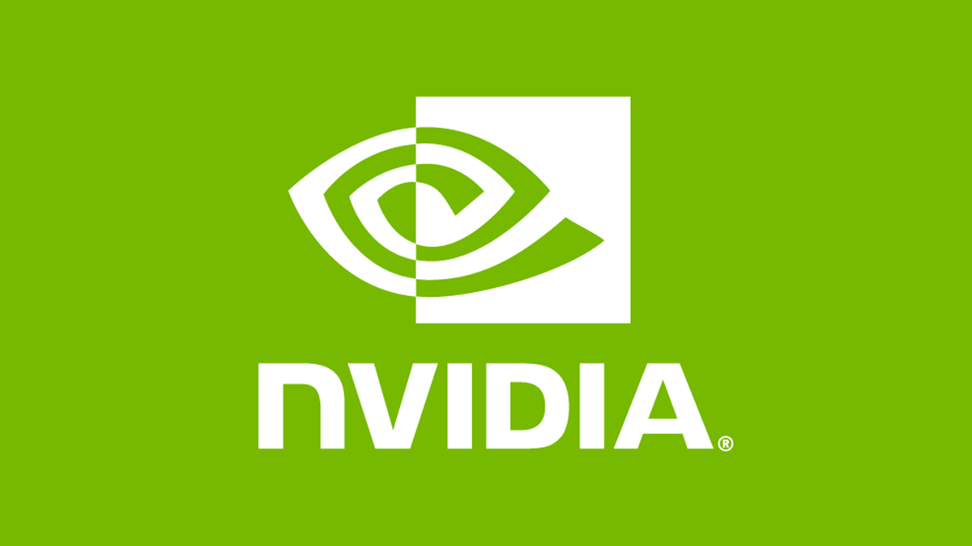
DART
Data Assimilation
Research Testbed
Participants
Helen Kershaw, Chris Riedel & Ben Johnson
National Center for Atmospheric Research
Mentors
Raj Kumar, Carl Ponder & Pranay Kommera
Nvidia Corporation

Slide 2
What is data assimilation?

Slide 3
What is data assimilation?

Slide 4
What is data assimilation?

Slide 5
What is data assimilation?

Slide 6
What is data assimilation?

Slide 7
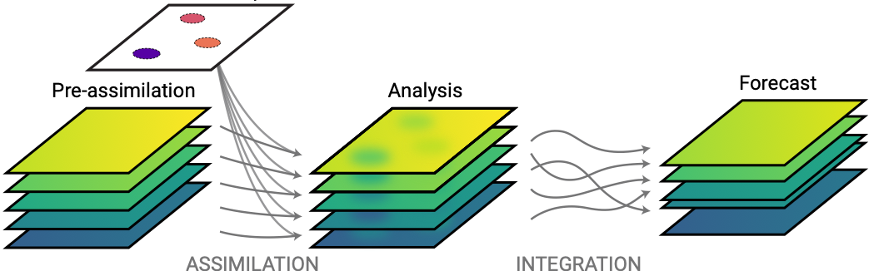
What is data assimilation?

Slide 8



What is DART?
General-purpose codebase
Interfaces with atmospheric, oceanographic, cryospheric, land surface & space weather models.
Works with any type of observation
Satellites, weather balloons, undersea gliders, radar stations, GPS, etc. Each type can pose unique challenges.
Range of users
Students use it to learn from conceptual models on their laptops. Experts run large-scale experiments.
Written in FORTRAN
Implements algorithms currently used in weather forecasting and experimental techniques
Accommodates huge state vectors; one-way MPI communications
Working to improve DART’s get_close algorithm

