Slide 1
CSE687 - Object Oriented Design class notes
Survey of the
C++
Programming Language
Jim Fawcett
Spring 2005

Slide 2
Survey
Major features of the Standard C++ Language
  Classes
  Constructors and destructors
  Operator model
  Class relationships
  References
  Exceptions
  Templates
Major features of the Standard C++ Library
  Streams
  STL – containers, iterators, algorithms

Slide 3
C++ Classes
Three design prime directives are:
  Make designs cohesive
  Use strong encapsulation
  Minimize coupling
C++ Class Model
  C++ evolved initially by adding classes to the C language.
  Classes provide direct support for the last two directives:
    Support public, protected, and private access control
    Eliminate the need for global data
    Provide const qualifiers used to qualify member functions and their arguments.
  C++ classes support a deep copy object model.
    Assignment and Copy construction are value-based operations.
    If you define a destructor you almost always need to define copy construction and assignment operations, or make them private.
  Member functions are the exclusive mechanism for transforming and accessing class data.
Defining a class:
SurvivalGuide.doc#classes

Slide 4
Features
Constructors and destructors
  Objects are created from a class pattern only by calling a constructor.
  Whenever the thread of execution leaves a scope, all objects created in that scope are destroyed, even in the presense of exceptions. Part of that destruction is the execution of the objects’ destructors.
  The C++ ctor/dtor model is intended to be the universal mechanism for managing allocated resources. Exceptions make this essential.
Operator model:
  Helps to move source code closer to the application domain.
  x@y ⬄ x.X::operator@(y) member operator
  x@y ⬄ ::operator@(x,y) global operator
Class relationships
  Inheritance, composition, aggregation, and using
  Support a rich model for managing run-time behavior of programs.
    On demand construction
    Lazy evaluation
References
  X& rx = x an alias
Exceptions
  throw, try, catch don’t have to constantly check for rare events

Slide 5
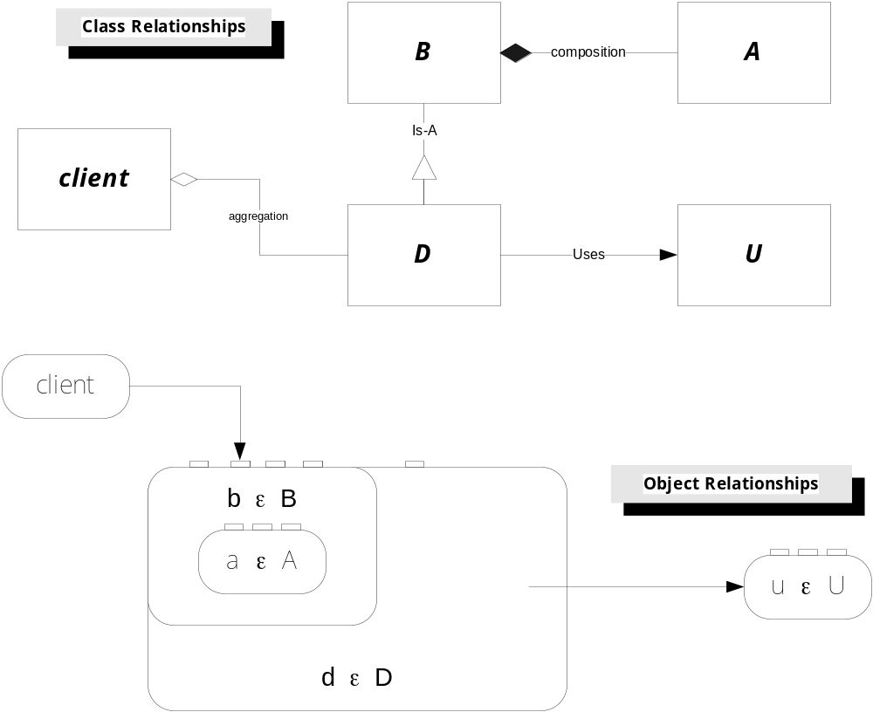

Slide 6
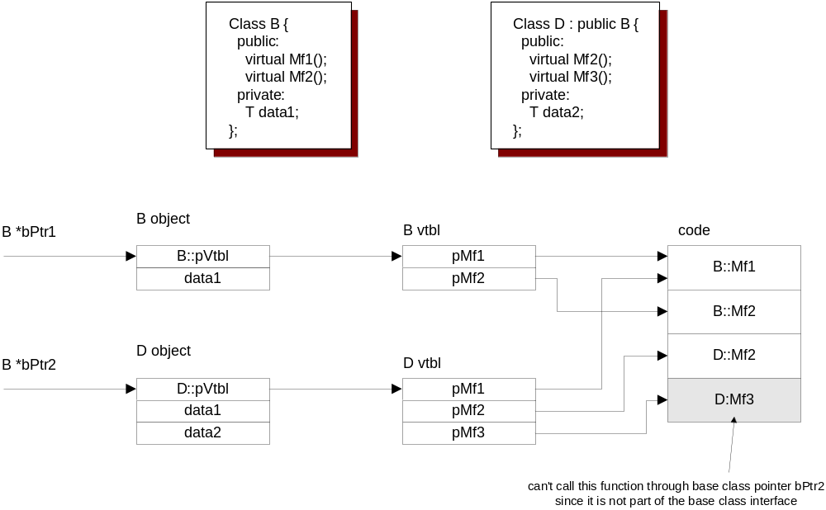
VTbls

Slide 7
Features
Templates
  Generic functions and classes:
    Defer specifying one or more library types until design of an application
  Policies:
    Configure classes with specific behaviors at application design time
    SmartPtr ⬄ ownership, checking, memory allocation, threading
  Template Metaprogramming
    Compile time computations on types
    Functors use Typelist to support variable argument type sequences
  Partial Template Specialization
    Detailed control of class’s type definitions
  Template Template parameters
    Template arguments may be generic types, integral types, function pointers, and other templates

Slide 8
Streams
Simple structure:
  std::ios supports formatting and error reporting.
  streambuf manages the transfer of character strings to and from devices.
  iostream provides a user interface and conversion of base types to and from strings of characters.
Stream classes:
  iostream: console input and output
  iofstream: input and output to files
  iostringstream: input and output to strings in memory

Slide 9
Standard Template Library
Generic containers:
  vector<T>
  dequeue<T>
  list<T>
  set<T>, multiset<T>
  map<U,V>, multimap<U,V>
iterators:
  forward, reverse, constant, bidirectional, random access
algorithms
  many solution-side operations that take iterators and functors to provide a simple connection to the STL containers
  work with simple arrays as well

Slide 10
Bad Designs
What makes a design bad? Robert Martin suggests[1]:
  Rigidity
  It is hard to change because every change affects too many other parts of the system.
  Fragility
  When you make a change, unexpected parts of the system break.
  Immobility
  It is hard to reuse a part of the existing software in another application because it cannot be disentangled from the current application.
The design principles discussed in class are all aimed at preventing “bad” design.

Slide 11
Principles
Liskov Substitution Principle
  A pointer or reference to a base class may be replaced by a pointer or reference to a derived class without making any changes to its clients.
  Supports the powerful hook idea – allow applications to specify what a specific library’s function call means.
Open/Closed Principle
  Components should be open for extension but closed for modification.
  Dynamic binding and templates are excellent means to accomplish this.
Dependency Inversion Principle
  Policies and their Implementations should depend on shared abstractions, not on each other’s concrete details.
  Programming to interfaces and using object factories are what’s needed.
Interface Segregation Principle
  A using class should not have to bind to parts of an interface it doesn’t need.
  Careful partitioning of classes, mixins, and multiple interfaces per class help support this principle.

Slide 12
Next Standardization
Process underway for several years
Will probably finish in 2009
Focus mostly on library

Slide 13
In Balance
Pros
  Very flexible construction of program structure and syntax.
  Deep control of memory and execution
    Rich memory model
    Scope-based resource management
    Powerful access to objects and functions through pointers
  Very flexible management of binding using virtual functions and templates
  Can write very efficient code
    Easier to manage data than C
    Better control of memory than Fortran, C#, and Java
  Many examples of excellent code
    STL library
    Boost library
    Loki library
Cons
  Complex language
    Need help to understand all the features
      ref #1, Stroustrup
    Need help to use effectively
      Ref #2, Sutter & Alexandrescu
      Ref #3, Dewhurst
    Need help to avoid traps & pitfalls
      Ref #4, Sutter
      Ref #5, Dewhurst
  Can write very inefficient code
    Copying into and out of stack frames
    Copying into heap
  Clients hold type information of their servers
    Makes change much more labor intensive
    Need interfaces and object factories to avoid this extra labor

Slide 14
References
Understand language details
C++ Programming Lanaguage, Bjarne Stroustrup, Addison-Wesley, 1997
Use language effectively
C++ Coding Standards, Herb Sutter and Andrei Alexandrescu, Addison-Wesley, 2005
C++ Common Knowledge, Stephen Dewhurst, Addison-Wesley, 2005
Effective STL, Scott Meyers, Addison-Wesley, 2001
Avoid Traps and Pitfalls
Exceptional C++ Style, Herb Sutter, Addison-Wesley, 2005
C++ Gotchas, Stephen Dewhurst, Addison-Wesley, 2003
Compare with C# - understand, use effectively, avoid pitfalls
Effective C#, Bill Wagner, Addison-Wesley, 2005

Slide 15
Additional References
Speaking C++ as a Native, Bjarne Stroustrup
http://conferences.fnal.gov/acat2000/program/plenary/STROUSTRUP.pdf
Wrapping C++ Member Function Calls, Bjarne Stroustrup, C++ User’s Report, June 2000
http://www.research.att.com/~bs/wrapper.pdf
  Same idea used in lockingPtr.
  Provides a before and after call interception for service code.
Stroustrup’s home page:
http://www.research.att.com/~bs/homepage.html
Scott Meyer’s Publications:
http://www.aristeia.com/publications_frames.html
Herb Sutter’s Publications:
http://www.gotw.ca/publications/index.htm
Andre Alexandrescu’s Publications:
www.moderncppdesign.com/publications/main

Slide 16
End of Presentation

