Slide 1
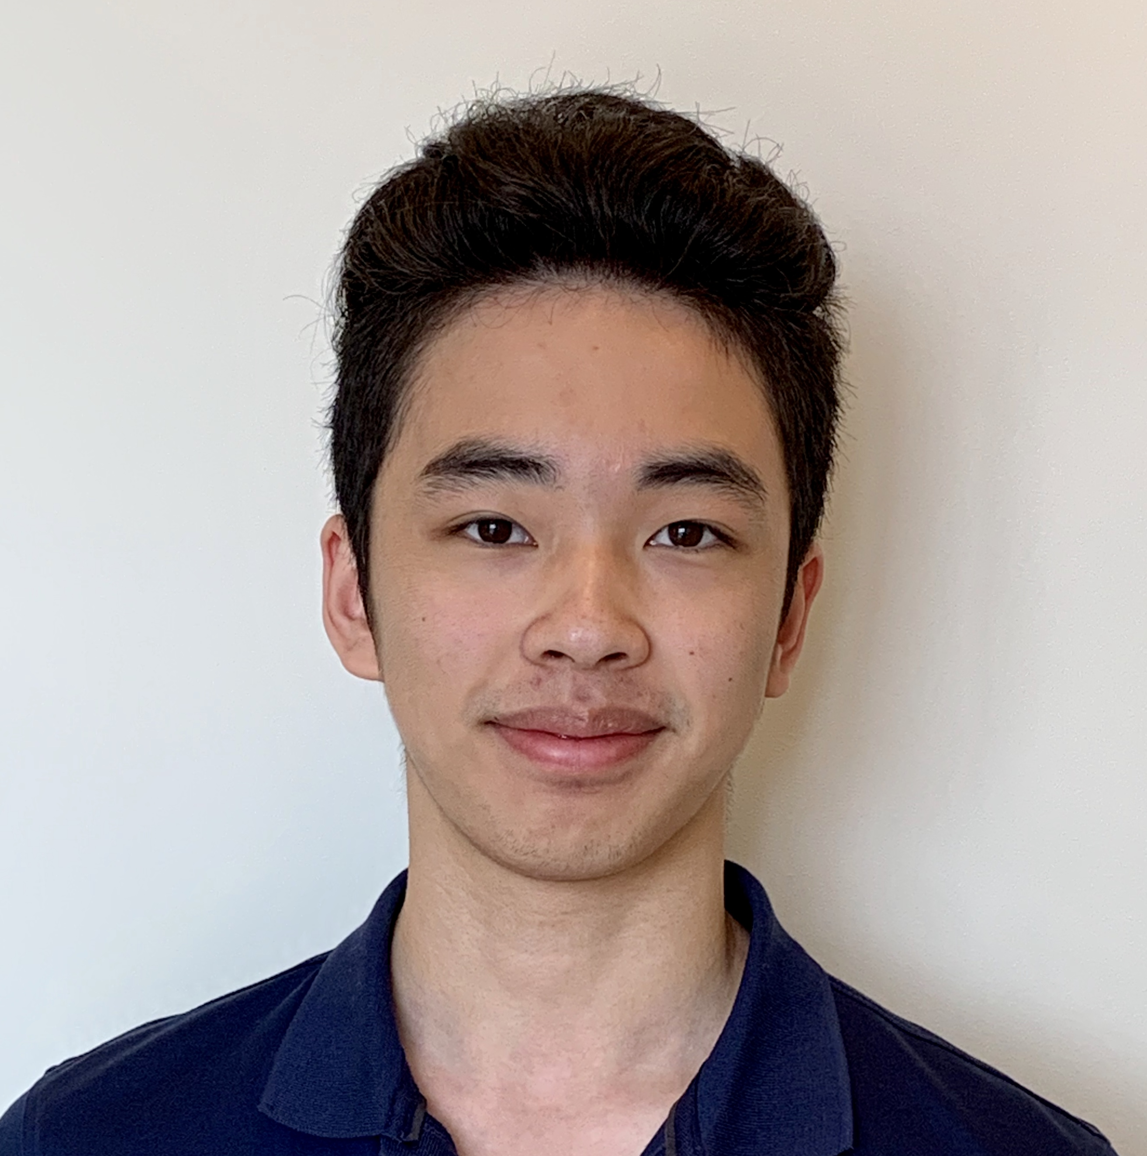
Johnson’s Personal Website Showcasing your best self
Johnson Chau

Slide 2
Agenda
Problem
Solution
Technology
Future Developments

Slide 3
1.
Problem

Slide 4
Recruiting is Hard!
52% of recruiters find shortlisting the right applicants the most difficult part
87% of HR professionals reported “few or no qualified applicants" for open positions
Candidates need to stand out by showcasing their skills

Slide 5
How can candidates showcase their skills to recruiters?

Slide 6
1.
Solution

Slide 7
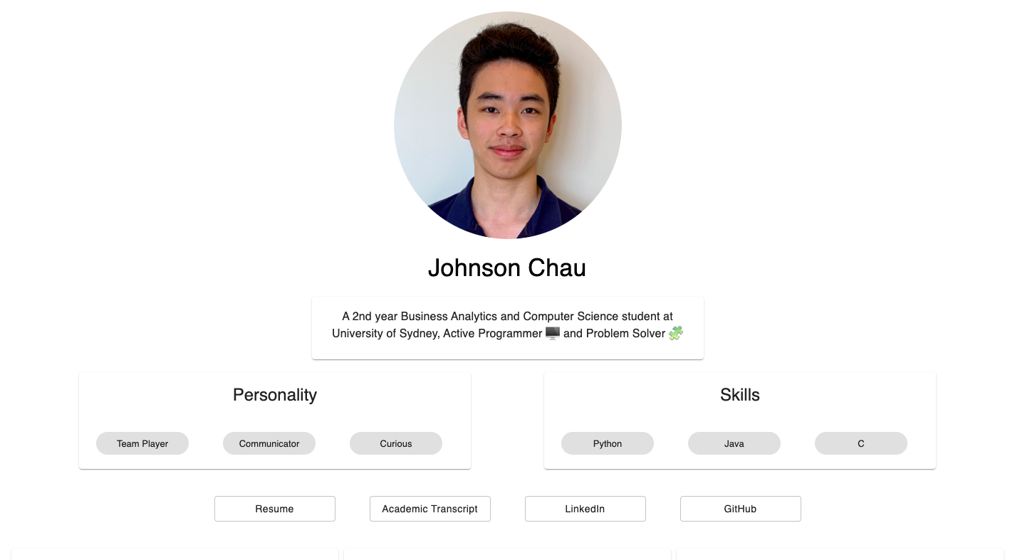
Johnson’s Personal Website
Central Hub for Information
Portfolio Showcase
Demonstrate Your Skills

Slide 8
Target Audience
Industry
Recruiters
Co-workers
Strategic partners
Peers
Friends
Family
University teammates
56% of recruiters are more impressed by personal website than any other promotional tools

Slide 9
1.
Technology

Slide 10
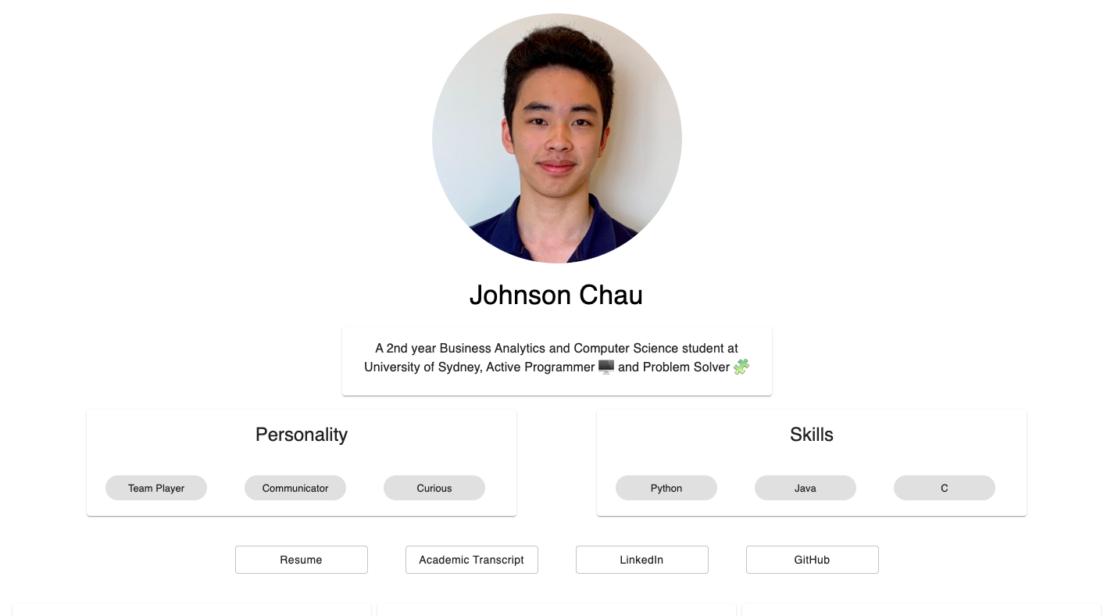
Demo
Personal statement on who I am
Showcase for key personality traits and work skills

Slide 11
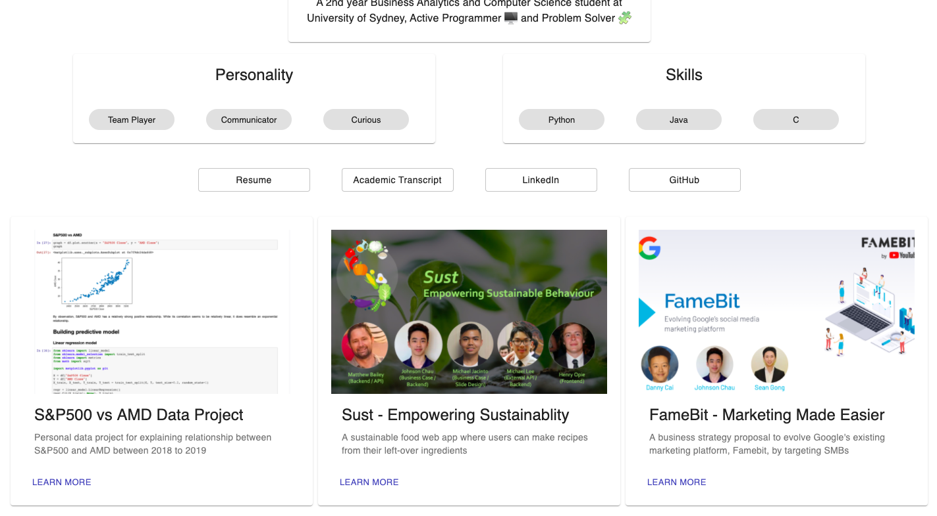
Demo
Centralised hub for key career information
Showcase of previous projects and links to source code

Slide 12
Solution Architecture
Heroku
User
ReactJS
+
Material UI

Slide 13
1.
Future Developments

Slide 14
Future Developments
Dashboard
Data visualisation for key academic results
Badges
Achievement board for competitions won
Showcase Platform
Platform for job-seekers to showcase their skills

Slide 15
Resources
My website: https://johnson-website.herokuapp.com/
Github: https://github.com/johnsonchau7/johnson-website
Benefits of personal website: https://www.blueskyresumes.com/blog/create-a-gorgeous-personal-website-with-these-5-free-and-easy-tools/
Challenges faced by recruiters: https://www.talentlyft.com/en/blog/article/331/top-20-recruitment-challenges-to-tackle-in-2020
Challenges in shortlisting: https://ideal.com/shortlisting/

Slide 16
1.
Thank you!

