Slide 1
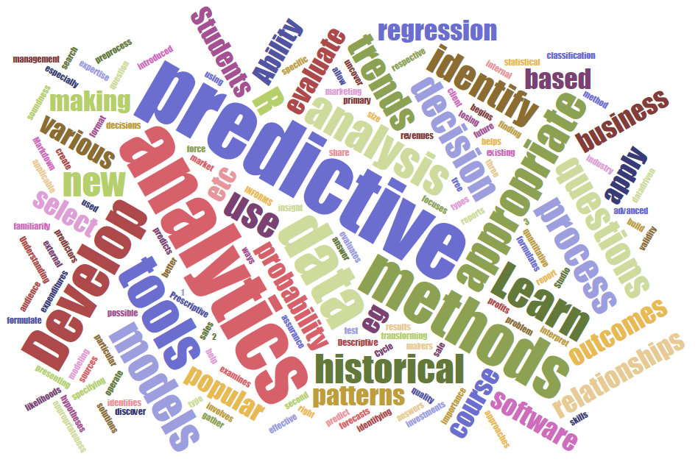
ITEC 621 Predictive Analytics 1. Course Introduction Prof. J. Alberto Espinosa Last updated 1/14/2023

Slide 2
A Few Popular Quotes
“In God we trust. All others must bring data” W. Edwards Deming, engineer and statistician
“If statistics are boring, you’ve got the wrong numbers” Peter Drucker, management author
“Torture the data, and it will confess to anything” Ronald Coase, Economics, Nobel Prize
“He uses statistics as a drunken man uses lamp posts – for support rather than illumination” Andrew Lang, Scottish poet and anthropologist, 1844-1912

Slide 3



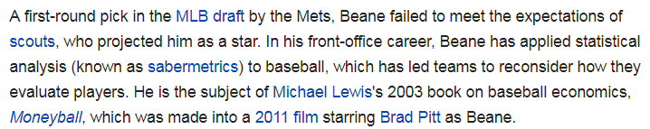


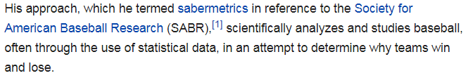
Billy Beane (Oakland A’s) incorporated (“sabermetrics”) analytics and statistics, reaching record profits in baseball
Moneyball

Slide 4

Key Learning Objectives
We will cover all aspects of the analytics cycle, but with an emphasis on predictive modeling and interpretation
This is NOT a Statistics class, but it requires an understanding of Statistics and Machine Learning
This is NOT a Programming class, but it requires the ability to use analytics tools, like
The main learning objective in this course is to learn how to identify, select, justify and employ the most appropriate model to answer a business analytics question and provide meaningful managerial interpretations of your results

Slide 5
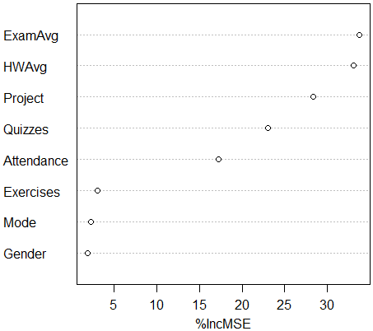
ITEC 621 Historical Component Importance Random Forest Model
How to Succeed in this Class
Acquire key knowledge & skills to succeed as an analytics professional—ability to:
Frame a compelling business question
Gather and pre-process, transform and prepare the data for analysis.
Select and apply the best modeling method that:
Meets your analysis goals (i.e., interpretation, prediction, inference)
Identify the best model specification (e.g., variable selection, feature engineering, etc.) for your modeling approach
Of all viable models and specifications, select the ones that yield the best predictive accuracy (i.e., machine learning/cross validation)
Interpret and explain your results to your target audience
Key → You cannot learn everything about analytics in one course. The goal in this class is to learn how to continue learning on your own !!

Slide 6
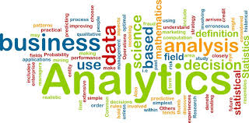
Analytics
“It is the scientific process of transforming data into insight for making better decisions” (INFORMS)
Analytics Question → Analysis → Insights → Storytelling
In analytics, the starting point is a specific business question you want to answer or hypotheses you want to test, and provide a compelling story for your audience
6
Notes:
6

Slide 7
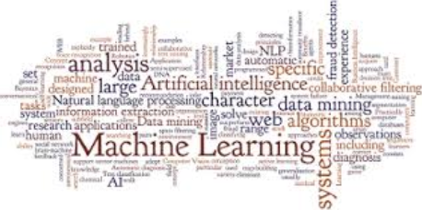
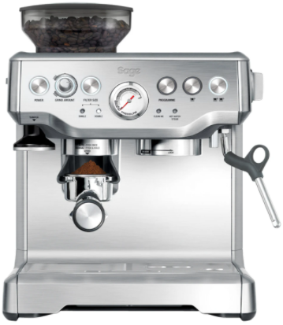



Machine Learning
Is a method of data analysis that uses algorithms that learn from data iteratively allowing computers to find hidden insights without being explicitly programmed (SAS: http://www.sas.com/en_us/insights/analytics/machine-learning.html)
Unsupervised learning → data exploration without specific goals (closely associated with descriptive analytics and data mining, e.g., clustering, correlation analysis, histograms)
Supervised learning → data analysis with specific goals in mind (closely associated with analytics, e.g., regression) → not much different than predictive modeling
7
Notes:
7

Slide 8
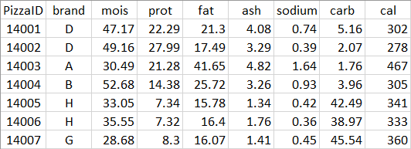
Machine Learning: Develop Familiarity with the Data
Descriptive Analytics

Slide 9
Machine Learning: Develop Predictive Models
Predictors →
Outcome

Slide 10
Machine Learning: Split, Train, Test, Re-Sample
Training Subset: Train Model →
Outcome
Testing Subset: Test Model’s Accuracy →
Outcome

Slide 11

Data Science
“Is a set of fundamental principles that guide the extraction of knowledge from data.” (Provost & Fawcett, Data Science for Business)
A data scientist has deep knowledge on analytics, all aspects of data, the discipline or functional domain in which analysis is conducted (marketing, healthcare, social media, etc.), and the underlying core disciplines (e.g., statistics, mathematics, database, software programming, etc.)
11

Slide 12



Analytics Zoo
Math
Statistics
Data Science
Machine Learning
Analytics
Predictive Modeling
Business Intelligence
Data Mining
Computer Science & Programming
Database & Big Data
12

Slide 13
Syllabus Overview (See Canvas)

Slide 14
Predictive Analytics Overview

Slide 15
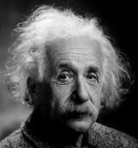
Food for Thought
Humans are live predictive analytics entities
Politician's tricks → single data point; single variable prediction
Does one case prove anything? Statistical power?
Is there really a gender pay gap?
↑ $1 minimum wage → Impact on unemployment?
What doctors do? → diagnosis, treatment
Why are you in the MS program? What are you predicting?
Who in this class will be the first to become CEO?
How much money will you make 5 years after graduation?
Will you make more than $200K 5 years after graduation?
What’s the financial impact of providing free WiFi?
How to fight cybercrime, terrorism (Shining Path), fraud, etc.?
Interesting cases: Target, Starbucks, Oakland A’s

Slide 16
The Analytics Life Cycle

Slide 17
CRISP-DM Cross-Industry Standard Process for Data Mining
CDM-1
CDM-2
Business Understanding
Data Understanding
CDM-3
Data Preparation
Data
CDM-6
CDM-4
Deployment
Modeling
CDM-5
Evaluation
17

Slide 18
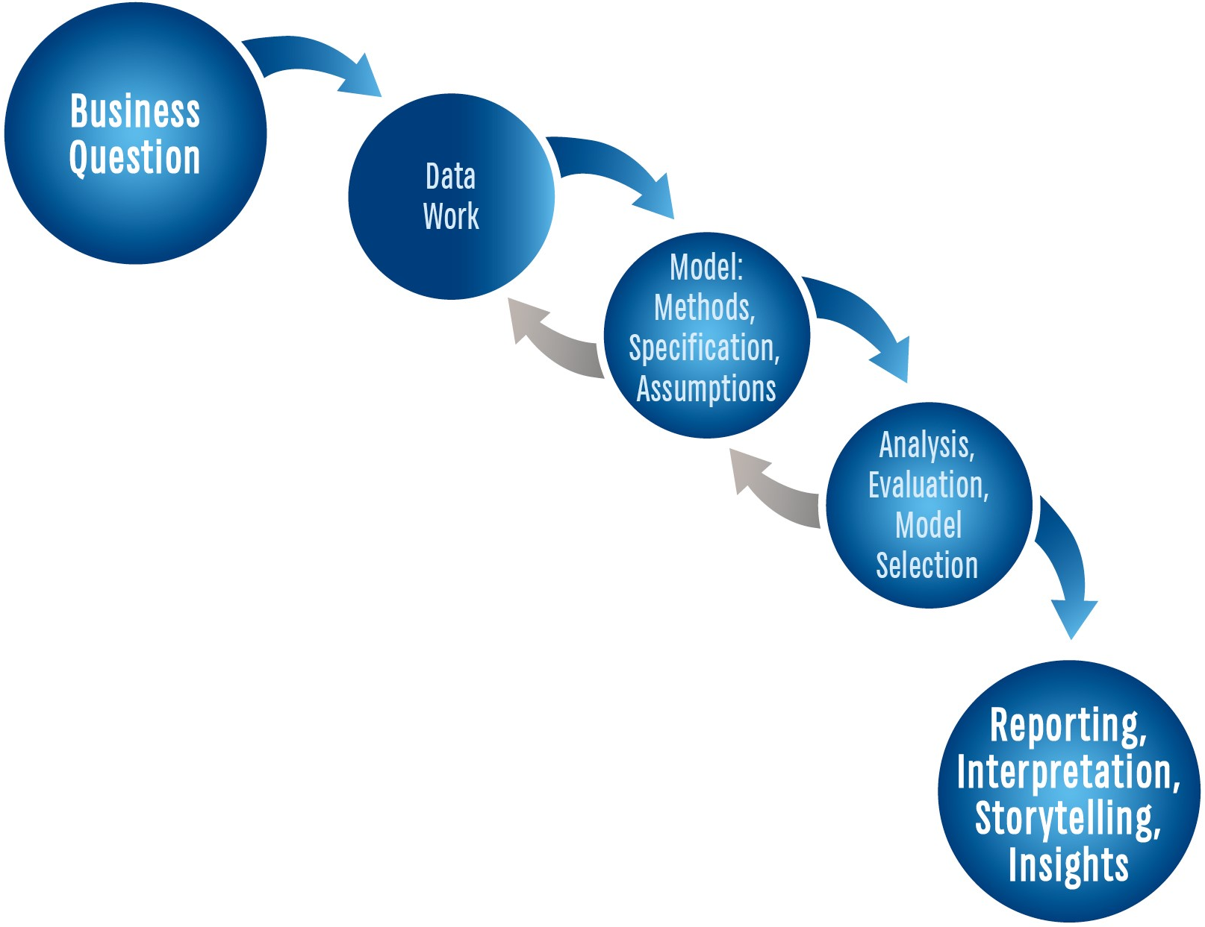
The Analytics Life Cycle for ITEC 621

Slide 19
Step 1 Business & Analytics Question

Slide 20
The Business Question & Case
Business Question:
Is the main project driver
Articulated in general and managerial terms
Examples: How can the spread of an epidemic be controlled? What factors lead to increased sales in a store?
Business Case:
Rationale for the importance of the business question
Why is it important for the business?
What is the value proposition?

Slide 21
The Analytics Question
Translate the business question into one or more analyzable questions. More specifically, define:
What is the outcome variable and its type?
Quantitative Value – e.g., salaries, sales, credit rating
Classification – e.g., loan default (yes/no), credit application (approved/declined) → binary vs. multiple categories
What are the key predictors of interest?
Focal predictors of interest – e.g., GPA, advertising expenditures, annual income, education level
Control variables – e.g., not of main interest, but may influence the outcome

Slide 22
Step 2 Data Work

Slide 23
Important Data Issues
ETL → Extract (from multiple data sources), Transform (into structured formats) and Load (into analysis environment)
Missing values, data cleansing, data curation (i.e., organization and integration → often part of ETL)
Pre-processing → necessary or optional data transformations for the analysis
Data structures → vectors, matrices, data frames, lists, etc.
Data types → numeric, character, categorical, etc.
Data notations → matrix notation, data models

Slide 24

Data Frames, Matrices & Vectors
Data Frame → Pizzas
Matrix → PizzaMat
Columns are “vectors” (variables)
Data across columns can be of different types
Data within columns must be of same type
All data must be of same type
Usually numeric
Vector → Pizzas$carb
Vectors can be extracted from data frames
Vectors can be aggregated into data frames
Data within a vector must be of same type

Slide 25
Matrix Notation We will not use much matrix notation or algebra, but it helps to understand its basics and the textbook sometimes makes reference to it.
Data
Coefficients Prediction Error
y₁
y₂
y₃
_{Etc,}
y_{n}
x₁₁ x_{21 ….} x_{k1}
x₁₂ x_{22 ….}x_{k2}
x₁₃ x_{23 ….}x_{k3}
_{Etc,}
x_{1n} x_{2n ….}x_{kn}
ŷ₁
ŷ₂
ŷ₃
_{Etc,}
ŷ_{n}
ε₁
ε₂
ε₃
_{Etc,}
ε_{n}
β₁ β₂ β_{3 Etc,} β_{k}
+
Y
(n x 1)
X
(n x k)
β
(1 x k)
Ŷ
(n x 1)
ε
(n x 1)
Predictors → Independent Variables (matrix) (each variable is a vector)
Outcomes → Dependent Variable (vector)
Matrix algebra facilitates computation, e.g.:
Predictive Model: Y = Ŷ + ε = βX + ε
Sum of Squared Errors: ε’ε
Regression Coefficients: β = (X’ X)⁻¹ X’Y

Slide 26

More on Matrices: Covariance & Correlation
Covariance Matrix
Correlation Matrix
σ₁² σ₁₂ σ_{13 ….} σ_{1k} σ₂₁ σ₂² σ_{23 ….} σ_{2k} σ₃₁ σ₃₂ σ₃² …. σ_{3k} …. σ_{n1} σ_{n2} σ_{n3 ….} σ_{n}²
1 ρ₁₂ ρ_{13 ….} ρ _{k} ρ₂₁ 1 ρ_{23 ….} ρ_{2k} ρ₃₁ ρ₃₂ 1 …. ρ_{3k} …. ρ_{n1} ρ_{n2} ρ_{n3 ….} 1
$$ρ_{ij}=σ_{ij}/σ_{i}σ_{j}$$
Σ = Cov(X)
R = Corr(X)
The scale of the data matters
The scale of the data doesn’t matter → [bound -1 to 1]

Slide 27
Steps 3 & 4 Modeling & Analysis

Slide 28
Predictive Modeling → Y = f (X)
Y is the outcome → can be quantitative (value) or classification (likelihood of the outcome or actual prediction)
X is the set of predictors
f (X) is the function that maps the predictors to the outcomes
Parametric Model: f (X) is restricted by parameters and relies on assumptions about these parameters (e.g., f (X) is linear, Y is normally distributed, e.g., linear or logistic regression)
Non-Parametric Model: f (X) is not restricted by parameters → no need to check assumptions (e.g., KNN., trees)
Desirable Predictive Model Properties:
Interpretable → results explain relationships between Y and X well
Accurate → predictions of Y are very close to actual values of Y
Unbiased → the effects of X on Y are close to the true effects
Low variance → different data samples yield similar effects of X on Y

Slide 29
Analytics Modeling Options
 | Modeling Method
 | Structured |  | Visual, Text, Unstructured, etc.
Descriptive | Cluster analysis, correlation, market basket analysis, sample statistics, ANOVA |  | Bubble charts, network diagrams, natural language processing, clustering dendrograms, etc.
Predictive | Association | Decision Tree | Charts
Quantitative Value | Regression | Regression Trees | Regression plots, scatter plots, Tableau diagrams, trend charts, etc.
Classification | Logistic Regression; Other Categorical Regression Models | Classification Trees | Tree maps, interactive diagrams,
Prescriptive | Operations research, decision modeling, optimization, linear programming |  | Simulations, etc.

Slide 30
Ordinary Least Squares
Weighted Least Squares
Generalized Linear Model
Ridge Regression
LASSO Regression
Principal Components Regression
Partial Least Squares
Non-Linear Models
Piecewise Linear Regression
Step Regression
Linear, Cubic, Smoothing Splines
Neural Networks
Structural Equation Modeling
Etc.
Analytics Modeling Options
 | Modeling Method
 | Structured |  | Visual, Text, Unstructured, etc.
Descriptive | Cluster analysis, correlation, market basket analysis, sample statistics, ANOVA |  | Bubble charts, network diagrams, natural language processing, clustering dendograms, etc.
Predictive | Association | Decision Tree | Charts
Quantitative Value | Regression | Regression Trees | Regression plots, scatter plots, Tableau diagrams, trend charts, etc.
Classification | Logistic Regression; Other Categorical Regression Models | Classification Trees | Tree maps, interactive diagrams,
Prescriptive | Operations research, decision modeling, optimization, linear programming |  | Simulations, etc.
Regression Trees
Classification Trees
Bootstrap Aggregation (Bagging)
Random Forest
Boosting Trees
Ensemble Models
Etc.
Binomial Logistic Regression
Multinomial Logistic Regression
Probit Regression
Linear Discriminant Analysis
Quadratic Discriminant Analysis
Neural Networks
Etc.

Slide 31
Predictive Modeling Goals
Predictive modeling is not just about making predictions
It all depends on what your analysis goals are
Understanding the analytics question(s) you are trying to answer will give you clarity about the analysis goals
Defining the specific goal(s) of your analysis will help you decide which modeling method is most appropriate.
Your analysis goal could be one or more of these 3:
Interpretation
Inference
Prediction
Notes:
HERE on Tue

Slide 32
Modeling Goal 1: Interpretation
Interpretation is about explaining what the model results are telling us
For example:
Holding weight, size and cylinder size constant (i.e., controlling for), adding one more vehicle cylinder reduces gas mileage by 2 mpg
Holding weight, exercise activity and cholesterol constant (i.e., controlling for), smoking one additional cigarette per day increases the chances of a heart attack by 0.5%
Some methods are great for interpretation (e.g., OLS regression, logistic regression); others are not (e.g., regression trees, support vector machines)

Slide 33
Modeling Goal 2: Inference
Inference is about hypothesizing an effect and testing it to see if the data supports it, for example:
Increased advertising leads to higher sales
Increased minimum wage leads to less unemployment
More years of college education leads to higher income
Low amounts of aspirin reduces heart disease
Testing hypotheses → null and alternative hypotheses:
H₀: The null hypothesis (i.e., there is no effect)
H₀ cannot be accepted → either reject or fail to reject it
H_{A}: Alternative hypothesis is supported if H₀ is rejected
It is better to set H_{A} as what we are trying to prove, e.g.,
H₀: β = 0 → no effect
If rejected, then H_{A}: β ≠ 0 → effect is significant

Slide 34
Modeling Goal 3: Prediction
Which model is most accurate at predicting outcomes? e.g.,
What are the chances that a credit card charge is fraudulent?
What are the chances that a new email is spam?
How much income is a college graduate from Kogod expected to earn 5 years after graduation?
Machine learning helps evaluate predictive accuracy:
Train the model using part of the data, then
Test the resulting model on the rest of the data
Re-sample train and test sets and re-train and re-test
Cross-validation: testing the mean squared error (MSE) or deviance of the trained model using the test data
Select the model with the lowest MSE or deviance
Re-fit the selected model with the full data
As new data arrives, re-train and re-evaluate the model

Slide 35
Explainability
Explainable Models
Easy to explain how the model works and what the results mean → e.g., OLS regression, logistic regression, decision trees → good for interpretability and inference
Black Box Models
The complexities of the internal model are difficult to explain → e.g., neural networks, deep learning → good for predictive accuracy

Slide 36
Modeling Method vs. Specification
Modeling Method:
Is the particular modeling approach used to analyze the data – e.g., random forest tree, logistic regression, linear regression, Ridge regression, etc.
Model Specification:
For any given modeling method, there are many choices on how to specify a model (feature engineering) – e.g., which variables to include; whether to transform which variables; whether to include quadratic, polynomial or interaction variables, etc.

Slide 37
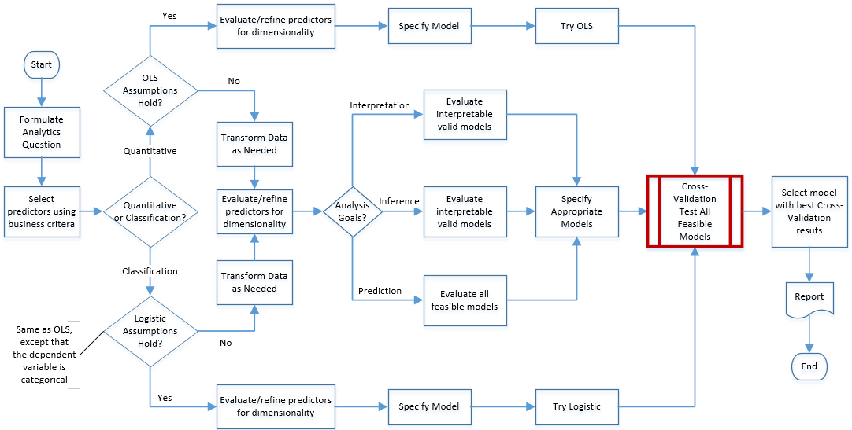
Analytics Model Selection Process

Slide 38
Step 5 Interpretation & Storytelling

Slide 39
What yields the best predictive model?
The most sophisticated model?
The most complex specification?
The most parsimonious (i.e., simple) model/specification?
The least biased model?
Model with least variance?
The model that better fits the data?
The most accurate model?
The most interpretable model?
The model that fulfills the data and model assumptions?
The highest data quality possible?
The most appropriate (business) selection of predictors?
Quadratic and other transformations that fit data the best?
All of the above?
→ It depends on your analytic goals !!

Slide 40
Interpretation & Storytelling
If the goal is predictive accuracy, then interpretation and storytelling are less important → e.g., read handwritten zip codes, train self-driving vehicles, tumor detection, etc.
Machine learning, cross-validation and black box models
The goal is predictive accuracy
But in most business applications, the goal is to inform managers and clients for decision making about the model
Interpret the overall fit statistics of the model → R², mean squared error (MSE), deviance, error rates, etc.
For classification methods → overall model accuracy, correct (or false) positives, correct (or false) negatives)
Bias and variance of the model
And about the predictors
Effect and significance of predictors (in plain English)
Variable importance

Slide 41
Final Notes

Slide 42
Final Notes
The main goal in this course is for you to learn how to formulate a question, then select, justify and employ the most appropriate data, modeling method and specification to answer the predictive analytics question, and interpret the results in a way that makes sense to managers
We will cover some methods in depth
And provide only a high-level overview of others
You will also learn how to use R for modeling methods covered in the course, but you will also be able to explore other modeling methods in R or Python on your own
KEY: Become a good analytics learner !! → with what you will learn in this class you should be able to learn several other modeling approaches on your own

