Slide 1
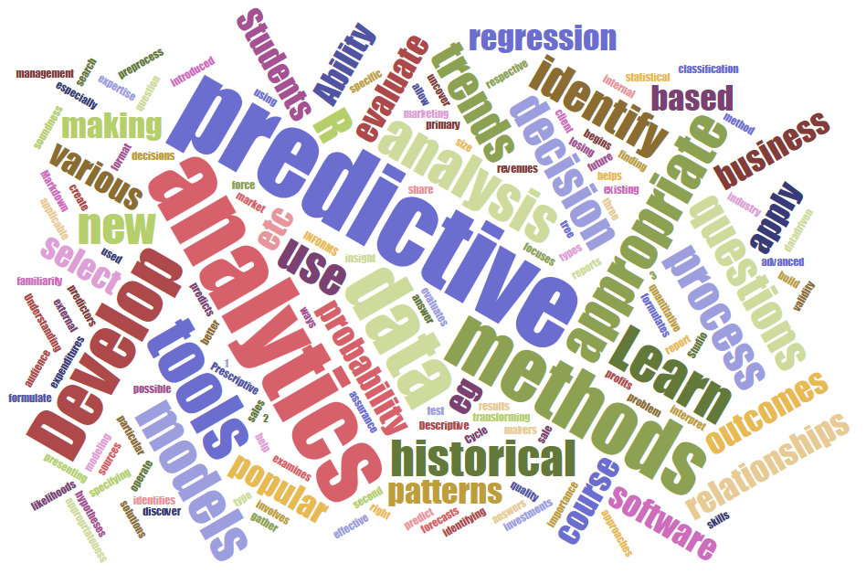
ITEC 621 Predictive Analytics 2. Foundations Prof. J. Alberto Espinosa Last updated 1/15/2023

Slide 2
ITEC 621 Predictive Analytics 2.1 Stats Refresher Script: ITEC621_Stats.R

Slide 3
Analytics Modeling Options
 | Modeling Method
 | Structured |  | Visual, Text, Unstructured, etc.
Descriptive | Cluster analysis, correlation, market basket analysis, sample statistics, ANOVA |  | Bubble charts, network diagrams, natural language processing, clustering dendograms, etc.
Predictive | Association | Decision Tree | Charts
Quantitative Value | Regression | Regression Trees | Regression plots, scatter plots, Tableau diagrams, trend charts, etc.
Classification | Logistic Regression; Other Categorical Regression Models | Classification Trees | Tree maps, interactive diagrams,
Prescriptive | Operations research, decision modeling, optimization, linear programming |  | Simulations, etc.

Slide 4
Descriptive Analytics

Slide 5
Understanding Variability
Variance
Explains how spread out are the values of a single variable from its mean
Covariance
Explains how 2 variables co-vary together
Covariance can be difficult to evaluate if the 2 variables are of different types (e.g., categorical x quantitative) or have dissimilar scale (e.g., miles per gallon vs. kilometers per liter will yield different values)

Slide 6

Variance Refresher
A lot of what we do in analytics is understanding and explaining variance and covariance. Knowing these concepts is key
Variance is how much values vary relative to the mean. The value is squared so that values, both below and above the mean contribute positively to the variance statistic
The square root of the variance is the standard deviation
$$Var(x)=\frac{\sum_{i=1}^{n}{{\left(x_{i}−\overline{x}\right)}^{2}}}{n−1} {{=σ(x)}^{2} =Std Dev (x)}^{2}$$

Slide 7
Covariance and Correlation

Slide 8
Covariance Challenges
Because of issues of scale and data types, we often evaluate how variables co-vary as follows:
Quantitative x Quantitative → Correlation → normalize the variables so that the correlation range is from -1 to 1
Quantitative x Categorical → ANOVA → analyze if the means vary widely across categories
Categorical x Categorical → χ2 (Chi Square) Test of Independence → evaluate if values of one categorical variable values are associated with values from another (dependent) or not (independent)

Slide 9
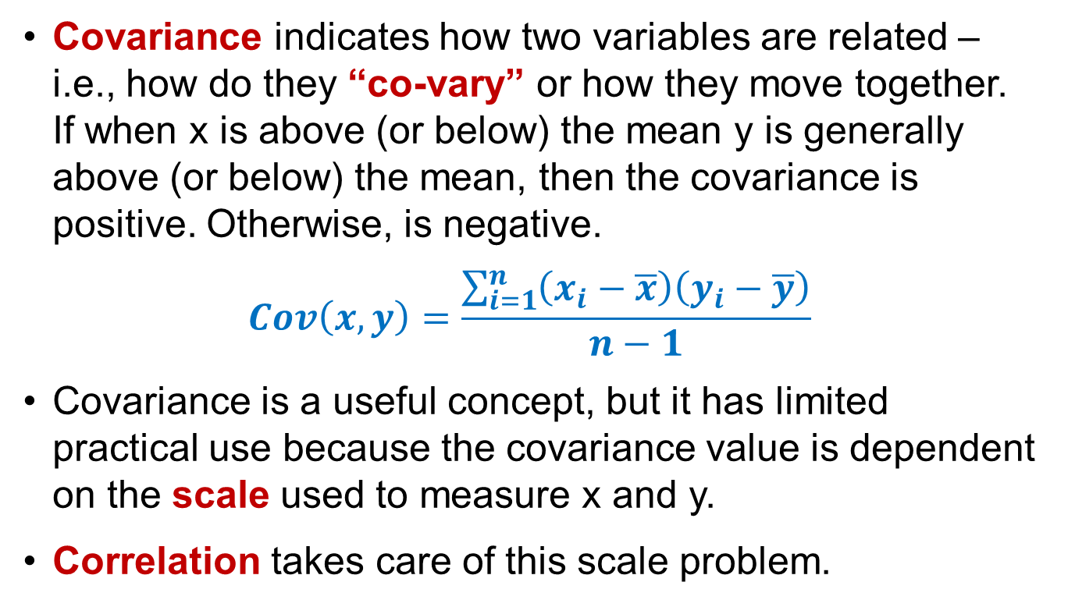
Covariance Refresher
Covariance indicates how two variables are related – i.e., how do they “co-vary” or how they move together. If when x is above (or below) the mean y is generally above (or below) the mean, then the covariance is positive. Otherwise, is negative.
$$Cov\left(x,y\right)=\frac{\sum_{i=1}^{n}{\left(x_{i}−\overline{x}\right)\left(y_{i}−\overline{y}\right)}}{n−1}$$
Covariance is a useful concept, but it has limited practical use because the covariance value is dependent on the scale used to measure x and y.
Correlation takes care of this scale problem.

Slide 10

Correlation Refresher (Quant x Quant)
Correlation measures co-variability like covariance, but the deviation from the mean of each variable are divided by the standard deviation of the variables → it can be shown mathematically that the correlation of two variables will not change with re-scaling.
Mathematically, correlation statistics ranges from -1.0 to 1.0
Provides an indication for whether two quantitative variables vary in the same or opposite direction, or not (independent)
$$ρ\left(x,y\right)=\frac{1}{n−1}\sum_{i=1}^{n}{\left(\frac{x_{i}−\overline{x}}{σ_{x}}\right)\left(\frac{y_{i}−\overline{y}}{σ_{y}}\right)=\frac{Cov\left(x,y\right)}{σ_{x}σ_{y}}}$$
Analyzing the descriptive statistics (i.e., mean and standard deviation) and the correlation among all variables is a necessary first step (i.e., descriptive analytics) before building predictive models → it is good to eye-ball the data → Ideally:
Predictors should be correlated with the outcome variable
But should be somewhat uncorrelated with each other

Slide 11
2 Key Correlation Values
Magnitude – how large is the association
ρ = 1.0 Perfectly positively correlated ρ = + Positively correlated
ρ = Around 0 Uncorrelated (i.e., independent)
ρ = - Negatively correlated
ρ = - 1.0 Perfectly negatively correlated
Significance – probability that the observed correlation happened by chance – i.e., H₀: ρ=0 (no correlation)
p >= 0.10 → Not significantly ≠ 0 → i.e., independent
p < 0.10 → Moderately significant
p < 0.05 → Significant
p < 0.01 → Very significant
p < 0.001 → Highly significant
It is useful to inspect the correlation matrix →

Slide 12

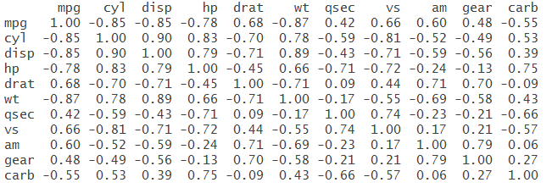
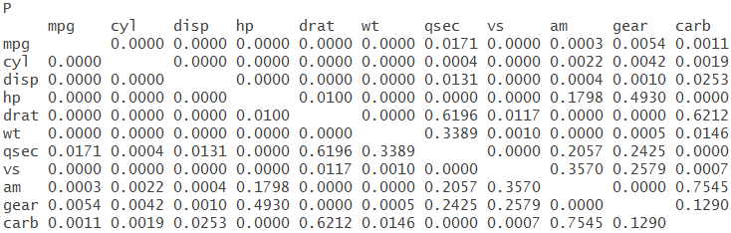
Example: Correlation
rcorr{Hmisc} → Package to prepare correlation matrices with p-values
# rcorr( ){Hmisc} Function
library(Hmisc) # contains rcorr( ) rcorr(as.matrix(mtcars)) # mtcars is available in {datasets}

Slide 13
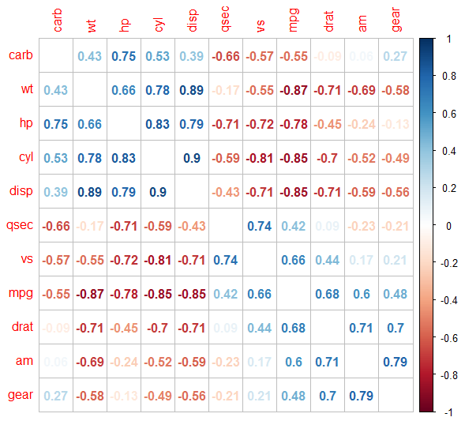
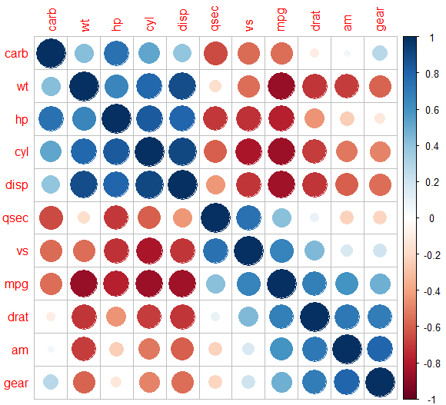
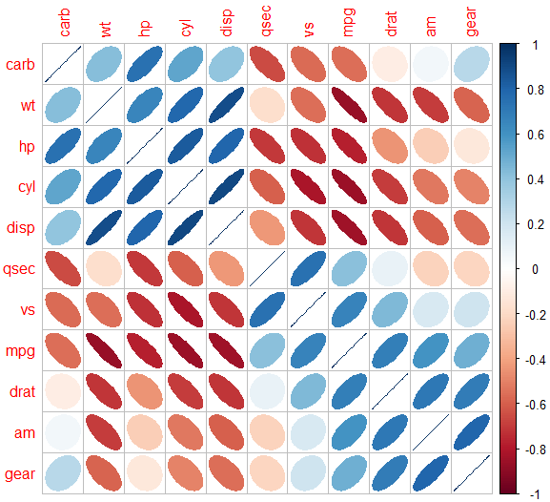
Example: Visual Correlation
# corrplot() for Visual Correlation library(corrplot) # Library for correlation plots mtCorr <- cor(mtcars) # Store the correlation object corrplot(mtCorr, method = "number", order = “hclust") # Try method = “circle" or "ellipse"

Slide 14
ANOVA (Quant x Categorical)

Slide 15
ANOVA Refresher
Analysis of variance (ANOVA) tests whether the mean of a given quantitative variable is the same between two or more categories or groups.
It is called analysis of “variance” and not analysis of “means” because it compares the variance within each group against the variance of the means between groups.
For example, if we want to test if the mileage is different between foreign and domestic cars, or if the price of a diamond is different for various color classifications, we can do an ANOVA test.
The intuition is that if the variance between groups is significantly larger than the variance within groups, then the means are significantly different across groups. Otherwise, they are not.

Slide 16
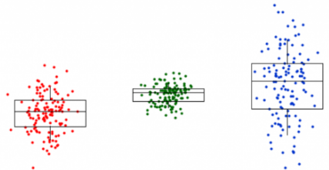
Boxplots: ANOVA Visual Exploration
Boxplots are excellent to explore variation of means across categories
In the boxplot below, you can inspect visually how the data varies around the mean for each category A, B and C.
If the boxplot means and boxes roughly align, ANOVA will most likely yield a non-significant p-value
i.e., H₀: No difference in means across categories → supported !!
If the means and boxes in some categories are noticeably higher or lower than others, ANOVA will most likely yield a significant p-value
i.e., H₀: No difference in means across categories → rejected !!
Extreme Values
Upper Whisker
A B C
Upper Quartile
50% of the data
75% of the data
Median
Lower Quartile
Lower Whisker
Extreme Values
How to Read a Boxplot

Slide 17
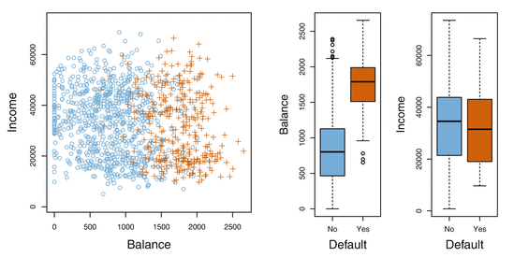
Illustration: Eyeballing ANOVA
aov(Balance ~ Default, data=Credit) → Probably significant → means & boxes very different
aov(Income ~ Default, data=Credit) → Probably not significant → means & boxes align
Default
No Default

Slide 18

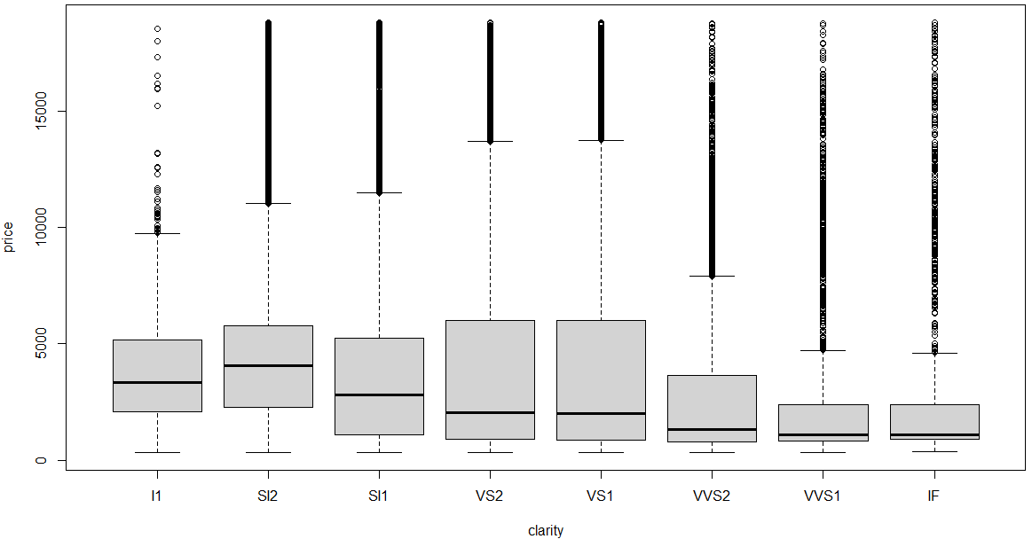
ANOVA Test: Differences in Means
# aov(){stats} Function library(ggplot2) # Contains diamonds data set MyAOV <- aov(price ~ clarity, data = diamonds) summary(MyAOV) boxplot(price ~ clarity, data = diamonds)

Slide 19
Chi Square Test of Independence
(Categorical x Categorical; Non-Parametric)

Slide 20
Chi Square Test of Independence
Suppose that you want to test the effectiveness of two donation campaigns A and B, on driving donations
Correlation and ANOVA will NOT work to evaluate if one campaign was more successful than the other because Campaign and Donation are categorical variables
The most common way to test whether two categorical variables are related (one influences the other) or independent (no influence) is with a Chi Square Test of Independence
The first step is to cross-tabulate the data with Donation (yes or no) as rows and Campaign (A or B) as columns and enter the respective counts in the cells.
Then run a Chi Square test on the cross table
Donor | Campaign | Donation
1 | A | Yes
2 | A | Yes
3 | B | No
4 | B | Yes
5 | A | No
Etc. | B | Yes

Slide 21
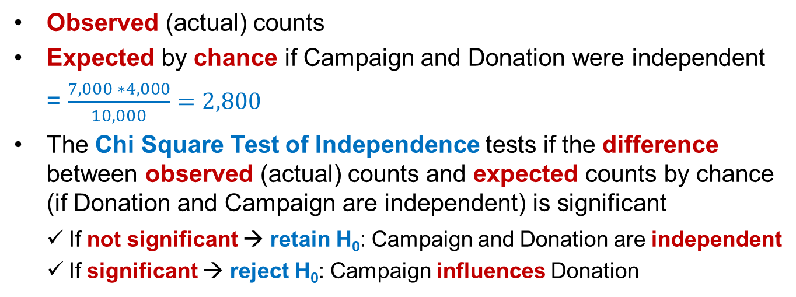
Chi Square Test Explained
Campaign has no effect Campaign has effect
 | Campaign
Donation | A | B | Total
No | 2,820 | 4,180 | 7,000
Yes | 1,180 | 1,820 | 3,000
Total | 4,000 | 6,000 | 10,000
 | Campaign
Donation | A | B | Total
No | 2,100 | 4,900 | 7,000
Yes | 1,900 | 1,100 | 3,000
Total | 4,000 | 6,000 | 10,000
(2,800)
(4,200)
(2,800)
(4,200)
(1,200)
(1,800)
(1,200)
(1,800)
Observed (actual) counts
Expected by chance if Campaign and Donation were independent
= $\frac{7,000 ∗4,000}{10,000}=2,800$
The Chi Square Test of Independence tests if the difference between observed (actual) counts and expected counts by chance (if Donation and Campaign are independent) is significant
If not significant → retain H₀: Campaign and Donation are independent
If significant → reject H₀: Campaign influences Donation

Slide 22
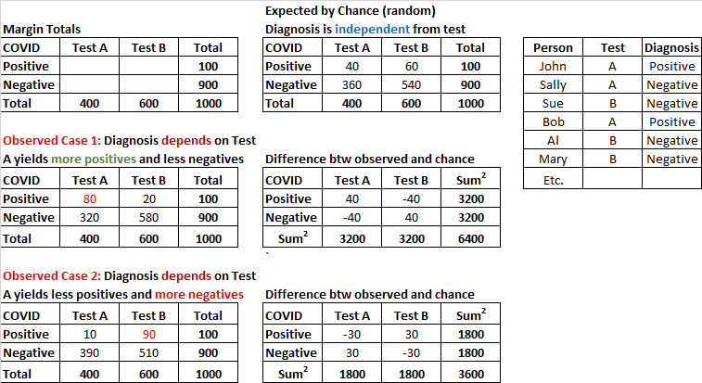
Illustration

Slide 23
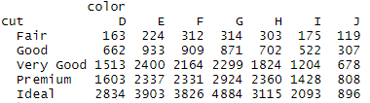
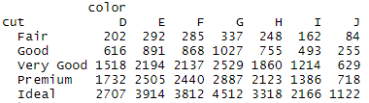

Chi Square Test of Independence
## Chi-Square Test of Independence library(ggplot2) # Contains the diamonds dataset attach(diamonds) # For convenience to avoid using diamonds$ cross.table <- table (cut, color) # Cross tabulate cut with color cross.table # Check it out
rowSums(cross.table) # Check the row totals colSums(cross.table) # Check the column totals sum(colSums(cross.table)) # Total counts
chiSq.diamonds <- chisq.test(cross.table) # Chi Square Test chiSq.diamonds$observed # Check the observed values, or simply enter cross.table print(chiSq.diamonds$expected, digits=2) # Check the expected values
chiSq.diamonds # Check out Chi Square Test results
Observed
Expected by Chance

Slide 24
ITEC 621 Predictive Analytics 2.2 Regression Refresher Script: ITEC621_Regression.R

Slide 25
Analytics Modeling Options
 | Modeling Method
 | Structured |  | Visual, Text, Unstructured, etc.
Descriptive | Cluster analysis, correlation, market basket analysis, sample statistics, ANOVA |  | Bubble charts, network diagrams, natural language processing, clustering dendograms, etc.
Predictive | Association | Decision Tree | Charts
Quantitative Value | Regression | Regression Trees | Regression plots, scatter plots, Tableau diagrams, trend charts, etc.
Classification | Logistic Regression; Other Categorical Regression Models | Classification Trees | Tree maps, interactive diagrams,
Prescriptive | Operations research, decision modeling, optimization, linear programming |  | Simulations, etc.

Slide 26
Simple Linear Regression

Slide 27
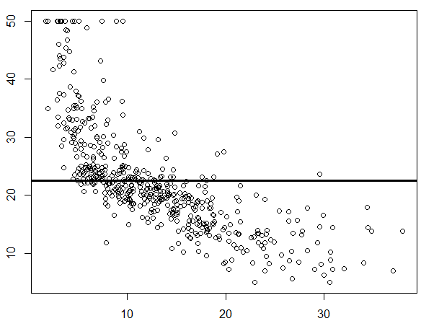


The Null Model: No Predictors
$$y$$
Find a line that minimizes $\sum{ε_{i}^{2}→OLS}$
We can do better
$$y=β_{0}+ε= \overline{y}+ε$$
$$\overline{y}$$
$${ε=y}_{i}−\overline{y}$$
$$y_{i}$$
x

Slide 28
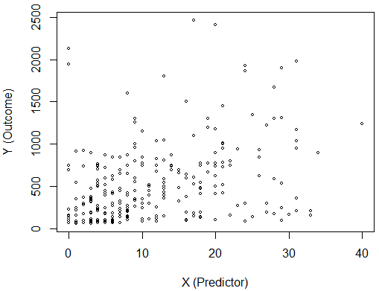



Simple Linear Regression
Questions
How do you find the regression line that best fits your data?
How do you minimize errors (i.e., deviations from the regression line)?
In statistical parlance, how do you “estimate” (fit) the regression line?
There are many “estimation methods”
The most popular one is called “Ordinary Least Squares” (OLS)
It is the line that minimizes the sum of errors squared
Effect Size β₁: Slope, or how much Y changes when X changes by 1 unit
1
$$\hat{y}$$
(error)
$$\overline{y}$$

Slide 29
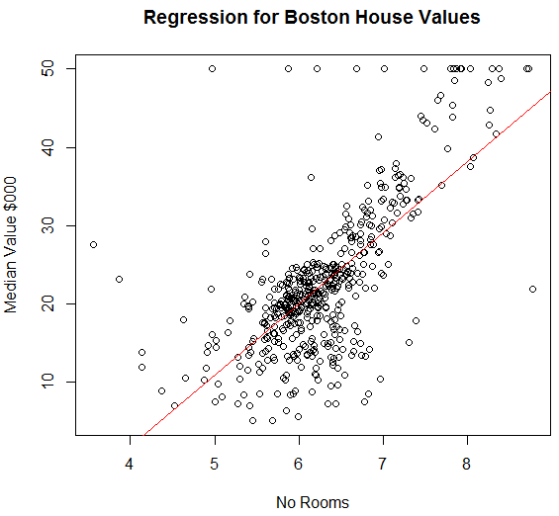
Estimation (Boston{MASS})
Questions
Estimation is about the method and model specification used to train your model
Is OLS the best estimation method?
OLS minimizes the sum of squared errors.
But weighted least squares (WLS) may be more efficient method when residuals are uneven
Quadratic OLS
Piecewise, or Spline regressions may be more accurate predictors
Polynomial regressions may even be more accurate but it suffers from “over-identification”.
Selecting your estimation method is key!!
PolynomialOLS
OLS
WLS
Quadratic OLS
Piecewise/Spline

Slide 30
Important Regression Statistics
β₀ = The intercept → Y’s predicted value when X = 0
β₁ = Slope of the regression line – i.e., change in Y when X increases by 1 unit or the “effect size”
Significance = whether β₁ is significantly different than 0
p-value = measures significance (same as with correlation) i.e., the probability that H₀: β₀, β₁, etc. = 0 → i.e., the observed effects happened by chance → the smaller the p-value the better
Confidence = 1 - p; e.g., p=0.05 implies we are (0.95 or) 95% confident that the effect did not happen by chance
Standard Errors (SE): useful to eyeball results → the 95% confidence interval for a coefficient is β +/- 2*SE

Slide 31
OLS Model Diagnostics

Slide 32

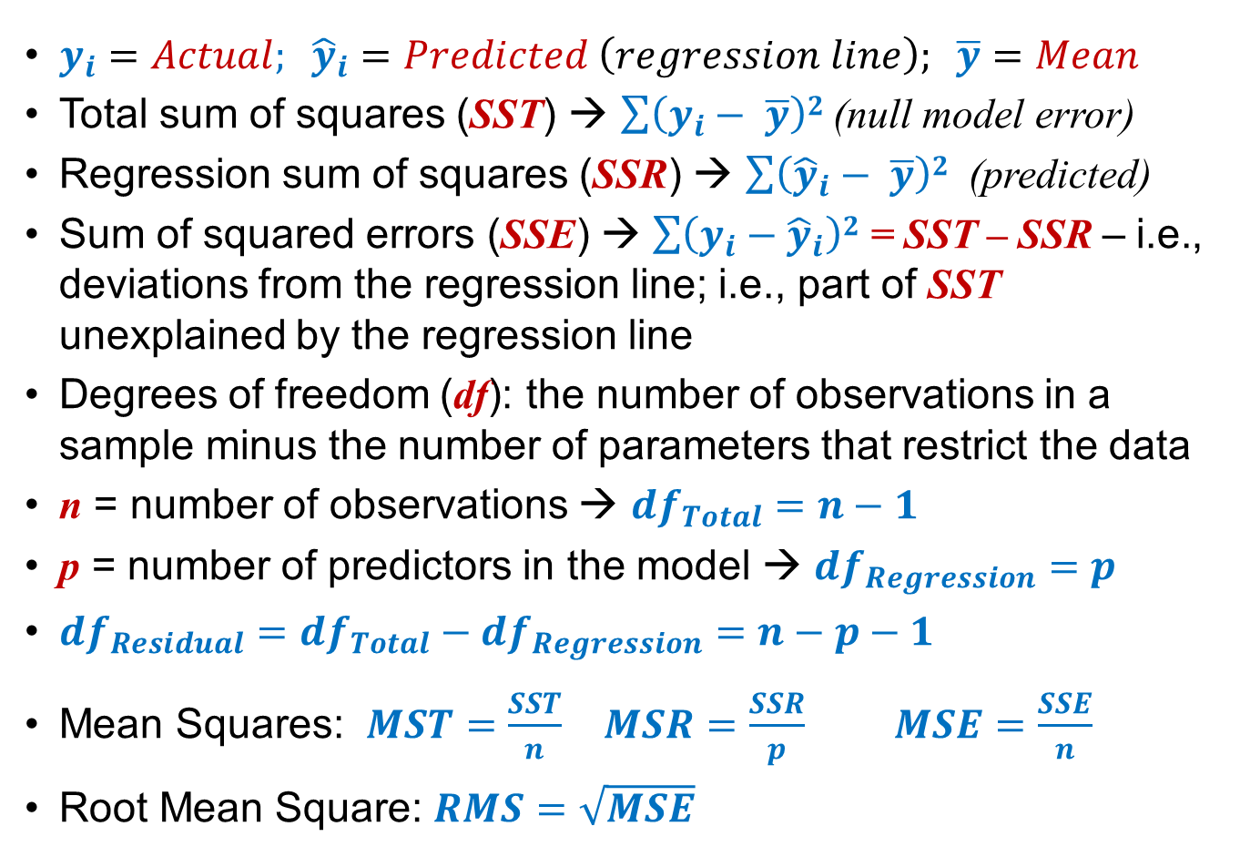
OLS: Fit Statistics
$y_{i}=Actual; {\hat{y}}_{i}=Predicted \left(regression line\right); \overline{y}=Mean$
Total sum of squares (SST) → $\sum{\left(y_{i}− \overline{y}\right)2}$ (null model error)
Regression sum of squares (SSR) → $\sum{\left({\hat{y}}_{i}− \overline{y}\right)2 }$ (predicted)
Sum of squared errors (SSE) → $\sum{\left(y_{i}−{\hat{y}}_{i}\right)2}$ = SST – SSR – i.e., deviations from the regression line; i.e., part of SST unexplained by the regression line
Degrees of freedom (df): the number of observations in a sample minus the number of parameters that restrict the data
n = number of observations → ${df}_{Total}=n−1$
p = number of predictors in the model → ${df}_{Regression}=p$
${df}_{Residual}={df}_{Total}−{df}_{Regression}=n−p−1$
Mean Squares: $MST=\frac{SST}{n}$ $MSR=\frac{SSR}{p}$ $MSE=\frac{SSE}{n}$
Root Mean Square: $RMS=\sqrt{MSE}$

Slide 33
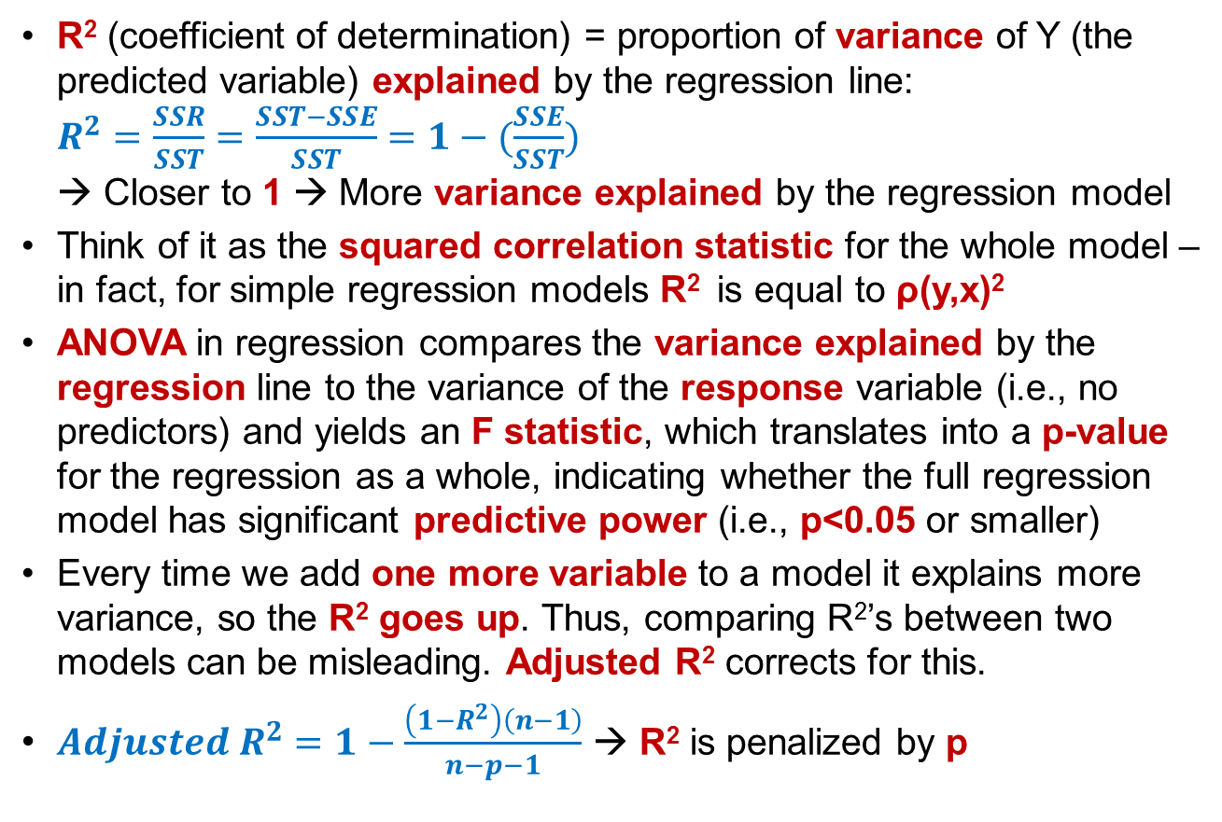
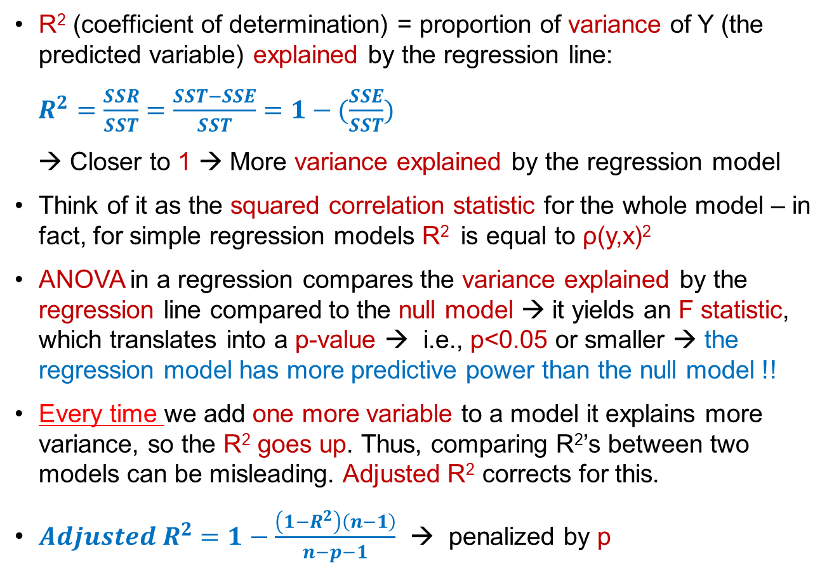
OLS Predictive Power and Fit
R² (coefficient of determination) = proportion of variance of Y (the predicted variable) explained by the regression line:
$R^{2}=\frac{SSR}{SST}=\frac{SST−SSE}{SST}=1−(\frac{SSE}{SST})$
→ Closer to 1 → More variance explained by the regression model
Think of it as the squared correlation statistic for the whole model – in fact, for simple regression models R² is equal to ρ(y,x)²
ANOVA in a regression compares the variance explained by the regression line compared to the null model → it yields an F statistic, which translates into a p-value → i.e., p<0.05 or smaller → the regression model has more predictive power than the null model !!
Every time we add one more variable to a model it explains more variance, so the R² goes up. Thus, comparing R²’s between two models can be misleading. Adjusted R² corrects for this.
$Adjusted R^{2}=1−\frac{\left(1−R^{2}\right)\left(n−1\right)}{n−p−1}$ → penalized by p

Slide 34


Understanding R² Further
Unexplained Error
$$\hat{y}$$
Total Error
Explained Error
$$\overline{y}$$
$R^{2}=\frac{Explained Variance}{Total Variance}= 1−\frac{Unexplained Variance}{Total Variance}$

Slide 35

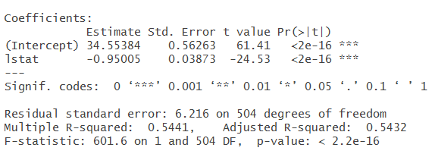
Simple Linear Regression
## Simple Linear Regression library(MASS) # Contains the Boston data set lm.fit.null <- lm(medv ~ 1, data = Boston) # Use 1 for no predictors summary(lm.fit.null) # The null model mean(Boston$medv) # Mean = intercept in null model lm.fit <- lm(medv ~ lstat, data = Boston) # Simple linear model summary(lm.fit) # With 1 predictor

Slide 36
Dummy Variables
Notes:
I’m HERE on Tue

Slide 37
Adding a Dummy (Binary) Variable
What if a car’s year is a marginal predictor of mileage (mpg) but you suspect that this effect may be different between domestic and foreign cars?
In this case, you can add a binary variable “Origin” to the model, which takes the value of 1 if the car is foreign and 0 if it is domestic.
The model will then look like this (Year is continuous; Origin is 0 or 1):
mpg = β₀ + β_{Year}(Year) + ε
mpg = β₀ + β_{Origin}(Origin) + β_{Year}(Year) + ε
mpg
mpg
β_{Year (unbiased)}
(Origin=1)
(Foreign cars data)
β_{Year (biased)}
(Origin=0)
β₀
(Domestic cars data)
β_{Origin}
β₀
Year
Year

Slide 38

Dummy Variables: Intuition
A regression with one or more dummy variables is very common in predictive modeling.
As the diagram in the previous slide illustrates a dummy variable shows a parallel shift in the regression line. For example, a model that predicts miles per gallon in a vehicle based on the vehicle origin and its year is:
mpg = β₀ + β_{Origin}(Origin) + β_{Year}(Year) + ε
Origin = 0 for domestic cars and Origin = 1 for foreign cars
β_{Year} is the effect of vehicle year on mileage “controlling for” (taking into account) vehicle origin.
β_{Origin} is the effect of origin on mileage “controlling for” year.
Thus, you can think of the model above as two separate regression models:
For domestic cars, Origin = 0 → mpg = β₀ + β_{Year}(Year) + ε
For foreign cars, Origin = 1 → mpg = (β₀ + β_{Origin}) + β_{Year}(Year) + ε
So, β₀ is the intercept for domestic cars;
β₀ + β_{Origin} is the intercept for foreign cars
β_{Origin} is the effect difference between domestic and foreign cars

Slide 39
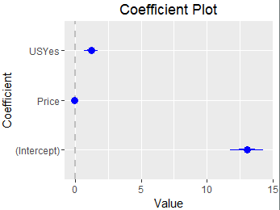
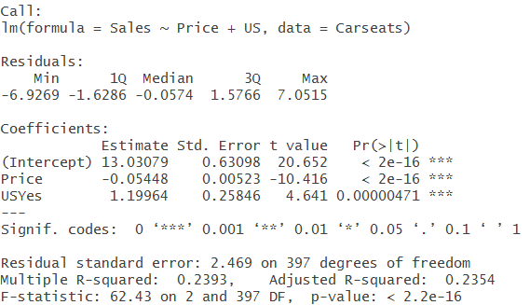
Regression w/Dummy Variable
## Regression with a Dummy Variable library(ISLR) # Contains the "Carseats" data set lm.fit <- lm(Sales ~ Price + US, data = Carseats) # US is a dummy (Yes =1, No =0) summary(lm.fit)
library(coefplot) coefplot(lm.fit)

Slide 40
Multi-Variate Regression

Slide 41
Multi-Variate Regression (or Multiple Linear Regression)
Most regression models include more than one “predictor” variable and possibly more than one “control” variable
Predictor and control variables are ALL “independent variables” Y = β₀ + β₁(X₁) + β₂(X₂) + β₃(X₃) + …… + β₄(X₄) + β₅(X₅) + β₆(X₆) + ε
Predictors
Controls
Independent Variables
Interpretation: β₁ is the effect size of X₁, that is, how much Y changes, when X₁ increases by 1 unit, holding X₂ …….X₅ constant. Same for β₂, etc.
Predictors and controls work in the exact same way. They are just labels:
A predictor is a variable we believe will predict Y
A control is a variable that may affect Y, so we include it for control

Slide 42
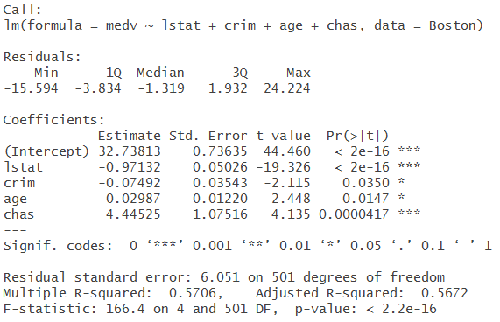
Multivariate Regression
## Multiple Linear Regression library(MASS) # Contains the “Boston" housing data set lm.fit <- lm(medv ~ lstat + crim + age + chas, data = Boston) # chas → proximity to the Charles River (1 = yes; 0 = no) summary(lm.fit)

Slide 43
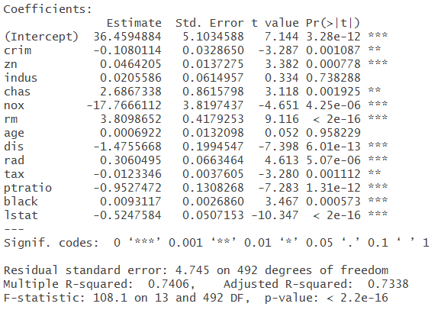
Model with all Predictors
# Cont’d library(MASS) # Contains the “Boston" housing data set lm.fit <- lm(medv ~ ., data = Boston) # use . to include all predictors summary(lm.fit)
Notes:
Review example 812-815

Slide 44
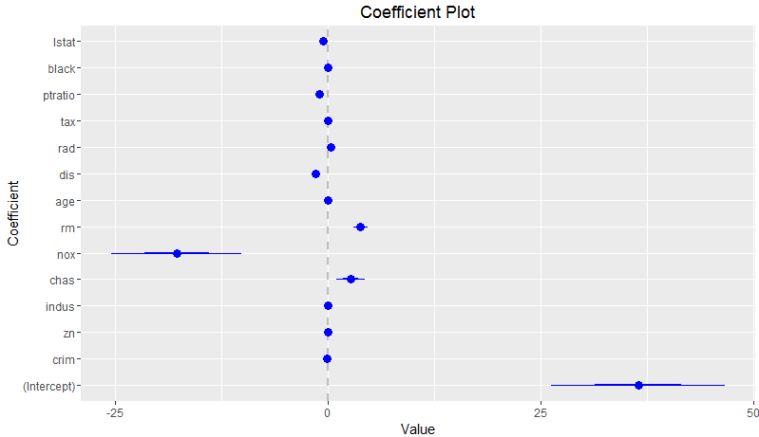
Coefficient Plot
# Cont’d. coefplot(lm.fit)
Notes:
Review example: 817

Slide 45
ANOVA in Regressions

Slide 46
ANOVA in Regressions
ANOVA and regression are tightly related because ANOVA tests whether the variance explained by the regression line (or the various variables in the model) is significantly different than the variance of the dependent variable alone.
As we will see later, ANOVA is very useful when comparing whether one regression model explains more variance than another, so it is a key test when evaluating predictive models.
The regression’s F-test yields a p-value, measuring the overall predictive power of the regression model. What does this measure?

Slide 47
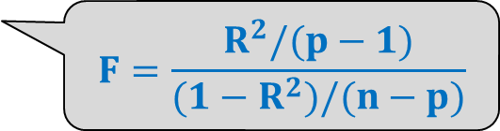
ANOVA in Regressions
Consider the following 3 nested regression models:
Null Model: Y = β₀ + ε (no predictors, just the mean and variance of Y)
Small Model: Y = β₀ + β₁ (X₁) + etc. + ε (a few predictors)
Large Model: Y = β₀ + β₁ (X₁) + … + β_{p} (X_{p}) + etc. + ε (more predictors)
Testing a Single Model
The ANOVA F-Test for a single model compares the variance of Y explained by the regression model (i.e., R²) against the variance of Y explained by the Null model
If significant (p < 0.05), the model is better at predicting Y than the Null model.
$$F=\frac{R^{2}/(p−1)}{(1−R^{2})/(n−p)}$$

Slide 48
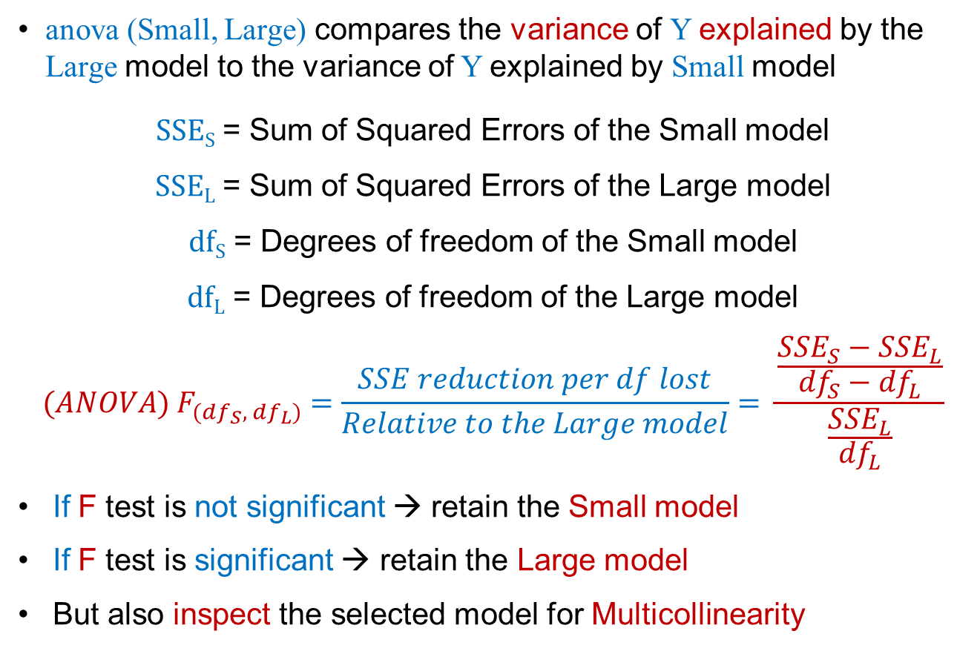
ANOVA (Nested) Model Comparison
anova (Small, Large) compares the variance of Y explained by the Large model to the variance of Y explained by Small model
SSE_{S} = Sum of Squared Errors of the Small model
SSE_{L} = Sum of Squared Errors of the Large model
df_{S} = Degrees of freedom of the Small model
df_{L} = Degrees of freedom of the Large model
$${(ANOVA) F}_{({df}_{S},{ df}_{L})} =\frac{SSE reduction per df lost}{Relative to the Large model}= \frac{\frac{{SSE}_{S}−{SSE}_{L}}{{df}_{S}−{df}_{L}}}{\frac{{SSE}_{L}}{{df}_{L}}}$$
If F test is not significant → retain the Small model
If F test is significant → retain the Large model
But also inspect the selected model for Multicollinearity

Slide 49
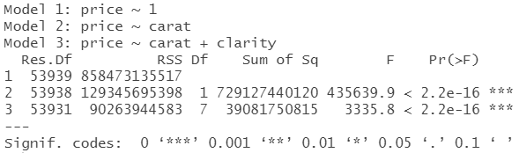
ANOVA: Comparing Nested Models
# ANOVA in Regressions lm.null <- lm(price ~ 1, data = diamonds) # Null model lm.small <- lm(price ~ carat, data = diamonds) # Small model lm.large <- lm(price ~ carat + clarity, data = diamonds) # Large anova(lm.null, lm.small, lm.large) # Compare 3 nested models

