Slide 1
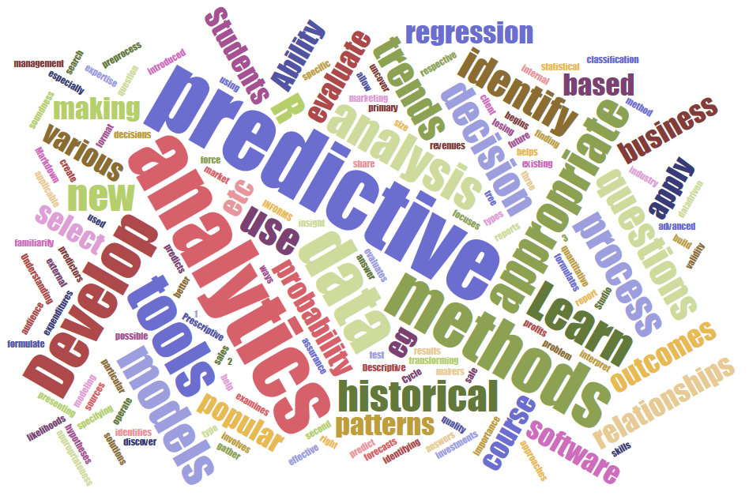
ITEC 621 Predictive Analytics 3. Basic Models Use ITEC621_Regression.R Prof. J. Alberto Espinosa Last updated 1/21/2023

Slide 2
ITEC 621 Predictive Analytics 3.1 OLS Assumptions (See Predictive Modeling Summary on Canvas)

Slide 3
OLS Regression Assumptions

Slide 4
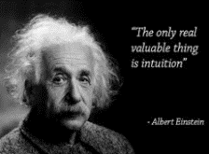
OLS Assumptions: Intuition
How does OLS find a regression line that minimizes the SSE? →The coefficient vector is obtained with this matrix operation β = (X’ X)⁻¹ X’Y
It can be shown mathematically that this matrix operation yields the OLS line
This matrix operation may seem complicated, but it can be computed easily with software that handles matrix operations, like Python, R, etc.
But this formula is derived from a complex mathematical proof that simplifies substantially with some simplifying assumptions.
If some of these assumptions are not met, the above formula does not necessarily produce the best set of unbiased coefficients for a regression line that minimizes the SSE.
Other methods may be more appropriate in such cases

Slide 5
It’s Good to be BLUE
When the OLS assumptions are met, the OLS estimators are said to be the “Best Linear Unbiased Estimator” (BLUE)
Best → Estimators have the lowest variance
Linear → The regression is a linear combination of variables and coefficients.
Unbiased → the estimated β coefficients represent the true effect (remember that some models yield biased coefficients, for example, if important variables are omitted from the model).
→ Need to test if OLS assumptions are met

Slide 6
Parametric vs. Non-Parametric Methods
Parametric methods: are based on assumptions made about the parameters of the model. Parameters impose constraints on the model to simplify and facilitate the model estimation. But the estimation is incorrect if the parametric assumptions don’t hold.
For example: the outcome variable should have a Normal (OLS), Poison (count data) or Binomial (Logistic) distribution. Y should have a linear relationship with the X’s (OLS). More restrictive models require the predictors to be normally distributed (Linear Discriminant Analysis).
Non-Parametric methods: don’t rely on assumptions or parametric constraints on the model. These models are useful when we don’t know much about the data or when parametric assumptions don’t hold (e.g., K-Nearest Neighbors, Decision Trees, Support Vector Machines, Deep Neural Networks).
OLS is a Parametric Method → Relies on several assumptions

Slide 7
OLS Regression Assumptions
(YC) The outcome variable (Y) is continuous
(EN) Errors (residuals) are normally distributed
(XI) The predictors (X’s) are independent (i.e., uncorrelated)
(LI) The outcome (Y) and predictor (X’s) variables have a linear relationship
(OI) (Data) Observations are independent
(EI) Errors (residuals) are independent
(EA) The average of the errors (residuals) = 0
(EV) The variance of the errors (residuals) is constant (errors are “homoscedastic”)

Slide 8
OLS Assumption 1
YC → Y is continuous – if Y is binary, categorical, discrete or truncated, other methods are needed (Logistic, Probit, Linear Discriminant Analysis, etc.)
Test: observe Y values and check for distributions
Corrections:
Use the Generalized Linear Model (GLM), rather than OLS method with the appropriate distribution family (e.g., binomial, poison, etc.) – more on this later
Use other classification methods (e.g., classification trees, linear or quadratic discriminant analysis, etc.)
If Y is binary or categorical use Logistic regression, but ensure that all other OLS assumptions hold

Slide 9
OLS Assumption 2
EN → Errors (ɛ) are normally distributed – there are acceptable transformations when errors (i.e., residuals) are not normally distributed. Generally (not always), if Y is (not) normally distributed → ɛ is not either
Test: residual plots; QQ-Plots; normality tests
Correction: transform Y to achieve normal distribution [e.g., log(Y), Box-Cox, 1/Y, quadratic, etc.]

Slide 10

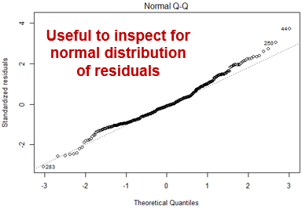
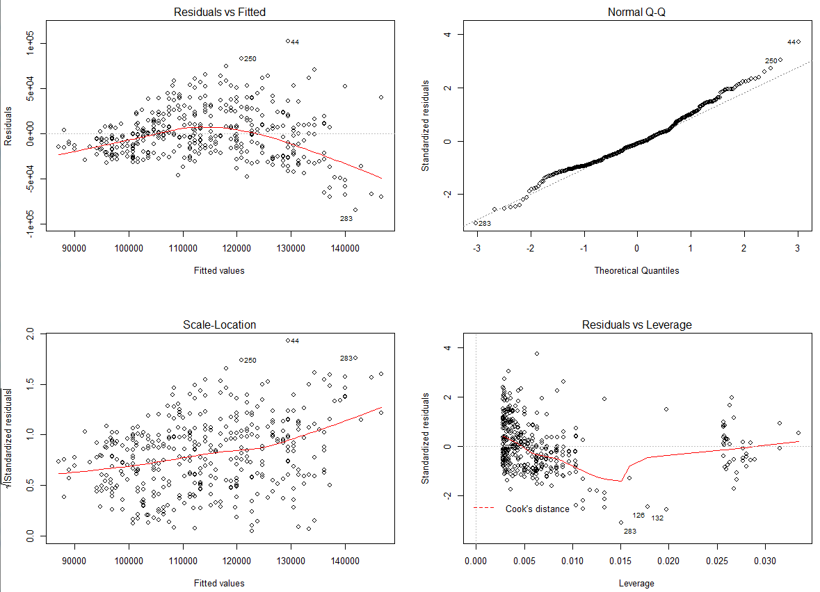
Regression Plots
QQ-Plot → Visual inspection for normally distributed residuals
Useful to spot heteroscedasticity and serial correlation
Useful to inspect for normal distribution of residuals
Also useful to spot heteroscedasticity and serial correlation
Useful to spot outliers and influential data points

Slide 11
OLS Assumption 3
XI → X’s are independent (uncorrelated) – some correlation in the X’s are tolerable, as long as multi-collinearity is not severe.
Test: Condition Index (CI) and Variance Inflation Factors (VIF)
Correction: With severe multi-collinearity, other methods are more appropriate (e.g., Ridge, LASSO, Principal Components Regression PCR, Partial Least Squares PLS, etc.)

Slide 12
OLS Assumption 4
LI → Y and X’s have linear relationship – if not, some X’s can be transformed (log, squared, etc.) to create a linear model
Test: scatter plots; compare linear to non-linear model fit statistics
Correction: use non-linear models (e.g., interactions, polynomials, piecewise models, splines, etc.)

Slide 13
OLS Assumptions 5 & 6
OI → Observations are independent – if one observation is influenced by another (e.g., a stock price today will be correlated with its price tomorrow; survey responses by members of a family or association).
EI → Errors are independent – if errors are correlated it is an indication that there is a missing variable in the model or there is serial correlation. If OI does not hold, usually neither does EI
Test: serial or auto correlation (e.g., Durbin-Watson)
Corrections:
Use forecasting, time series, causal models, or other methods that correct for serial correlation
Lagging the outcome variable or the predictors often helps reduce serial or auto correlation.

Slide 14
OLS Assumptions 7 & 8
EA → The error average is 0 (+/– errors average out)
Test: sum or average the residuals → not necessary if the model has an intercept → OLS calculations take care of this
EV → The error variance is constant (homoscedastic) – uneven residuals (heteroscedastic) cause observations with large errors to pull the regression strongly in both directions, thus increasing variance.
Test: inspect residual plots, conduct heteroscedasticity tests (e.g., Breusch-Pagan Test)
Correction: use robust methods, Weighted Least Squares (WLS), etc.

Slide 15
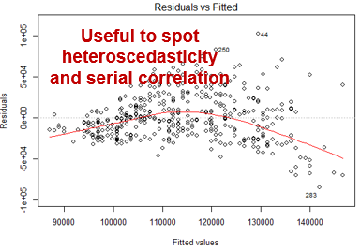
Regression Plots
Residual Plot → Visual inspection for Heteroskedasticity and Serial Correlation
Useful to spot heteroscedasticity and serial correlation
Useful to inspect for normal distribution of residuals
Also useful to spot heteroscedasticity and serial correlation
Useful to spot outliers and influential data points

Slide 16
OLS Assumptions & Predictive Modeling

Slide 17
Predictor Assumptions in OLS
With a large samples of 50 degrees of freedom (number of observations, minus number of predictors, minus 1), the predictors don’t have to be normally distributed to use OLS
Predictors can be counts, binary, categorical, etc.
With small samples, the predictors must be normally distributed
In contrast, other modeling methods like Linear Discriminant Analysis (LDA), Quadratic Discriminant Analysis (QDA), do indeed require predictors to be normally distributed.

Slide 18
Predictive Model Selection Process
Narrow down the model choices based on the response variable type
Try OLS for quantitative predictions first – OLS is BLUE if assumptions hold
Try Logistic for classification predictions first – logit has the same properties as OLS once the response variable is logit-transformed
Test OLS/Logistic assumptions → if they hold, you are done
If not, make necessary corrections or select appropriate model
And/Or:
Narrow the choice of models based on your analytics goals: interpretation, inference (i.e., testing hypotheses), and/or prediction
Do cross-validation (CV) testing – even if OLS assumptions are not fully met, CV testing will find the most accurate model (more on this later).
If CV test results are not very different between models, select the most interpretable model.

Slide 19
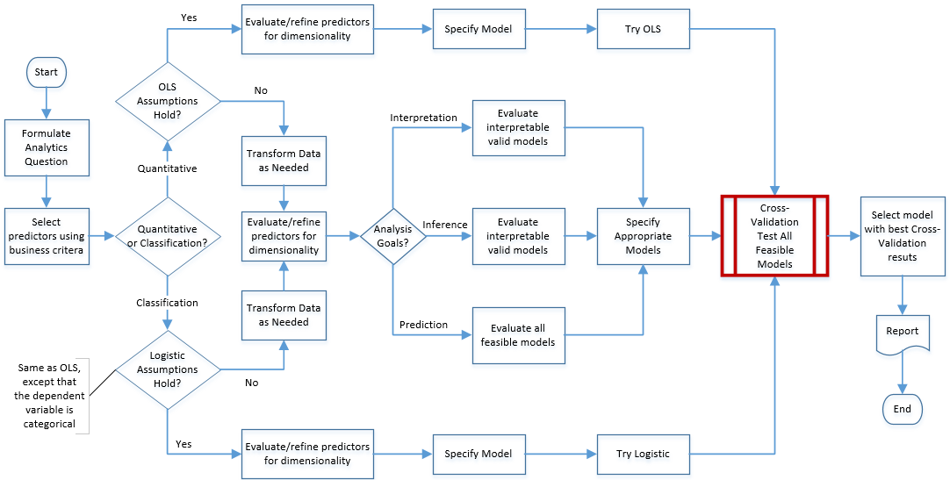
Predictive Model Selection Process

Slide 20
ITEC 621 Predictive Analytics 3.2 Weighted Least Squares (WLS)

Slide 21
Heteroskedasticity: EV: error (residual) variance is not constant

Slide 22

Heteroscedasticity: Intuition
The OLS estimation method fits a line that minimizes the SSE.
But if the errors grow or shrink systematically along the outcome variable it causes the squared errors to be too large (or too small) in some parts of the regression line.
If so, OLS is still unbiased
But OLS is no longer most efficient (least variance)
This problem of “uneven” error variance is referred to as “heteroscedasticity” or “non-spherical residuals”

Slide 23
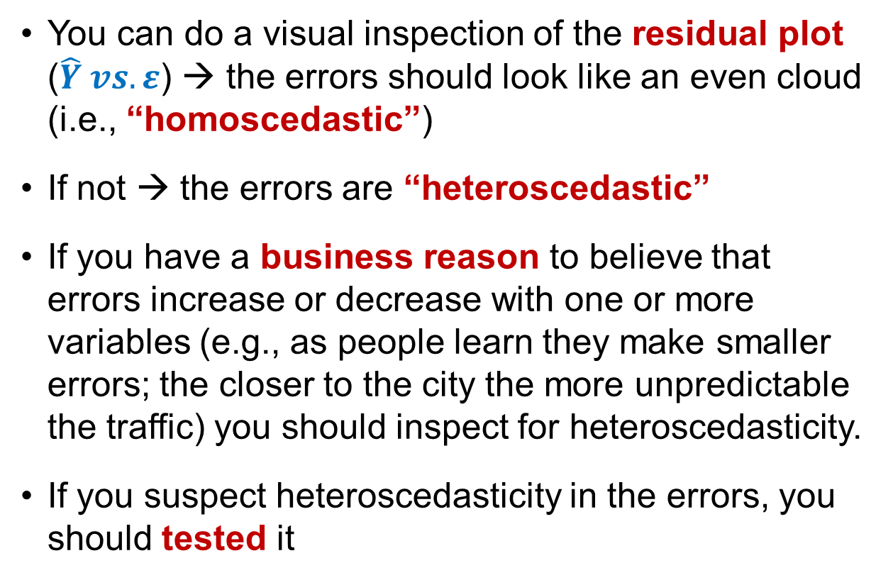
Detecting Heteroscedasticity
You can do a visual inspection of the residual plot ($\hat{Y} vs. ε$) → the errors should look like an even cloud (i.e., “homoscedastic”)
If not → the errors are “heteroscedastic”
If you have a business reason to believe that errors increase or decrease with one or more variables (e.g., as people learn they make smaller errors; the closer to the city the more unpredictable the traffic) you should inspect for heteroscedasticity.
If you suspect heteroscedasticity in the errors, you should tested it

Slide 24
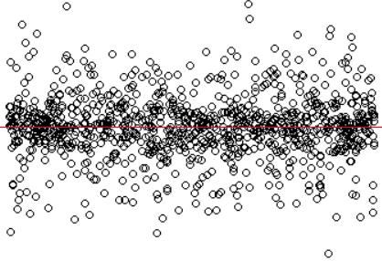

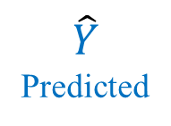

Homoscedasticity Illustration
Residual Plot (vs. Predicted Values)
$$ɛ$$
$$0$$
$\hat{Y}$ Predicted

Slide 25
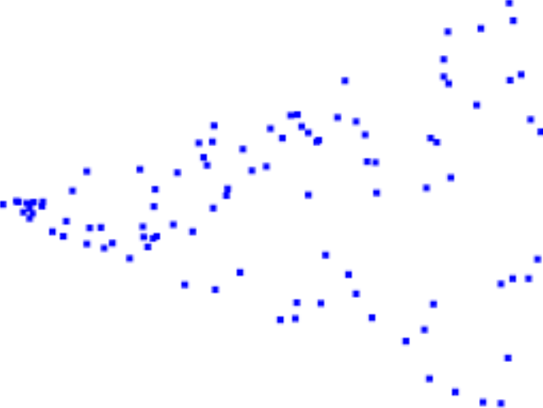
Heteroscedasticity Illustration Residual Plot (vs. Predicted Values)
$$ɛ$$
$$0$$
$$\hat{Y}$$

Slide 26
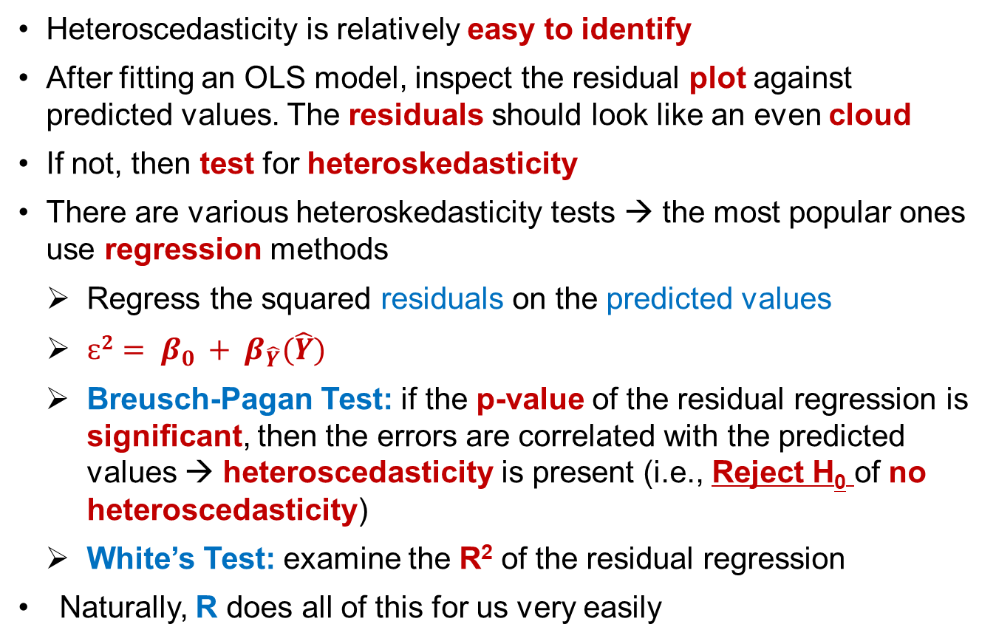
Testing for Heteroscedasticity
Heteroscedasticity is relatively easy to identify
After fitting an OLS model, inspect the residual plot against predicted values. The residuals should look like an even cloud
If not, then test for heteroskedasticity
There are various heteroskedasticity tests → the most popular ones use regression methods
Regress the squared residuals on the predicted values
$ɛ2= β_{0 }+ β_{\hat{Y}}(\hat{Y})$
Breusch-Pagan Test: if the p-value of the residual regression is significant, then the errors are correlated with the predicted values → heteroscedasticity is present (i.e., Reject H₀ of no heteroscedasticity)
White’s Test: examine the R² of the residual regression
Naturally, R does all of this for us very easily

Slide 27
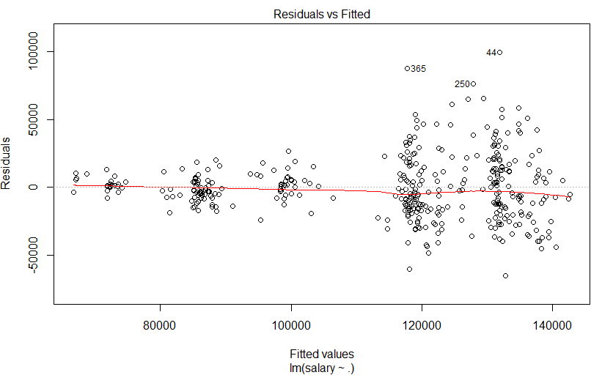
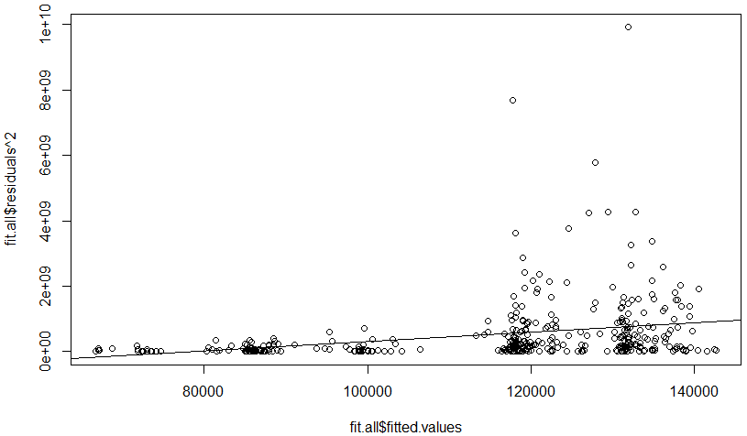
Heteroscedasticity Illustration
fit.all <- lm(salary~., data = Salaries) see Homework 2
Plot (Predicted vs. Residuals) →
Plot (Predicted vs. Residuals²) →
$$ɛ2= β_{0 }+ β_{\hat{Y}}(\hat{Y})$$

Slide 28


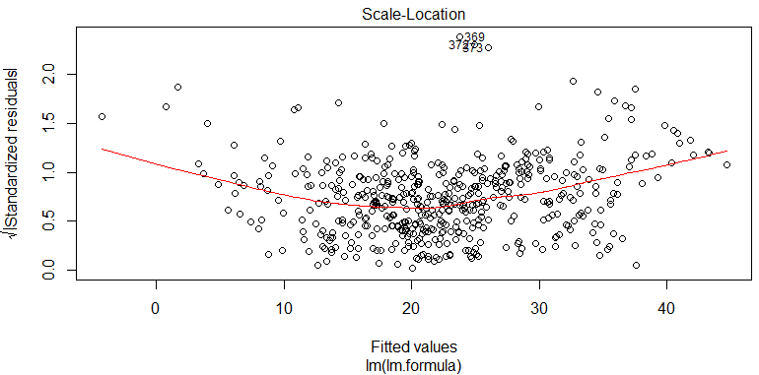
Breusch-Pagan Test
# Testing for Heteroskedasticity library(MASS) # Contains the “Boston" housing data set library(lmtest) # Contains bptest( ) and more lm.ols <- lm(medv ~ ., data = Boston) # Fit the model using all predictors for medv bptest(lm.ols, data = Boston) # Breusch-Pagan test plot(lm.fit, which = 1) # First plot() renders the residual plot

Slide 29
Weighted Least Squares (WLS)
Correcting for heteroskedasticity

Slide 30
Weighted Least Squares (WLS): Intuition
Regression models with heteroskedastic residuals can be easily corrected with WLS
WLS is a generic regression estimation method that minimizes a weighted sum of error squares, rather than just the sum of error squares
The idea is to give less weight to data points with large residuals, and more weight to those with small residuals
If OLS assumptions (other than EV) hold, both OLS and WLS are unbiased
But with heteroskedasticity WLS has lower variance → the regression is more stable with more significant coefficients
Many weighting methods are available for WLS, but the most popular and effective approach is to use the OLS residuals

Slide 31
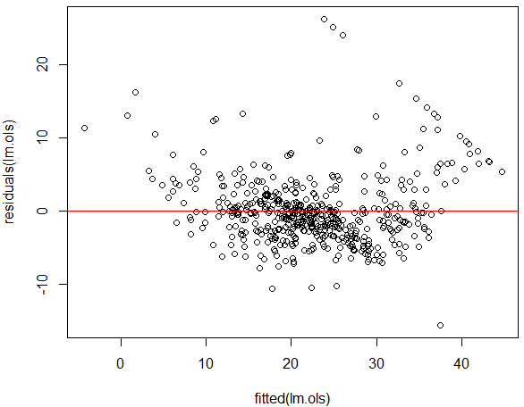
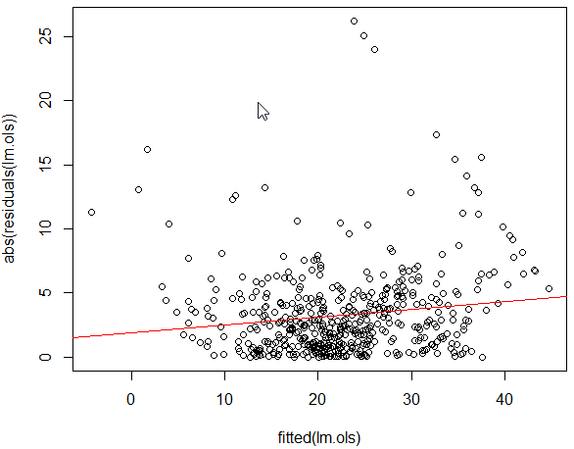
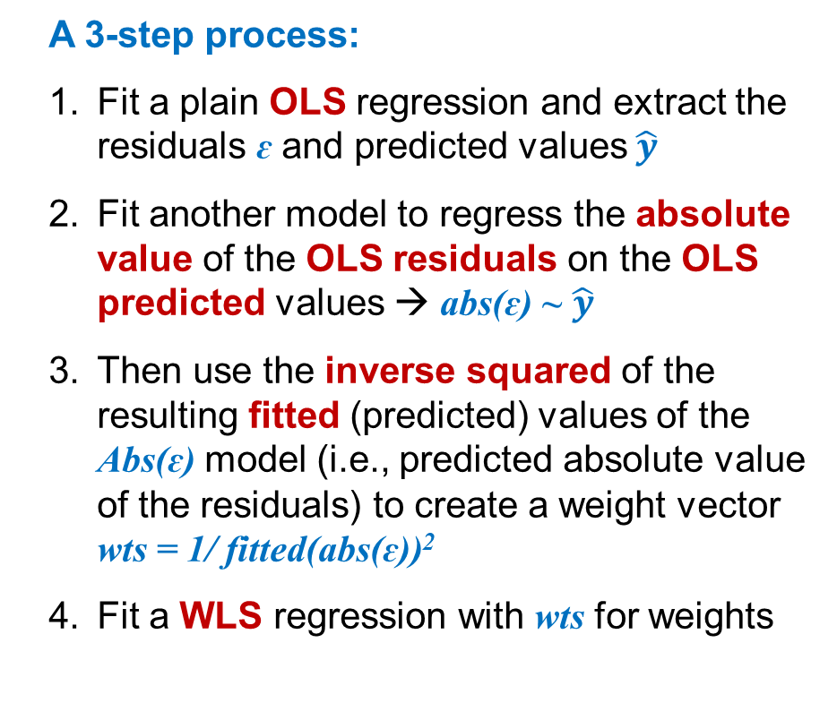
Fitting a WLS Model
A 3-step process:
Fit a plain OLS regression and extract the residuals ɛ and predicted values $\hat{y}$
Fit another model to regress the absolute value of the OLS residuals on the OLS predicted values → abs(ɛ) ~ $\hat{y}$
Then use the inverse squared of the resulting fitted (predicted) values of the Abs(ɛ) model (i.e., predicted absolute value of the residuals) to create a weight vector wts = 1/ fitted(abs(ɛ))²
Fit a WLS regression with wts for weights

Slide 32

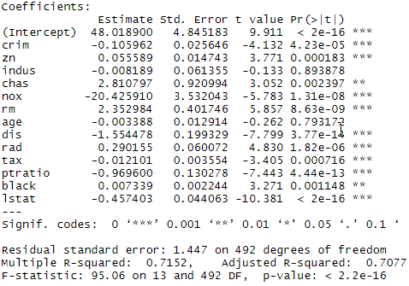
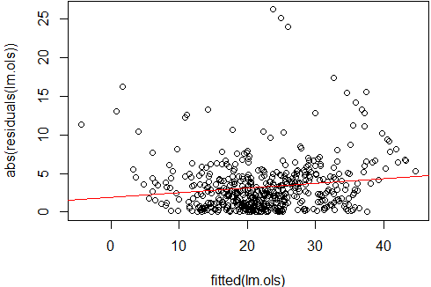
Example: WLS Regression
# Fitting WLS lm.ols <- lm(medv ~ ., data = Boston) # Fit OLS regression lm.abs.res <- lm( abs(residuals(lm.ols)) ~ fitted(lm.ols) ) # Regress absolute value of OLS residuals on fitted values plot(fitted(lm.ols), abs(residuals(lm.ols))) abline(lm.abs.res, col="red") # Draw regression line
wts <- 1 / fitted(lm.abs.res) ^ 2 # Weight vector, inverse of predicted absolute value of residuals, squared lm.wls <- lm(medv ~ ., data = Boston, weights = wts) summary(lm.wls) # More stable model (i.e., lower variance) than OLS, the coefficients are similar.

Slide 33
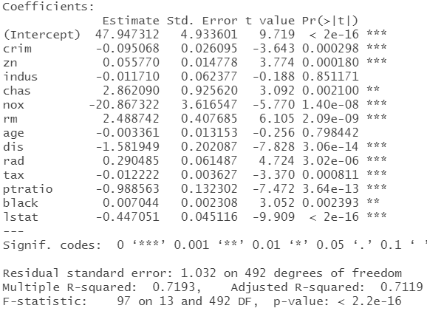
Example: WLS Regression (alternative)
# Fitting WLS (alternative method with squared residuals, instead of absolute values) lm.ols <- lm(medv ~ ., data = Boston) # Fit OLS regression lm.res2 <- lm(residuals(lm.ols) ^ 2 ~ fitted(lm.ols)) # Regress the squared OLS residuals on fitted values wts2 <- 1 / fitted(lm.res2) # Weight vector, inverse of predicted squared residuals lm.wls2 <- lm(medv ~ ., data = Boston, weights = wts2) summary(lm.wls2) # Similar results to lm.wls above

Slide 34
ITEC 621 Predictive Analytics 3.3 Generalized Linear Models (GLM) Use ITEC621_Regression.R

Slide 35
Maximum Likelihood Estimation (MLE)

Slide 36

Maximum Likelihood: Intuition
Maximum Likelihood Estimation (MLE) seeks to maximize the likelihood that a model fits the data accurately
That is, it seeks to fit a model that has a good level of “agreement” between what the model predicts and the actual outcomes in the data
For each observation, the likelihood function provides the likelihood that the respective outcome is predicted the correctly – i.e., the correct value or correct classification

Slide 37
Maximum Likelihood: Details
A regression estimated with MLE (rather than OLS) finds the set of β coefficients that maximizes the likelihood of a correct prediction
As such MLE provides more precise estimates when the outcome variable is not normally distributed (e.g., Poison, Logit) – i.e., the outcome is not continuous (e.g., binary, categorical, counts)
However, if the outcome variable is continuous and normally distributed, MLE and OLS yield the exact same results

Slide 38
Generalized Linear Models (GLM) OLS EN(✗) Use when errors or Y are not normally distributed

Slide 39
Generalized Linear Models (GLM)
OLS models are fit by finding the line that minimizes SSE
R fits OLS regressions with the “Linear Model” lm( ) function, which should only be used when OLS assumptions are met
But if Y or the residuals don’t follow a normal distribution, the model should be fit with the GLM
In R, GLM is fitted with the glm( ) function
The glm( ) syntax is similar to lm( ), but you also need to specify the type of distribution of the outcome variable and a link function.

Slide 40
GLM Regression Assumptions
Not an assumption
Modified from OLS
Same as with OLS
(YC) The outcome variable (Y) is continuous
(ED) Errors (residuals) and Y are NOT required to be normally distributed, but to follow a particular Distribution Family (e.g., Gaussian, Poison, Binomial, Multinomial)
(XI) The predictors (X’s) are independent (i.e., uncorrelated)
(LL) Not the outcome (Y), but the linear transformation of the outcome by the Link function and predictor (X’s) variables have a linear relationship
(OI) (Data) Observations are independent
(EI) Errors (residuals) are independent
(EA) The average of the errors (residuals) = 0
(EV) The variance of the errors (residuals) is constant (errors are “homoscedastic”)

Slide 41
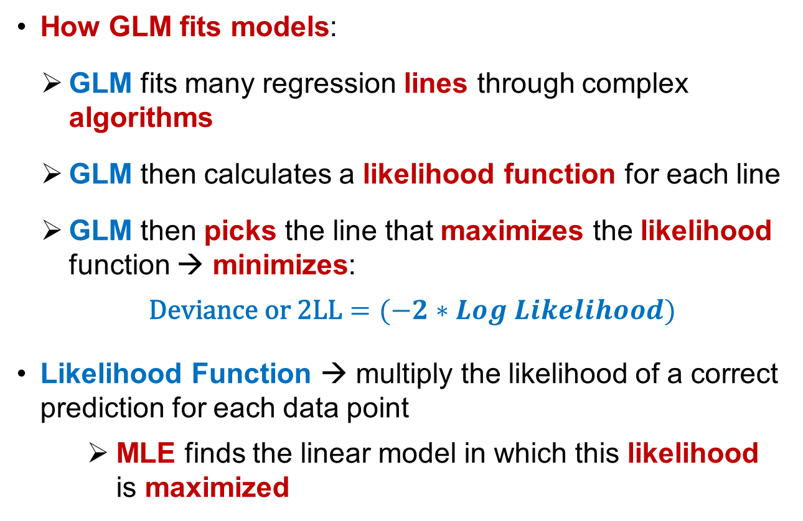
Fitting GLM Models
How GLM fits models:
GLM fits many regression lines through complex algorithms
GLM then calculates a likelihood function for each line
GLM then picks the line that maximizes the likelihood function → minimizes:
$\text{Deviance} \text{or}\text{ 2}\text{LL}=(−2∗Log Likelihood)$
Likelihood Function → multiply the likelihood of a correct prediction for each data point
MLE finds the linear model in which this likelihood is maximized

Slide 42
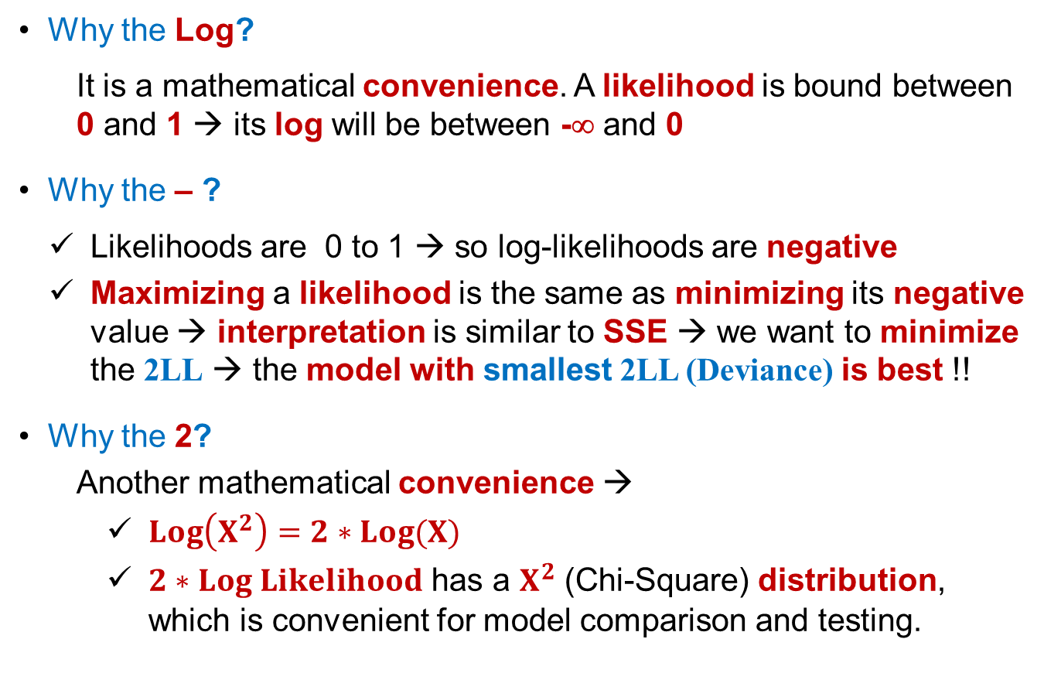
-2 Log Likelihood (2LL) Explained
Why the Log?
It is a mathematical convenience. A likelihood is bound between 0 and 1 → its log will be between -∞ and 0
Why the – ?
Likelihoods are 0 to 1 → so log-likelihoods are negative
Maximizing a likelihood is the same as minimizing its negative value → interpretation is similar to SSE → we want to minimize the 2LL → the model with smallest 2LL (Deviance) is best !!
Why the 2?
Another mathematical convenience →
$Log\left(X^{2}\right)=2∗Log(X)$
$2∗Log Likelihood$ has a $X^{2}$ (Chi-Square) distribution, which is convenient for model comparison and testing.

Slide 43
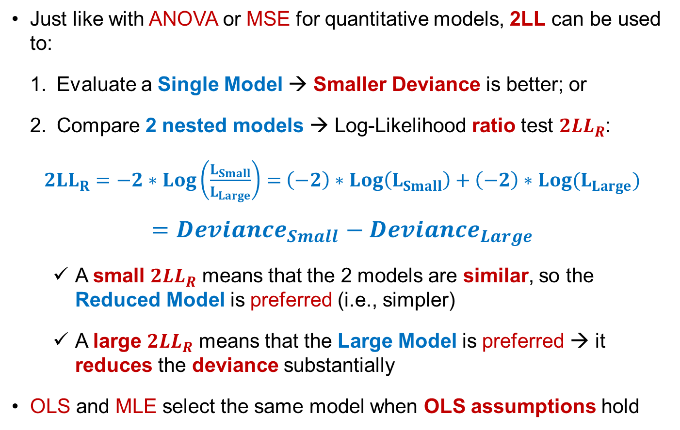
2LL = Deviance
Just like with ANOVA or MSE for quantitative models, 2LL can be used to:
Evaluate a Single Model → Smaller Deviance is better; or
Compare 2 nested models → Log-Likelihood ratio test ${2LL}_{R}$:
${2LL}_{R}=−2∗Log\left(\frac{L_{Small}}{L_{Large}}\right)=$ ${\left(−2\right)∗Log\left(L_{Small}\right)+\left(−2\right)∗Log(L}_{Large})$
$${=Deviance}_{Small}− {Deviance}_{Large}$$
A small ${2LL}_{R}$ means that the 2 models are similar, so the Reduced Model is preferred (i.e., simpler)
A large ${2LL}_{R}$ means that the Large Model is preferred → it reduces the deviance substantially
OLS and MLE select the same model when OLS assumptions hold

Slide 44
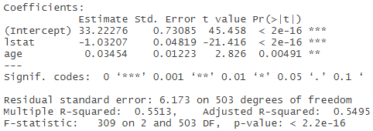
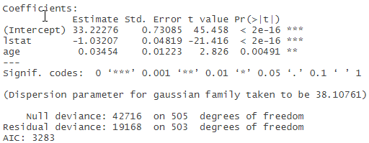
Example: GLM Regression
## Generalized Linear Methods (GLM) library(MASS) # Contains the Boston housing data set lm.fit <- lm(medv ~ lstat + age, data = Boston) # OLS summary(lm.fit)
glm.fit <- glm(medv ~ lstat + age, data = Boston, family = gaussian(link = "identity")) # GLM # family = gaussian(link = "identity") means medv is normally distributed and not transformed # Note: family = gaussian(link = "identity") is the default, so this will yield the same results:
glm.fit <- glm(medv ~ lstat + age, data = Boston) summary(glm.fit) # Same coefficients as with lm(), different fit statistics reported
# You can derive the R-square of a GLM model as follows res.dev <- glm.fit$deviance; null.dev <- glm.fit$null.deviance dev.Rsq <- (null.dev-res.dev) / null.dev; dev.Rsq # Deviance explained by the model
medv is normally distributed
Do not transform medv
=
lm.fit
glm.fit

Slide 45
ITEC 621 Predictive Analytics 3.4 Logistic Regression Use ITEC621_Regression.R

Slide 46
Odds and Probabilities

Slide 47
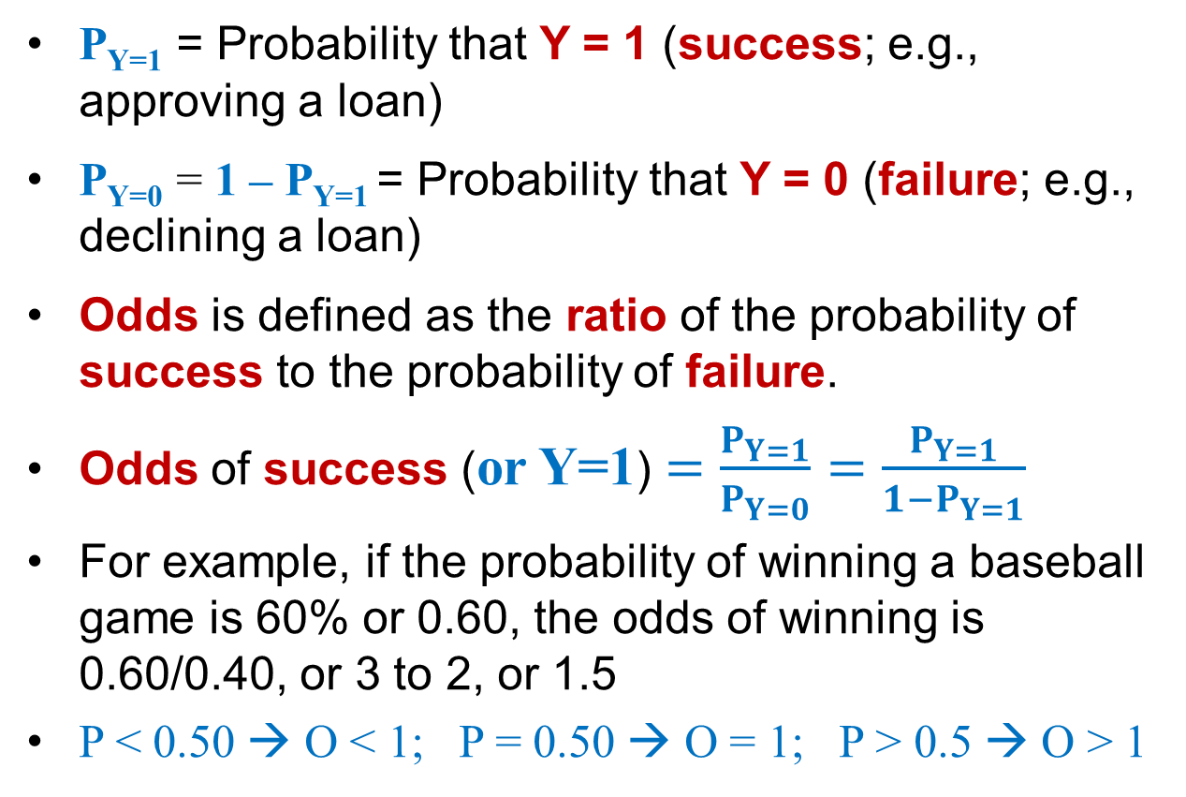
Odds and Probabilities
P_{Y=1} = Probability that Y = 1 (success; e.g., approving a loan)
P_{Y=0} = 1 – P_{Y=1} = Probability that Y = 0 (failure; e.g., declining a loan)
Odds is defined as the ratio of the probability of success to the probability of failure.
Odds of success (or Y=1) $=\frac{P_{Y=1}}{P_{Y=0}}=\frac{P_{Y=1}}{1−P_{Y=1}}$
For example, if the probability of winning a baseball game is 60% or 0.60, the odds of winning is 0.60/0.40, or 3 to 2, or 1.5
P < 0.50 → O < 1; P = 0.50 → O = 1; P > 0.5 → O > 1

Slide 48
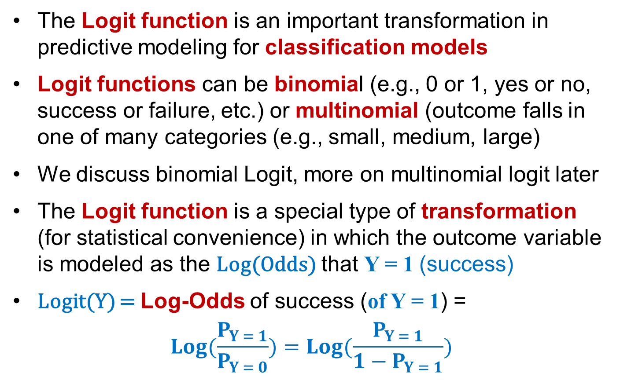
Log-Odds: The Logit Function
The Logit function is an important transformation in predictive modeling for classification models
Logit functions can be binomial (e.g., 0 or 1, yes or no, success or failure, etc.) or multinomial (outcome falls in one of many categories (e.g., small, medium, large)
We discuss binomial Logit, more on multinomial logit later
The Logit function is a special type of transformation (for statistical convenience) in which the outcome variable is modeled as the Log(Odds) that Y = 1 (success)
Logit(Y) = Log-Odds of success (of Y = 1) =
$$Log(\frac{P_{Y = 1}}{P_{Y = 0}})=Log(\frac{P_{Y = 1}}{1−P_{Y = 1}})$$

Slide 49
Conversion Examples
If the probability that the Redskins will win a game P_{W} is 0.25 or 25%
Then the probability of losing is
$$P_{L}=1−0.25=0.75=75\%$$
The odds of winning are
$$\frac{P_{W}}{P_{L}}=\frac{0.25}{0.75}=0.33= \frac{1}{3} or 1 to 3$$
The log-odds of winning are: $Log\left(0.33\right)=−1.109$
The odds of winning are $e^{−1.109}=0.33$

Slide 50
Logistic (Logit) Models OLS YC(✗) Use when Y is categorical (not continuous) →
(1) Only 2 categories → Binomial Logit (2) More than 2 categories → Multinomial Logit

Slide 51
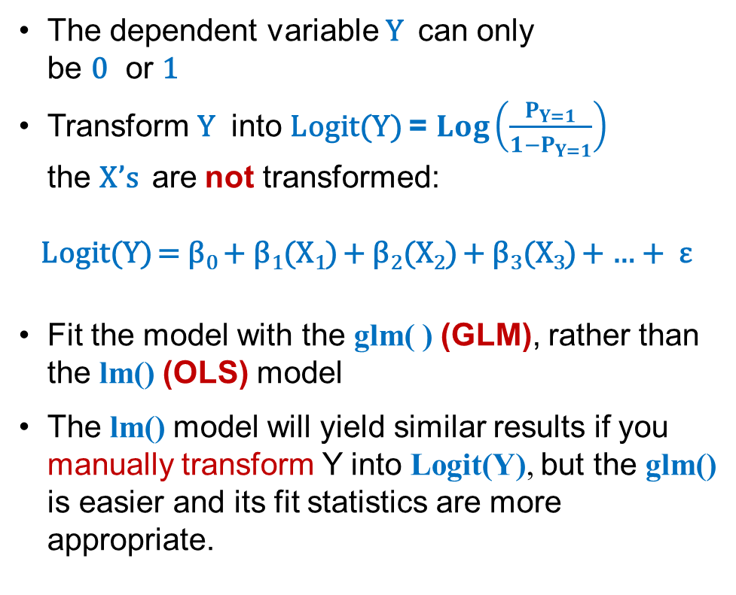
The Logistic Regression Model
The dependent variable Y can only be 0 or 1
Transform Y into Logit(Y) = $Log\left(\frac{P_{Y=1}}{1−P_{Y=1}}\right)$ the X’s are not transformed:
Logit(Y) = β₀ + β₁(X₁) + β₂(X₂) + β₃(X₃) + … + ε
Fit the model with the glm( ) (GLM), rather than the lm() (OLS) model
The lm() model will yield similar results if you manually transform Y into Logit(Y), but the glm() is easier and its fit statistics are more appropriate.
Y
✗
1
0
X
Y
1
✓
0
X

Slide 52
Logistic Model Interpretation
The OLS regression coefficients β show how much Y changes when the corresponding X increases by 1
In contrast, the Logistic regression coefficients β show, on average and holding everything else constant, how much the Log-Odds of Y=1 (e.g., success) changes when the corresponding X increases by 1

Slide 53
Logistic Regression Assumptions
Not an assumption
Modified from OLS
Same as with OLS
(YC) The outcome variable (Y) is categorical (binary or multinomial, not continuous)
(EN) Errors (residuals) are normally distributed
(XI) The predictors (X’s) are independent (i.e., uncorrelated)
(LL) The outcome (Logit of Y) and predictor (X’s) variables have a linear relationship
(OI) (Data) Observations are independent
(EI) Errors (residuals) are independent
(EA) The average of the errors (residuals) = 0
(EV) The variance of the errors (residuals) is constant (errors are “homoscedastic”)

Slide 54
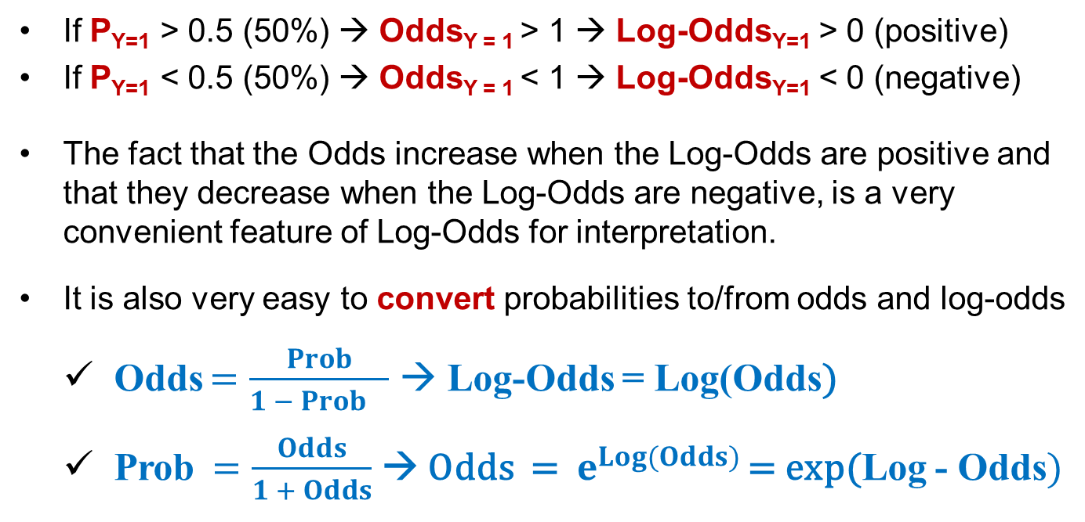
Fun Facts about Log-Odds
If P_{Y=1} > 0.5 (50%) → Odds_{Y = 1} > 1 → Log-Odds_{Y=1} > 0 (positive)
If P_{Y=1} < 0.5 (50%) → Odds_{Y = 1} < 1 → Log-Odds_{Y=1} < 0 (negative)
The fact that the Odds increase when the Log-Odds are positive and that they decrease when the Log-Odds are negative, is a very convenient feature of Log-Odds for interpretation.
It is also very easy to convert probabilities to/from odds and log-odds
Odds $=\frac{Prob}{1 − {Prob}_{}}$ → Log-Odds = Log(Odds)
Prob $=\frac{Odds}{1 + Odds}$ → Odds = $e^{Log(Odds)}$ = exp(Log - Odds$)$

Slide 55
More Fun Facts About Logs

Slide 56
[Aside] Fun Facts about Logs
Logarithms have a base → If b^{x} = y → Log_{b}(y) = x
That is, the Log of y on base b is x
So, if y = 10^{x}, then log₁₀(y) = x → the Log of y on base 10 is x
If y = e^{x}, then log_{e}(y) = LN(y) = x
That is, the Natural Log of y (on base e) is x
Where e is the Euler number = 2.718 …., widely used in math
All logs in statistics are natural logs (on base e)
So, when we write log(x) it is implied that it is base e or LN

Slide 57
What is e any way?
It is your professor’s last name, but also Euler’s
Interestingly, it can be computed in many ways
For example, $1 invested at an annual interest rate of 100% yields (1+1) = $2 in one year
If interest is compounded monthly it yields (1+1/12)¹² = $2.61
Compounded daily yields (1+1/365)³⁶⁵ = $2.714
As the number of compounding periods gets larger (∞), the yield approximates e = (1+1/∞)∞ = 2.718 …
Interestingly e is also = 1/0! + 1/1! + 1/2! + 1/3! + etc.

Slide 58

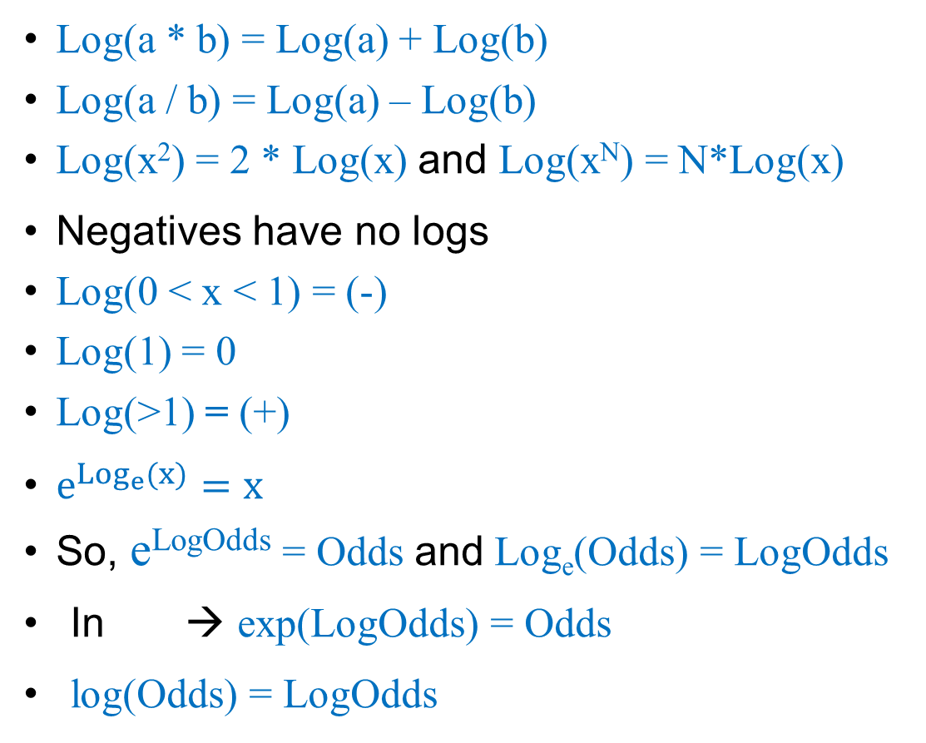
Useful Facts about Logs
Log(a * b) = Log(a) + Log(b)
Log(a / b) = Log(a) – Log(b)
Log(x²) = 2 * Log(x) and Log(x^{N}) = N*Log(x)
Negatives have no logs
Log(0 < x < 1) = (-)
Log(1) = 0
Log(>1) = (+)
$e^{{Log}_{e}(x)}=x$
So, e^{LogOdds} = Odds and Log_{e}(Odds) = LogOdds
In → exp(LogOdds) = Odds
log(Odds) = LogOdds

Slide 59
Prob | Prob% | Odds | Log Odds
 |  | p / (1-p) | Ln(o)
0.001 | 0.1% | 0.001 | -6.907
0.01 | 1% | 0.010 | -4.595
0.1 | 10% | 0.111 | -2.197
0.2 | 20% | 0.250 | -1.386
0.3 | 30% | 0.429 | -0.847
0.4 | 40% | 0.667 | -0.405
0.5 | 50% | 1.000 | 0.000
0.6 | 60% | 1.500 | 0.405
0.7 | 70% | 2.333 | 0.847
0.8 | 80% | 4.000 | 1.386
0.9 | 90% | 9.000 | 2.197
1.0 | 100%
Log Odds | Odds | Prob | Prob%
 | e^{(Log Odds)} | o / (1+o)
-6.907 | 0.001 | 0.001 | 0%
-4.595 | 0.010 | 0.01 | 1%
-2.197 | 0.111 | 0.1 | 10%
-1.386 | 0.250 | 0.2 | 20%
-0.847 | 0.429 | 0.3 | 30%
-0.405 | 0.667 | 0.4 | 40%
0.000 | 1.000 | 0.5 | 50%
0.405 | 1.500 | 0.6 | 60%
0.847 | 2.333 | 0.7 | 70%
1.386 | 4.000 | 0.8 | 80%
2.197 | 9.000 | 0.9 | 90%
 |  | 1.0 | 100%
Log Conversions
Log Odds (0) → Odds = 1 → Prob = 0.5 → chance (flip a coin)
If β = 0 (i.e., not significant) the predictor doesn’t change the odds
If Log Odds (-) → Odds < 1 → Prob < 0.5 → (-) β in a logistic regression → The log odds go down → The odds go down by a (<1) factor
If Log Odds (+) → Odds > 1 → Prob > 0.5 → (+) β in a logistic regression → The log odds go up → The odds go up by a (>1) factor

Slide 60

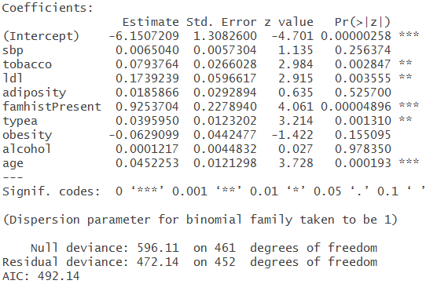
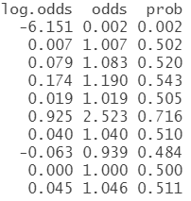
Logistic Regression
## Logistic with GLM heart <- read.table("Heart.csv", sep = ",", head = T) heart.fit <- glm(chd ~ ., family = binomial(link = “logit"), data = heart ) # chd → coronary heart disease summary(heart.fit)
log.odds <- coef(heart.fit); odds <- exp(coef(heart.fit)); prob <- odds/(1+odds) round(cbind(log.odds, odds, prob), digits = 3)

Slide 61
ITEC 621 Predictive Analytics 3.5 Trees Use ITEC621_Trees.R

Slide 62
Analytics Modeling Options
 | Modeling Method
 | Structured |  | Visual, Text, Unstructured, etc.
Descriptive | Cluster analysis, correlation, market basket analysis, sample statistics, ANOVA |  | Bubble charts, network diagrams, natural language processing, clustering dendograms, etc.
Predictive | Association | Decision Tree | Charts
Quantitative Value | Regression | Regression Trees | Regression plots, scatter plots, Tableau diagrams, trend charts, etc.
Classification | Logistic Regression; Other Categorical Regression Models | Classification Trees | Tree maps, interactive diagrams,
Prescriptive | Operations research, decision modeling, optimization, linear programming |  | Simulations, etc.

Slide 63
Decision Trees Overview

Slide 64
Decision Trees: Intuition
Trees are non-parametric models → no need to check assumptions
There are two types of decision trees:
Regression Trees – the outcome is quantitative → solve similar problems than linear regression models → but less interpretable
Classification Trees – the outcome is categorical → solve similar problems than Logistic, LDA and QDA models → but less interpretable

Slide 65
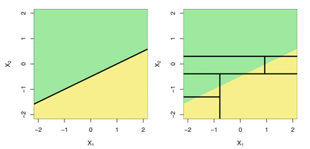
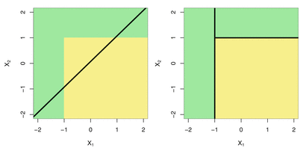
Comments on Trees
Both, regression and classification trees are similar in that:
Observations are split recursively into nested “regions” (leaves) to guide the prediction of new observations into one of the resulting regions.
Which model type is better, tree or regression? It depends !
The 2 left diagrams below show both models when the “true” relationship between 2 variables is linear. The 2 right diagrams they are not.

Slide 66
Regression Trees

Slide 67
Analytics Modeling Options
 | Modeling Method
 | Structured |  | Visual, Text, Unstructured, etc.
Descriptive | Cluster analysis, correlation, market basket analysis, sample statistics, ANOVA |  | Bubble charts, network diagrams, natural language processing, clustering dendograms, etc.
Predictive | Association | Decision Tree | Charts
Quantitative Value | Regression | Regression Trees | Regression plots, scatter plots, Tableau diagrams, trend charts, etc.
Classification | Logistic Regression; Other Categorical Regression Models | Classification Trees | Tree maps, interactive diagrams,
Prescriptive | Operations research, decision modeling, optimization, linear programming |  | Simulations, etc.

Slide 68
Regression Trees: Intuition
The intuition is simple. If we have a quantitative outcome Y, we find the value of predictor X₁ that separates the outcomes the farthest in the data and split the data at that “node”, creating 2 tree branches.
We then find the predictor X₂ (or X₁ again) that can separate the outcomes the farthest within each branch; and so on
We predict an outcome using the mean of the outcome variable in the tree region they belong

Slide 69
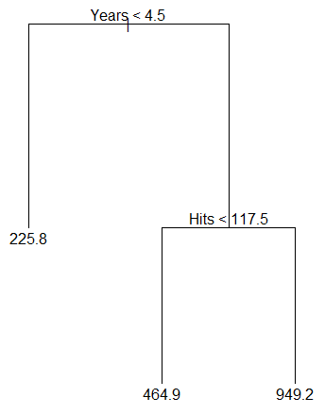
Regression Tree Illustration
In the tree illustration (see textbook) we are predicting baseball player Salary based on the player’s number of years in the major leagues and number of hits per year.
So, on average, a player with less than 4.5 years will make a Salary of $225.8K
A player with more than 4.5 years and more than 117.5 hits will make a Salary of $949.2K
A player with more than 4.5 years but with less than 117.5 hits will make a Salary of $464.9K
Outcome: Salary ($K)

Slide 70
Regression Trees: Explained
Essentially, we partition the data into “regions” such that the distance within regions is minimal and the distance between regions is largest.
The points where the branches split are called “nodes”
Any region can be further subdivided into more regions
All observations within a region are assigned the same prediction equal to the mean of all outcome values in the region

Slide 71
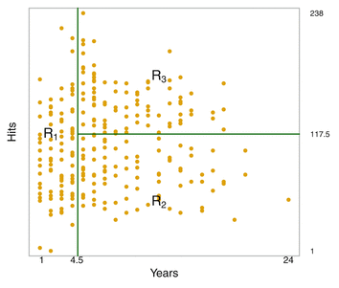
Tree Regions
The diagram shows two partitions in the baseball salary example, with the first partition at Years < 4.5 and the region for Years >= 4.5 further sub-partitioned at Hits < 117.5
With P predictors, the regression tree method finds the specific predictor x_{i} and cutoff vales of that predictor that minimizes the ESS
It then finds which of the resulting partitions to split, one at a time, and where, such that ESS is further reduced and minimized again
We then continue splitting regions into further sub-regions until each branch has exactly one data point, although we typically stop growing the tree at some point (more on this later).

Slide 72
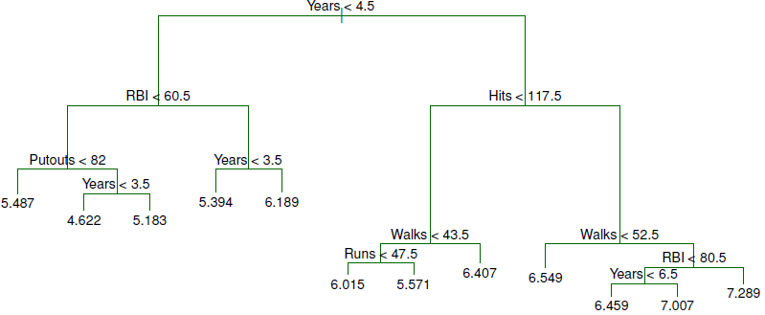
Baseball (Log) Salaries Illustration
Salary Paths
Highest
Lowest

Slide 73
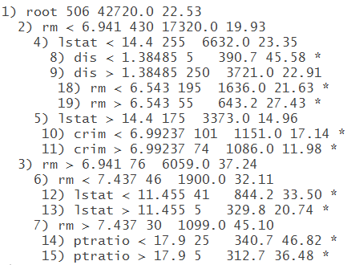
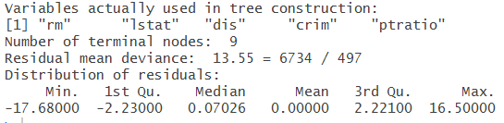
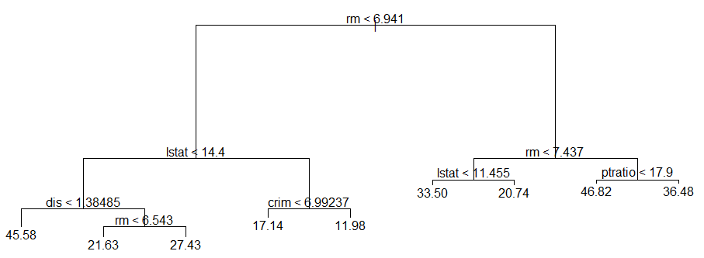
Regression Trees
## Regression Trees library(MASS) # Contains the Boston data set library(tree) # Needed to fit decision trees tree.boston <- tree(medv ~ ., Boston) # Fit the tree tree.boston # Check the specific split points
summary(tree.boston) # Basic results
plot(tree.boston) # Plot the tree text(tree.boston, pretty = 0) # Add pretty labels

Slide 74
Growing Trees

Slide 75
When do we Stop Growing a Tree?
A tree can be grown until every leaf in the tree is single data point
However, growing large trees is not very useful and often you can’t even display the resulting tree
Later in the course, we will discuss how to grow and prune trees based on cross-validation testing, which will yield the particular tree size that maximizes predictive accuracy
For now, you can control the size of the tree by changing the mindev attribute in the tree( ) function
The default is mindev = 0.01 → when the deviance (MSE) in a leaf is less than 0.01 or 1% of the deviance in the root leaf, tree( ) stops growing the tree → a further split is no longer worth the deviance reduction
Increase the value of mindev to get fewer leaves, decrease it to get more leaves

Slide 76
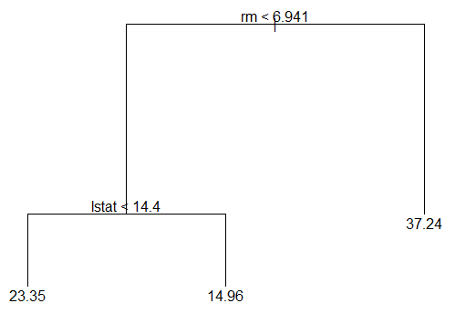
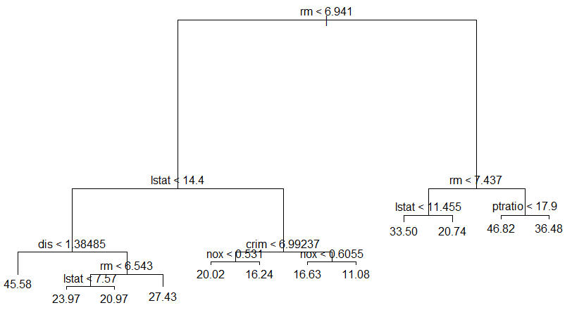
Example: Growing Trees
# Controlling Tree Size with mindev tree.boston.small <- tree(medv ~ ., Boston, mindev = 0.1) plot(tree.boston.small) # Plot the tree text(tree.boston.small, pretty = 0) # Pretty labels
tree.boston.large <- tree(medv ~ ., Boston, mindev = 0.005) plot(tree.boston.large) # Plot the tree text(tree.boston.large, pretty = 0) # Pretty labels
Small Tree
Large Tree

Slide 77
Classification Trees

Slide 78
Analytics Modeling Options
 | Modeling Method
 | Structured |  | Visual, Text, Unstructured, etc.
Descriptive | Cluster analysis, correlation, market basket analysis, sample statistics, ANOVA |  | Bubble charts, network diagrams, natural language processing, clustering dendograms, etc.
Predictive | Association | Decision Tree | Charts
Quantitative Value | Regression | Regression Trees | Regression plots, scatter plots, Tableau diagrams, trend charts, etc.
Classification | Logistic Regression; Other Categorical Regression Models | Classification Trees | Tree maps, interactive diagrams,
Prescriptive | Operations research, decision modeling, optimization, linear programming |  | Simulations, etc.

Slide 79
Classification Trees: Intuition
Classification trees are very similar in concept to regression trees
Except that the outcome is qualitative consisting of K possible classes
K = 2 → Binomial classification trees
K > 2 → Multinomial classification trees
The classification is based on the highest probability of classifying observation in the correct class
So, it is an alternative method to Logistic Regression

Slide 80
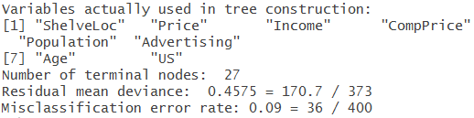
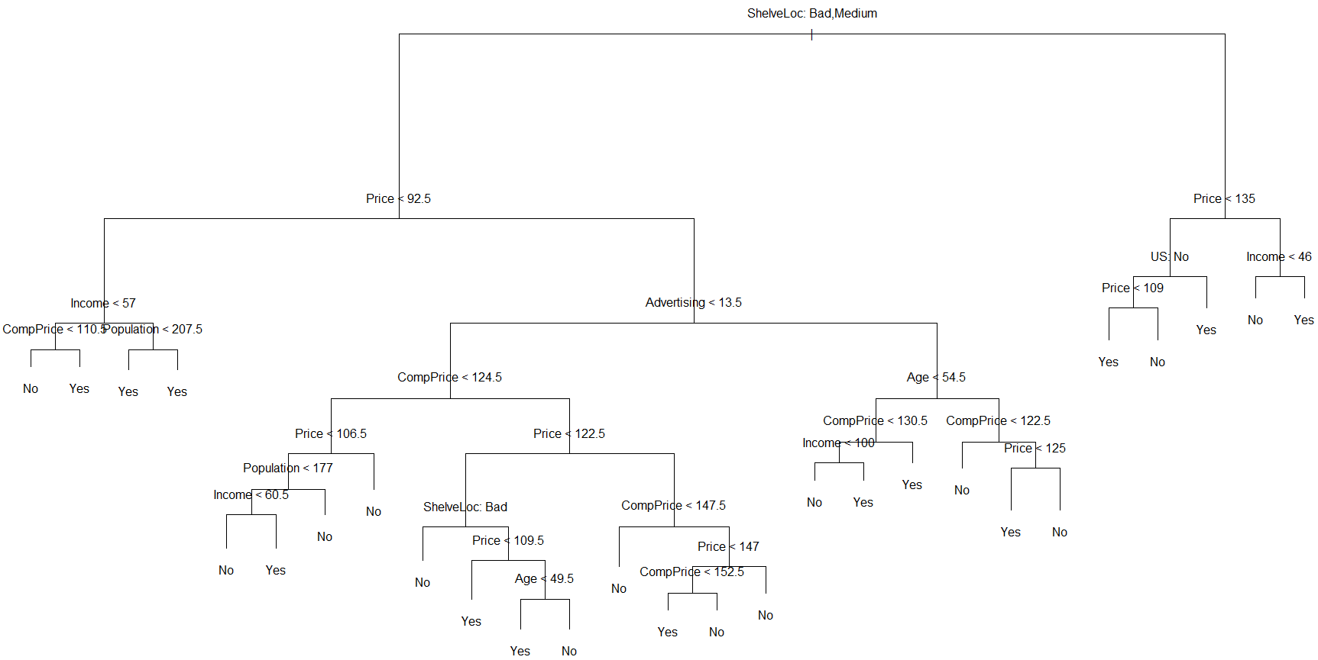
Example: Classification Trees
## Classification Trees library(ISLR); attach(Carseats) # Contains the Carseats data set library(tree) # Contains the tree functions High <- ifelse(Sales <= 8, “No", "Yes") # Create a binary response variable High=“Yes” if Sales>8K High <- as.factor(High) # Convert text to factor variable
Carseats <- data.frame(Carseats, High) # Add the High variable to the data set tree.carseats <- tree(High ~ . -Sales, Carseats) # Fit the tree on all the data (except Sales) summary(tree.carseats) # Get basic data on the fitted model
plot(tree.carseats); text(tree.carseats, pretty = 0) # Display tree with pretty labels

