Slide 1
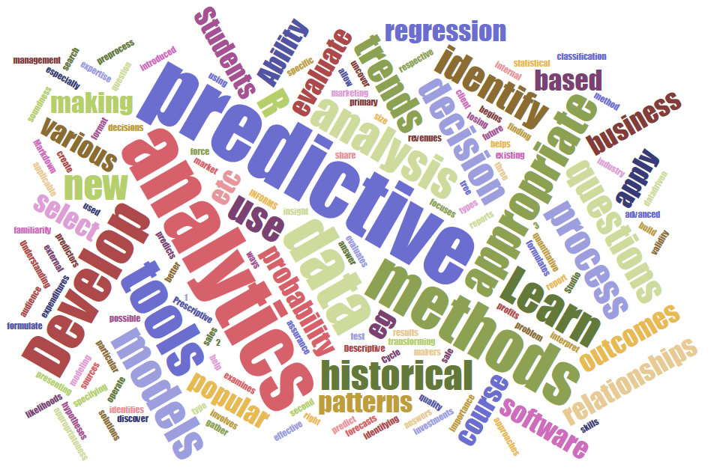
ITEC 621 Predictive Analytics 4. Data Pre-Processing Use ITEC621_DataPreProcessing.R Prof. J. Alberto Espinosa Last updated 2/6/2023

Slide 2
Overview

Slide 3
Variable Types

Slide 4
Variable Types
Understanding variable types is the first step in pre-processing
Dependent (predicted or response) vs. Independent (predictor) variables
Ex: Income <- f (Age + Education Level + School + City)
Variable Content Types:
Numeric:
Continuous – e.g., 4.32, 0.48 – can do math
Discrete – e.g., 10, 20, 30, etc. – no decimals, can do math
Binary – 0, 1 (e.g., no/yes; approved/declined; sold/not)
Character:
Ordinal – e.g., 1-7 survey scale (can’t do math, e.g., SET’s)
Categorical or Factor – e.g., Foreign/Domestic; Urban/Suburban/Rural
Text – e.g., E-mail subject or content, speech transcriptions

Slide 5
Why Pre-Process Data?

Slide 6
Introduction
As we discussed earlier, two key steps in the business analytics cycle are: (1) Model Method Selection; and (2) Model Specification.
One important aspect of developing a Model Specification predictive modeling is Feature Engineering
For any model tried or selected, Feature Engineering is about manipulating and preparing variables for the Model Specification step.
Two key aspects of Feature Engineering include:
Data Pre-Processing and Transformations (this week) – e.g., logs, lagging, categorical to binary, centering, standardizing, aggregating rows, etc.
Variable Selection (in 2 weeks) – i.e., identifying the optimal set of predictors for the problem at hand.

Slide 7
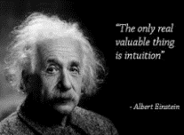
Data Pre-Processing: Intuition
About 80% to 90% of the work in analytics is getting the data ready for analysis.
Data is often pre-processed to correct data problems
But pre-processing is sometimes done to improve model performance – “feature engineering”
For example, a popular technique to detect spam mail is to look for the proportion of upper case letters in the subject. This requires pre-processing the subject headers.
Pre-processing needs are often based on the functional domain knowledge rather than mathematical reasons

Slide 8
Why Pre-Process Data?
Typical problems with the data include: missing values; inconsistent data; outliers; skewed or bi-modal distributions.
Some times the data is simply not in the appropriate format for the type of analysis to be done.
Some times the data needed for the analysis needs to be gathered from multiple data sources and joined
Or the data needs to be scaled, centered or normalized
Or it needs to be aggregated, summarized, etc.
Especially when data is not at the “unit of analysis” level
For example, you may have data on prices and features for individual houses, but you need to analyze housing by counties in the US – i.e., the unit of analysis is the county, not the individual homes → the data needs to be aggregated

Slide 9
Data Transformations Predictors, Outcome or Both?

Slide 10
Key Modeling Data Issues: Independent (Predictor) Variables
Predictors:
Can be continuous, discrete, binary, categorical or ordinal
With large samples (50+ data points) predictors don’t have to be normally distributed
With small samples, they need to be normal (for OLS, etc.)
Categorical (Factor) variables need to be transformed into dummy variables. R does this for you.
Categorical (Factor) variables can also be used to aggregate data by categories (e.g., counts, sums, average)
Text data often needs to be pre-processed to create meta data (e.g., word counts, character counts, event counts, matching text, synonyms, etc.)
Notes:
CORRECTION: added (Factor) after Categorical

Slide 11
Key Modeling Data Issues:
Dependent (Outcome) Variables
For OLS, the outcome variable needs to be normally distributed
Note: what really matters is that the regression residuals are normally distributed. But if the outcome variable is normally distributed, the residuals will generally be normally distributed too.
The type of dependent (outcome or response) variable determines what type of modeling methods can be employed. If Y is →
Continuous → Regression and regression trees
Count (discrete, non-negative) → GLM with Poisson distribution
Binary → Classification models like, logistic regression, classification trees, discriminant analysis, etc..
Categorical (Factor) → Multinomial logistic regression, multinomial discriminant analysis, classification trees
Ordinal → Ordered Logistic, Ordered Probit regressions
Time Sensitive → Forecasting or time-series regression models
Notes:
CORRECTIONS:
Added “discriminant analysis”
Changed “Discrete” with “Categorical (Factor)”

Slide 12
Overview
(Pred) Categorical to Dummy Variable → relevel( )
(Pred) Polynomials → I(x^2 ), I(x^3 ), etc.
Later in the semester → poly(x, n) function → x¹ + x² + …. + x^{n}
Log Transformations → log( )
(Outc & Pred) Linear-Log, Log-Linear, Log-Log (Elasticity) Models
(Outc) Logit Models → glm( ) → family = binomial(link = “logit”)
(Outc) Count Data → glm( ) → family = poisson(link = “log”)
(Outc & Pred) Centering → scale(… , center = T, scale = F)
(Outc & Pred) Standardization →scale(… , center = F, scale = T); lm.beta( )
(Outc & Pred) Lagging Data → dwtest( ); slide( ){DataCombine}

Slide 13
[Top] Transformation #1: Predictors: Categorical to Dummy Variables
OLS LI(✗) – Relationship between Y and X’s are not linear

Slide 14

Categorical Variables: Intuition
Categorical (i.e., factor) variables are not quantitative, so the assumption of linearity does not hold. But a very simple transformation using dummy variables solves this problem.
For example, if you have a categorical variable called State, it will contain a text value of 2 upper case letters with a value corresponding to one of the 50 U.S. states.
If you want to predict housing prices, the State where the house is located will probably make a difference. So, how do we model the effect of State location?
The answer is to convert the categorical variable State into 50 dummy variables, each named after the corresponding State, with a value of 1 if the house is in that State and 0 otherwise.
For example, the variable MD would have a 1 for all houses in the state of Maryland and 0 for any of the other states.
This will yield 50 dummy (quantitative) variables to model

Slide 15
The Dummy Variable Trap
This is a well-known problem when you convert a categorical variable into various “mutually exclusive” dummy variables.
For example, if you have a categorical variable called “LocationType” and it has one of three possible values (Urban, Suburban and Rural) we can create 3 dummy variables called Urban, Suburban and Rural, respectively.
If LocationType=“Urban” → Urban = 1; 0 otherwise If LocationType=“Suburban” → Suburban = 1; 0 otherwise If LocationType=“Rural” → Rural = 1; 0 otherwise
However, these three dummy variables are mutually exclusive, so if Urban = Suburban = 0, then Rural has to be 1, etc.
So, the value in any of these variables is dependent on the other 2
Including all 3 variables in a regression model will not only violate the assumption of independence, but will also create infinite multicollinearity and infinite standard errors

Slide 16
Modeling Categorical Predictors
If an independent variable is categorical, you can convert it to N dummy variables, where N is the number of categories in the data for that variable → R does this automatically for you
Due to the dummy variable trap, you can only model N-1 dummy variables.
The variable left out is called the “baseline” or “reference” variable (e.g., MD)
The regression intercept represents the effect of the reference variable, when all other variables are 0 (e.g., house value for houses in MD – i.e., all included dummy variables = 0).
A coefficient for any of the other variables (e.g., VA) represents the effect difference between that variable (e.g., VA) and the reference variable (e.g., MD), all else equal)
Notes:
CORRECTION:
Added “→ Factor variables do this automatically for you”

Slide 17
Categorical Predictor Illustration
If you wish to predict car seat sales, using shelve location and price as predictors, and there are 3 possible shelve locations, R creates 3 dummy variables:
If ShelveLoc=“Bad” → ShelveLocBad = 1; 0 otherwise If ShelveLoc=“Medium” → ShelveLocMedium = 1; 0 otherwise If ShelveLoc=“Good” → ShelveLocGood = 1; 0 otherwise
And drops the first one alphabetically (ShelveLocBad) unless you relevel()
lm(Sales ~ Price + ShelveLoc, data = Carseats)
Sales
Same
β_{Price}
β_{ShelveLocGood}
ShelveLocGood = 1
β_{Price}
β_{ShelveLocMedium}
β_{Price}
ShelveLocMedium = 1
ShelveLocBad = 1 or ShelveLocGood = ShelveLocMedium = 0
β₀
Price

Slide 18
Categorical (Factor) Variables in R
Like most modern statistical software:
If you include a categorical variable in a model, R will automatically convert it into N-1 dummy variables
By default, R will leave out the dummy variable corresponding to the first category alphabetically (to avoid the dummy variable trap)
But often, there is a different categorical value that makes more sense to use as a reference level.
In that case you can use the relevel() function to specify which dummy variable to leave out as a reference

Slide 19
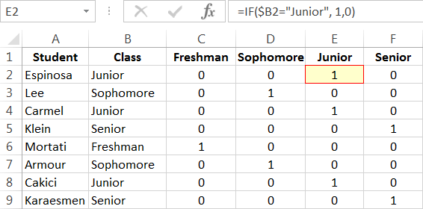
Categorical to Dummy: Intuition
As we discussed earlier, a categorical variable with N distinct categories can be transformed into N dummy variables
For example, this model: StudentRetention = f(GPA, Major, Class) Has 1 continuous and 2 categorical variables, for example Class can be Freshman, Sophomore, Junior, Senior
We can create a dummy variable Junior = 1 if the student is a Junior, 0 otherwise, etc.
Because of the dummy variable trap, we can only model 3 of the 4 variables (i.e., N-1 variables)
And leave one out as the reference level

Slide 20

Converting Categorical to Dummy in
Look at the categorical values you are interested in analyzing
And create one binary variable for each category of interest
R does this for you. It creates dummy variables named using the factor variable name, followed by the category they represent
Income | Loc
80,000 | Urban
90,000 | Urban
60,000 | Suburban
100,000 | Urban
45,000 | Rural
75,000 | Suburban
30,000 | Rural
LocUrban | LocSuburban | LocRural
1 | 0 | 0
1 | 0 | 0
0 | 1 | 0
1 | 0 | 0
0 | 0 | 1
0 | 1 | 0
0 | 0 | 1
IMPORTANT !! When working with categorical variables it is important to have a sufficient number of observations in each category. As a rule of thumb, I recommend merging categories with <10 observations.

Slide 21

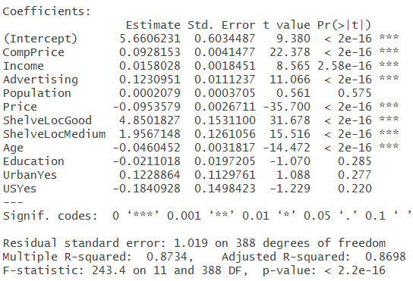
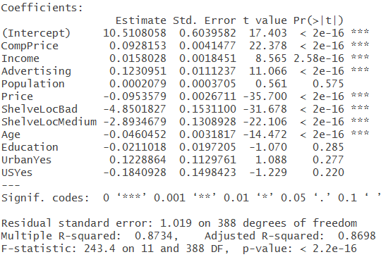
Example: Categorical Variables
## Transformation 1: Categorical To Dummy Variable Predictors library(ISLR) # Contains the "Carseats" data set class(Carseats$ShelveLoc) # It’s a factor (or categorical) variable levels(Carseats$ShelveLoc) lm.fit <- lm(Sales ~ ., data = Carseats) summary(lm.fit) # ShelveLocBad is the default reference category
Carseats$ShelveLoc <- relevel(Carseats$ShelveLoc, ref = "Good") # Change it to Good summary(lm(Sales ~ ., data = Carseats)) # Compare the outputs

Slide 22
[Top] Transformation #2: Predictors: Polynomials
OLS LI(✗) – Relationship between Y and X’s are not linear

Slide 23
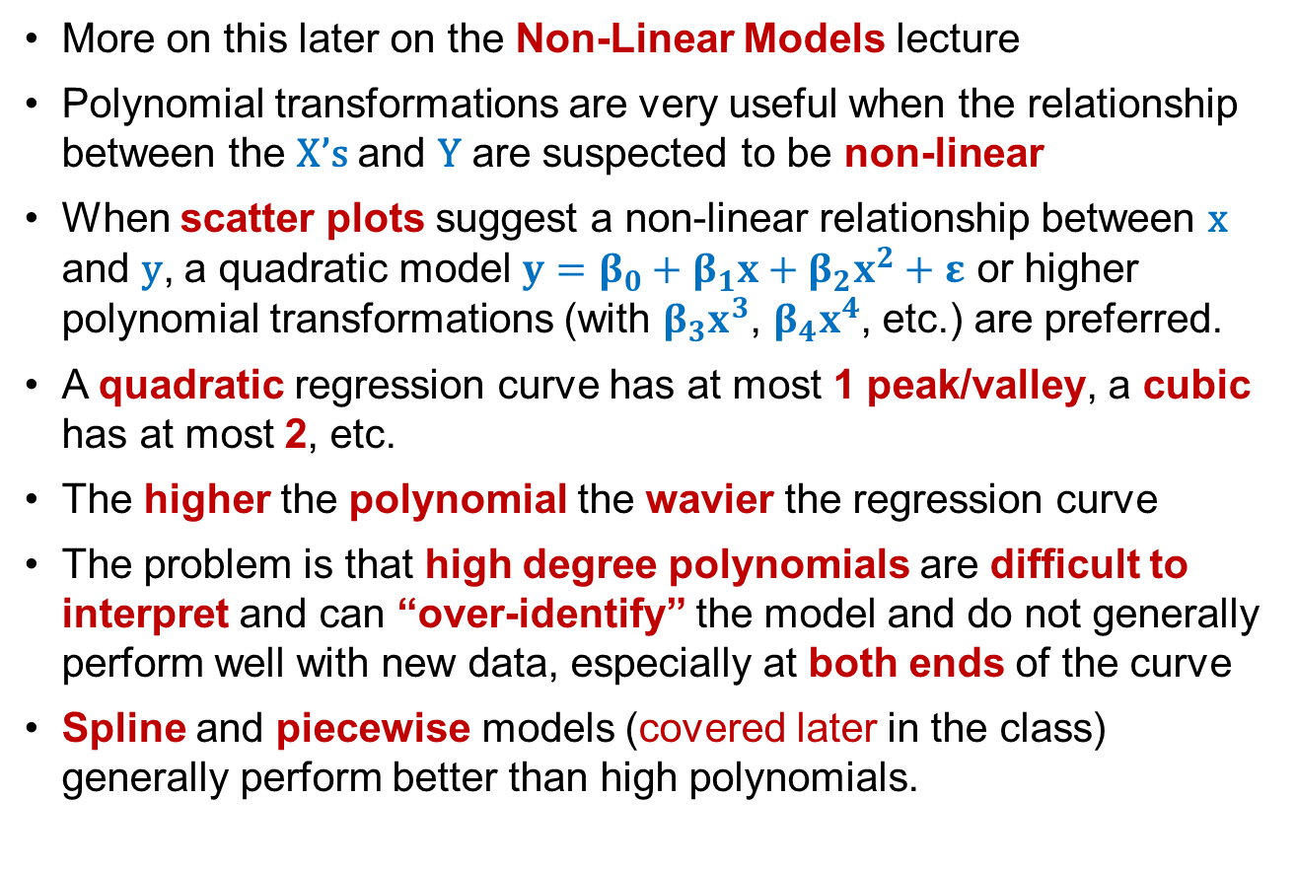
Polynomials: Intuition
More on this later on the Non-Linear Models lecture
Polynomial transformations are very useful when the relationship between the X’s and Y are suspected to be non-linear
When scatter plots suggest a non-linear relationship between x and y, a quadratic model $y=β_{0}+β_{1}x+β_{2}x^{2}+ε$ or higher polynomial transformations (with $β_{3}x^{3}$, $β_{4}x^{4}$, etc.) are preferred.
A quadratic regression curve has at most 1 peak/valley, a cubic has at most 2, etc.
The higher the polynomial the wavier the regression curve
The problem is that high degree polynomials are difficult to interpret and can “over-identify” the model and do not generally perform well with new data, especially at both ends of the curve
Spline and piecewise models (covered later in the class) generally perform better than high polynomials.

Slide 24
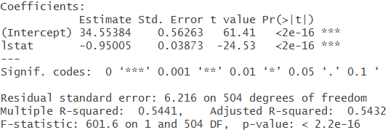
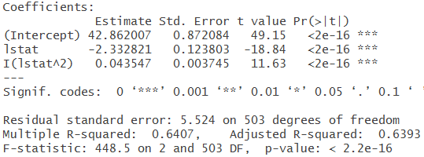
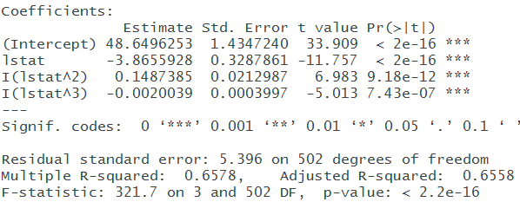
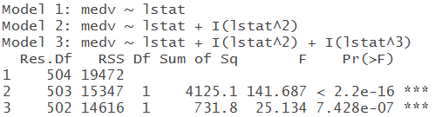
Example: Polynomials
## Transformation 2: Polynomials library(MASS) # Contains the Boston housing data set lm.fit1 <- lm(medv ~ lstat, data = Boston) # Linear lm.fit2 <- lm(medv ~ lstat + I(lstat^2), data = Boston) # Quadratic lm.fit3 <- lm(medv ~ lstat + I(lstat^2) + I(lstat^3), data = Boston) # Cubic # Later in the semester we will try poly(x, n) → x + x² + x³ + … + x^{n}
summary(lm.fit1); summary(lm.fit2); summary(lm.fit2)
anova(lm.fit1, lm.fit2, lm.fit3) # Compare the models

Slide 25
[Top] Transformation #3: Predictors & Outcome: Log Models
OLS LI(✗) – Relationship between Y and X’s not linear, or
OLS YN(✗) – Y is not normally distributed

Slide 26
Importance of Log Models
You can log the response variable Y or any of the quantitative predictors X’s that can never be negative (i.e., salaries, enrollments, miles per gallon, etc.)
If the response variable Y is not normal (OLS assumption), logging may (or may not) solve the problem, but no need to do this when the residuals are normally distributed
Both, the response Y and some predictors X are sometimes logged for convenience (e.g., to improve interpretation, statistical power, elasticity models).
But → logging changes the interpretation of the coefficients.

Slide 27
Log Models: Intuition
Log transformations are useful when the distribution of the data is skewed to the right → the distribution usually becomes more normal
You can inspect a variable for normality visually with:
QQ-Plots – shows data departures from perfect normality.
Histograms – curve should be bell-shaped
You can also test for normality quantitatively with tests like Shapiro-Wilks, but there are 2 caveats:
This test is useful with small samples, but it is notorious for rejecting normality with large samples → always inspect visually
For this reason, the shapiro.test(){stats} function does not allow samples larger than 5,000 (you can take a smaller random sample)
Cannot log variables with negative values (no logs for negatives)
Useful with truncated data (e.g., count data – truncated at 0)
Useful to model elasticity (%) effects (explained shortly)

Slide 28

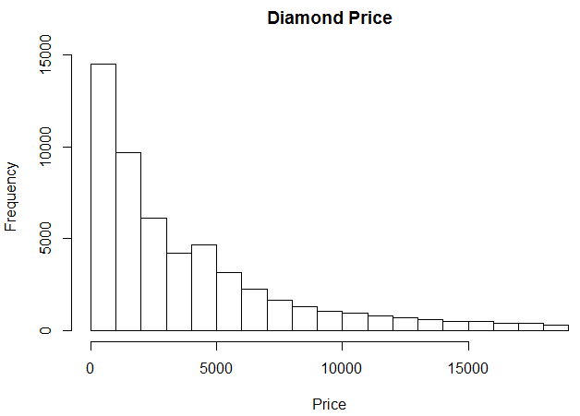
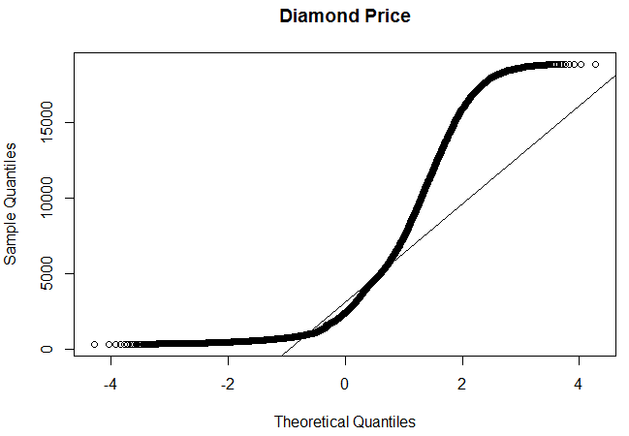

Example: Checking Normality
# Inspecting for Normality library(ggplot2) # Contains the "diamonds" data set hist(diamonds$price, main = "Diamond Price", xlab = "Price")
qqnorm(diamonds$price, main = "Diamond Price") qqline(diamonds$price)
shapiro.test(diamonds$price) # Will fail because sample>5,000, Try a smaller sample
shapiro.test(diamonds[sample(nrow(diamonds), 5000), ]$price)

Slide 29
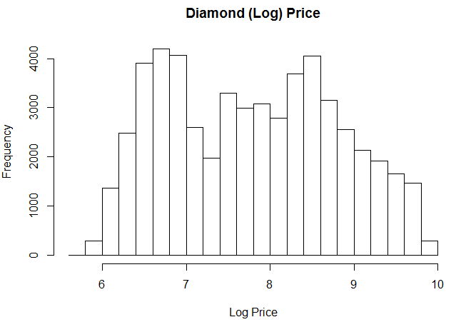
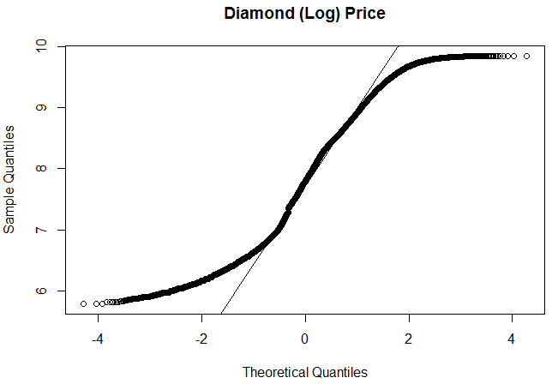
Example: Correcting Non-Normality
# Inspecting for Normality (Cont’d.) hist(log(diamonds$price), main = "Diamond (Log) Price", xlab = "Log Price")
qqnorm(log(diamonds$price), main = "Diamond (Log) Price") qqline(log(diamonds$price))

Slide 30
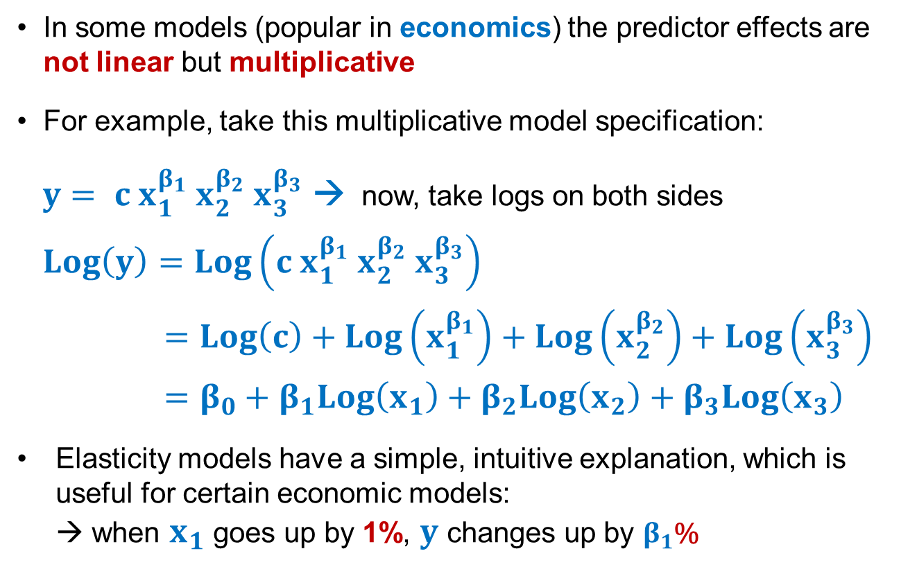
Elasticity (Log-Log) Models
In some models (popular in economics) the predictor effects are not linear but multiplicative
For example, take this multiplicative model specification:
$y= c{ x}_{1}^{β_{1}} x_{2}^{β_{2}}{ x}_{3}^{β_{3}}$ → now, take logs on both sides
$Log\left(y\right)=Log\left(c x_{1}^{β_{1}} x_{2}^{β_{2}} x_{3}^{β_{3}}\right)$
$=Log\left(c\right)+Log\left(x_{1}^{β_{1}}\right)+Log\left(x_{2}^{β_{2}}\right)+Log\left(x_{3}^{β_{3}}\right)$
$=β_{0}+β_{1}Log\left(x_{1}\right)+β_{2}Log\left(x_{2}\right)+β_{3}Log\left(x_{3}\right)$
Elasticity models have a simple, intuitive explanation, which is useful for certain economic models: → when $x_{1}$ goes up by 1%, $y$ changes up by $β_{1}$%

Slide 31
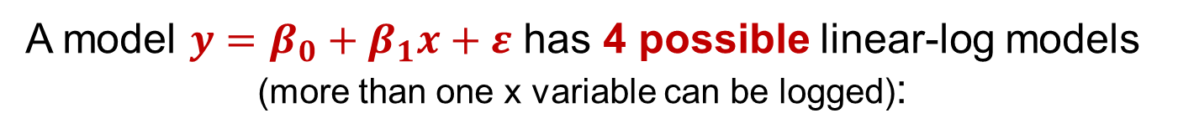
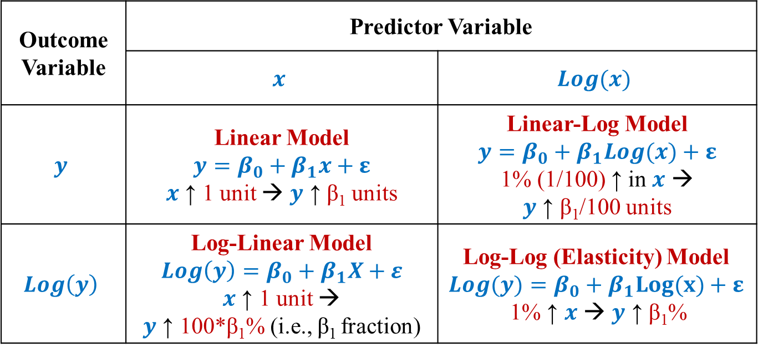
Log Models: Interpreting Effects
A model $y=β_{0}+β_{1}x+ε$ has 4 possible linear-log models (more than one x variable can be logged):
Outcome Variable | Predictor Variable
 | $$x$$ | $$Log(x)$$
$$y$$ | Linear Model $$y=β_{0}+β_{1}x+ε$$ $x$ ↑ 1 unit → $y$ ↑ β₁ units | Linear-Log Model $$y=β_{0}+β_{1}Log(x)+ε$$ 1% (1/100) ↑ in $x$ → $y$ ↑ β₁/100 units
$$Log\left(y\right)$$ | Log-Linear Model $Log\left(y\right)=β_{0}+β_{1}X+ε$ $x$ ↑ 1 unit → $y$ ↑ 100*β₁% (i.e., β₁ fraction) | Log-Log (Elasticity) Model $$Log(y)=β_{0}+β_{1}Log(x)+ε$$ 1% ↑ $x$ → $y$ ↑ β₁%

Slide 32

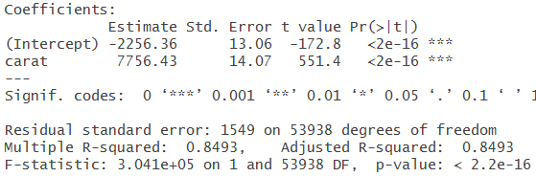
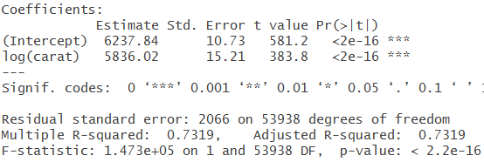
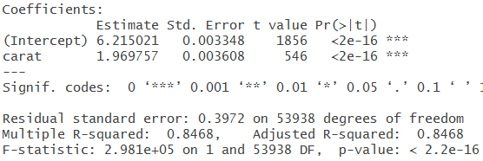
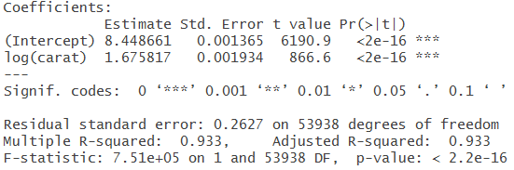
Example: Log Transformations
# Log-Transformed Models summary(lm(price ~ carat, data = diamonds)) summary(lm(log(price) ~ carat, data = diamonds)) summary(lm(price ~ log(carat), data = diamonds)) summary(lm(log(price) ~ log(carat), data = diamonds))

Slide 33
[Top] Transformation #3.1: Outcome: Logit-Transformed Models (already covered in the Regression lecture) See: # Logit-Transformed Models (Binary Y) in script OLS LI(✗) – Relationship between Y and X’s not linear,
OLS YN(✗) – Y is not normally distributed, or
OLS YC (✗) – Y is not continuous → binary: 0,1; yes/no; success/failure, etc.

Slide 34
[Top] Transformation #3.2: Outcome: Log-Transformed Models for Count Data
OLS YC(✗) – Y is not continuous, but integer counts, truncated at 0 OLS EV(✗) - The error variance is not constant

Slide 35
Count Data Models: Intuition
Predicting counts is a common problem in analytics – e.g., number of students enrolled, number of customers in a store, number of votes in an election, number of days to sell a house
It is not uncommon to see predictive models with counts as an outcome variable using OLS
But this is incorrect for a number of reasons, including
Counts are discrete, not continuous (i.e., no decimals)
Counts are positive – i.e., can’t be less than 0 (i.e., data is “truncated” at 0.
The distribution of count data is not normal
The error variance is not constant – relatively low near 0 and increasing as counts get larger
In many count data sets, there is a disproportionate amount of 0’s

Slide 36
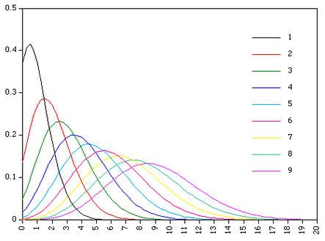
The Poisson Distribution
The Normal distribution: is symmetrical around the mean; it’s tails extend indefinitely at both ends; and it is continuous.
The Poisson distribution: is bounded at 0; is asymmetrical; varies in shape as the mean increases (it approaches a normal distribution when counts have very wide ranges)
As it turns out, count data follow a Poisson distribution
Notice in the diagram how the shape of the distribution curve changes with the count mean and how it becomes more normal with large means.
Mean(count)

Slide 37
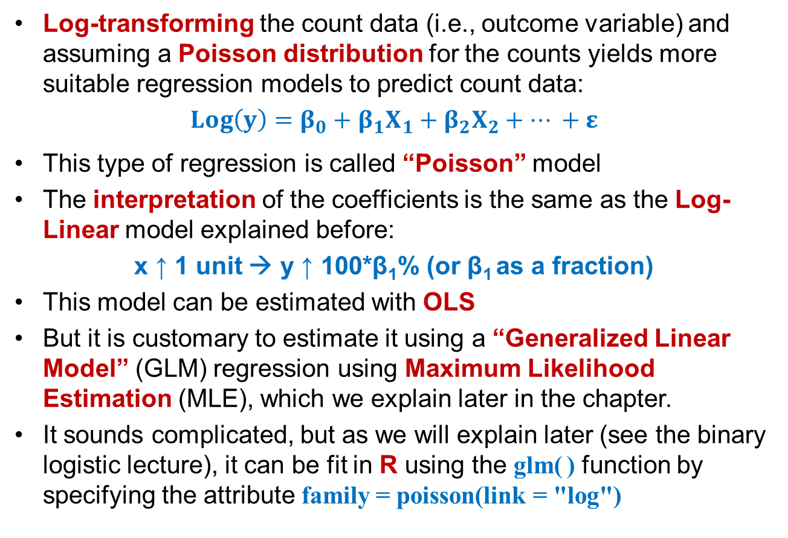
Count Data Models: Details
Log-transforming the count data (i.e., outcome variable) and assuming a Poisson distribution for the counts yields more suitable regression models to predict count data:
$Log\left(y\right)=β_{0}+β_{1}X_{1}+β_{2}X_{2}+… +ε$
This type of regression is called “Poisson” model
The interpretation of the coefficients is the same as the Log-Linear model explained before:
x ↑ 1 unit → y ↑ 100*β₁% (or β₁ as a fraction)
This model can be estimated with OLS
But it is customary to estimate it using a “Generalized Linear Model” (GLM) regression using Maximum Likelihood Estimation (MLE), which we explain later in the chapter.
It sounds complicated, but as we will explain later (see the binary logistic lecture), it can be fit in R using the glm( ) function by specifying the attribute family = poisson(link = "log")

Slide 38
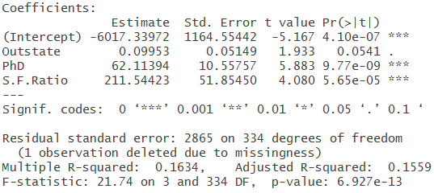
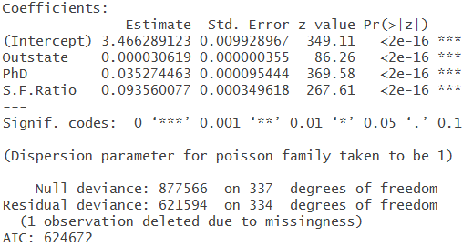
Example: Count Data
# Log-Transformed Models (Count Y) lm.fit <- lm(Apps ~ Outstate + PhD + S.F.Ratio, data = College) summary(lm.fit)
glm.count.fit <- glm(Apps ~ Outstate + PhD + S.F.Ratio, family = poisson(link = "log"), data = College)) summary(glm.count.fit)

Slide 39
[Top] Transformations #4: Centering Outcome and Predictors:
Same as OLS

Slide 40
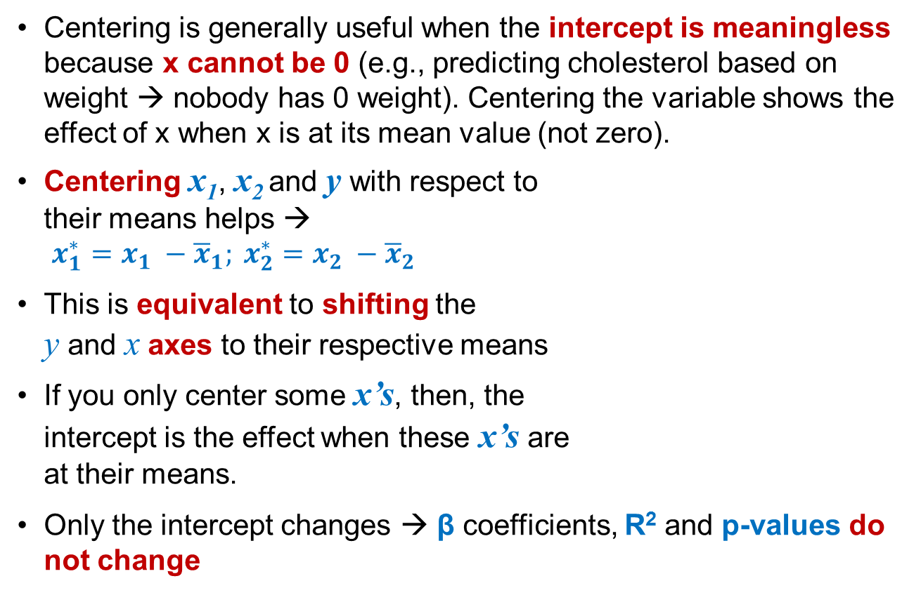
Centering: Intuition
Centering is generally useful when the intercept is meaningless because x cannot be 0 (e.g., predicting cholesterol based on weight → nobody has 0 weight). Centering the variable shows the effect of x when x is at its mean value (not zero).
Centering x₁, x₂ and y with respect to their means helps → $x_{1}^{∗}=x_{1} −{\overline{x}}_{1}; x_{2}^{∗}=x_{2} −{\overline{x}}_{2}$
This is equivalent to shifting the y and x axes to their respective means
If you only center some x’s, then, the intercept is the effect when these x’s are at their means.
Only the intercept changes → β coefficients, R² and p-values do not change
Y
Y*
X*
X
Y
Y
X
X*

Slide 41
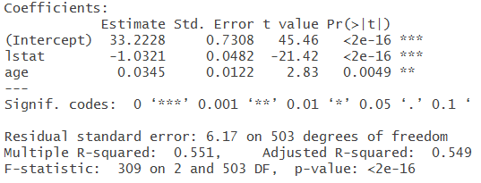
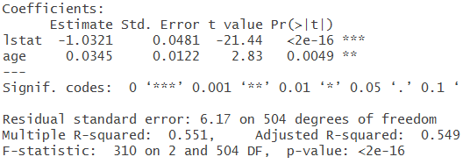
Centering
## Transformation 5: Centering Data library(MASS) # Contains the Boston housing data set Boston.centered <- data.frame(scale(Boston, center = T, scale = F)) summary(lm(medv ~ lstat + age, data = Boston))
summary(lm(medv ~ lstat + age -1, data = Boston.centered)) # -1 removes the intercept # See R script to see how to center specific variables, rather than the entire data frame
Un-Centered Model
Centered Model

Slide 42
[Top] Transformations #5: Standardization Outcome and Predictors:
Same as OLS

Slide 43
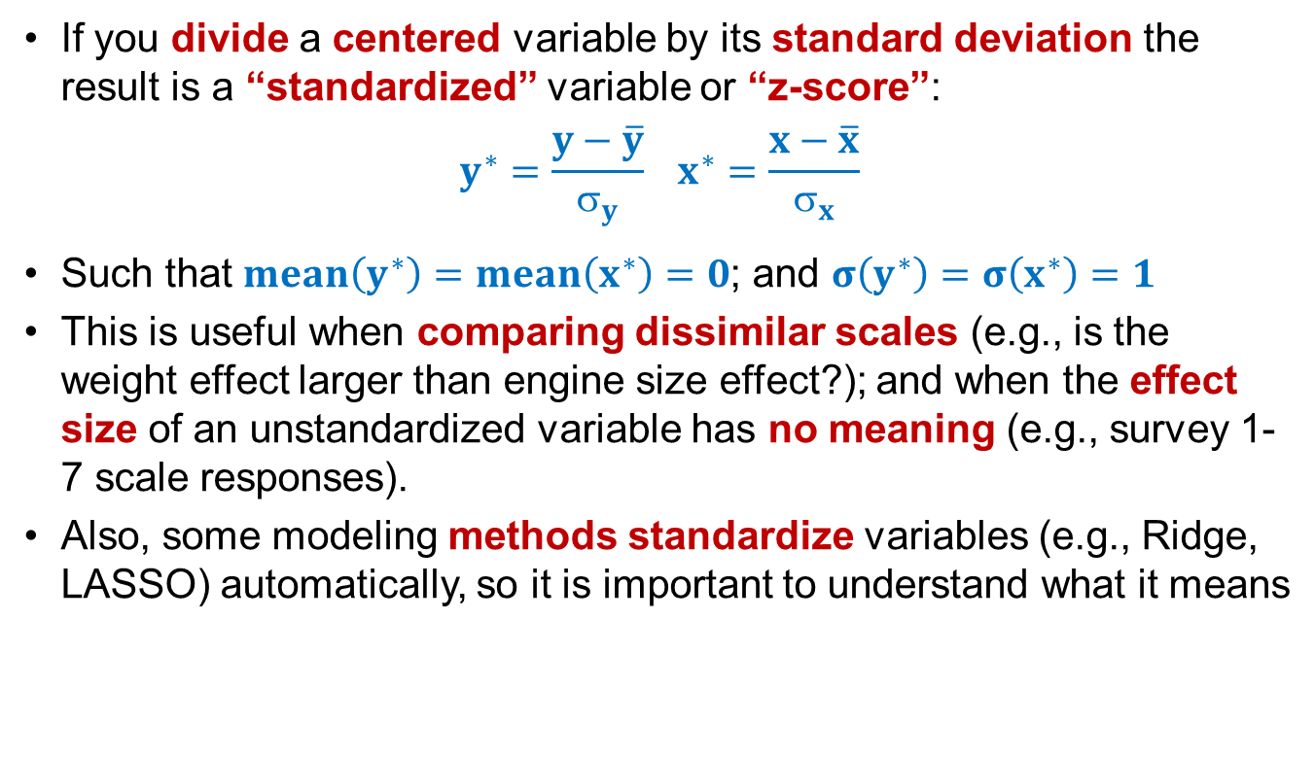
Standardization: Intuition
If you divide a centered variable by its standard deviation the result is a “standardized” variable or “z-score”:
$$y^{∗}=\frac{y−\overline{y}}{σ_{y}} x^{∗}=\frac{x−\overline{x}}{σ_{x}}$$
Such that $mean\left(y^{∗}\right)=mean\left(x^{∗}\right)=0$; and $σ\left(y^{∗}\right)=σ\left(x^{∗}\right)=1$
This is useful when comparing dissimilar scales (e.g., is the weight effect larger than engine size effect?); and when the effect size of an unstandardized variable has no meaning (e.g., survey 1-7 scale responses).
Also, some modeling methods standardize variables (e.g., Ridge, LASSO) automatically, so it is important to understand what it means

Slide 44
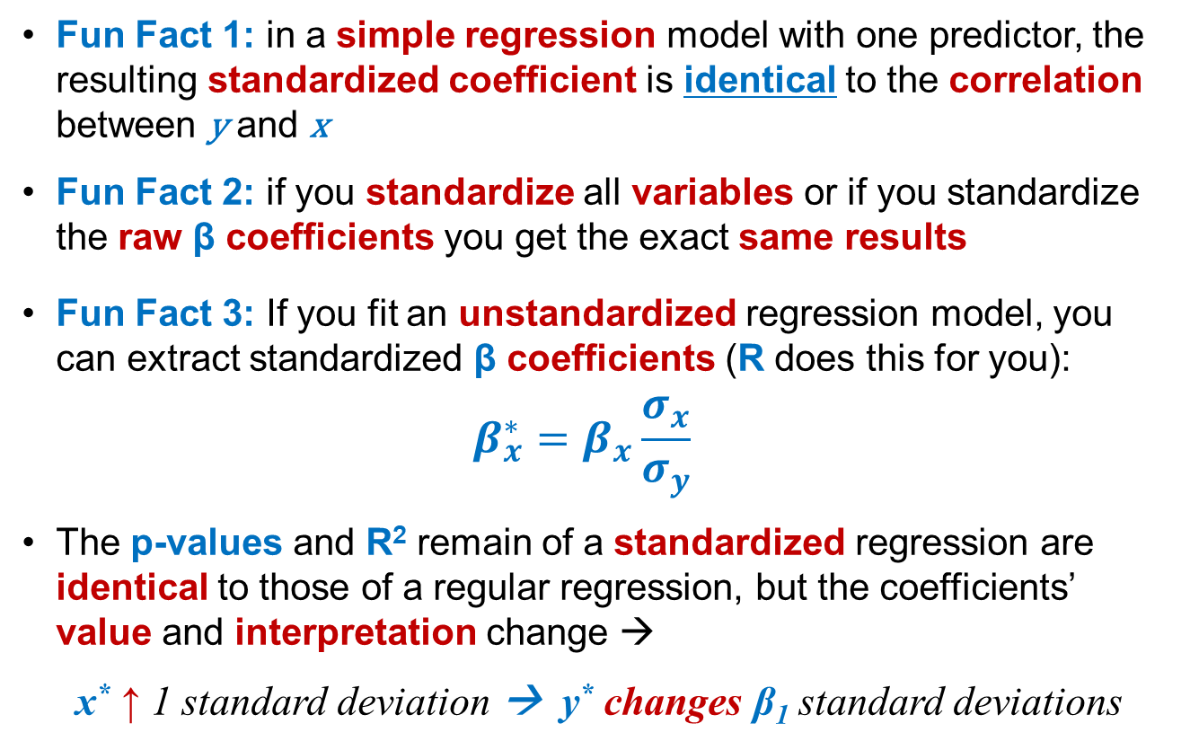
Standardized Regression: Details
Fun Fact 1: in a simple regression model with one predictor, the resulting standardized coefficient is identical to the correlation between y and x
Fun Fact 2: if you standardize all variables or if you standardize the raw β coefficients you get the exact same results
Fun Fact 3: If you fit an unstandardized regression model, you can extract standardized β coefficients (R does this for you):
$$β_{x}^{∗}=β_{x}\frac{σ_{x}}{σ_{y}}$$
The p-values and R² remain of a standardized regression are identical to those of a regular regression, but the coefficients’ value and interpretation change →
x* ↑ 1 standard deviation → y* changes β₁ standard deviations

Slide 45
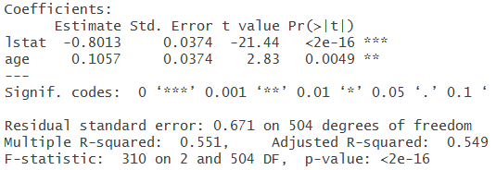
Example: Standardizing (Scaling)
## Transformation 5: Standardizing Data library(MASS) # Contains the Boston housing data set Boston.standardized <- data.frame(scale(Boston, center = F, scale = T)) summary(lm(medv ~ lstat + age, data = Boston))
summary(lm(medv ~ lstat + age -1, data = Boston.standardized)) # See R script to see how to standardize some variables, rather than the entire data frame
Un-Standardized Model
Standardized Model
You can run an unstandardized model and then extract standardized coefficients with the lm.beta() function in one fitting, as shown in the next slide:
→

Slide 46
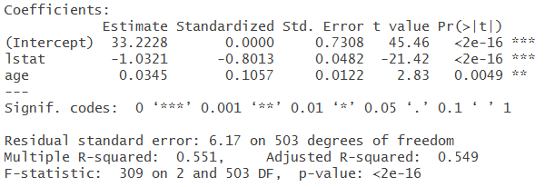
Example: Standard Coefficients
# Standardized regression library(MASS) # Contains the Boston housing data set library(lm.beta) # Contains the lm.beta() function to extract standardized coefficients lm.fit <- lm(medv~lstat+age,data=Boston) lm.standardized <- lm.beta(lm.fit) summary(lm.standardized)
Both Models

Slide 47
[Top] Transformation #6: Predictors: Lagging Data
EI(✗) – Errors are not independent

Slide 48
Forecasting Models
Models aimed at making predictions outside the existing data range are called forecasting models. Like any forecasting (e.g., the economy, the weather), the prediction confidence declines as you get farther away from the existing data range
The difficulty with forecasting, is that present values of the dependent variable (e.g., your height today) are sometimes highly correlated with prior values (e.g., your height yesterday), which violates a key OLS assumption of data independence or error independence
This problem is known as serial correlation or auto correlation
Lagging can help reduce serial correlation, although there are more sophisticated and robust forecasting models (outside our scope)
Most lagged models predict over time → Time Series Models

Slide 49
Time Series Models: Intuition
Time series models come in different flavors of three main types
(Univariate) Time Series – predicting future values of a variable based on its prior historical values (e.g., predict tomorrow’s weather)
Forecasting methods → moving averages, exponential smoothing, etc.
Multivariate Time Series – like time series, but also include other predictors and control variables
Predictive models → Check for dependencies between observations, like serial correlation, time effects, etc.
In depth analysis of forecasting and panel data models is beyond the scope of this course, but time effects need to be tested and lagging outcome or predictors may overcome some issues.

Slide 50
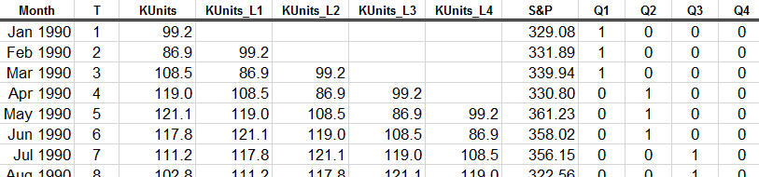
Multivariate Time Series Models
Say, we want to forecast monthly house starts (in thousands; KUnits)
Because KUnits in one month may be highly correlated with KUnits in prior months → serial correlation is a concern
Lagging the KUnits (the outcome variable) may help correct for this → Univariate Time Series
The table below shows KUnits lagged by 1 to 4 months
Based on business knowledge you may want to include additional variables model (e.g., S&P, quarters) → Multivariate Time Series

Slide 51
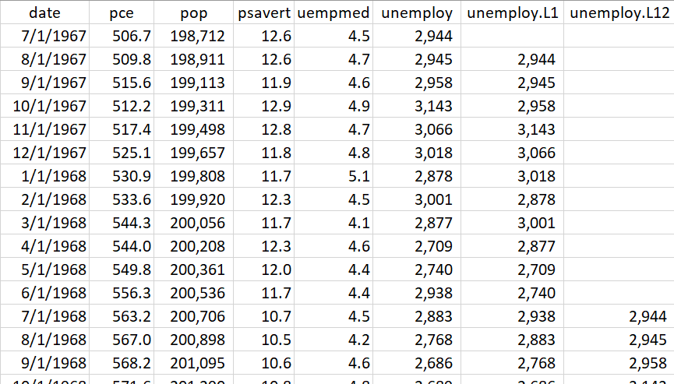
Multivariate Time Series & Lags
economics dataset in {ggplot2} package
pce → personal consumption expenditures ($ billons)
pop → total population (thousands)
psavert → personal savings rate
uempmed → median duration of unemployment in weeks
unemploy → number of people unemployed (thousands)

Slide 52
Serial Correlation

Slide 53
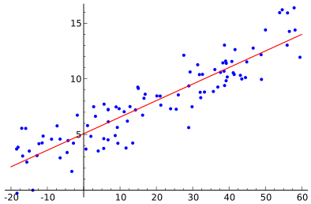
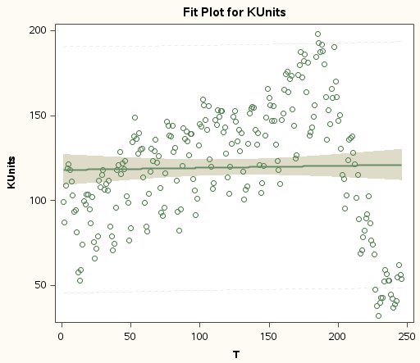
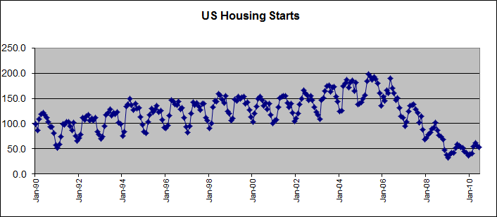
Serial Correlation
One important OLS regression assumption is that the errors between various observations are not systematically correlated.
When errors are correlated, this provides an indication that we are missing something in our model that makes the errors exhibit systematic patterns (errors should look like a “cloud”).
This can be observed visually by plotting the sequence variable (e.g., time) against the predicted variable.
It can also be tested with a Durbin-Watson or similar test
Curvilinear
Cyclical
No Serial Correlation
Serial Correlation

Slide 54
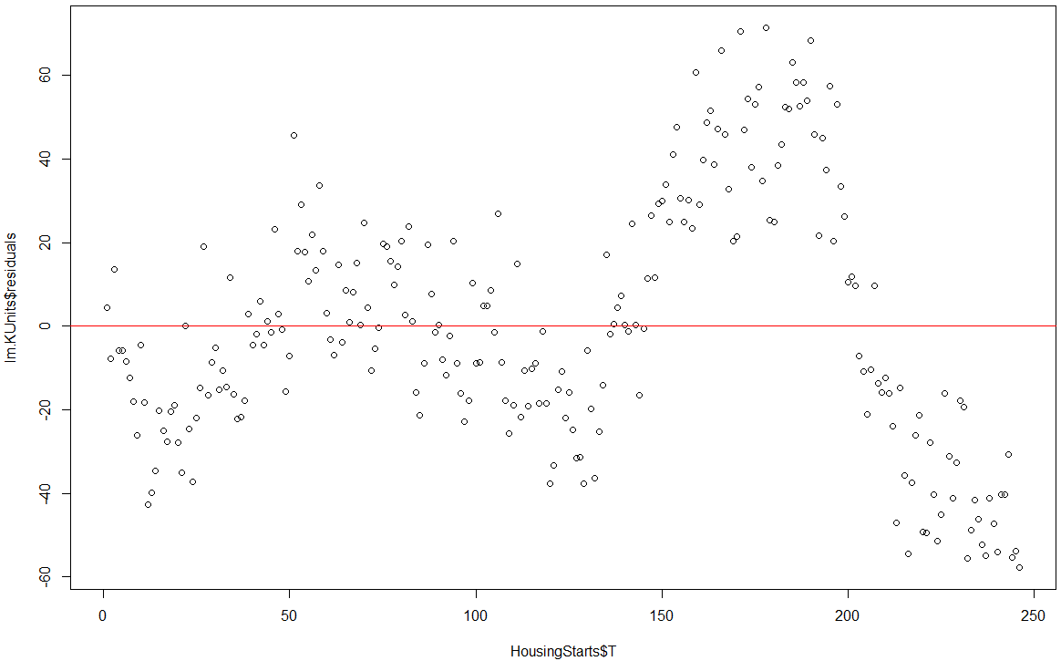
Serial Correlation Visual Inspection
## Transformation 6: Lagging data HousingStarts <- read.csv("HousingStarts.csv", header = T, na.strings = "?") HousingStarts <- na.omit(HousingStarts) # Removes NA's – important when lagging lm.KUnits <- lm(KUnits ~ T + S.P + Q2 + Q3 + Q4, data = HousingStarts) plot(HousingStarts$T, lm.KUnits$residuals) # Plot residuals against ordered time T abline(0, 0, col = "red") # Red line with intercept and slope equal to 0

Slide 55
Testing for Serial Correlation
If serial correlation is present means that if you order your data by the ordinal variable (e.g., by time), then an error at time t will be highly correlated with the error at time t-1 and t+1 – i.e., errors next to each other are very similar.
If the data is seasonal (e.g., sales fluctuate by quarter or by month of the year), the data maybe strongly correlated by season – e.g., errors in Q1 is highly correlated with errors in Q1 the prior year; or errors in December are highly correlated with errors in December the prior year.
There are various tests for serial correlation → they all focus on evaluating the correlation or difference between errors of nearby observations. The most popular are:
Durbin-Watson (evaluates squared difference of nearby errors)
Breusch-Godfrey (regress errors on prior errors and check the R²)

Slide 56
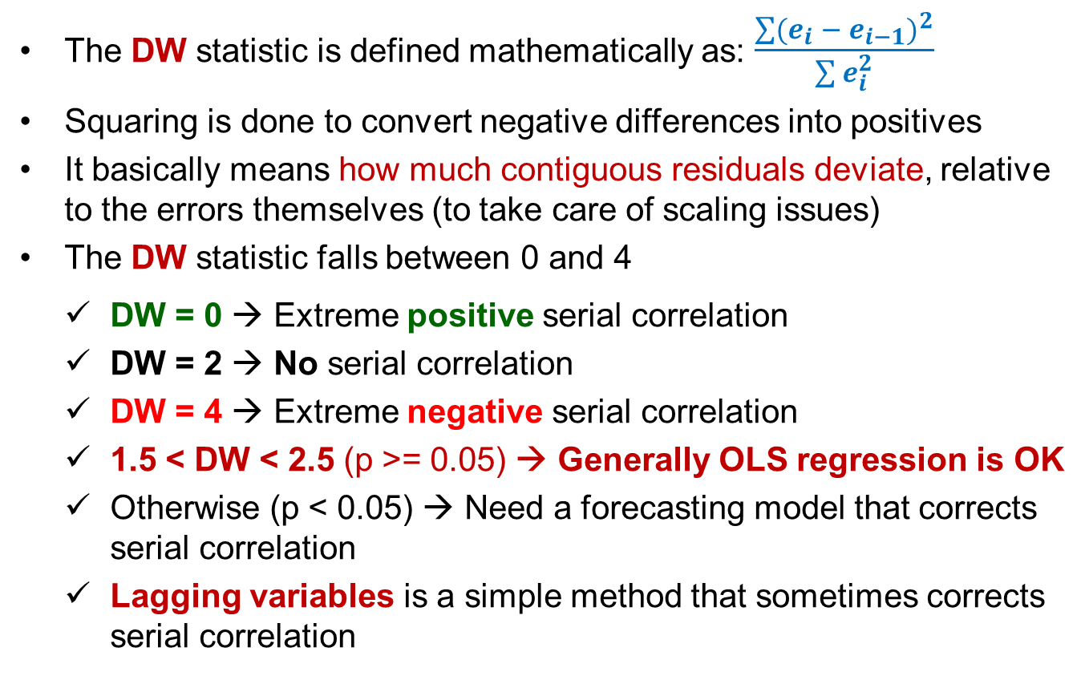
Durbin-Watson (DW) Test
The DW statistic is defined mathematically as: $\frac{\sum{{(e_{i} − e_{i−1})}^{2}}}{\sum{e_{i}^{2}}}$
Squaring is done to convert negative differences into positives
It basically means how much contiguous residuals deviate, relative to the errors themselves (to take care of scaling issues)
The DW statistic falls between 0 and 4
DW = 0 → Extreme positive serial correlation
DW = 2 → No serial correlation
DW = 4 → Extreme negative serial correlation
1.5 < DW < 2.5 (p >= 0.05) → Generally OLS regression is OK
Otherwise (p < 0.05) → Need a forecasting model that corrects serial correlation
Lagging variables is a simple method that sometimes corrects serial correlation

Slide 57
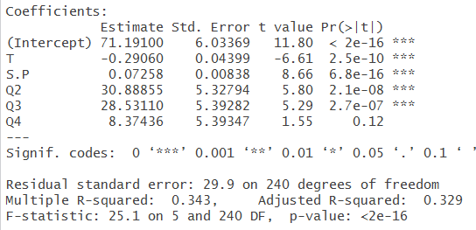
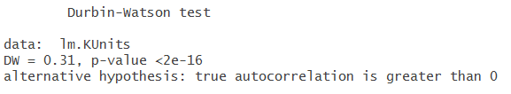
Example: Durbin-Watson Test for Serial Correlation
# Testing for Serial Correlation library(lmtest) # Activate the package summary(lm.KUnits)
dwtest(lm.KUnits)

Slide 58
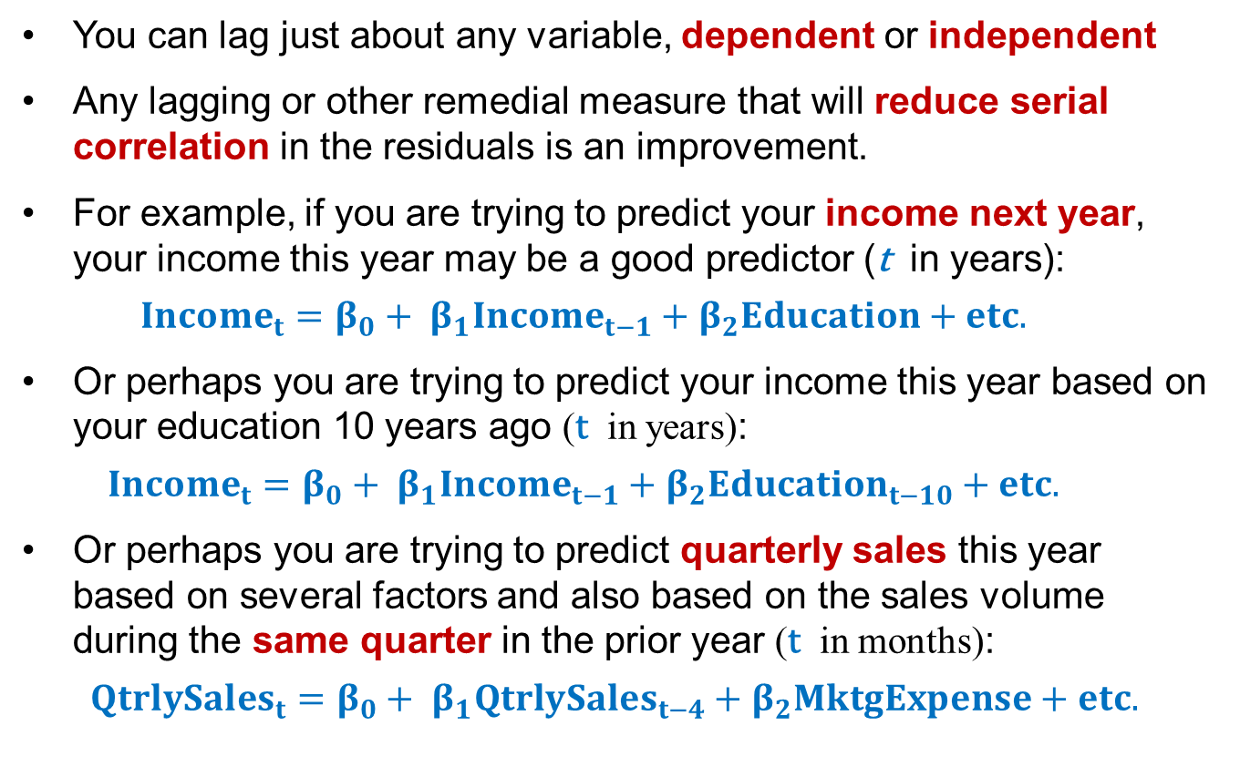
What and How Much to Lag?
You can lag just about any variable, dependent or independent
Any lagging or other remedial measure that will reduce serial correlation in the residuals is an improvement.
For example, if you are trying to predict your income next year, your income this year may be a good predictor (t in years):
$${Income}_{t}=β_{0}+ β_{1}{Income}_{t−1}+β_{2}Education+etc.$$
Or perhaps you are trying to predict your income this year based on your education 10 years ago (t in years):
$${Income}_{t}=β_{0}+ β_{1}{Income}_{t−1}+β_{2}{Education}_{t−10}+etc.$$
Or perhaps you are trying to predict quarterly sales this year based on several factors and also based on the sales volume during the same quarter in the prior year (t in months):
$${QtrlySales}_{t}=β_{0}+ β_{1}{QtrlySales}_{t−4}+β_{2}MktgExpense+etc.$$

Slide 59
Building Multivariate Time Series Models
Specify a multivariate model without lagged variables
Conduct a DW or BG test for serial correlation
If 1.5 < DW < 2.5 or if BG are not-significant → model is OK
If 1.5 > DW > 2.5 or BG is significant → (+ or -) serial correlation
The larger the DW deviation from 2 and the more significant the BG test, the more severe the serial correlation
Lag response and/or predictor variables as needed based on business knowledge
Check again for serial correlation; repeat until you get an acceptable model

Slide 60
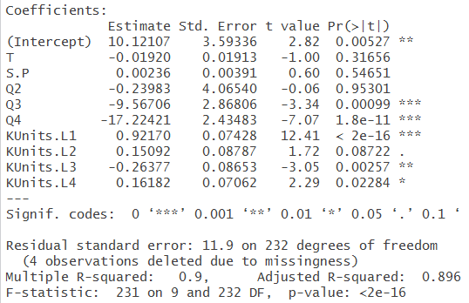

Example: Multivariate Time Series
# Multivariate Time Series Models library(DataCombine) # Contains the slide() function HousingStarts <- slide(HousingStarts, Var = "KUnits", NewVar = "KUnits.L1", slideBy = -1) HousingStarts <- slide(HousingStarts, Var = "KUnits", NewVar = "KUnits.L2", slideBy = -2) HousingStarts <- slide(HousingStarts, Var = "KUnits", NewVar = "KUnits.L3", slideBy = -3) HousingStarts <- slide(HousingStarts, Var = "KUnits", NewVar = "KUnits.L4", slideBy = -4)
lm.KUnits.all <- lm(KUnits ~T + S.P + Q2 + Q3 + Q4 + KUnits.L1 + KUnits.L2 + KUnits.L3 + KUnits.L4, data = HousingStarts)
summary(lm.KUnits.all)
dwtest(lm.KUnits.all);

Slide 61
Other Transformations

Slide 62
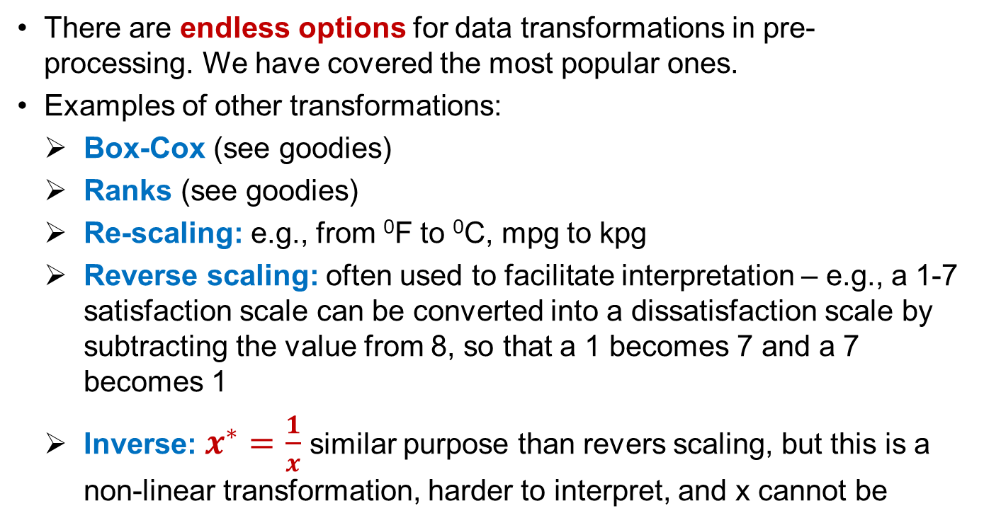
Other Transformations
There are endless options for data transformations in pre-processing. We have covered the most popular ones.
Examples of other transformations:
Box-Cox (see goodies)
Ranks (see goodies)
Re-scaling: e.g., from ⁰F to ⁰C, mpg to kpg
Reverse scaling: often used to facilitate interpretation – e.g., a 1-7 satisfaction scale can be converted into a dissatisfaction scale by subtracting the value from 8, so that a 1 becomes 7 and a 7 becomes 1
Inverse: $x^{∗}=\frac{1}{x}$ similar purpose than revers scaling, but this is a non-linear transformation, harder to interpret, and x cannot be

