Slide 1


NASDAQ: SMCI
Current Price: $30.54
Target: $47.00 (54% upside)
Consensus: Buy To Hold
Johnson Chen (johnsonchen2026@gmail.com), Jacob Liu (jliufc18@gmail.com)
Rochester Adams High School, Troy High School (Michigan)
month.day.year

Slide 2

Agenda
1
Target Overview
2
Industry Overview
3
Theses
4
Valuation
5
ESG/Overview Consideration
6
Risks & Mitigants
7
Final Recommendation

Slide 3
Target & Industry Overviews

Slide 4
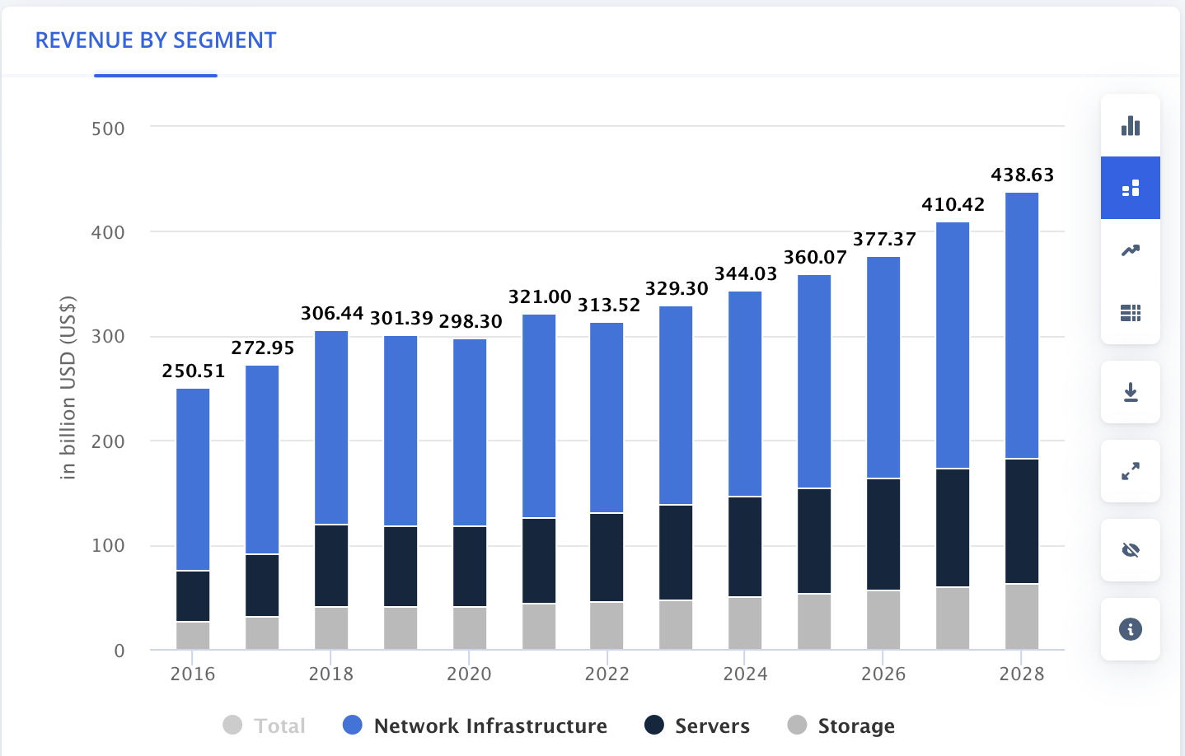
Company Overview
Background
Company Health
Revenue Streams
Super Micro Computer (NASDAQ: SMCI) designs, manufactures, and sells high-performance server and storage solutions for AI/ML, cloud, enterprise, and edge workloads
Founded in 1993 by Charles Liang (current CEO/Chairman) in San Jose, CA; vertically integrated with in-house motherboard design, chassis manufacturing, and system assembly
Fastest-growing server OEM globally, riding unprecedented AI infrastructure demand to $40B+ in projected FY2026 revenue
"Building Block Solutions" modular architecture enables rapid customization at scale with 6-12 week time-to-market vs. 6-12 months for Dell/HPE
Industry leader in Direct Liquid Cooling (DLC) rack-scale solutions, the fastest-growing product line as GPU power densities make air cooling inadequate
Current EV: ~$19.1B | Market Cap: ~$18.3B
Q2 FY2026: Record $12.7B quarterly revenue (+123% YoY); FY2026 guidance raised to $40B+
$13B+ Blackwell Ultra backlog provides 3+ quarters of forward revenue visibility
Gross margin concern: Collapsed from 18.0% (FY2023) to 6.3% (Q2 FY2026), approaching ODM-level profitability
Governance overhang: EY auditor resigned Oct 2024; BDO issued adverse opinion on internal controls; DOJ/SEC investigations ongoing
FCF turned negative (-$950M in Q1 FY2026) due to $6B+ inventory buildup to support backlog
Server & Storage Systems: ~80% of revenue
Subsystems & Accessories: ~12%
Services & Other: ~8%
Geography: ~50% US, ~33% APAC, ~13% Europe, ~4% RoW
Customer mix: ~55-65% Hyperscale/Cloud, ~25-30% Enterprise, ~5-10% Government
Critical: One customer = ~63% of Q2 FY2026 revenue, indicating extreme concentration risk
Company
Industry
Theses
Valuation
ESG
Risks

Slide 5
Industry Overview
AI Infrastructure Market
Key Growth Catalysts
Global AI server TAM projected to grow from ~$125B (2024) to $400B+ (2028) at ~34% CAGR, driven by LLM training, enterprise AI deployment, and sovereign AI initiatives
Liquid cooling solutions are the fastest-growing sub-segment: ~$5B (2024) to ~$25B (2028) at ~50% CAGR as power densities exceed 100kW/rack
NVIDIA GPU roadmap (H100 to H200 to B200 to GB200 NVL72) drives sustained upgrade demand; each generation increases rack power from ~40kW to ~120kW
AI server market set to grow 55% in 2025 alone to ~$252B (Bloomberg Intelligence); hyperscaler capex budgets continuing to expand
GPT-5 class models require 10x+ the compute of GPT-4; AI inference workloads projected to exceed training by 2027
Generative AI training compute scaling 10x+ per generation
Enterprise AI inference deployment at scale (exceeds training by 2027)
Data center power/cooling constraints (>100kW/rack = liquid cooling required)
Sovereign AI: Governments investing in domestic AI compute infrastructure
Edge AI expansion for latency-sensitive inference applications
Segment | 2024E | 2028P | CAGR
AI Servers | ~$125B | ~$400B | ~34%
Liquid Cooling | ~$5B | ~$25B | ~50%
HPC | ~$45B | ~$75B | ~14%
Total DC Infra | ~$350B | ~$600B | ~15%
Company
Industry
Theses
Valuation
ESG
Risks

Slide 6
Industry Overview
Competitive Edge in Industry
Factor | SMCI | Dell | HPE | ODMs
Time-to-Market | 6-12 weeks | 6-12 months | 6-12 months | 3-6 months
Customization | Very High | Medium | Medium | High
Liquid Cooling | Leader | Developing | Developing | Limited
Gross Margin | 6-11% | 20-21% | 30-32% | 4-6%
AI Server Focus | Primary | ~15% of rev | ~20% of rev | Contract-based
Mkt Share (AI) | ~15-20% | #1 | #3-4 | Varies
Services/SW | Limited | Extensive | Extensive | None
Key Competitive Dynamics:
Speed is the core differentiator: When NVIDIA launches a new GPU, SMCI has validated designs within weeks vs. 6-12 months for Dell/HPE. In a market where every quarter of delay = lost AI training revenue, this speed premium is substantial
Dell ($104B TTM rev) has a massive enterprise sales force and full-stack solutions; HPE ($34B) has strong gov't relationships and GreenLake as-a-service. Both are investing aggressively in liquid cooling.
ODMs (Quanta, Wistron, Foxconn) build custom hyperscaler designs at 4-6% margins with no brand/IP; in-house designs (Google TPU, Amazon Trainium) are a long-term structural threat to all OEMs
SMCI holds ~25-30% share in liquid cooling specifically (market leader) but margins (6-11%) are well below Dell (20-21%) and HPE (30-32%), reflecting a volume/speed model vs. premium pricing
Company
Industry
Theses
Valuation
ESG
Risks
Notes:
Both from Bloomberg

Slide 7
II. Thesis Points

Slide 8
Thesis 1: AI INFRASTRUCTURE PICK & SHOVEL PLAY
Strong AI Growth Sentiment & Positioning
DLC Structure Market
SMCI is the purest-play public equity on the AI infrastructure buildout: FY2026 revenue guided to $40B+ (from $22B in FY2025), a feat no other server OEM can match
$13B+ Blackwell Ultra backlog provides 3+ quarters of revenue visibility; GB200 NVL72 rack-scale deployments carry ~$3M+ ASPs per system
AI server TAM growing at ~34% CAGR through 2028 to $400B+; SMCI holds ~15-20% market share in GPU servers with clear leadership in liquid cooling (~25-30%)
NVIDIA partnership depth: Early access to Blackwell/GB200 platforms; first OEM to ship GB200 NVL72 rack-scale systems, demonstrating engineering trust
Catalyst: NVIDIA Blackwell Ultra production ramp in H1 CY2026 validates demand sustainability and converts backlog to recognized revenue
Direct Liquid Cooling (DLC) is transitioning from optional to mandatory as GPU power densities exceed 100kW/rack; SMCI is the acknowledged market leader with broadest product line
DLC attachment rates expected to increase from ~20% today to ~60-70% by 2028, expanding SMCI's addressable market within the broader AI server ecosystem
GB200 NVL72 requires liquid cooling by design (100% attach rate on NVIDIA's flagship platform); liquid-cooled systems create deeper switching costs (piping, manifolds, CDU infrastructure)
SMCI's DLC patents and thermal engineering expertise provide 12-18 month technology lead over Dell/HPE; rack-scale solutions carry higher ASPs than air-cooled equivalents
Risk: Dell and HPE investing heavily in DLC capabilities; technology gap could narrow within 18-24 months as competition intensifies
Company
Industry
Theses
Valuation
ESG
Risks

Slide 9
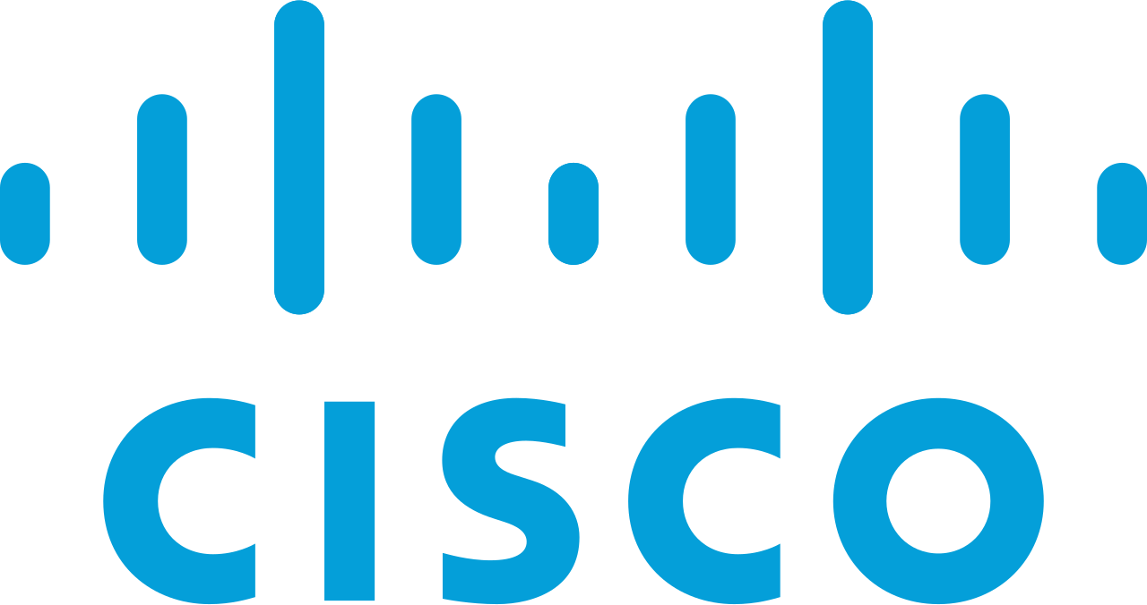

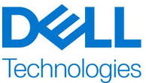
Thesis 2: Margins and Reversal
Margin Reversal
Period | Gross Margin | Commentary
FY2020 | 15.7% | Pre-AI baseline
FY2023 | 18.0% | PEAK - AI premium pricing
FY2024 | 13.8% | Compression begins - volume/price trade-off
FY2025 | 11.1% | Significant deterioration
Q1 FY2026 | 9.5% | Continued decline
Q2 FY2026 | 6.3% | Near ODM-level margins
Margin compression driven by: (1) competitive hyperscale pricing, (2) product mix shift to lower-margin complete rack solutions, (3) component cost pass-through dynamics
Key test: Q3 FY2026 gross margin. Below 7% = margin recovery thesis weakens significantly; above 8% = bullish inflection signal
Our view: Margins likely stabilize at 8-10% over 12-18 months but will NOT return to 15-18% pre-AI era. Business model has structurally shifted toward high-volume, lower-margin.
Company
Industry
Theses
Valuation
ESG
Risks

Slide 10
THESIS 3: GOVERNANCE CREATES DISCOUNT (BEAR)
Individual Factor Chart Ratings
Factor | Assessment | Rating
Auditor Stability | EY resigned Oct 2024; BDO appointed Nov 2024 | RED FLAG
Internal Controls | Material weakness; adverse opinion from BDO | RED FLAG
SEC/DOJ Investigation | Ongoing document subpoenas | RED FLAG
Board Independence | Majority independent post-Special Committee reforms | Improved
CEO Control | Charles Liang: Founder/CEO/Chairman since 1993; ~10-12% ownership | Mixed
Related Party Txns | $17.5M SEC settlement in 2020 for prior accounting issues | Elevated
The EY auditor resignation citing 'integrity' concerns is unprecedented for a company of this size; BDO's adverse opinion on internal controls as of June 30, 2024 remains the most serious qualitative risk to the investment thesis
DOJ investigation remains open with no timeline for resolution; prior 2020 SEC settlement creates pattern risk and regulators may pursue more aggressively (potential $50M-$500M penalties based on precedents)
Mitigant: Special Committee found 'no evidence of misconduct'; BDO validated financial statements with no restatements required; board reconstituted with majority independent directors
Catalyst (positive): DOJ closing investigation without charges + clean internal controls opinion from BDO = significant de-risking and potential 30%+ re-rating
Catalyst (negative): Enforcement action, executive departures, or further accounting restatements could trigger 50%+ downside as institutional holders exit positions
Company
Industry
Theses
Valuation
ESG
Risks

Slide 11
III. Valuation

Slide 12
FINANCIAL PROJECTIONS (FY2024A - FY2029E)
Line Item | FY2024A | FY2025A | FY2026E | FY2027E | FY2028E | FY2029E
Revenue ($M) | $14,989 | $21,970 | $40,000 | $52,000 | $60,000 | $66,000
YoY Growth | 110% | 47% | 82% | 30% | 15% | 10%
Gross Margin | 13.8% | 11.1% | 8.0% | 9.5% | 10.5% | 11.0%
Operating Income ($M) | $1,211 | $1,248 | $1,800 | $3,224 | $4,380 | $5,148
Op Margin | 8.1% | 5.7% | 4.5% | 6.2% | 7.3% | 7.8%
Net Income ($M) | $1,153 | $1,049 | $1,271 | $2,480 | $3,468 | $4,139
Diluted EPS | $1.92 | $1.75 | $2.02 | $3.87 | $5.33 | $6.26
EBITDA ($M) | $1,187 | $1,430 | $2,200 | $3,744 | $4,980 | $5,808
EBITDA Margin | 7.9% | 6.5% | 5.5% | 7.2% | 8.3% | 8.8%
Key Assumptions:
Revenue: FY2026 per mgmt guidance; FY2027-29 reflects AI capex cycle deceleration (30% to 15% to 10%) as base effect increases
Gross Margin: Troughs at ~8% in FY2026 then recovers via DLC mix shift to 40%+ of rev, pricing normalization, and next-gen product margin improvement
OpEx Leverage: R&D + SG&A decline from 3.5% to 3.2% of rev due to scale; drives operating margin from 4.5% to 7.8% over forecast period
FCF: Turns positive FY2027 as inventory normalizes from $6B+ to 40-45 days COGS; scales to ~5% FCF margin by FY2029; CapEx 1.2-1.5% of rev (Malaysia/Taiwan expansion)
Company
Industry
Theses
Valuation
ESG
Risks

Slide 13
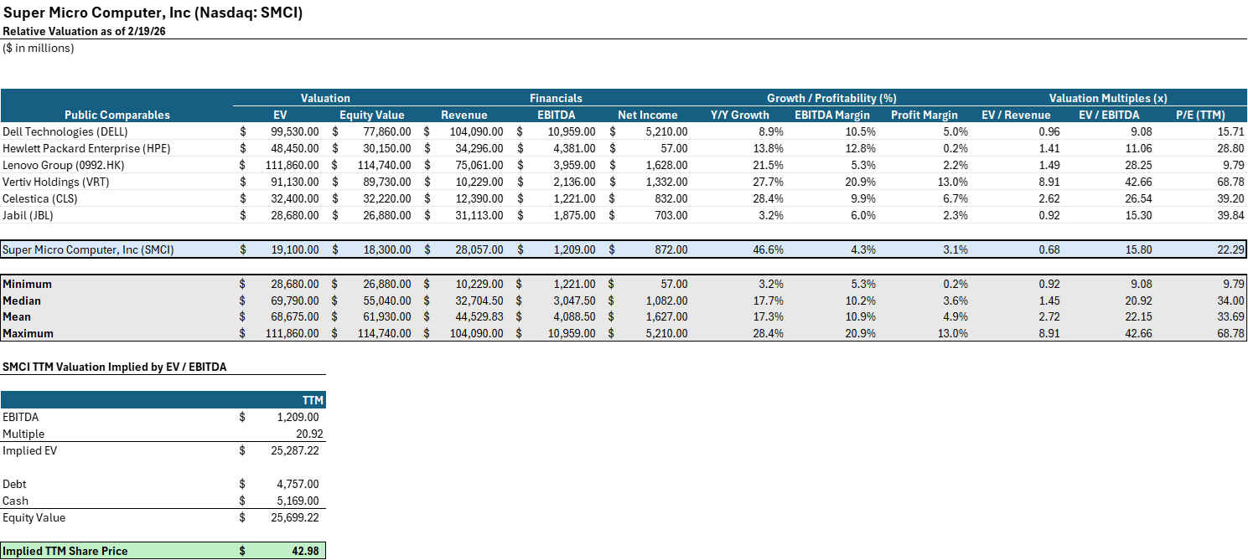
VALUATION ANALYSIS
Company
Industry
Theses
Valuation
ESG
Risks
Notes:
Selling Ships:
Capsize ships (175k DWT)
ACHIEVEMENT
GENIUS
INTEGRITY
INGENUITY
PEACE
E TRADER
W TRADER
5 yr ship for 45.5M
15 yr ship for 23 M
https://www.hellenicshippingnews.com/capesize-values-for-older-vessels-rise-in-october/
Using their underperforming ships as collateral, just as they are presently doing with 24 ships for their revolving credit facility, can enable them to access a larger amount of capital at more favorable interest rates, specifically at S+400. By using their underperforming ships as collateral - just as they are doing with 24 ships for their revolver - Danaos can access a larger amount of capital at more favorable interest rates, specifically at a SOFR+400.

Slide 14
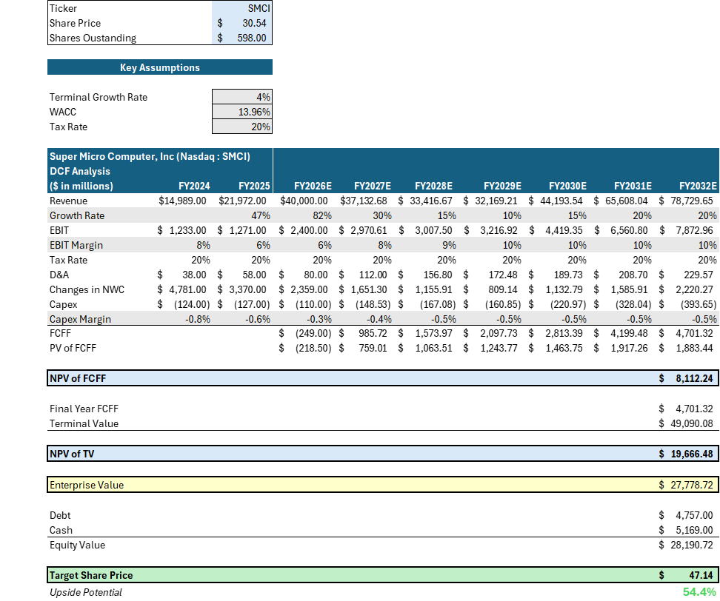
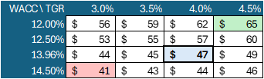

DCF SENSITIVITY
Company
Industry
Theses
Valuation
ESG
Risks
Notes:
Selling Ships:
Capsize ships (175k DWT)
ACHIEVEMENT
GENIUS
INTEGRITY
INGENUITY
PEACE
E TRADER
W TRADER
5 yr ship for 45.5M
15 yr ship for 23 M
https://www.hellenicshippingnews.com/capesize-values-for-older-vessels-rise-in-october/
Using their underperforming ships as collateral, just as they are presently doing with 24 ships for their revolving credit facility, can enable them to access a larger amount of capital at more favorable interest rates, specifically at S+400. By using their underperforming ships as collateral - just as they are doing with 24 ships for their revolver - Danaos can access a larger amount of capital at more favorable interest rates, specifically at a SOFR+400.

Slide 15
IV. ESG/Overview Considerations

Slide 16
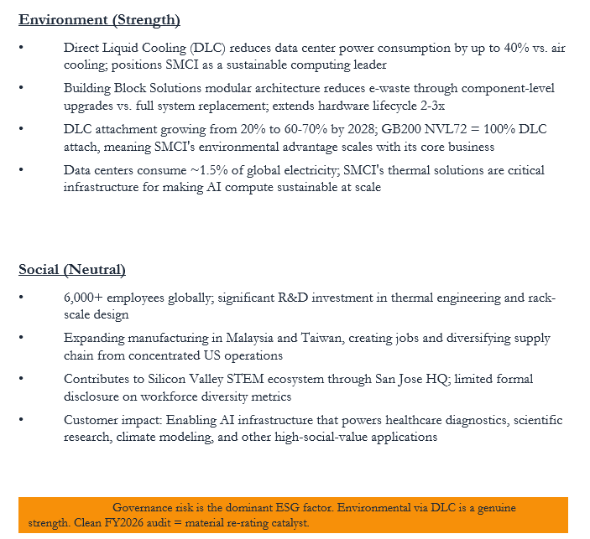
ESG CONSIDERATIONS
ESG Risk Assessment
Category | Rating | Trend | Assessment
Environment | Positive | Improving | DLC = 40% power savings
Social | Neutral | Stable | 6,000+ employees; STEM impact
Governance | Negative | Improving | EY exit, DOJ/SEC open
Overall ESG | 42/100 | Mixed | Below Avg (CSRHub)
Governance (Primary Risk)
EY auditor resigned Oct 2024 citing integrity concerns; unprecedented for company of SMCI's size
BDO issued adverse opinion on internal controls (IC) as of June 30, 2024; remediation underway
DOJ/SEC investigations remain open; $17.5M SEC settlement in 2020 creates pattern risk
Special Committee found no misconduct; board reconstituted with majority independent directors
Catalyst: Clean BDO IC opinion on FY2026 10-K + DOJ closure = significant de-risking event
Board Independence: 67% refreshed post-2024 | CEO Ownership: ~10-12% (aligned)
Capital Allocation: No dividends/buybacks; reinvesting in Malaysia/Taiwan capacity + $6B+ inventory buildup
Company
Industry
Theses
Valuation
ESG
Risks

Slide 17
AI: OPPORTUNITY & RISK ANALYSIS
AI As Opportunity
AI AS Risk
SMCI is arguably the most direct public equity beneficiary of AI development: every LLM trained and every inference served requires server hardware that SMCI manufactures
AI compute scaling follows a 10x+ rule per model generation (GPT-3 to GPT-4 to GPT-5); this exponential demand directly drives SMCI's $40B+ FY2026 revenue trajectory
NVIDIA's GPU roadmap (H100 → B200 → GB200 → Rubin) creates recurring upgrade cycles; each generation requires new server platforms = repeat design wins for SMCI
Liquid cooling becomes mandatory as AI model scale increases rack power from 40kW to 120kW+; SMCI's DLC leadership (25-30% share) scales directly with AI complexity
Enterprise AI adoption is in early innings: only ~5% of enterprises have deployed production AI infrastructure, implying 10-20x expansion of addressable market through 2030
Custom silicon threat: Google (TPUs), Amazon (Trainium), Microsoft (Maia) designing in-house AI chips that bypass OEMs; if 30%+ of AI compute shifts to custom silicon, SMCI's TAM contracts materially
AI efficiency breakthroughs: Model distillation, mixture-of-experts, and sparse architectures could reduce compute per unit of AI capability, slowing hardware demand
Commoditization risk: Software-defined DC architectures could reduce hardware differentiation; SMCI's speed advantage may erode as workloads standardize
Geopolitical: US export controls on AI chips to China (~22% APAC rev) could intensify; sovereign AI may partially offset
AI Growth Driver | Current | By 2028 | Impact on SMCI
AI Server TAM | ~$150B | $400B+ | 28% CAGR = demand runway
DLC Attach Rate | ~20% | 60-70% | 100% on GB200 NVL72
Enterprise AI Adoption | ~5% | 25-30% | New customer segments
Hyperscaler Capex | $465B/yr | $700B+/yr | $13B+ SMCI backlog
Inference vs Training | 30/70 | 70/30 | Volume shift favors OEMs
AI Risk Factor | Prob. | Impact | Timeline
Custom silicon displaces OEMs | Med | HIGH | 3-5 years
AI efficiency reduces compute | Low-Med | Medium | 2-4 years
HW commoditization | Medium | Medium | 3-5 years
Export control expansion | Med-High | HIGH | 0-12 months
AI capex cycle downturn | Low | V. HIGH | 12-24 months
Company
Industry
Theses
Valuation
ESG
Risks

Slide 18
MOAT ANALYSIS & PORTER'S FIVE FORCES
Force | Rating | Trend | Key Driver
Customer Power | 4/5 Unfavorable | Worsening | 1 customer = 63% of rev; hyperscalers have enormous leverage
Competitive Rivalry | 3/5 Moderate | Intensifying | Dell/HPE investing aggressively in AI + liquid cooling
Supplier Power | 4/5 Unfavorable | Stable | NVIDIA ~80%+ share in DC GPUs; allocation = revenue
Substitutes | 2/5 Favorable | Stable | No substitute for on-prem AI training at scale
Barriers to Entry | 3/5 Moderate | Stable | 12-18mo validation cycles + thermal expertise required
Moat Source | Strength | Durability | Assessment
Intangible Assets | Moderate | 2-3 years | Patents, NVIDIA relationship, first to GB200 NVL72; narrowing as Dell/HPE invest
Switching Costs | Moderate | 1-2 yr/cycle | DLC infra is sticky (piping, manifolds, CDUs); customers maintained orders despite governance controversy
Cost Advantages | Weak | Permanent | Vertical integration provides modest advantage; but GM (6-11%) below Dell (20%) and HPE (31%)
Efficient Scale | Moderate | 3-5 years | 5,000+ racks/month capacity; market supports 3-5 players profitably
Company
Industry
Theses
Valuation
ESG
Risks

Slide 19
V. Risks & Mitigants

Slide 20
Risks & Mitigants
Level of Risk
Mitigation:
Gross Margin Structural
Compression (18% to 6.3%)
High
DLC mix shift expected to improve margins to 8-10% by FY2027. OpEx leverage from scale drives operating margin expansion. Management guidance implies trough at Q2 FY2026; Q3 margin above 8% = bullish inflection signal.
Level of Risk
Mitigation:
Governance & Accounting
Overhang (EY/BDO/DOJ)
High
Special Committee found no evidence of misconduct. BDO validated financial statements with no restatements required. Board reconstituted with majority independent directors. Clean BDO IC opinion on FY2026 10-K = significant de-risking catalyst.
Level of Risk
Mitigation:
Extreme Customer Concentration:
One Customer = 63% of Revenue
Medium
Enterprise AI adoption broadening customer base beyond hyperscalers. International expansion (Malaysia, Taiwan) diversifies geographic mix. $13B+ backlog from multiple hyperscalers provides some diversification within cloud segment.
Level of Risk
Mitigation:
NVIDIA Supplier Dependency:
~80%+ DC GPU Supply Control
Low
SMCI diversifying with AMD MI300X/MI400 platforms. Strong NVIDIA partnership depth (first to ship GB200 NVL72) suggests favorable allocation. Multi-vendor strategy reduces single-supplier risk over 12-18 month horizon.
Company
Company
Industry
Industry
Theses
Theses
Value Adds
Valuation
ESG
Risks
Forex Risk
As a global shipping company, Danaos is exposed to currency risk that could affect its revenue and profit margins, especially if a large portion of its debt is denominated in a different currency than its earnings.
Danaos Corporation can mitigate currency risk by using natural hedging techniques, such as matching its currency flows, and by employing typical forex hedging instruments like forwards, futures, or options to manage its exposure to currency fluctuations

Slide 21
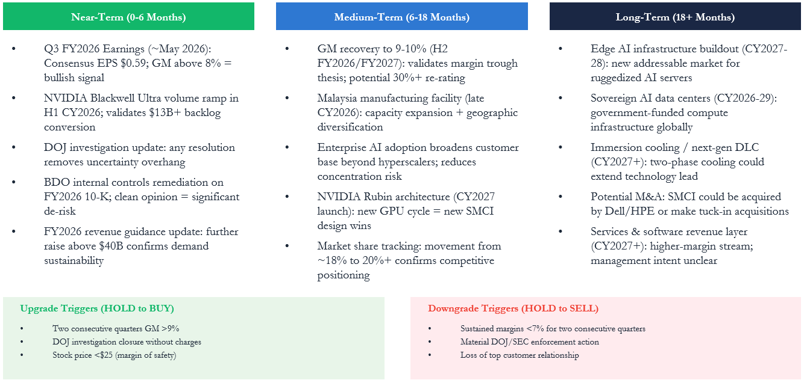
CATALYSTS & TIMELINE
Company
Company
Industry
Industry
Theses
Theses
Value Adds
Valuation
ESG
Risks
Forex Risk
As a global shipping company, Danaos is exposed to currency risk that could affect its revenue and profit margins, especially if a large portion of its debt is denominated in a different currency than its earnings.
Danaos Corporation can mitigate currency risk by using natural hedging techniques, such as matching its currency flows, and by employing typical forex hedging instruments like forwards, futures, or options to manage its exposure to currency fluctuations

Slide 22
Final Recommendation
Sensitivity Analysis
Investment Points
BLENDED TARGET PRICE:
(34%-113% Upside) $41-$65
1
Purest AI Infrastructure Play
Fastest-growing server OEM globally; $40B+ FY2026 revenue with $13B+ Blackwell Ultra backlog. AI server TAM growing at 28% CAGR to $400B+ by 2028.
2
DLC Market Leadership
25-30% share in liquid cooling with 12-18mo tech lead. GB200 NVL72 requires 100% DLC attach, scaling SMCI's advantage with NVIDIA's roadmap.
3
Growth-Adjusted Undervaluation
PEG of 0.65 vs. peer average 1.2 implies ~70% growth-adjusted discount. Forward P/E ~13x at 80%+ revenue growth is compelling.
Key Metrics
Strategic Priorities
Target: $47
54% Upside
Lease Optimization:
Better Management:
DLC
Expansion
Governance
Resolution
Lease Optimization:
Faster leasing, market expansion, risk reduction & stabilize finances
Better Management:
Expand asset revenue, streamline costs & integrate technology

