Slide 1


NASDAQ: SMCI
Current Price: $30.50
Target: $46.00 (+51% upside)
Consensus: HOLD (Reinforced)
Johnson Chen (johnsonchen2026@gmail.com), Jacob Liu (jliufc18@gmail.com)
Rochester Adams High School, Troy High School (Michigan)
May 19, 2026

Slide 2

Agenda
1
Target Overview
2
Industry Overview
3
Theses
4
Valuation
5
ESG/Overview Consideration
6
Risks & Mitigants
7
Final Recommendation

Slide 3
Target & Industry Overviews

Slide 4
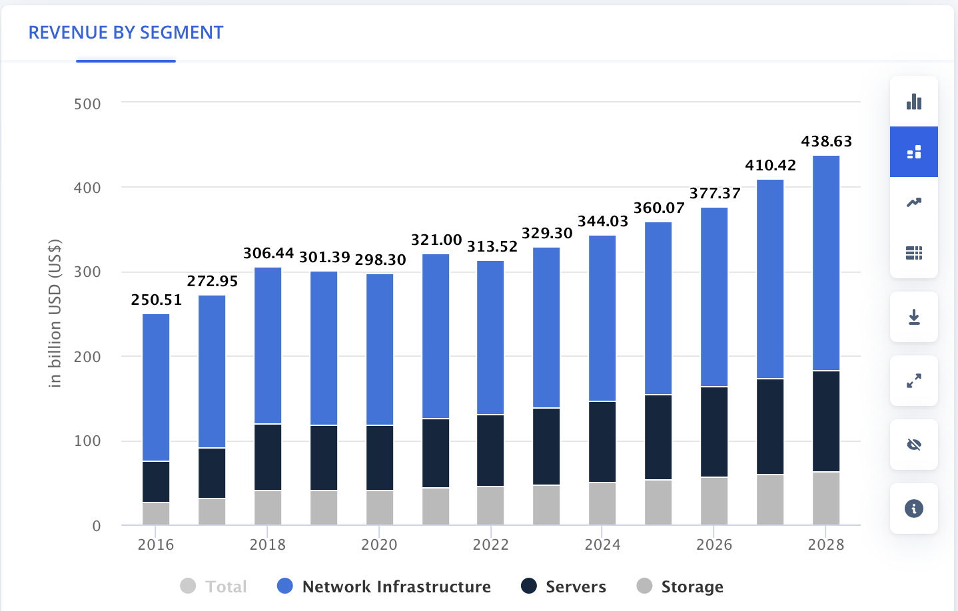
Company Overview
Background
Company Health
Revenue Streams
Super Micro Computer (NASDAQ: SMCI) designs, manufactures, and sells high-performance server and storage solutions for AI/ML, cloud, enterprise, and edge workloads
Founded in 1993 by Charles Liang (current CEO/Chairman) in San Jose, CA; vertically integrated with in-house motherboard design, chassis manufacturing, and system assembly
Fastest-growing server OEM globally, riding unprecedented AI infrastructure demand to $40B+ in projected FY2026 revenue
"Building Block Solutions" modular architecture enables rapid customization at scale with 6-12 week time-to-market vs. 6-12 months for Dell/HPE
Industry leader in Direct Liquid Cooling (DLC) rack-scale solutions, the fastest-growing product line as GPU power densities make air cooling inadequate
Current Price: ~$30.50 (mid-May 2026) | Market Cap ~$18.3B | EV ~$27.7B
Q3 FY2026 (reported May 5, 2026): Net sales $10.24B (+123% YoY); GAAP GM 9.9% / non-GAAP 10.1% (vs 6.3% Q2); net income $483M; diluted EPS $0.72
FY2026 guide REAFFIRMED at $38.9-40.4B per 8-K filed 2026-05-05; Q4 FY26 guide $11.0-12.5B; backlog at record high; AI-GPU platforms >80% of revenue
Governance: DOJ indicted 3 individuals on Mar 19, 2026 (~$2.5B alleged China diversion) — SMCI NOT charged; 2nd internal investigation underway (Munger Tolles/AlixPartners/BDO); class action pending (Bhuva, lead-plaintiff deadline May 26, 2026)
Q3 FY2026 mix: OEM/large data center $7.4B = 72% of revenue (+183% YoY)
Enterprise channel $2.8B = 28% of revenue (+46% YoY, +45% QoQ); up from 15% in Q2 FY26
AI-GPU related platforms >80% of total revenue
Customer concentration Q3 FY26: top customer 27% (down from ~63% in Q2 FY26); second customer 10%
Geography: ~50% US, ~33% APAC, ~13% Europe, ~4% RoW
Company
Industry
Theses
Valuation
ESG
Risks

Slide 5
Industry Overview
AI Infrastructure Market
Key Growth Catalysts
Global AI server TAM projected to grow from ~$125B (2024) to $400B+ (2028) at ~34% CAGR, driven by LLM training, enterprise AI deployment, and sovereign AI initiatives
Liquid cooling solutions are the fastest-growing sub-segment: ~$5B (2024) to ~$25B (2028) at ~50% CAGR as power densities exceed 100kW/rack
NVIDIA GPU roadmap (H100 to H200 to B200 to GB200 NVL72) drives sustained upgrade demand; each generation increases rack power from ~40kW to ~120kW
AI server market set to grow 55% in 2025 alone to ~$252B (Bloomberg Intelligence); hyperscaler capex budgets continuing to expand
GPT-5 class models require 10x+ the compute of GPT-4; AI inference workloads projected to exceed training by 2027
Generative AI training compute scaling 10x+ per generation
Enterprise AI inference deployment at scale (exceeds training by 2027)
Data center power/cooling constraints (>100kW/rack = liquid cooling required)
Sovereign AI: Governments investing in domestic AI compute infrastructure
Edge AI expansion for latency-sensitive inference applications
Segment | 2024E | 2028P | CAGR
AI Servers | ~$125B | ~$400B | ~34%
Liquid Cooling | ~$5B | ~$25B | ~50%
HPC | ~$45B | ~$75B | ~14%
Total DC Infra | ~$350B | ~$600B | ~15%
Company
Industry
Theses
Valuation
ESG
Risks

Slide 6
Industry Overview
Competitive Edge in Industry
Factor | SMCI | Dell | HPE | ODMs
Time-to-Market | 6-12 weeks | 6-12 months | 6-12 months | 3-6 months
Customization | Very High | Medium | Medium | High
Liquid Cooling | Leader | Developing | Developing | Limited
Gross Margin | 9-10% (Q3 FY26 recovery) | 20-21% | 30-32% | 4-6%
AI Server Focus | Primary | ~15% of rev | ~20% of rev | Contract-based
Mkt Share (AI) | ~15-20% | #1 | #3-4 | Varies
Services/SW | Limited | Extensive | Extensive | None
Key Competitive Dynamics:
Speed is the core differentiator: When NVIDIA launches a new GPU, SMCI has validated designs within weeks vs. 6-12 months for Dell/HPE. In a market where every quarter of delay = lost AI training revenue, this speed premium is substantial
Dell ($104B TTM rev) has a massive enterprise sales force and full-stack solutions; HPE ($34B) has strong gov't relationships and GreenLake as-a-service. Both are investing aggressively in liquid cooling.
ODMs (Quanta, Wistron, Foxconn) build custom hyperscaler designs at 4-6% margins with no brand/IP; in-house designs (Google TPU, Amazon Trainium) are a long-term structural threat to all OEMs
SMCI holds ~25-30% share in liquid cooling specifically (market leader) but margins (6-11%) are well below Dell (20-21%) and HPE (30-32%), reflecting a volume/speed model vs. premium pricing
Company
Industry
Theses
Valuation
ESG
Risks
Notes:
Both from Bloomberg

Slide 7
II. Thesis Points

Slide 8
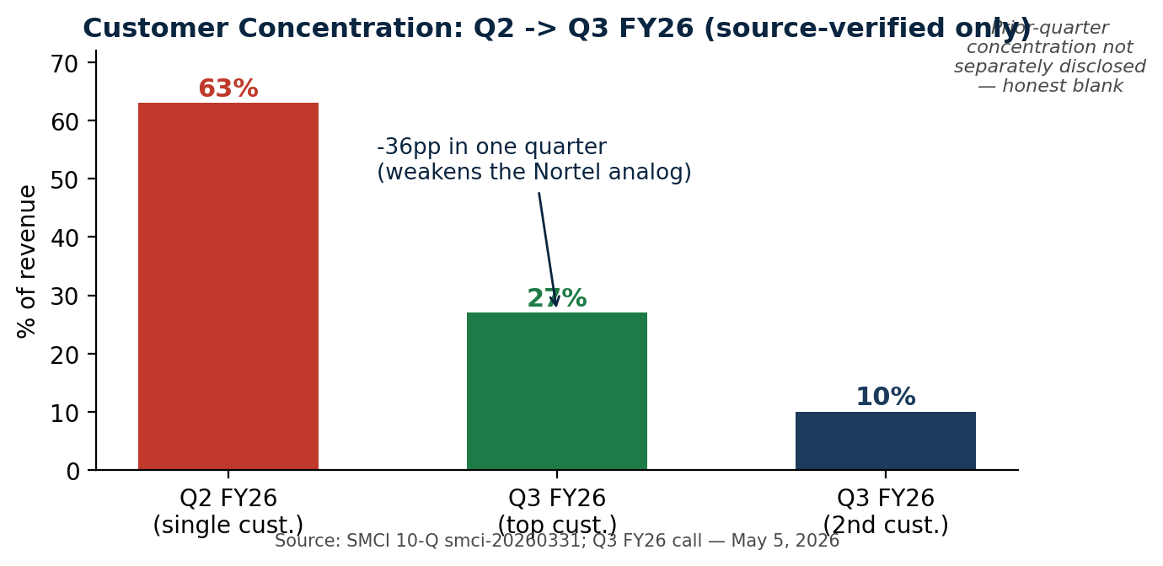
Thesis 1: AI INFRASTRUCTURE PICK & SHOVEL PLAY
Strong AI Growth Sentiment & Positioning
DLC Structure Market
LEDE: Top-customer concentration collapsed 63% (Q2 FY26) -> 27% (Q3 FY26); enterprise channel doubled to 28% of revenue (+46% YoY). Directly weakens the Nortel failed-lookalike comparison.
FY2026 revenue guide REAFFIRMED at $38.9-40.4B per 8-K filed May 5, 2026; record-high backlog; AI-GPU platforms >80% of revenue
Hyperscaler FY26 capex guides (MSFT/GOOGL/AMZN/META) — all raised in last 2 cycles, combined ~$320B+ guided minimums; SMCI sits at the demand-receiving end of that capex chain
Caveat (Q4 FY26 test): AR concentration Customer A 32.2% (10-Q smci-20260331) is higher than revenue concentration 27% -> Q4 FY26 (Aug 11, 2026) confirms whether diversification is structural or billing-timing
Direct Liquid Cooling: SMCI in volume shipments of NVIDIA GB300 NVL72 / B300; DLC-2 captures up to 98% of system heat at up to 1,400W/GPU
Dell'Oro: data-center liquid cooling market ~$7B by 2029 (Jan 2026 report); transitioning from optional to mandatory at >100kW/rack
Process moat (6-12wk vs Dell/HPE 6-12mo) + DLC-2 capacity is the durable application-layer edge; not facilitation, not commoditized yet
Company
Industry
Theses
Valuation
ESG
Risks

Slide 9

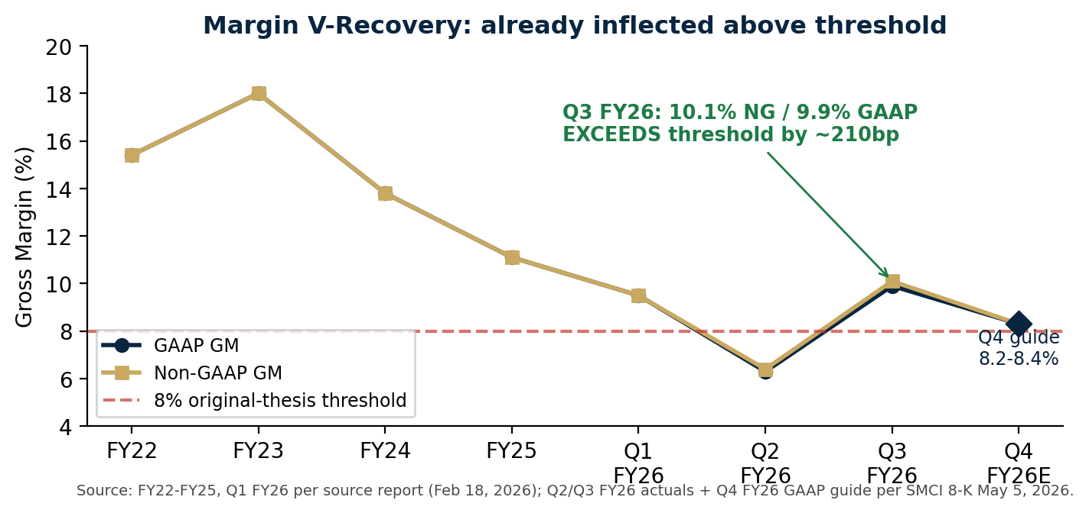


Thesis 2: Margins and Reversal
Margin Reversal
Period | Gross Margin | Commentary
FY2020 | 15.7% | Pre-AI baseline
FY2023 | 18.0% | PEAK - AI premium pricing
FY2024 | 13.8% | Compression begins - volume/price trade-off
FY2025 | 11.1% | Significant deterioration
Q1 FY2026 | 9.5% | Pre-Q2 expedite charges
Q2 FY2026 | 6.3% GAAP / 6.4% NG | Trough — one-time expedite (CFO)
LEDE: Q3 FY26 non-GAAP GM 10.1% (9.9% GAAP) EXCEEDS the 8% bullish-inflection threshold from the original report by ~210bp; +370bp QoQ recovery from Q2's 6.4%
Q2 compression: 'heavy one-time expedite charges from a large December deployment' per CFO Weigand — did not recur in Q3 and not expected to repeat at that scale
Structural mix shift: DCBBS GM 'consistently above 20%' per CEO Liang; expected to contribute >25% of profit; software bookings >$46M in Q3 FY26
Q4 FY26 GAAP GM guide 8.2-8.4% — sustained recovery, ABOVE the 8% original-thesis threshold; non-GAAP EPS guide $0.65-0.79
Our view (reinforced): margins now likely stabilize at 9-11% over 12-18 months as DCBBS mix grows; deferred revenue $1.47B vs $0.37B at FY25 close (+298%) is a hard balance-sheet signal of attach growth
Company
Industry
Theses
Valuation
ESG
Risks

Slide 10
THESIS 3: GOVERNANCE DISCOUNT (REFRAMED — MULTI-STAGE CLOSURE PATH)
Individual Factor Chart Ratings
Factor | Assessment | Rating
Auditor Stability | EY resigned Oct 2024 -> BDO; FY25 10-K opinion clean on financials | AMBER
Internal Controls | BDO adverse ICFR as of Jun 30 2024 (FY24); remediation underway; FY26 10-K opinion = key test Aug 2026 | AMBER
SEC/DOJ Investigation | DOJ indicted 3 individuals Mar 19 2026; SMCI NOT charged; SEC investigation separately ongoing; 2nd internal investigation in progress | REFRAMED
Board Independence | Majority independent post-Special Committee reforms | Improved
CEO Control | Charles Liang: Founder/CEO/Chairman since 1993; ~10-12% ownership | Mixed
Related Party Txns | $17.5M SEC settlement in 2020 for prior accounting issues | Elevated
Mar 19, 2026: DOJ unsealed indictment of 3 individuals over alleged ~$2.5B China diversion (2024-25). Indicted: co-founder/board director Yih-Shyan 'Wally' Liaw (resigned, pleaded not guilty); Taiwan GM Ruei-Tsang 'Steven' Chang (terminated, fugitive); contractor Ting-Wei 'Willy' Sun. CRITICALLY: SMCI itself NOT charged, NOT a named defendant.
Apr 7, 2026: 2nd independent investigation launched (Scott Angel + Tally Liu lead independent directors; Munger Tolles & Olson + AlixPartners; coordinating with BDO USA). No timeline disclosed.
May 26, 2026: securities class-action lead-plaintiff deadline (Bhuva v. SMCI, No. 26-cv-02606 N.D. Cal.) — names SMCI, Liang, Weigand; class period Apr 30 2024 - Mar 19 2026 (capped damages).
Reframed thesis: worst-tail (corporate indictment) AVOIDED. Discount closes 50-100% over 18-24 months via SEQUENTIAL stream resolution: (1) class-action MTD ruling, (2) 2nd investigation conclusion, (3) SEC closure. Boeing post-737-MAX analog: staged recovery on each stream close.
Catalyst (positive): each stream close historically compresses ~15-25% of similar discounts; SMCI currently at 16x EV/EBITDA vs peer 21x = ~24% EV/EBITDA discount, ~60% P/E discount.
Company
Industry
Theses
Valuation
ESG
Risks

Slide 11
III. Valuation

Slide 12
FINANCIAL PROJECTIONS (FY2024A - FY2029E)
Line Item | FY2024A | FY2025A | FY2026E | FY2027E | FY2028E | FY2029E
Revenue ($M) | $14,989 | $21,970 (actual) | $39,650 (guide mid) | $52,000 | $60,000 | $66,000
YoY Growth | 110% | 47% | 82% | 30% | 15% | 10%
Gross Margin | 13.8% | 11.1% | 8.5-9.0% (Q3 actual 10.1% NG; Q4 guide 8.2-8.4% GAAP) | 9.5% | 10.5% | 11.0%
Operating Income ($M) | $1,211 | $1,248 | $1,800 | $3,224 | $4,380 | $5,148
Op Margin | 8.1% | 5.7% | 4.5% | 6.2% | 7.3% | 7.8%
Net Income ($M) | $1,153 | $1,049 | $1,271 | $2,480 | $3,468 | $4,139
Diluted EPS | $1.92 | $1.75 | $2.02 | $3.87 | $5.33 | $6.26
EBITDA ($M) | $1,187 | $1,430 | $2,200 | $3,744 | $4,980 | $5,808
EBITDA Margin | 7.9% | 6.5% | 5.5% | 7.2% | 8.3% | 8.8%
Key Assumptions:
FY2026 revenue: guide range $38.9-40.4B reaffirmed per 8-K 2026-05-05; midpoint $39.65B used
FY2026 gross margin: weighted ~8.5-9.0% — Q3 FY26 already at 10.1% non-GAAP (above 8% original-thesis threshold); Q4 guide 8.2-8.4% GAAP sustains recovery
FY27-29: growth decelerates as base effect compounds; GM recovers toward application-layer equilibrium 10-11%; not facilitation multiples
Net debt updated to ~$7.48B (debt $8.773B - cash $1.290B per Q3 FY26 8-K); 692M diluted shares
Company
Industry
Theses
Valuation
ESG
Risks

Slide 13
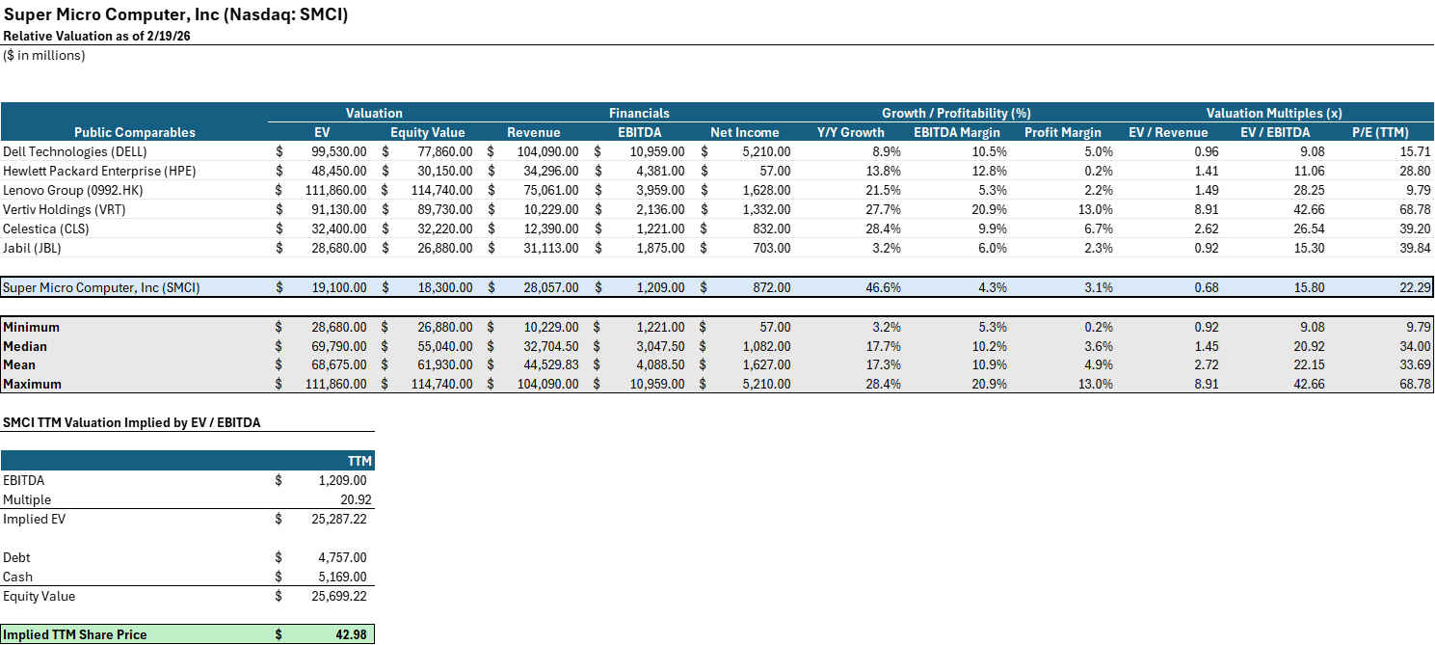
VALUATION ANALYSIS
Company
Industry
Theses
Valuation
ESG
Risks
Notes:
Selling Ships:
Capsize ships (175k DWT)
ACHIEVEMENT
GENIUS
INTEGRITY
INGENUITY
PEACE
E TRADER
W TRADER
5 yr ship for 45.5M
15 yr ship for 23 M
https://www.hellenicshippingnews.com/capesize-values-for-older-vessels-rise-in-october/
Using their underperforming ships as collateral, just as they are presently doing with 24 ships for their revolving credit facility, can enable them to access a larger amount of capital at more favorable interest rates, specifically at S+400. By using their underperforming ships as collateral - just as they are doing with 24 ships for their revolver - Danaos can access a larger amount of capital at more favorable interest rates, specifically at a SOFR+400.

Slide 14
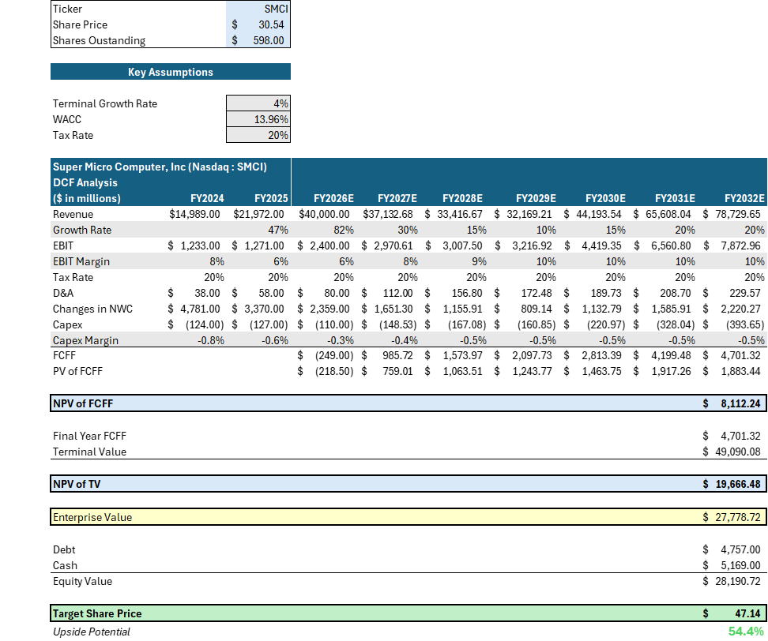
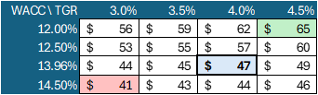

DCF SENSITIVITY
Company
Industry
Theses
Valuation
ESG
Risks
Notes:
Selling Ships:
Capsize ships (175k DWT)
ACHIEVEMENT
GENIUS
INTEGRITY
INGENUITY
PEACE
E TRADER
W TRADER
5 yr ship for 45.5M
15 yr ship for 23 M
https://www.hellenicshippingnews.com/capesize-values-for-older-vessels-rise-in-october/
Using their underperforming ships as collateral, just as they are presently doing with 24 ships for their revolving credit facility, can enable them to access a larger amount of capital at more favorable interest rates, specifically at S+400. By using their underperforming ships as collateral - just as they are doing with 24 ships for their revolver - Danaos can access a larger amount of capital at more favorable interest rates, specifically at a SOFR+400.

Slide 15
IV. ESG/Overview Considerations

Slide 16
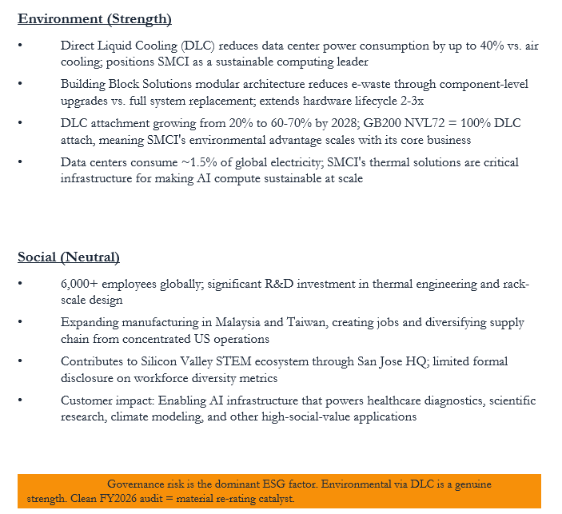
ESG CONSIDERATIONS
ESG Risk Assessment
Category | Rating | Trend | Assessment
Environment | Positive | Improving | DLC = 40% power savings
Social | Neutral | Stable | 6,000+ employees; STEM impact
Governance | Negative | Improving | DOJ acted on individuals not SMCI; 2nd probe + class action + SEC streams in progress; staged closure path
Overall ESG | 42/100 | Mixed | Below Avg (CSRHub)
Governance (Primary Risk)
Mar 19 2026: DOJ indicted 3 individuals; SMCI NOT charged
Apr 7 2026: 2nd independent investigation underway (Angel/Liu; Munger Tolles; AlixPartners; BDO)
May 26 2026: securities class-action lead-plaintiff deadline (Bhuva)
Catalysts (sequential): class-action MTD ruling (Q4'26-Q1'27) + 2nd investigation conclusion (unknown) + SEC closure (unknown) + BDO clean ICFR on FY26 10-K (Aug'26)
Board Independence: 67% refreshed post-2024 | CEO Ownership: ~10-12% (aligned)
Capital Allocation: No dividends/buybacks; reinvesting in Malaysia/Taiwan capacity + $6B+ inventory buildup
Company
Industry
Theses
Valuation
ESG
Risks

Slide 17
AI: OPPORTUNITY & RISK ANALYSIS
AI As Opportunity
AI AS Risk
SMCI is arguably the most direct public equity beneficiary of AI development: every LLM trained and every inference served requires server hardware that SMCI manufactures
AI compute scaling follows a 10x+ rule per model generation (GPT-3 to GPT-4 to GPT-5); this exponential demand directly drives SMCI's $40B+ FY2026 revenue trajectory
NVIDIA's GPU roadmap (H100 → B200 → GB200 → Rubin) creates recurring upgrade cycles; each generation requires new server platforms = repeat design wins for SMCI
Liquid cooling becomes mandatory as AI model scale increases rack power from 40kW to 120kW+; SMCI's DLC leadership (25-30% share) scales directly with AI complexity
Enterprise AI adoption is in early innings: only ~5% of enterprises have deployed production AI infrastructure, implying 10-20x expansion of addressable market through 2030
Custom silicon threat: Google (TPUs), Amazon (Trainium), Microsoft (Maia) designing in-house AI chips that bypass OEMs; if 30%+ of AI compute shifts to custom silicon, SMCI's TAM contracts materially
AI efficiency breakthroughs: Model distillation, mixture-of-experts, and sparse architectures could reduce compute per unit of AI capability, slowing hardware demand
Commoditization risk: Software-defined DC architectures could reduce hardware differentiation; SMCI's speed advantage may erode as workloads standardize
Geopolitical: US export controls on AI chips to China (~22% APAC rev) could intensify; sovereign AI may partially offset
AI Growth Driver | Current | By 2028 | Impact on SMCI
AI Server TAM | ~$150B | $400B+ | 28% CAGR = demand runway
DLC Attach Rate | ~20% | 60-70% | 100% on GB200 NVL72
Enterprise AI Adoption | ~5% | 25-30% | New customer segments
Hyperscaler Capex | ~$320B+ FY26 guided | $500B+/yr | $13B+ SMCI backlog
Inference vs Training | 30/70 | 70/30 | Volume shift favors OEMs
AI Risk Factor | Prob. | Impact | Timeline
Custom silicon displaces OEMs | Med | HIGH | 3-5 years
AI efficiency reduces compute | Low-Med | Medium | 2-4 years
HW commoditization | Medium | Medium | 3-5 years
Export control expansion | Med-High | HIGH | 0-12 months
AI capex cycle downturn | Low | V. HIGH | 12-24 months
Company
Industry
Theses
Valuation
ESG
Risks

Slide 18
MOAT ANALYSIS & PORTER'S FIVE FORCES
Force | Rating | Trend | Key Driver
Customer Power | 4/5 Unfavorable | Worsening | Top customer 27% Q3 FY26 (was 63% Q2); enterprise channel 28% of rev — diversifying. AR concentration (Cust-A 32.2%) is the Q4 test.
Competitive Rivalry | 3/5 Moderate | Intensifying | Dell/HPE investing aggressively in AI + liquid cooling
Supplier Power | 4/5 Unfavorable | Stable | NVIDIA ~80%+ share in DC GPUs; allocation = revenue
Substitutes | 2/5 Favorable | Stable | No substitute for on-prem AI training at scale
Barriers to Entry | 3/5 Moderate | Stable | 12-18mo validation cycles + thermal expertise required
Moat Source | Strength | Durability | Assessment
Intangible Assets | Moderate | 2-3 years | Patents, NVIDIA relationship, first to GB200 NVL72; narrowing as Dell/HPE invest
Switching Costs | Moderate | 1-2 yr/cycle | DLC infra is sticky (piping, manifolds, CDUs); customers maintained orders despite governance controversy
Cost Advantages | Weak | Permanent | GM 9-10% Q3 FY26 (recovered from 6.3% trough) vs DELL ~10% / HPE ~13% — consistent with application-layer; not facilitation premium
Efficient Scale | Moderate | 3-5 years | 5,000+ racks/month capacity; market supports 3-5 players profitably
Company
Industry
Theses
Valuation
ESG
Risks

Slide 19
V. Risks & Mitigants

Slide 20
Risks & Mitigants
Level of Risk
Mitigation:
Gross Margin Risk:
Recovery vs structural: Q3 FY26 9.9% GAAP / 10.1% NG
High
Mitigation: Q3 FY26 non-GAAP GM 10.1% — already above the 8% original-thesis threshold (Q2 trough was one-time expedite per CFO). Q4 FY26 GAAP guide 8.2-8.4% sustains recovery. DCBBS GM >20% (CEO) is the structural mix-shift driver.
Level of Risk
Mitigation:
Governance / Legal Risk:
DOJ indicted individuals Mar 19; class action + 2nd probe + SEC streams open
High
Mitigation: DOJ chose individuals over corporation (not charged); 2024 Special Committee found no senior fraud; BDO financial statements 'present fairly'; FY25 10-K filed clean; 2nd probe scoped to export-controls; class-period closed -> damages bounded; ~$1.3B cash absorbs plausible $100-500M settlement.
Level of Risk
Mitigation:
Customer Concentration Risk:
Top customer 27% Q3 FY26 (was 63% Q2); AR Cust-A 32.2%
Medium
Mitigation: Q3 FY26 already shows concentration 63%->27%, enterprise channel doubled to 28% of rev. Backlog at record high; deferred revenue $1.47B (+298% vs FY25 close). Multi-vendor strategy (AMD MI300X) reduces single-source dependency.
Level of Risk
Mitigation:
NVIDIA Supplier Dependency:
~80%+ DC GPU Supply Control
Low
SMCI diversifying with AMD MI300X/MI400 platforms. Strong NVIDIA partnership depth (first to ship GB200 NVL72) suggests favorable allocation. Multi-vendor strategy reduces single-supplier risk over 12-18 month horizon.
Company
Company
Industry
Industry
Theses
Theses
Value Adds
Valuation
ESG
Risks

Slide 21
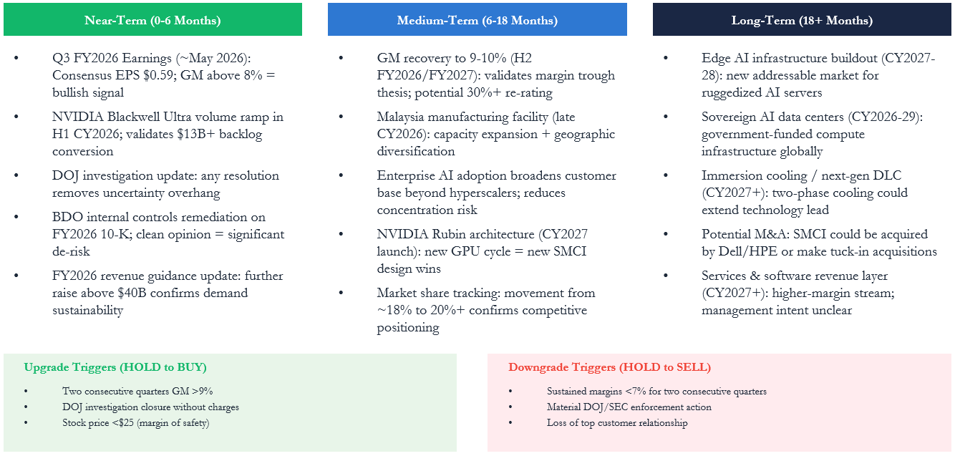
CATALYSTS & TIMELINE
12-Month Catalyst Calendar — Reinforced Thesis
Date | Event | Type | Direction
May 26, 2026 | Class-action lead-plaintiff deadline (Bhuva v. SMCI) | Procedural | Neutral / structural
Jun-Jul 2026 | Consolidated complaint expected | Informational | Bear if expanded
Aug 11, 2026 | Q4 / FY26 earnings — CRITICAL: (a) FY26 in $38.9-40.4B? (b) Q4 GAAP GM 8.2-8.4% holds? (c) concentration trend continues? | Operational | Critical
Aug 2026 | NVIDIA earnings (next cycle) — Blackwell + Rubin commentary | Indirect | Bull if DC accel
Q3 2026 | Hyperscaler earnings cycle — FY27 capex guides | Indirect | Bull if capex up
Q4 2026 / Q1 2027 | Class-action motion to dismiss ruling | Legal | Bull if granted
Unknown (any time) | 2nd independent investigation conclusion | Governance | Binary / no timeline
Q1 2027 | NVDA Rubin GPU ramp | Indirect | Bull
Q2 2027 | SEC enforcement decision | Regulatory | Binary
Gold rows = imminent (May 26) and most informational (Aug 11). Source: SMCI 8-K 2026-05-05; Bhuva docket; rgrdlaw.com — all accessed 2026-05-19.
Company
Company
Industry
Industry
Theses
Theses
Value Adds
Valuation
ESG
Risks

Slide 22
Final Recommendation
Sensitivity Analysis
Investment Points
BLENDED TARGET PRICE:
(34%-113% Upside) $41-$65
1
AI Growth + Diversifying Customer Mix
Customer concentration 63% -> 27% in one quarter; enterprise channel doubled to 28% of revenue (+46% YoY). FY2026 revenue guide REAFFIRMED at $38.9-40.4B per 8-K filed 2026-05-05. AI-GPU platforms >80% of revenue; record-high backlog.
2
Margin Recovery Confirmed
Q3 FY26 non-GAAP gross margin 10.1% (9.9% GAAP) EXCEEDS the 8% original-thesis bullish-inflection threshold by ~210bp. Q2 trough was one-time expedite (CFO). Q4 FY26 GAAP guide 8.2-8.4% sustains the recovery.
3
Governance Discount — Reframed
DOJ acted Mar 19 2026 on 3 individuals; SMCI NOT charged. Multi-stage closure path (class-action MTD, 2nd investigation, SEC) historically closes 50-100% of governance discounts within 18-24 months. Reinforced PT $46 reconciles original $46 PT within 2%.
Key Metrics
Strategic Priorities
Target: $46
+51% Upside
DLC
Expansion
Governance
Resolution

