Slide 1


NYSE: DAC
Current Price: $74.31
MOIC: 2.60x
IRR: 28.2%
Michael Attisha, Ryan Zimmerman, Jack Gibbs, David Chen, Abhi Chundru
| 1

Slide 2
Agenda
1
Target Overview
2
Industry Overview
3
Theses
4
Value Add & Downside Protection
5
Valuation
6
Risks & Mitigants
7
Appendix
| 2

Slide 3
I. Target & Industry Overviews
| 3

Slide 4
Target Overview
Background
Company Health
Revenue Streams
Danaos (NYSE: DAC) is a Greek maritime company that owns and leases vessels to shipping operators
John Coustas, current CEO, inherited the company from his father Dimitri
Largest independent charter company for container ships (Liners)
Diverse and well-maintained fleet focused on efficient, eco-friendly container vessels
Current EV near 15-year low
Exceptional financial health: Total Debt/EBITDA of 0.62
Contracted EBITDA over the next five years exceeds current EV
Generates revenue through contracts with container ship companies
Current average charter term is ~2 years; leases are locked in at near-COVID rates
Long-term lease structure insulates Danaos from volatile spot shipping rates
Diversified, modern fleet supports sustained revenue growth
Company
Industry
Theses
Value Adds
Valuation
Risks
| 4

Slide 5
Industry Overview
Industry Dynamics
Industry Whims
Liner companies (Maersk, MSC, ZIM) handle point-to-point logistics
Liners lease nearly half of their ships from charterers like Danaos
Chartering gives liners operational and capital-structure flexibility
Occasionally exposed to supply and demand shocks
Environmental rules will reduce future cargo-ship supply
Geopolitical conflict in the Middle East adds route risk
Industry Drivers
E-commerce growth is reshaping shipping logistics
Globalization in developing and emerging markets lifts shipping demand
Projected CAGR of the shipping market is 7.4% through 2031
Source: Grand View Research via Statista (2020–2028 projected)
Company
Industry
Theses
Value Adds
Valuation
Risks
| 5

Slide 6
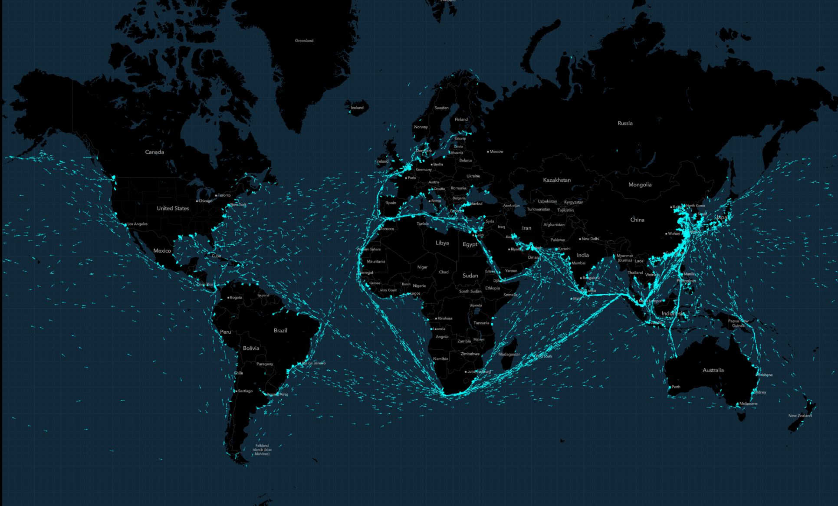
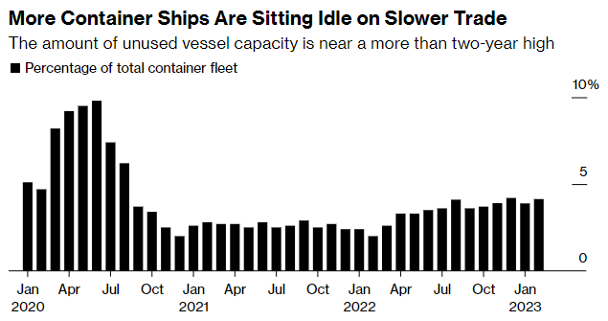
Industry Overview
Current Global Environment
Current Shipping Routes
Idleness of Container Ships
Company
Industry
Theses
Value Adds
Valuation
Risks
| 6
Notes:
Both exhibits from Bloomberg

Slide 7
II. Thesis Points
| 7

Slide 8


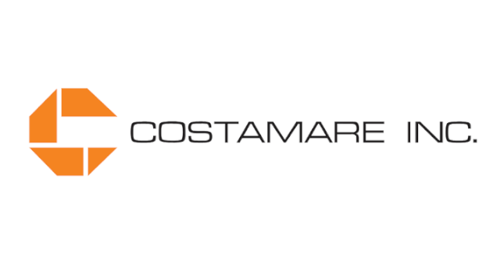

Thesis 1: Discounted Entry Price (Buying the Dip)
Previous Capital ROI
Low Debt
Danaos' previous capital expenditures yielded a 6–10% ROI
The Eagle Bulk stake outperformed after its merger with Star Bulk
Long-term debt of $447M sits below projected 2023 EBIT of $540M
Paid down $889M in 2022; Debt/EBITDA of 0.50 vs. 3.55 industry median
Undervalued on Multiples
Trades at a 57% discount to NAV
P/TBV of 0.45
EV/EBITDA of 2.04 vs. an industry median of 5.26
Company
Industry
Theses
Value Adds
Valuation
Risks
| 8

Slide 9
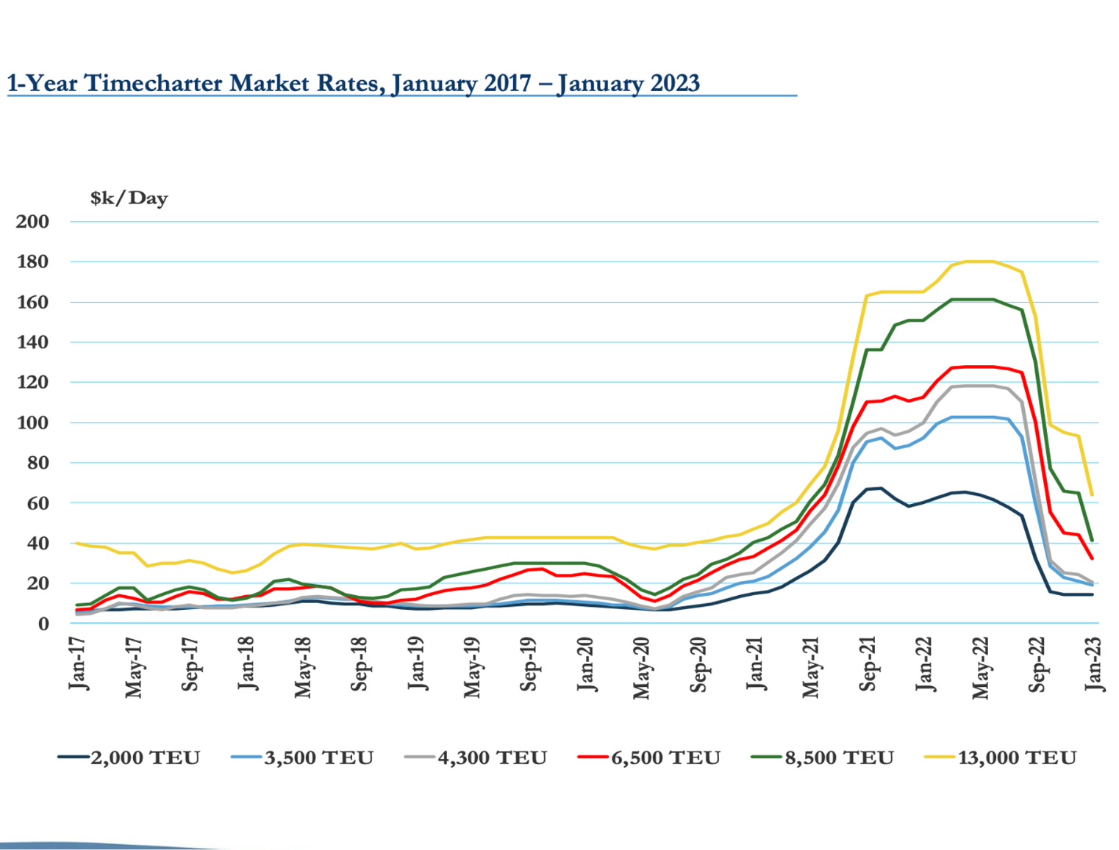
Thesis 2: Market Pricing Reversion
High Market Pessimism
1-Year Timecharter Rates, Jan-17 to Jan-23
Consensus expects charter rates to fall well below Covid peaks
Rates rose sharply while overall ship supply shrank
Expanded shipping demand suggests the pessimism is overblown
Long-Term Leases
Long-term contracts secure most revenue and blunt rate drops
Retiring older vessels will tighten supply of smaller charter ships
59% increase in 8,500 TEU charter rate
79% increase in 6,500 TEU charter rate
83% increase in 4,500 TEU charter rate
103% increase in 3,500 TEU charter rate
Company
Industry
Theses
Value Adds
Valuation
Risks
| 9

Slide 10
III. Value Add & Downside Protection
| 10

Slide 11
Value Add: Increasing Operational Efficiency
Lease Optimization
Management Efficiency
Problem: 7 ships are not leased out, racking up maintenance costs with no revenue
Solution: Faster leasing lifts revenue while putting idle ships to use
Expansion: New geographies and customer segments reduce route concentration
Asset Management: Grow fees from managing vessels for other owners
Cost Management: Streamline maintenance, repair and logistics
Technology: Analytics for fleet management and predictive maintenance
Company
Industry
Theses
Value Adds
Valuation
Risks
| 11

Slide 12
IV. Valuation
| 12

Slide 13
Financing
Sources of Funds ($M)
Capital Structure Mix
Source | EBIT turns | $ investment | % ownership | Rate
Term Loan A | 0.40x | 261.37 |  | SOFR + 4%
Term Loan B | 0.40x | 261.37 |  | SOFR + 4%
Senior Secured Note | 0.50x | 326.72 |  | 10% fixed
Senior Unsecured Note | 0.50x | 326.72 |  | 12% fixed
Management rollover | 0.34x | 220.00 | 21.6%
Sponsor equity | 1.22x | 798.50 | 78.4%
Total sources |  | $2,194.69 | 100.0%
Company
Industry
Theses
Value Adds
Valuation
Risks
| 13

Slide 14
Returns
Bull Case
Bear Case
Exit EV / EBIT multiple | 3.26x
2029 EBIT | $431.95
Implied enterprise value | $1,406.35
Gross debt | $653.44
Cash | $60.00
Implied equity value | $812.91
Sponsor equity at exit | $637.32
Sponsor entry equity | $798.50
MOIC | 2.60x
IRR | 28%
Exit EV / EBIT multiple | 3.26x
2029 EBIT | $341.43
Implied enterprise value | $1,111.64
Gross debt | $653.44
Cash | $60.00
Implied equity value | $518.20
Sponsor equity at exit | $406.27
Sponsor entry equity | $798.50
MOIC | 1.75x
IRR | 16%
Company
Industry
Theses
Value Adds
Valuation
Risks
| 14

Slide 15
Sponsor Cash Flows (Bull Case, $M)
 | 2023P | 2024P | 2025P | 2026P | 2027P | 2028P | 2029P
Sponsor equity | (798.50) |  |  |  |  |  | 637.32
Dividends |  | 170.82 | 168.07 | 96.55 | 339.88 | 286.52 | 282.52
Sale of ships |  |  | 32.20 | 32.20 | 32.20
Cash inflows / (outflows) | (798.50) | 170.82 | 200.27 | 128.75 | 372.08 | 286.52 | 919.84
Company
Industry
Theses
Value Adds
Valuation
Risks
| 15

Slide 16
V. Risks & Mitigants
| 16

Slide 17
Risks and Mitigants
Level of Risk
Mitigation:
Environmental regulation raises operating costs
High
Route optimization and slow steaming cut fuel use and emissions without major new investment, keeping the fleet compliant.
Level of Risk
Mitigation:
Charter-rate swings hit overall returns
Medium
The model carries bull and bear cases, plus a sale of old and idle ships that protects sponsor returns if rates sour.
Level of Risk
Mitigation:
Global demand shocks hit shipping volumes
Medium
Long-term contracts, financial discipline and buying assets at cycle lows turn volatility into opportunity.
Level of Risk
Mitigation:
Concentrated ownership: CEO holds 45%
Low
The equity rollover lets the CEO keep a stake, aligning management with the sponsor through the hold.
Company
Industry
Theses
Value Adds
Valuation
Risks
| 17

Slide 18
Final Recommendation
Sensitivity Analysis
Investment Theses
Entry & Exit EBIT Multiple: 3.26x
1
Discounted Entry Price
Strong ROI and market leadership; trades at a deep discount with low debt, leaving room for strategic leverage.
Premium paid \ Term A / EBIT | 0.40x | 0.45x | 0.50x | 0.55x | 0.60x
20% | 55% | 42% | 46% | 47% | 56%
25% | 36% | 38% | 41% | 41% | 48%
30% | 33% | 34% | 37% | 36% | 42%
35% | 31% | 32% | 34% | 32% | 37%
40% | 28% | 29% | 31% | 29% | 33%
2
Market Pricing Reversion
Long-term contracts and fleet renewal let Danaos weather the correction from COVID peaks.
3
Resilient Contracts
Robust contracts secure revenue, backed by liner companies' strong balance sheets.
Value Adds
Key Metrics
Lease Optimization
Management Efficiency
MOIC: 2.60x
IRR: 28.2%
| 18

